Slide 1
Human training wheels
Digitaler Rinderhack präsentiert: Digitaler Abriss

Slide 2
Problem
Objects should be watched 24/7 for cracks
Only achievable by using the power of machines
Artificial intelligence has to be trained
Complex decisions require a lot of training
AI model may be unusable in early stages
Important decisions made by machines?

Slide 3

Idea: Human in the loop
Model updates
Images
Artificial
Intelligence
Server
Object with
potential crack
Automated, regular
image acquiring
Accurate
evaluations
Classifications
Preselected
suggestions
Human
technicians

Slide 4
Advantages
AI preselects images by estimated importance and confidence
Humans in control of important decisions
Steadily improving assistance system
Human workload decreases as system learns

Slide 5
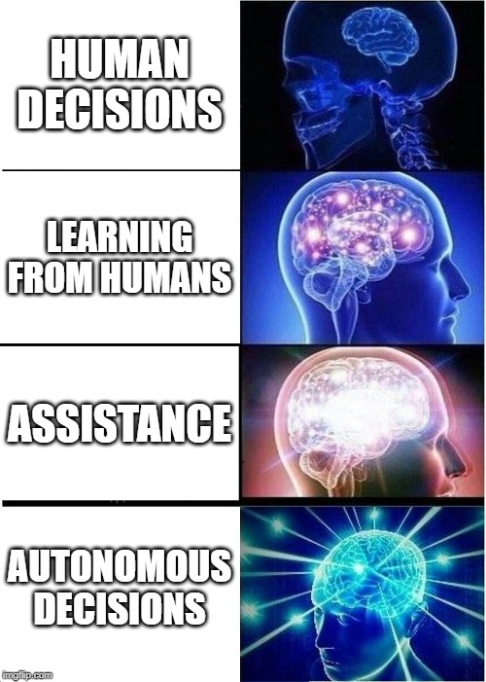
AI matures over time

Slide 6
Advantages
System provides assistance from the very beginning
Starts with pre-trained model
Eventually hand over control for high enough confidence classifications
Fluid, flexible assistance system

Slide 7
Technical realization
AI posts image to a messenger (e.g. Slack) channel
Human responds with assessment (yes/no/gradual value)
AI only posts images with a predicted crack possibility over a certain threshold

