Slide 1
select file tab and chose import
Select existing maven project
Browse the root directory then click finish

Slide 2
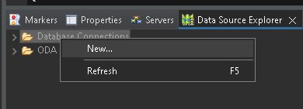
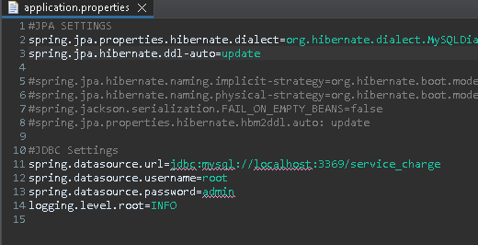
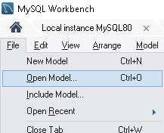
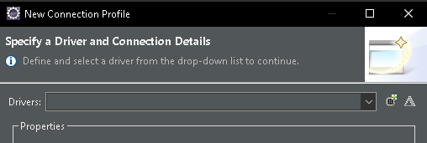
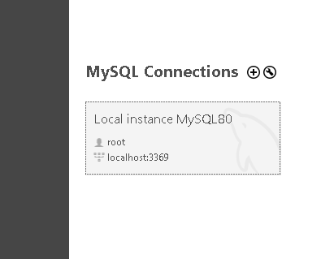
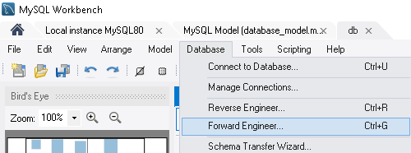
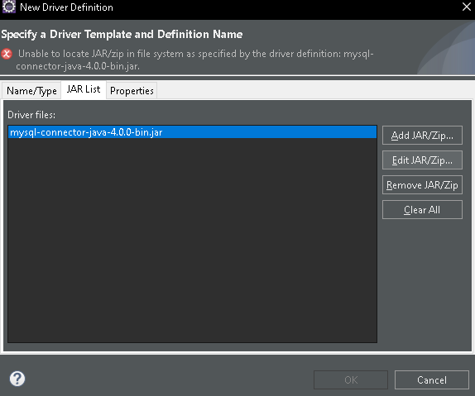
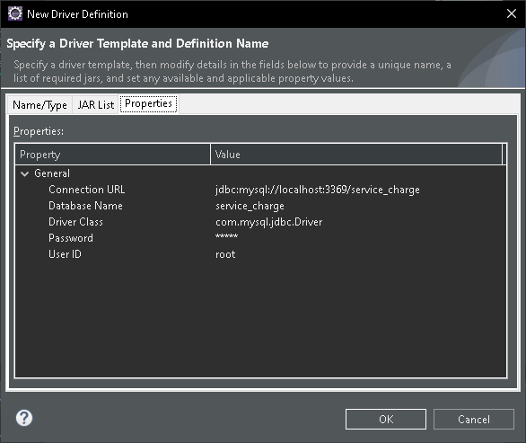
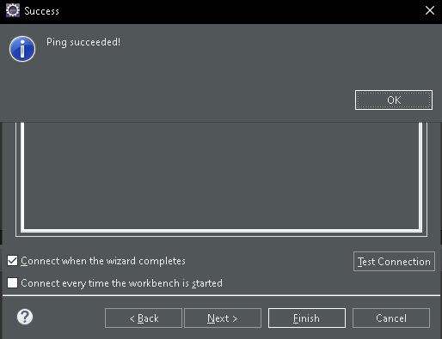
Select data source explorer.
right click and select new
Open application.properties and configure the port base on ur mysql connections
select file tab and chose open model then choose database_model
Select my sql
select database tab and choose forward engineer
Click the driver file and edit jar/zip
Just click next and finish
Open file “mysql-connector-j-8.0.32”
Then check every attributes if it sync with your database that u configure earlier
Then click test connection if it is success

Slide 3
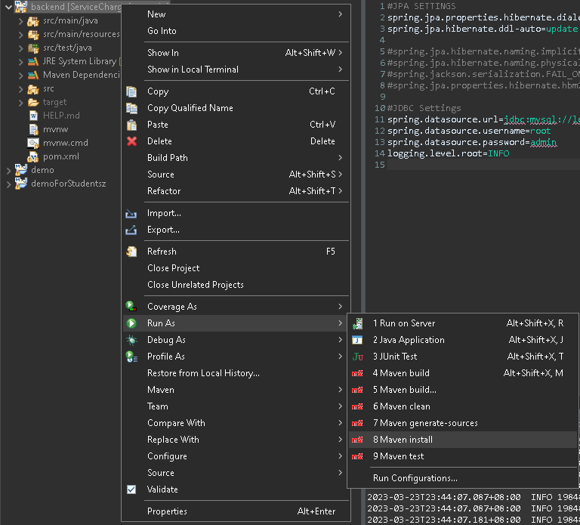
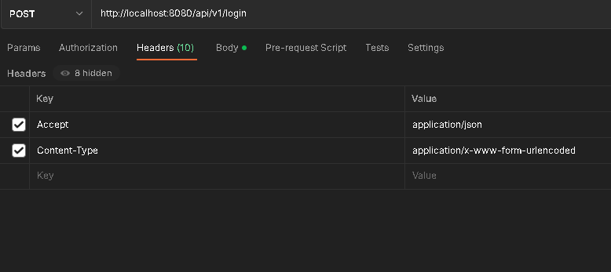
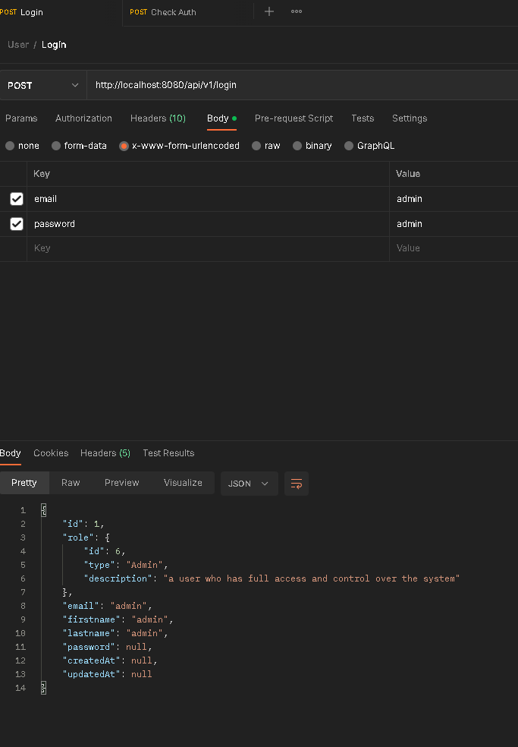
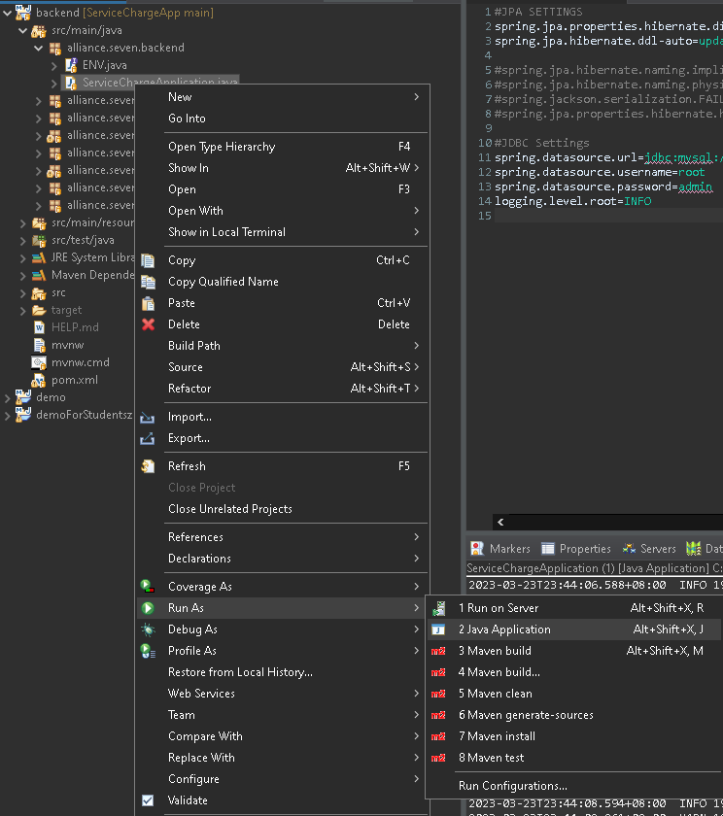
Right click the project then select run as then maven install
If everything is up and running go to ur postman
Create a post request and configure the headers accordingly
U should see the result as follows
If build is success then right click the ServiceChargeApplication.java select run as then java application

