Slide 1

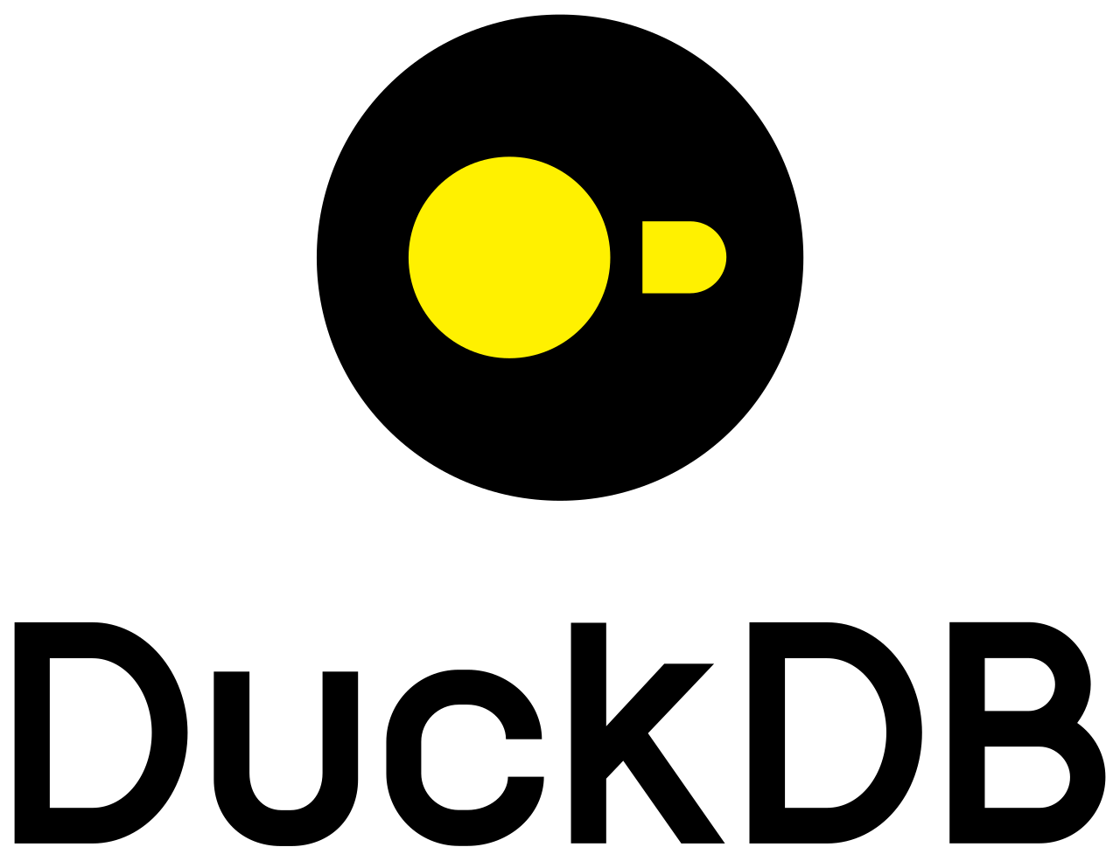
OPENING QUESTION
What survives when the database system changes?
ONE RELATION INSTANCE
ONE RELATIONAL QUESTION
road(City, City)
SELECT DISTINCT r1.src, r2.dst
FROM road AS r1 JOIN road AS r2
ON r1.dst = r2.src;
Logan
→
Salt Lake City
→
Provo
TWO EXECUTION BOUNDARIES
client ↔ server process ↔ managed table + indexes
The query crosses a process boundary.
SAME ANSWER
Logan → Provo
in-process engine ↔ table or view over Parquet
The application and engine share one process.
The SQL never says “server,” “Parquet,” “scan,” “index,” “join order,” or “materialize.”
So where does the executable program come from?
01
Notes:
0:00-0:08. Begin with silence for ten seconds: ask students to name what is identical and what changes. First establish the concrete instance and the set-valued two-hop answer. Then reveal the two execution boundaries. Do not yet define a database or survey systems. Press on the missing words in the SQL: none of the process, storage, access, order, or materialization choices appear. Transition with the final question: if the query does not contain a loop, where does the loop come from?
[Sources]
- /Users/stargazermiao/workspace/join-processing-datalog/doc/notes/01-a-little-database-a-few-questions.md
- https://dev.mysql.com/doc/dev/mysql-server/latest/PAGE_PROTOCOL.html
- https://duckdb.org/docs/stable/clients/python/overview
- https://duckdb.org/docs/current/guides/file_formats/query_parquet
- https://upload.wikimedia.org/wikipedia/en/d/dd/MySQL_logo.svg
- https://upload.wikimedia.org/wikipedia/commons/4/40/DuckDB_logo.svg
[/Sources]

Slide 2
THE COURSE'S CENTRAL BOUNDARY
The query fixes the answers; compilation chooses an execution.
THE SET-VALUED CONTRACT
two_hop(x, z) :- road(x, y), road(y, z)
Q(I) = { (x, z) | ∃y . (x, y) ∈ I(road) ∧ (y, z) ∈ I(road) }
DISTINCT makes the SQL result a set, matching this relation.
Fixed by the query
Chosen by compilation and execution
1
Input vocabulary and types: road(City, City)
A
Access: scan, hash lookup, trie navigation
2
Output relation: pairs (x, z)
B
Order: which occurrence drives, and when
3
Which tuples belong—for every valid instance I
C
State and control: stream, table, batch, push, pull
This is the correctness obligation.
This is the implementation freedom.
Compile(Q) = P is correct only if ∀ valid I, P(I) = Q(I).
Optimization is the freedom to vary P without changing Q.
02
Notes:
0:08-0:12. Translate the familiar SQL into the course's conjunctive-query notation. Read the equation from the inside out: choose a witness y; both input tuples must exist; return x and z. Emphasize the universal quantifier in the compiler contract: an implementation is not validated by reproducing the Logan example alone. Ask students for one additional legal choice on the right and one illegal change that would alter the left. This slide supplies the thesis for the remaining 63 minutes: expose, justify, and test the choices between Q and P.
[Sources]
- /Users/stargazermiao/workspace/join-processing-datalog/doc/notes/01-a-little-database-a-few-questions.md
- /Users/stargazermiao/workspace/join-processing-datalog/doc/notes/syllabus.md
- /Users/stargazermiao/workspace/join-processing-datalog/doc/PROJECT-SKELETON.md
[/Sources]

