Slide 1
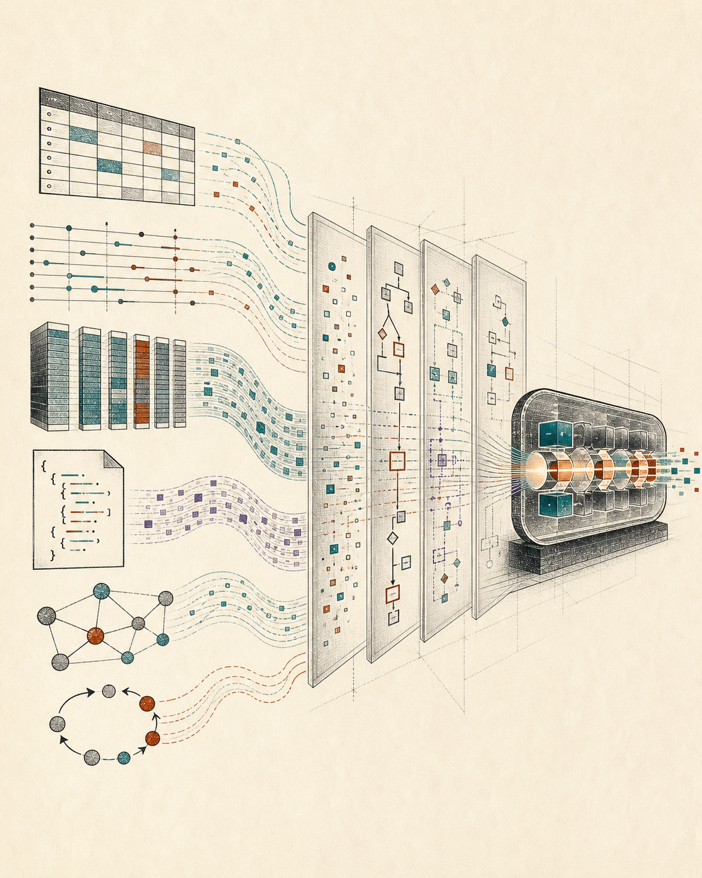
MODERN QUERY PROCESSING · 00
Why compile
a database?
Databases, query languages, Rust, and the machine we will make visible
Yihao Sun · Utah State University · Fall 2026
Notes:
Open with the central question. Do not define compilation yet. Ask students what they expect a course with this title to contain, then use the image to point out that tables are only one of several input worlds.
[Sources]
- OpenAI-generated editorial image, created for this deck on 2026-08-13
- /Users/stargazermiao/workspace/join-processing-datalog/doc/notes/syllabus.md
[/Sources]

Slide 2
START FROM WHAT YOU KNOW
Which of these feels like a database?
Δ
↺
Bank account
Parquet folder
Python DataFrame
Knowledge graph
Recursive rules
transactions + constraints
columnar files
in-memory values
entities + edges
derived facts
A database is not defined by one product, one data model, or one place on disk.
Modern Query Processing · Fall 2026
02
Notes:
Let students answer before revealing the sentence at the bottom. The point is not that every value is automatically a database. The point is that each object can participate in a database system once we specify the model, operations, and semantic contract.
[Sources]
- /Users/stargazermiao/workspace/join-processing-datalog/doc/notes/01-a-little-database-a-few-questions.md
- https://duckdb.org/docs/stable/clients/python/overview
[/Sources]

Slide 3
A VOCABULARY BEFORE PRODUCTS
A database has several independent characteristics
rows
documents
graphs
vectors
DATA MODEL
transactions
analytics
reasoning
search
WORKLOAD
network server
embedded process
cluster
edge
DEPLOYMENT
updates
append-only
snapshot
derived fixpoint
CHANGE
ACID
set/bag
open/closed world
approximate
CONTRACT
Products choose points in this space. Query processing asks what remains invariant as those points move.
Modern Query Processing · Fall 2026
03
Notes:
Use these axes as a reusable vocabulary. Emphasize that relational/document/graph is only one axis. MySQL and DuckDB share SQL and relations but differ sharply in workload and deployment. Later in the course, Datalog changes the semantic and change dimensions again.
[Sources]
- https://dev.mysql.com/doc/dev/mysql-server/latest/PAGE_PROTOCOL.html
- https://dev.mysql.com/doc/refman/8.0/en/mysql-acid.html
- https://duckdb.org/docs/stable/clients/python/overview
[/Sources]

Slide 4

ONE FAMILIAR POINT IN THE SPACE
MySQL centers a shared transactional server
MYSQL SERVER
web app
SQL execution
+ optimization
locks · MVCC
transactions
Clients cross a protocol boundary
admin tool
The server owns concurrency, recovery, and durable state.
service
durable tables + indexes + log
Modern Query Processing · Fall 2026
04
Notes:
This is a system contract, not a criticism. MySQL's protocol separates clients from a shared server; InnoDB supplies transactional guarantees and recovery mechanisms. Ask which responsibilities live outside the query itself.
[Sources]
- https://dev.mysql.com/doc/dev/mysql-server/latest/PAGE_PROTOCOL.html
- https://dev.mysql.com/doc/refman/8.0/en/mysql-acid.html
- https://upload.wikimedia.org/wikipedia/en/d/dd/MySQL_logo.svg
[/Sources]

Slide 5

SAME SQL FAMILY, DIFFERENT CONTRACT
DuckDB brings analytics into the process
No database server is required for the default in-memory connection.
{
PYTHON / R / RUST PROCESS
"city": "Logan",
"road": [ … ]
SQL can name files and in-memory DataFrames directly.
Parquet
DUCKDB
parse → optimize → vectorized execute
DataFrame
result as DataFrame / Arrow / rows
Arrow
Modern Query Processing · Fall 2026
05
Notes:
Contrast deployment and workload, not merely branding. DuckDB can directly query Parquet, CSV, JSON, Pandas, Polars, and Arrow values. Point out that the query language now crosses a host-language boundary without forcing a separate import step.
[Sources]
- https://duckdb.org/docs/stable/clients/python/overview
- https://duckdb.org/docs/current/guides/python/sql_on_pandas
- https://duckdb.org/docs/current/guides/file_formats/query_parquet
- https://upload.wikimedia.org/wikipedia/commons/4/40/DuckDB_logo.svg
[/Sources]

Slide 6
MYSQL → DUCKDB
The same word “database” hides different obligations
LIVES
as a shared server
LIVES
inside an application
OPTIMIZES FOR
concurrent transactions
OPTIMIZES FOR
analytical scans
OWNS
durability + isolation
READS
files + in-memory objects
QUERY CROSSES
a client/server protocol
QUERY CROSSES
language + data-format boundaries
Modern Query Processing · Fall 2026
06
Notes:
Read the columns as a change in system contract. Avoid implying that DuckDB replaces MySQL. The important observation for this course is that a high-level query can remain familiar while deployment, storage, and execution change beneath it.
[Sources]
- https://dev.mysql.com/doc/dev/mysql-server/latest/PAGE_PROTOCOL.html
- https://dev.mysql.com/doc/refman/8.0/en/mysql-acid.html
- https://duckdb.org/docs/stable/clients/python/overview
- https://duckdb.org/docs/current/guides/file_formats/query_parquet
[/Sources]

Slide 7
WHY QUERY LANGUAGES MATTER AGAIN
The query’s target is expanding
SELECT city
FROM roads
WHERE open;
SELECT *
FROM 'roads.parquet';
duckdb.sql(
"FROM roads_df"
)
MATCH (a)-[:ROAD]->(b)
RETURN a, b
stored table
file
program value
graph pattern
One declarative surface can outlive any one storage location—if a compiler can translate meaning into each target’s operations.
Modern Query Processing · Fall 2026
07
Notes:
The first three examples are directly grounded in DuckDB documentation. The graph syntax is illustrative of graph pattern languages; do not claim these languages are interchangeable. The slide's claim is about the widening set of query targets, not a single universal syntax.
[Sources]
- https://duckdb.org/docs/stable/clients/python/overview
- https://duckdb.org/docs/current/guides/file_formats/query_parquet
[/Sources]

Slide 8
DECLARATIVE LEVERAGE
The compiler absorbs variation the query should not mention
hash join
triangle(x, y, z) :-
R(x, y), S(y, z), T(z, x).
COMPILER
build · probe
meaning
+ facts
+ target
trie join
seek · intersect
semijoin
reduce · enumerate
JOIN ORDER
INDEXES
CONTROL
PARALLELISM
DEVICE
MATERIALIZATION
The query says what must be true. The compiler decides how the machine will make it true.
Modern Query Processing · Fall 2026
08
Notes:
This is the first direct answer to why query languages are valuable. They leave choices open. The compiler can specialize those choices for data, hardware, and workload while preserving the declarative meaning.
[Sources]
- /Users/stargazermiao/workspace/join-processing-datalog/doc/notes/syllabus.md
- /Users/stargazermiao/workspace/join-processing-datalog/doc/PROJECT-SKELETON.md
[/Sources]

Slide 9
THE MISSING PIECES ARE THE COURSE
A query is a program with control decisions left open
Where do rows come from?
scan / lookup / membership
triangle(x, y, z) :-
R(x, y),
S(y, z),
T(z, x).
Which bindings appear first?
join + variable order
Who asks for the next result?
pull / push / dataflow
What bounds the work?
cardinality / AGM / acyclicity
Meaning is explicit
What changes after recursion?
full / delta / fixpoint
Modern Query Processing · Fall 2026
09
Notes:
Use the questions as the semester map. A conjunctive query fixes logical meaning and source order in the course language, but does not spell a join operator or index. Later slides will show the exact named representations that answer each question.
[Sources]
- /Users/stargazermiao/workspace/join-processing-datalog/doc/DSL.md
- /Users/stargazermiao/workspace/join-processing-datalog/doc/notes/schedule.md
[/Sources]

Slide 10
A PIPELINE OF NAMED LANGUAGES
Compilation makes each decision inspectable
CQ
Relational
Plan
Index
Requirements
Rust Access
Plan
Iterator
Pipeline
Rust
meaning
logical edges
required keys
concrete access
lazy control
executable
Each arrow is small enough to call, test, print, and compare independently.
cargo xtask explain triangle
Modern Query Processing · Fall 2026
10
Notes:
This is the architectural promise of the project. Every important fact has a named representation. Students should be able to inspect two adjacent artifacts and ask exactly what decision changed.
[Sources]
- /Users/stargazermiao/workspace/join-processing-datalog/README.md
- /Users/stargazermiao/workspace/join-processing-datalog/doc/PROJECT-SKELETON.md
- /Users/stargazermiao/workspace/join-processing-datalog/doc/DSL.md
[/Sources]

Slide 11
WHY COMPILE EXECUTION
Operator boundaries help us think—but can cost work
INTERPRETED ITERATOR
COMPILED PIPELINE
scan.next()
for r in rows {
if let Some(s) = index.get(&r.y) {
for s in s {
if t.contains(&(s.z, r.x)) {
yield (r.x, r.y, s.z);
}
}
}
}
join.next()
filter.next()
project.next()
one boundary crossing per tuple per operator
data stays inside a compact control region
Modern Query Processing · Fall 2026
11
Notes:
Do not claim that iterators are always slow or that compilation must remove every abstraction. Neumann's motivation is that per-tuple operator calls can harm locality and branch predictability; compilation can blur boundaries and keep data in a compact pipeline. This course first makes the boundaries explicit, then studies alternative lowerings.
[Sources]
- https://www.vldb.org/pvldb/vol4/p539-neumann.pdf
- /Users/stargazermiao/workspace/join-processing-datalog/README.md
[/Sources]

Slide 12
SEMANTICS ACROSS STAGES
Lower representation without lowering trust
query meaning
successful valuations
logical plan
same relation
physical access
same bindings
control plan
same result stream
Rust program
same set of rows
Every pass needs a local before/after claim—not faith in the final output.
Modern Query Processing · Fall 2026
12
Notes:
This is why the course uses nominal typed IRs and pass contracts. Students should see semantic preservation as a chain of local obligations. The exact contract language appears later; today, establish the habit of naming what is preserved at each edge.
[Sources]
- /Users/stargazermiao/workspace/join-processing-datalog/doc/PROJECT-SKELETON.md
- /Users/stargazermiao/workspace/join-processing-datalog/doc/IR-FORMALIZATION.md
[/Sources]

Slide 13
WHAT WE WILL—AND WILL NOT—BUILD
Our target is a glass-box query processor
WE MAKE VISIBLE
WE DO NOT REBUILD
CQ meaning
SQL parser
logical and physical IRs
transactions
join algorithms
buffer manager
indexes and access
distributed runtime
pull / push control
production catalog
work counters
every database feature
recursive deltas
a leaderboard
The small scope is what lets every important boundary stay visible.
Modern Query Processing · Fall 2026
13
Notes:
Make the boundary explicit so students do not imagine a semester-long full DBMS build. Staff supplies parser, runtime scaffolding, workloads, tests, and later physical lowerings. Student work centers named transformations and operators.
[Sources]
- /Users/stargazermiao/workspace/join-processing-datalog/doc/notes/project.md
- /Users/stargazermiao/workspace/join-processing-datalog/README.md
- /Users/stargazermiao/workspace/join-processing-datalog/doc/PROJECT-SKELETON.md
[/Sources]

Slide 14
CONCRETE COMPILATION MAP
One triangle query becomes six inspectable artifacts
1
CQ
R(x,y), S(y,z), T(z,x)
2
RelationalPlan
scan · join · semijoin
3
IndexRequirements
S[0] · T[0,1]
4
RustAccessPlan
iter / get / contains
5
IteratorPipeline
scan · join · filter · distinct
6
Rust
map · flat_map · filter
Modern Query Processing · Fall 2026
14
Notes:
This is the concrete project spine. It is intentionally more detailed than a generic parser–optimizer–executor diagram. Tell students that later lectures will zoom into one edge at a time; no one must understand all six artifacts today.
[Sources]
- /Users/stargazermiao/workspace/join-processing-datalog/doc/DSL.md
- /Users/stargazermiao/workspace/join-processing-datalog/README.md
[/Sources]

Slide 15
WHY THIS COURSE
The course keeps meaning and work in the same frame
MEANING
WORK
Which tuples are answers?
How much must we touch?
q(x,z) :- road(x,y), road(y,z).
intermediate rows
intersections
probes
deltas
valuations · set semantics · fixed points
AGM: query shape gives a bound before code runs
A correct system needs both.
Modern Query Processing · Fall 2026
15
Notes:
This is the course's central intellectual tension. Database theory gives meaning and bounds; systems work exposes the physical cost. AGM is named here only as a promise: the course will connect query shape to worst-case output and intermediate work with counters.
[Sources]
- /Users/stargazermiao/workspace/join-processing-datalog/doc/notes/syllabus.md
- /Users/stargazermiao/workspace/join-processing-datalog/doc/notes/schedule.md
[/Sources]

Slide 16
COURSE SHAPE
No exams. One cumulative machine.
50
30
20
PROJECT
PRACTICA
DISCUSSION + PARTICIPATION
50%
30%
20%
open-note
three releases
one paper lead
reason from traces + evidence
code + tests + counters
claim + connection + questions
Modern Query Processing · Fall 2026
16
Notes:
Walk through the proportions, then state what is absent: no weekly problem sets, quizzes, midterm, or final. Practica assess reasoning with traces, bounds, and measurements; the project accumulates rather than restarting each assignment.
[Sources]
- /Users/stargazermiao/workspace/join-processing-datalog/doc/notes/syllabus.md
[/Sources]

Slide 17
PROJECT MAP
Three releases grow one engine
Week 5
Week 10
Week 14
R1
logical + physical lowering
pull / push control
R2
Yannakakis + triejoin
R3
semi-naive recursion
Reference checkpoints after R1 and R2 keep later ideas reachable even if an earlier pass is unfinished.
Modern Query Processing · Fall 2026
17
Notes:
Emphasize cumulative growth and the reference-checkpoint safety valve. The precise project contract remains the authority; this slide is orientation. Releases are planned for Weeks 5, 10, and 14 in the current draft schedule.
[Sources]
- /Users/stargazermiao/workspace/join-processing-datalog/doc/notes/schedule.md
- /Users/stargazermiao/workspace/join-processing-datalog/doc/notes/project.md
[/Sources]

Slide 18
HOW CLASS WORKS
A meeting moves from idea to evidence
1
2
3
4
name the question
derive or read
trace the machine
compare evidence
What must remain true?
rule · proof · paper
rows · probes · deltas
counterexample · counter
Lecture + discussion + shared trace—not a weekly coding lab.
Modern Query Processing · Fall 2026
18
Notes:
Set expectations for the seminar rhythm. A typical meeting mixes lecture or board derivation, discussion of one primary reading, and a short shared trace, inspection, or result comparison. Outside class, the project is cumulative.
[Sources]
- /Users/stargazermiao/workspace/join-processing-datalog/doc/notes/syllabus.md
[/Sources]

Slide 19


WHY THIS HOST LANGUAGE
Rust makes execution choices difficult to hide
Python
Rust
roads = {("Logan", "SLC")}
def has_road(roads, road):
return road in roads
fn has_road(
roads: &HashSet<Road>,
road: Road,
) -> bool {
roads.contains(&road)
}
concise values and exploration
ownership + types expose boundaries
We use Rust because the representation and cost model become discussable—not because Python is “bad.”
Modern Query Processing · Fall 2026
19
Notes:
Frame this as a pedagogical choice. Python remains useful for data exploration; Rust forces us to state ownership, borrowing, and exact representation. Those constraints make storage, iterators, and typed program values visible in the compiler.
[Sources]
- https://www.python.org/community/logos/
- https://www.rust-lang.org/logos/rust-logo-512x512.png
- https://doc.rust-lang.org/book/ch04-00-understanding-ownership.html
- /Users/stargazermiao/workspace/join-processing-datalog/doc/RUST-TUTORIAL-DESIGN.md
[/Sources]

Slide 20
MOVE AND BORROW
Ownership is permission over a value
MOVE
BORROW
roads
is_road(roads, …)
roads
is_road(&roads, …)
caller loses ownership
temporary read permission
Database consequence
storage owns rows · cursors borrow storage · outputs own projected values
Modern Query Processing · Fall 2026
20
Notes:
Use the road set from the notes. A move transfers ownership; a shared borrow grants temporary read access. Then connect the Rust rule to the database design: storage should own rows, a query cursor should borrow them, and projection constructs owned result values.
[Sources]
- https://doc.rust-lang.org/book/ch04-00-understanding-ownership.html
- /Users/stargazermiao/workspace/join-processing-datalog/doc/notes/01-a-little-database-a-few-questions.md
- /Users/stargazermiao/workspace/join-processing-datalog/doc/RUST-TUTORIAL-DESIGN.md
[/Sources]

Slide 21
PRODUCTS AND SUMS
Rust data types can make a language visible
STRUCT = PRODUCT
ENUM = TAGGED SUM
one value has all fields
one value is exactly one case
struct Atom {
relation: Ident,
variables: Vec<Ident>,
}
enum Operator {
Scan(Atom),
Join { left: Id, right: Id },
Project { input: Id },
}
An enum variant is not a subclass. Exhaustive match means every language case is handled.
Modern Query Processing · Fall 2026
21
Notes:
Teach the mathematical distinction explicitly. A struct is a product: all fields are present. An enum is a tagged sum: one alternative is present. This is why grammar cases map naturally to enum variants and why exhaustive matching is a compiler-design aid.
[Sources]
- https://doc.rust-lang.org/book/ch06-00-enums.html
- /Users/stargazermiao/workspace/join-processing-datalog/doc/RUST-TUTORIAL-DESIGN.md
[/Sources]

Slide 22
THE RUST BRIDGE
A program becomes a value—and can become a new program
source tokens
parse
typed value
transform
next syntax
triangle(x,y,z)
syn::parse2
cq::Module
compile_cq
quote! { … }
Compiler : ProgramValue → ProgramValue
Macros supply the expansion boundary; typed functions contain the course logic.
Modern Query Processing · Fall 2026
22
Notes:
This is the central Rust bridge from the notes. Procedural macros receive token streams and return token streams, but the project immediately parses into typed values. The important compiler work happens in ordinary functions between nominal typed IRs.
[Sources]
- https://doc.rust-lang.org/reference/procedural-macros.html
- /Users/stargazermiao/workspace/join-processing-datalog/doc/notes/rust-01-the-code-that-became-a-value.md
- /Users/stargazermiao/workspace/join-processing-datalog/doc/RUST-TUTORIAL-DESIGN.md
[/Sources]

Slide 23
RUST PAUSE
Live question: does a macro evaluate its input?
stringify!(1 + 1)
LIVE CODING / EXPANSION SPACE
Predict the result
"2"
"1 + 1"
compile error
The useful surprise: source code can be input data before it is evaluated.
Modern Query Processing · Fall 2026
23
Notes:
Pause here for live coding. Ask students to vote, run the expression, then try stringify!(x) after binding x. If time permits, show a tiny proc macro or the provided rust-01-stringify workspace. The reveal should lead to code-to-code transformation, not immediately to full proc-macro mechanics.
[Sources]
- https://doc.rust-lang.org/std/macro.stringify.html
- /Users/stargazermiao/workspace/join-processing-datalog/doc/notes/rust-01-the-code-that-became-a-value.md
- /Users/stargazermiao/workspace/join-processing-datalog/doc/notes/examples/rust-01-stringify/README.md
[/Sources]

Slide 24
FIRST CONCRETE EXAMPLE
A database begins when we name the recorded world
WORLD
RECORDED INSTANCE
SLC
HashSet::from([
("Logan", "SLC"),
("SLC", "Provo"),
])
Logan
Provo
membership is decidable here
Ogden
too large to enumerate completely
Closed world: ask “according to what we recorded?”
Modern Query Processing · Fall 2026
24
Notes:
Reconnect the database idea to the first conversational note. A Rust type describes shape; it does not prove geography. The finite HashSet gives the program a recorded world in which membership is decidable under a closed-world reading.
[Sources]
- /Users/stargazermiao/workspace/join-processing-datalog/doc/notes/01-a-little-database-a-few-questions.md
[/Sources]

Slide 25
CONCRETE END-TO-END ANCHOR
One triangle query can be read as logic or executed as SQL
y
SELECT DISTINCT R.x, R.y, S.z
FROM R
JOIN S ON R.y = S.y
JOIN T ON S.z = T.z AND R.x = T.x
R
x
S
T
z
MiniLinq result
[(1, 2, 3), (2, 3, 4)]
triangle(x, y, z) :-
R(x, y), S(y, z), T(z, x).
DuckDB result
[(1, 2, 3), (2, 3, 4)]
same inputs · same set semantics · exact equality check
Modern Query Processing · Fall 2026
25
Notes:
Use the checked-in triangle-duckdb example as the end-to-end anchor. MiniLinq and DuckDB consume the same rows; the SQL explicitly normalizes inputs and uses DISTINCT so it matches the course's set semantics. The example asserts exact ordered equality.
[Sources]
- /Users/stargazermiao/workspace/join-processing-datalog/examples/triangle-duckdb/main.rs
- /Users/stargazermiao/workspace/join-processing-datalog/doc/DSL.md
[/Sources]

Slide 26
THE HABIT FOR THE SEMESTER
Every lecture returns to four questions
1
2
3
4
Meaning
Representation
Algorithm
Evidence
What is an answer?
What facts must stay visible?
What work produces the answer?
How do we know the claim?
What decision is hidden inside a query you already use?
Modern Query Processing · Fall 2026
26
Notes:
Close by returning to the opening question. Invite students to name a familiar query and one hidden decision: join order, index, file scan, concurrency, materialization, recursion, or device. This resolves the deck without a generic thank-you slide.
[Sources]
- /Users/stargazermiao/workspace/join-processing-datalog/doc/notes/syllabus.md
- /Users/stargazermiao/workspace/join-processing-datalog/doc/notes/schedule.md
[/Sources]

