Slide 1
MODERN QUERY PROCESSING
Modern Query Processing
Databases and Reasoning
Yihao Sun
yihao.sun@usu.edu
Fall 2026
Notes:
Allow about 30-45 seconds. Greet the class and advance without previewing the definition of database.
[Sources]
- /Users/stargazermiao/workspace/join-processing-datalog/doc/notes/syllabus.md
- /Users/stargazermiao/workspace/StarGazerM.github.io/_config.yml
[/Sources]

Slide 2





WHAT IS A DATABASE?
Every product remembers something.
SERVER
orders
posts
→
SQL → PLAN
SELECT …
TRANSACTIONS
CACHE
TABLES / INDEXES
playlists
trips
LOGS
Notes:
3 minutes. First spend about 45 seconds on the four familiar products. Ask what each must remember: orders, posts, playlists, or trips. The logos illustrate application variety only; do not suggest that these products all run on MySQL. Then let MySQL supply the students' likely picture: a client sends SQL to a server containing many subsystems. Ask them to name anything else they associate with a database server. Preserve the provisional answer: database means complicated software that stores and manages data. Do not correct it yet.
[Sources]
- https://dev.mysql.com/doc/dev/mysql-server/latest/PAGE_PROTOCOL.html
- https://dev.mysql.com/doc/refman/9.2/en/innodb-architecture.html
- https://upload.wikimedia.org/wikipedia/en/d/dd/MySQL_logo.svg
- https://github.com/FortAwesome/Font-Awesome/blob/6.x/svgs/brands/amazon.svg
- https://github.com/FortAwesome/Font-Awesome/blob/6.x/svgs/brands/instagram.svg
- https://github.com/FortAwesome/Font-Awesome/blob/6.x/svgs/brands/spotify.svg
- https://github.com/FortAwesome/Font-Awesome/blob/6.x/svgs/brands/uber.svg
- /Users/stargazermiao/workspace/join-processing-datalog/doc/notes/01-a-little-database-a-few-questions.md
[/Sources]

Slide 3


WHAT CHANGED?
Same tables. No server.
$ sqlite3 app.db
sqlite> SELECT name, city
...> FROM users;
→
→
app.db
one file
users
id
name
city
42
Ada
Logan
81
Alice
Provo
Notes:
2.5 minutes. Read the command from left to right: a CLI opens app.db, passes SQL to SQLite, and reads the same kind of users table students expect from MySQL. Ask: where is the server? Then ask what they are calling the database: the file, the SQLite library, or the tables inside it. Hold all answers. The contrast should weaken the equation database equals server without yet supplying the definition.
[Sources]
- https://sqlite.org/quickstart.html
- https://sqlite.org/about.html
- https://commons.wikimedia.org/wiki/File:SQLite370.svg
- https://github.com/FortAwesome/Font-Awesome/tree/6.x/svgs/regular/file.svg
- /Users/stargazermiao/workspace/join-processing-datalog/doc/notes/01-a-little-database-a-few-questions.md
[/Sources]

Slide 4

WHAT REMAINED?
A database need not contain tables.
{
}
KEY
VALUE
"user:42"
:
{ name: "Ada", city: "Logan" },
:
19
"visits"
database ≠ DBMS
Notes:
3 minutes. Point to the outer braces first: conceptually, this is one map from keys to values, not two unrelated records. Let students read the entries before naming Redis. Ask verbally whether a database must manage tables. Then ask why a Redis server is not merely a shared HashMap; accept persistence, concurrency, remote access, data operations, and similar suggestions without listing them on the slide. Reveal only the distinction database is not DBMS. Do not define database yet. Transition exactly: We now know the database is not the same thing as its management software. To say what a database is, first ask what counts as data.
[Sources]
- https://redis.io/docs/latest/develop/data-types/
- https://redis.io/docs/latest/develop/data-types/hashes/
- https://commons.wikimedia.org/wiki/File:Redis_logo.svg
- /Users/stargazermiao/workspace/join-processing-datalog/doc/notes/01-a-little-database-a-few-questions.md
[/Sources]

Slide 5


WHAT IS DATA?
Same data. Different representations.
roads = [
("Logan", "Salt Lake City"),
("Salt Lake City", "Provo")
]
=
=
roads.xlsx
roads.parquet
FILE
FILE
VALUE IN MEMORY
Logan
Salt Lake City
Provo
same logical roads
Notes:
3 minutes. Ask verbally in sequence: Is roads.xlsx data? Is roads.parquet data even if the format is unfamiliar? If a running program holds the same two road values, did they stop being data? Clarify one precise point: roads is a variable name or binding; the array value bound to it can serve as data. The equal signs mean the examples can carry the same logical values, not that their bytes or representations are identical. The shared route at the bottom is the logical content. Do not teach XLSX or Parquet internals here. Conclude verbally: values are data; files and memory are different representations or locations. Transition exactly: However data is represented, software must turn a question into work. Where inside a DBMS does that happen?
[Sources]
- https://commons.wikimedia.org/wiki/File:Microsoft_Office_Excel_(2025%E2%80%93present).svg
- https://www.microsoft.com/en-gb/microsoft-365
- https://parquet.apache.org/
- https://github.com/apache/parquet-format/tree/master/logo
- /Users/stargazermiao/workspace/join-processing-datalog/doc/notes/01-a-little-database-a-few-questions.md
[/Sources]

Slide 6
COURSE SCOPE
Inside the DBMS
DBMS
OUR SCOPE
QUERY LANGUAGES
language
→
plan
→
work
QUERY PROCESSING
↑
TRANSACTIONS
STORAGE / INDEXES
rows
columns
index
FILES / MEMORY
Notes:
4 minutes. Point once to the whole stack, then to the two black bands: this course begins with query languages and continues through query processing; it does not build an entire DBMS. Name the languages we will study—conjunctive queries and positive Datalog—without surveying every query language. Follow the magnification into language, plan, and work. Ask verbally: Why does our scope reach down into the data representation? Take at most two answers. Accept row or column layout, indexes, ordering, hashing, size, and statistics. Conclude exactly: We study how a query language gives meaning to a request and how that request becomes executable work, but the work depends on what the data looks like. Transition: now you are the query processor.
[Sources]
- https://www.postgresql.org/docs/current/query-path.html
- https://www.postgresql.org/files/developer/tour.pdf
- /Users/stargazermiao/workspace/join-processing-datalog/doc/notes/syllabus.md
- /Users/stargazermiao/workspace/join-processing-datalog/doc/notes/project.md
[/Sources]

Slide 7
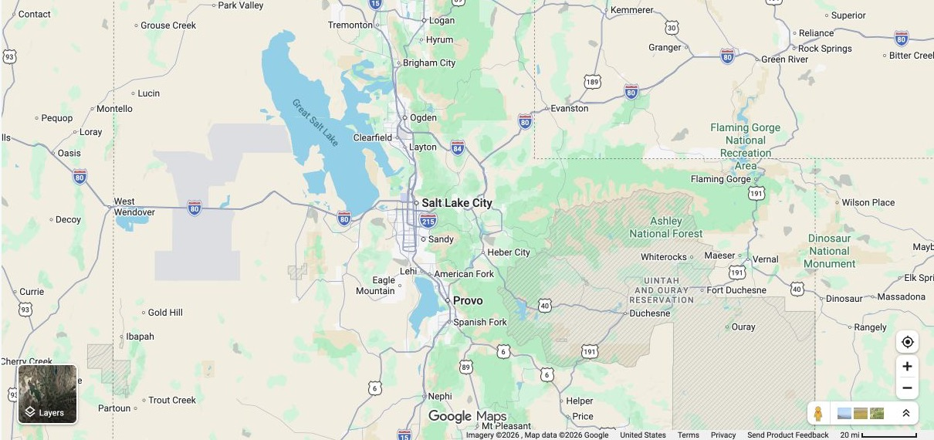
YOUR TURN
Salt Lake City → ? → Heber City
Logan
Brigham City
Ogden
Salt Lake City
Park City
Heber City
Provo
Notes:
3 minutes. Give students 45-60 seconds alone, then 45 seconds with a neighbor. Ask for every path containing exactly two stored directed routes from Salt Lake City to Heber City. The two answers are Salt Lake City → Park City → Heber City and Salt Lake City → Provo → Heber City. The other cities and routes are deliberately present: a query selects answers from a larger database. Clarify once that arrows indicate the direction stored in this teaching data, not legal one-way traffic. Ask two students how they searched; do not yet name a join algorithm. Transition: the question determines which paths count, but not how a machine should find them.
[Sources]
- https://www.google.com/maps/@40.98,-111.72,8z?entry=ttu
- https://maps.udot.utah.gov/image/rest/services/StateMap/Official_Utah_Highway_Map/ImageServer
- /Users/stargazermiao/workspace/join-processing-datalog/doc/notes/02-the-relation-that-wasnt-stored.md
[/Sources]

Slide 8
LOGIC MEETS OBJECTS
One relation can live inside many objects.
edge(A, y)
HASH MAP
B-TREE
GRAPH ADJACENCY
hash(A)
G
A
B
0
1
B C
3
4
5
A D
M R
A
D
A → [B,C]
M → […]
C
hash → probe → get
compare → descend → range
neighbors → traverse
same answer { B, C }
Notes:
2 minutes 15 seconds. The query expression is language-neutral: edge(A, y) asks for the values related to A. Hold the logical relation fixed. Ask students to name the verb each object actually offers. A hash map relies on key hashing and equality before returning the stored value; a B-tree relies on an ordering relation and supports ordered/range access; an adjacency-list graph exposes neighbor traversal. These are not three query languages and they are not three answers. They are three physical realizations whose primitive work differs. The figures are illustrative, not a claim that every implementation uses exactly these layouts. Transition: what lets us say that all three still represent the same edge relation?
[Sources]
- https://doc.rust-lang.org/std/collections/struct.HashMap.html
- https://doc.rust-lang.org/std/collections/struct.BTreeMap.html
- https://docs.rs/petgraph/latest/petgraph/graph/struct.Graph.html
- /Users/stargazermiao/workspace/join-processing-datalog/doc/notes/01-a-little-database-a-few-questions.md
[/Sources]

Slide 9
SEMANTIC MODEL
A model says what every object means.
PHYSICAL OBJECTS
edge(A, y)
HASH MAP
A → [B, C]
LOGICAL FACTS
0
1
B C
3
4
5
SEMANTIC
MODEL
edge(A, B)
edge(A, C)
object → relation
GRAPH
B
A
D
C
{ B, C }
same facts → same answer
Notes:
2 minutes. The model is the contract between representation and logic. In this set-semantics example, both physical objects denote the same two facts: edge(A,B) and edge(A,C). The query is interpreted over those facts and therefore returns B and C. The semantic model is not another storage layout and it is not a performance promise; it tells us what answers are correct. Later the course will define database instances, valuations, CQs, and Datalog more carefully. For now, ask whether changing bucket positions or graph node IDs changes the database meaning. It does not if the representation mapping yields the same logical facts. Transition: a system still needs executable code that preserves this contract.
[Sources]
- /Users/stargazermiao/workspace/join-processing-datalog/doc/notes/01-a-little-database-a-few-questions.md
- /Users/stargazermiao/workspace/join-processing-datalog/doc/notes/02-the-relation-that-wasnt-stored.md
- https://webdam.di.ens.fr/Alice/
[/Sources]

Slide 10
PROGRAMMING LANGUAGES
A compiler turns meaning into object operations.
HASH MAP
QUERY
by_src.get(&A)
hash + equality
TYPED
MEANING
LOWER
edge(A, y)
B-TREE
by_src.range(A..=A)
what must be true
relation = edge
bind src = A
ordered comparisons
GRAPH
graph.neighbors(A)
adjacency traversal
typed transformations preserve meaning while changing the program
Notes:
2 minutes 30 seconds. Programming languages give us a disciplined way to bridge meaning and machine operations: define semantics, represent programs as typed intermediate values, and lower those values into executable code. The three right-hand fragments are representation-specific examples. HashMap::get uses the hash-map contract; BTreeMap::range uses key ordering; Graph::neighbors uses adjacency. The slide does not claim a compiler chooses among these exact Rust types at runtime. It assumes a representation has been supplied or selected and shows the code that can be generated for it. An interpreter could execute the typed model through generic dispatch; this course emphasizes compilation because the chosen operations become inspectable and optimizable program structure. Transition: semantic preservation gives correctness, but not a good program.
[Sources]
- https://doc.rust-lang.org/std/collections/struct.HashMap.html
- https://doc.rust-lang.org/std/collections/struct.BTreeMap.html
- https://docs.rs/petgraph/latest/petgraph/graph/struct.Graph.html
- https://www.vldb.org/pvldb/vol4/p539-neumann.pdf
- /Users/stargazermiao/workspace/join-processing-datalog/doc/notes/rust-01-the-code-that-became-a-value.md
- /Users/stargazermiao/workspace/join-processing-datalog/doc/notes/project.md
[/Sources]

Slide 11
OPTIMIZATION
A correct program can still waste work.
QUERY-BY-QUERY
WORKLOAD-AWARE
build
src
Q1 src=A
Q1 src=A
src
build again
src
Q2 src=D
Q2 src=D
shared src index
build for one use
src
Q3 one-shot
Q3 one-shot
scan once
3 indexes · 3 builds
1 shared index · 1 scan
Notes:
2 minutes 15 seconds. All six paths on this slide can be semantically correct. The left side nevertheless duplicates a compatible source-key index for Q1 and Q2 and builds another structure for a one-shot small query. The right side shares one compatible index across Q1 and Q2 and lets Q3 scan without paying a new build cost. Whether sharing or skipping is legal depends on schema, key, semantics, updates, lifetime, and memory; the figure is a workload-level motivation, not a universal rule. The course project explicitly derives index requirements and tests compatible sharing. Ask students which resource is wasted on the left: both storage and build time. Transition: even after removing avoidable duplication, the best representation still depends on the data itself.
[Sources]
- /Users/stargazermiao/workspace/join-processing-datalog/README.md
- /Users/stargazermiao/workspace/join-processing-datalog/doc/notes/project.md
- https://www.vldb.org/pvldb/vol13/p1793-mcsherry.pdf
[/Sources]

Slide 12
DATA SHAPE
Data shape changes the sensible program.
A → ? → B
SPARSE · few neighbors
DENSE · many neighbors
B
C
E
A
A
B
D
F
adjacency bits
G
OUT[A]
IN[B]
follow a short neighbor list
AND
OUT[A] ∩ IN[B]
bit-parallel on CPU / GPU
Notes:
2 minutes 15 seconds. The logical query is the same on both sides: return each middle node y with edge(A,y) and edge(y,B). Under set semantics this is OUT[A] intersect IN[B]. For sparse adjacency, iterating a short neighbor list and testing membership can avoid touching absent edges. For denser data, fixed-width or compressed bitsets can turn the same intersection into word-, SIMD-, or GPU-parallel operations. The eight-bit vectors are a visible toy; they do not claim one universal machine instruction or a universal crossover point. Density, cardinality, skew, representation cost, memory, and hardware determine the winner. This is why query optimization needs facts about the data shape, not only the query text.
[Sources]
- https://graphblas.org/
- https://arxiv.org/abs/1709.07821
- /Users/stargazermiao/workspace/join-processing-datalog/doc/notes/syllabus.md
- /Users/stargazermiao/workspace/join-processing-datalog/doc/notes/project.md
[/Sources]

Slide 13
WHY THIS COURSE
This course studies the whole bridge.
MEANING
TYPED
IRs
CHOICE
PROGRAM
edge(A, y)
shape · bounds
indexes · algorithms
Mini-LINQ
semantic values
physical program
Rust · counters · hardware
preserve meaning
reduce work
semantics → algorithms → systems
Notes:
2.5 minutes. Read the bridge left to right. Mini-LINQ is the query surface used in this course; its early typed meaning is based on conjunctive-query and Datalog ideas. The compiler then moves through several typed IRs. Each IR makes a different contract explicit while preserving meaning; physical choice adds shape, bounds, indexes, and algorithms. The emitted Rust program is where work becomes measurable through counters and hardware behavior. The course therefore studies the entire bridge, not only a query notation or only a runtime loop.
[Sources]
- /Users/stargazermiao/workspace/join-processing-datalog/README.md
- /Users/stargazermiao/workspace/join-processing-datalog/doc/notes/project.md
- /Users/stargazermiao/workspace/join-processing-datalog/doc/notes/syllabus.md
[/Sources]

Slide 14
POSTGRESQL EXAMPLE
Compilation has a bill.
SELECT SUM(relpages) FROM pg_class;
NO JIT
0.365 ms
FORCED JIT
JIT 7.104 ms
7.416 ms
ms
0
2
4
6
8
Notes:
3 minutes. Ask for a prediction before reading the two numbers: should forcing compilation help this short aggregate? The PostgreSQL documentation reports 0.365 ms without JIT and 7.416 ms after lowering the JIT threshold for this same example. The reported JIT work totals 7.104 ms, so compilation dominates. These are documentation-example timings from one run, not a universal benchmark and not evidence that JIT is generally harmful. The lesson is conditional: compilation has an upfront cost and is valuable when enough repeated execution can repay it. Transition: our course will expose both the transformation cost and the execution work, then ask when each choice is justified.
[Sources]
- https://www.postgresql.org/docs/current/jit-decision.html
- /Users/stargazermiao/workspace/join-processing-datalog/doc/notes/syllabus.md
- /Users/stargazermiao/workspace/join-processing-datalog/doc/notes/project.md
[/Sources]

Slide 15
TOOL CHOICE
A query compiler needs two kinds of power.
COMPILER
MACHINE
TYPED
IRs
ROWS
mini_linq!
r0
r1
r2
r3
r4
rewrite · check · emit
INDEX
TIGHT
LOOP
programs as typed values
key
row 2
layout · ownership · cache
common industrial split: Python tooling ↔ C++ runtime
RUST
typed compiler
+
low-level execution
Notes:
2 minutes. Point to the left: a query compiler needs typed program representations, rewrites, checking, and code emission. Point to the right: the emitted program still owns rows, indexes, memory layout, and tight loops. The tool choice is therefore not a generic language contest; it is whether one teaching language can expose both kinds of work. The C++ runtime plus Python/tooling split is mature and effective in real systems. For this course, crossing that boundary would hide transformations students need to print, change, and test, so Rust spans the two halves.
[Sources]
- https://doc.rust-lang.org/book/ch00-00-introduction.html
- https://github.com/duckdb/duckdb#development
- https://duckdb.org/docs/stable/clients/python/overview
- /Users/stargazermiao/workspace/join-processing-datalog/doc/notes/project.md
[/Sources]

Slide 16
WHY RUST?
A new plan should expose every unfinished case.
TYPED PLAN VALUE
enum Access
OPTIMIZER
when can Trie be chosen?
Scan
Hash(Index)
EMITTER
how does Trie execute?
+ Trie(Index)
!
TESTS
which cases preserve meaning?
exhaustive matches reveal unfinished cases
Cargo
check · test · fmt · clippy · docs
Notes:
2.5 minutes. Do not teach enum syntax. Read the figure as a compiler-maintenance story: a student adds one physical access choice, Trie(Index). If optimizer and emitter logic use exhaustive matching, the Rust compiler identifies every place that has not handled the new state. Tests then state the semantic contract. Ask: which unfinished box would be most dangerous if it stayed silent? Accept optimizer or emitter. Qualify the claim: C++ can express variants and visitors too, and Rust exhaustiveness can be weakened by wildcard arms. The course benefit is the coherent default workflow around typed states, diagnostics, checking, tests, formatting, linting, and documentation.
[Sources]
- https://doc.rust-lang.org/book/ch06-00-enums.html
- https://doc.rust-lang.org/book/ch06-02-match.html
- https://doc.rust-lang.org/cargo/guide/why-cargo-exists.html
- /Users/stargazermiao/workspace/join-processing-datalog/doc/notes/project.md
[/Sources]

Slide 17
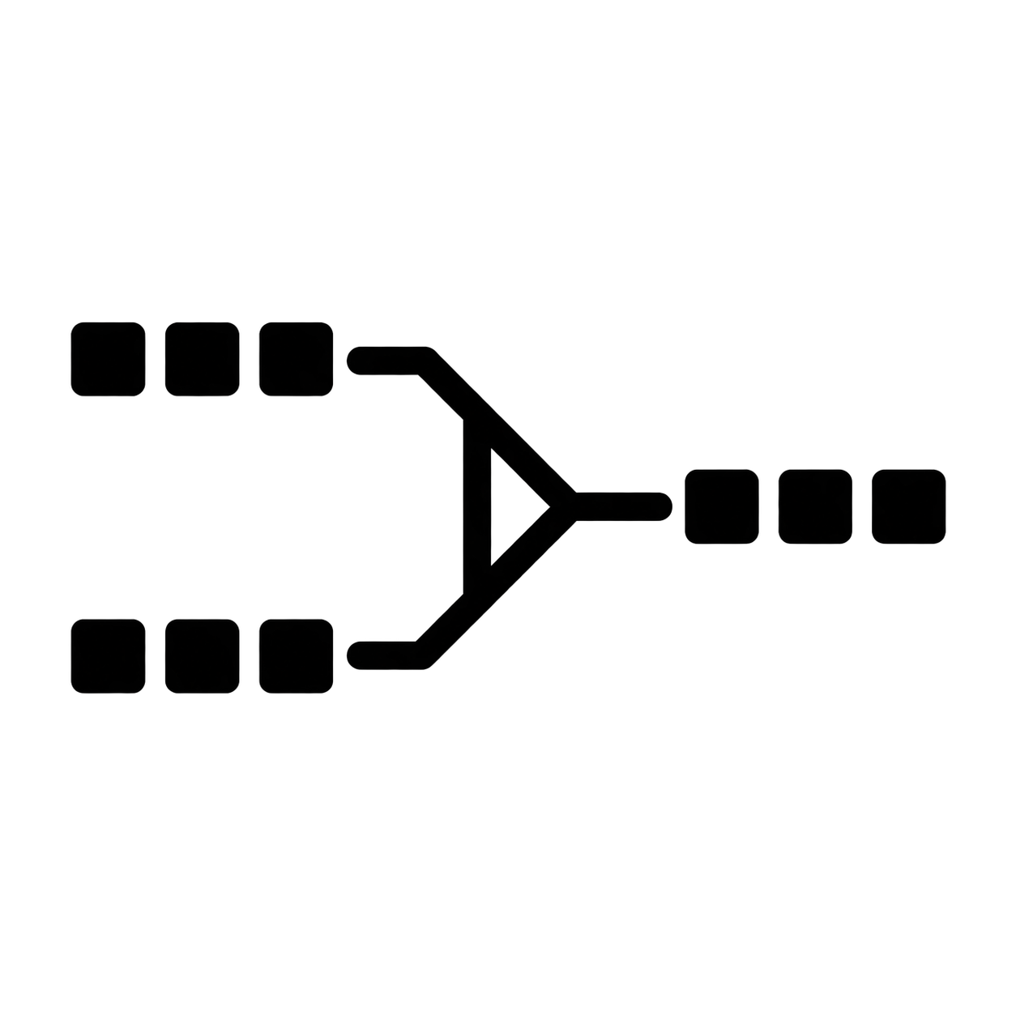
MINI-LINQ
The compiler becomes part of the experiment.
COMPILE TIME
RUST
TYPED IRs
IR₁ → IR₂ → …
PHYSICAL
CHOICE
CQ
mini_linq! {
…
}
surface syntax
macro boundary
executable
ORDINARY RUST VALUES + FUNCTIONS
print · change · test
Notes:
2.5 to 3 minutes. Name the course language explicitly: Mini-LINQ is the surface syntax students write. The procedural macro is the syntax boundary; staff supplies the parser and macro infrastructure. After CQ, the compiler crosses several typed IR levels rather than one monolithic logical plan. The ellipsis is intentional: examples in the scaffold include relational, index-requirement, access-plan, and iterator-pipeline values, but the first lecture need not name every one. These IRs and physical choices are ordinary Rust values transformed by ordinary Rust functions at compile time. The final emitted Rust runs later. Ask: which box is the running query? Answer: none of the middle boxes; this slide is compile time.
[Sources]
- https://doc.rust-lang.org/stable/reference/procedural-macros.html
- /Users/stargazermiao/workspace/join-processing-datalog/README.md
- /Users/stargazermiao/workspace/join-processing-datalog/doc/notes/rust-01-the-code-that-became-a-value.md
- /Users/stargazermiao/workspace/join-processing-datalog/doc/notes/project.md
- /Users/stargazermiao/workspace/join-processing-datalog/slides/assets/mini-linq-mark.png
[/Sources]

Slide 18
COURSE MAP
One question organizes the semester.
01
02—04
05—08
09—12
CQ MEANING
EXECUTION
JOIN ALGORITHMS
DATALOG
rules · valuations
joins · Rust · pull / push
AGM · Yannakakis · triejoin
fixed points · semi-naive
meaning
→
executable work
→
recursive execution
Notes:
3 minutes. Do not read this as a week-by-week list. Begin at CQ meaning: first we make the question precise. Move through binary joins, the Rust bridge, and pull/push as the first executable path. Then point to AGM bounds, Yannakakis, and triejoin as different ways to reason about and perform joins. End with positive Datalog and semi-naive evaluation: recursion reuses the same query-processing questions. Mention verbally that Weeks 13-15 are Thanksgiving break, project clinic, and synthesis. Transition: the project follows the same path, but packages it into three cumulative releases.
[Sources]
- /Users/stargazermiao/workspace/join-processing-datalog/doc/notes/syllabus.md
- /Users/stargazermiao/workspace/join-processing-datalog/doc/notes/schedule.md
[/Sources]

Slide 19
CUMULATIVE PROJECT
Three due checkpoints. One codebase.
DUE · WEEK 5
DUE · WEEK 10
DUE · WEEK 14
R1
R2
R3
COURSE START
binary plan
pull + push
semijoin
triejoin
semi-naive
recursion
due weeks only · starter releases announced separately
SUPPLIED SCAFFOLD · DATA · TESTS · WORK COUNTERS
Notes:
2.5 minutes. Read this as milestones, not assignment durations. The public schedule commits only to due checkpoints: R1 at the end of Week 5, R2 at the end of Week 10, and R3 at the end of Week 14. The continuous line is the same cumulative codebase and the bottom band is the staff-supplied scaffold. Do not infer starter-branch release dates from the distance between markers; those dates are announced separately. After R1 and R2, staff releases compatible reference checkpoints so students can continue later stages without losing later-stage points.
[Sources]
- /Users/stargazermiao/workspace/join-processing-datalog/doc/semester.md
- /Users/stargazermiao/workspace/join-processing-datalog/doc/notes/project.md
[/Sources]

Slide 20
HOW THE COURSE WORKS
Evidence comes from doing and discussing.
lecture / board
↔
paper discussion
↔
shared trace
one primary reading each content week
PROJECT
50
PRACTICA
30
PAPER
10
PARTICIP.
10
3 collaborative practica
1 student-led paper discussion
0 exams
Notes:
3.5 minutes. First read the meeting rhythm from left to right: a typical meeting combines a lecture or board derivation, discussion of the primary reading, and a short shared trace, code inspection, or result comparison. Each content week has one primary reading and no reading response. Then read the assessment bar once: cumulative engine project 50 points; three guided, open-note collaborative practica 30; paper-discussion leadership 10; prepared participation 10. There are no weekly problem sets, quizzes, midterm, or final exam. Participation means prepared contributions, not attendance alone. Transition: all of these activities return to the same question.
[Sources]
- /Users/stargazermiao/workspace/join-processing-datalog/doc/notes/syllabus.md
[/Sources]

Slide 21
MODERN QUERY PROCESSING
How does a short declarative
reasoning query become an efficient
executable program?
query
→
plan
→
work
Notes:
3 minutes. Pause before speaking. Then ask verbally: Name one decision that now lies between the query and the result. Take at most two answers. Accept data representation, join method, join order, an index, pull or push control, compilation versus interpretation, intermediate work, or recursion. Close with one sentence: the semester repeatedly makes those decisions visible, executable, and testable. Do not add a new example here; the remaining class time is genuine buffer and questions.
[Sources]
- /Users/stargazermiao/workspace/join-processing-datalog/doc/notes/syllabus.md
- /Users/stargazermiao/workspace/join-processing-datalog/doc/notes/project.md
- /Users/stargazermiao/workspace/join-processing-datalog/doc/notes/schedule.md
[/Sources]

