Slide 1
Cindy Corvalan & Joshua Abbott

Slide 2
Research question
Do higher elevations change to fall colors prior to areas at lower elevations?
Area of Interest:
Blue Ridge Mountains
Expect peak fall colors in mid-to-late October

Slide 3
hypothesis
Satellite imagery of the area at higher elevation will show lower values in NDVI at an earlier time than satellite imagery of the area at lower elevation.

Slide 4
method
Extract one image for three dates period based on least cloud coverage
Date periods: 10/1/2021-10/20/2021, 11/1/2021-11/20/2021, 12/1/2021-12/20/2021
Apply NDVI to entire PlanetScope scene.
Clip the three images at two areas, one at high elevation and one at low elevation
Pixel Histogram

Slide 5
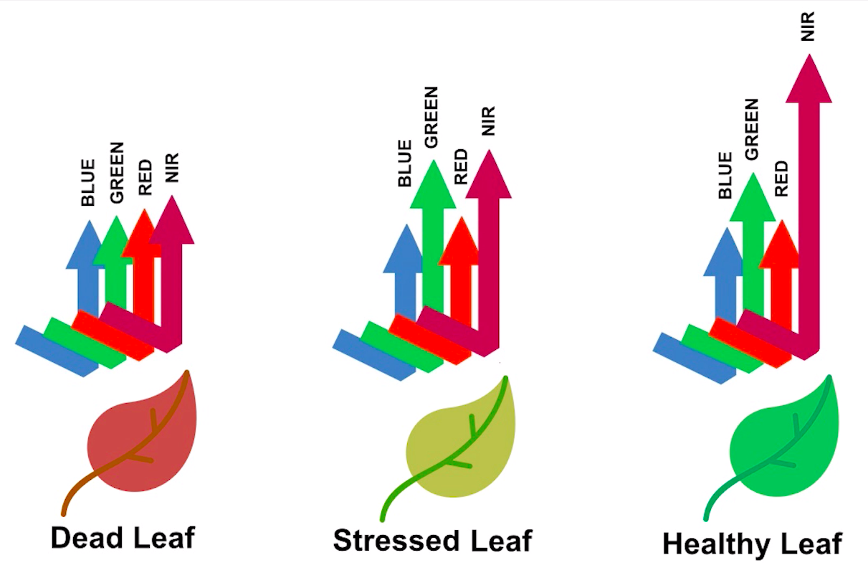
https://github.com/px39n/Awesome-Vegetation-Index#multispectral-vegetation-index

Slide 6
results

Slide 7
discussion
NDVI ranges from -1 to 1.
Areas with values closer to 1 indicating the presence of healthy vegetation.
Low positive values indicate areas with unhealth vegetation.
Negative values and values at 0 indicate nothing is growing (most likely urban areas or water bodies).

Slide 8
conclusion

Slide 9
References
https://developers.planet.com/docs/planetschool/calculate-an-ndvi-in-python/
https://www.visitroanokeva.com/region/seasons/fall/fall-color-schedule/#:~:text=Expect%20Peak%20Fall%20Color%20in,fall%20color%20at%20different%20times.

