Slide 1
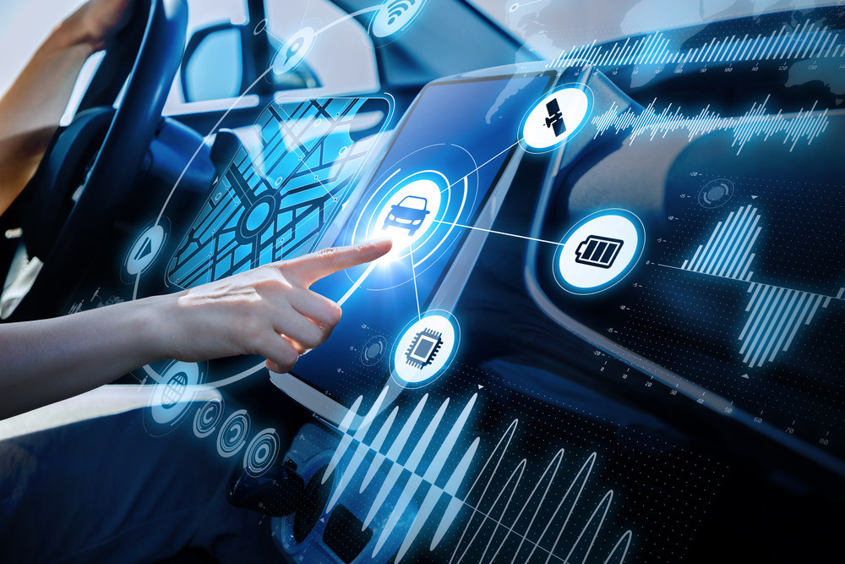
Charge Way
Kopfkino

Slide 2
STATISTIC
~ %82
~ %70
~ %25
2040
2030
2050
(Statista 2021)

Slide 3

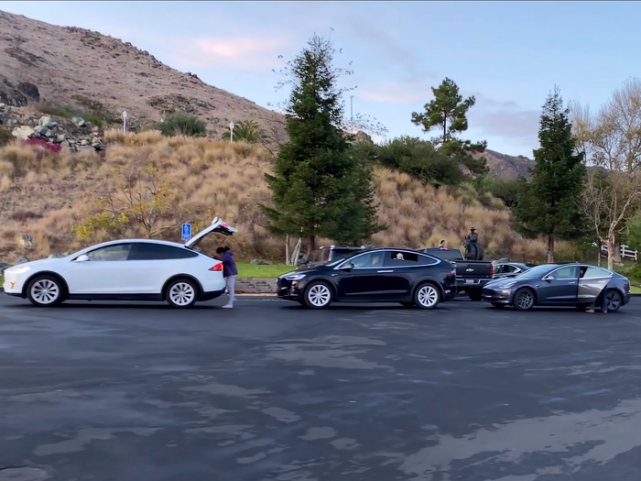
Problem Definition
Long Lines at
Charging Station
N memberships for
N companies

Slide 4
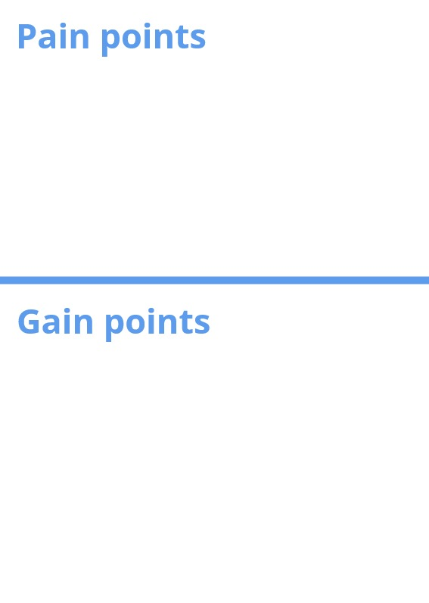
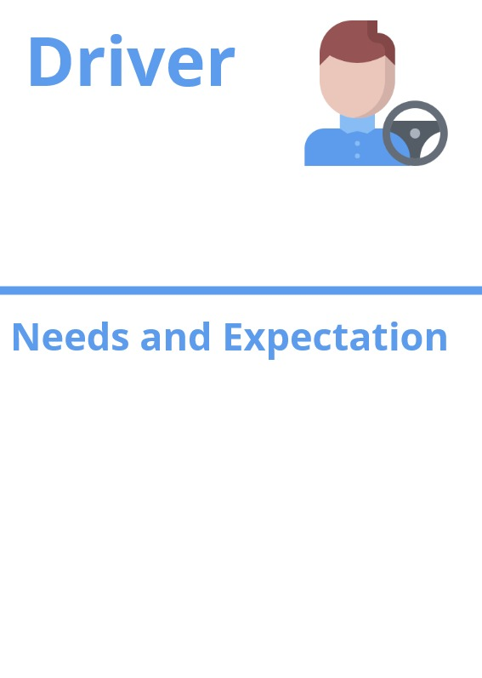
Target Group
Waiting in line too long
Specifically “ Travelers,
organized person,
people who value time
Next possible charging stations
Station on the way
Charging at any time/location
Range tracking
Minimum waiting time
In-car online reservation and payment
Reducing waste of time

Slide 5
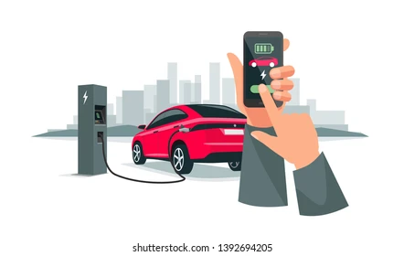
Our Solution
In-car Online Reservation and Payment System for charging an electric vehicle

Slide 6





Revenue Model
Commission From Company
Premium Option
Advertising Revenue
Open Source Service

Slide 7
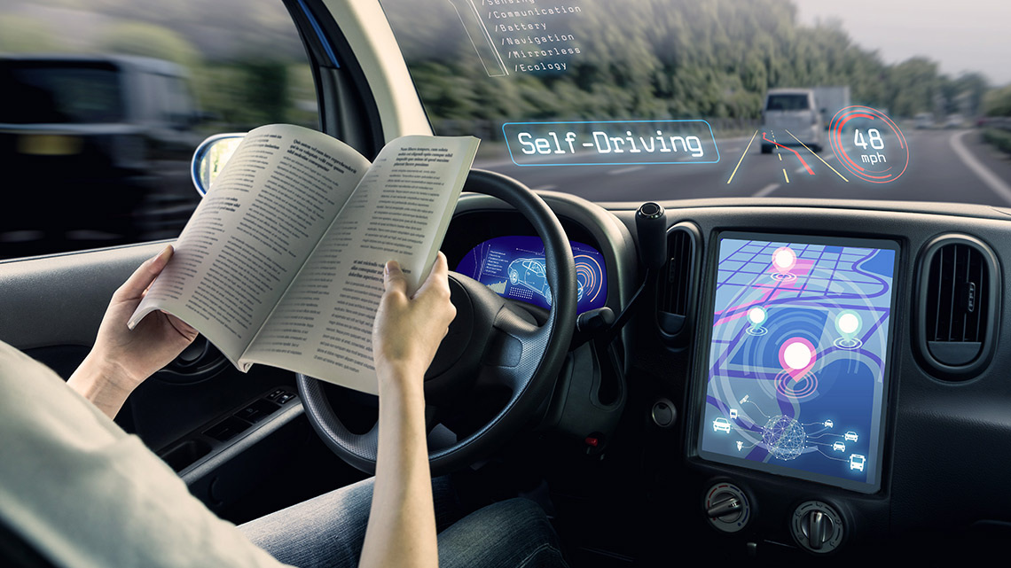
Future Vision
Fully Automated
Self-Learning Cars
Charge itself !

Slide 8
Thank You
For Your Time

