Slide 1
Module 10 The weather
Unit 2 The weather is fine all year round

Slide 2
Words and expressions
/maIl/
/raund /
/nɔ:θ'west /
/sauθ'i:st/
from time to time
英里 n.
mile
围绕地 adv.
round
西北 n.
西北的；朝西北的 adj.
northwest
东南 n.
东南的;朝东南的 adj.
southeast
有时;间或

Slide 3


When’s the best time to visit your
town or country? Why?
Example
S1: When is the best time to visit
our town/city?
S2: I think September is the best time.
S1: Why?
S2: Because it’s not too hot or cold
at that time.

Slide 4
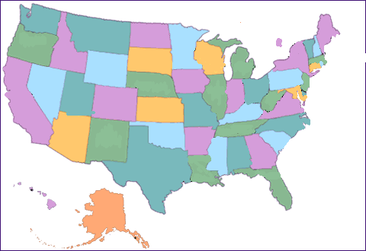
New England
California
New York
Washington DC
Los Angeles
Texas
Alaska

Slide 5
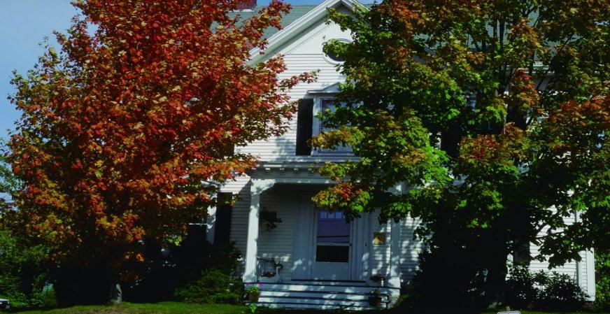
Enjoy some pictures.
Talk something about the pictures .
Fall in New England

Slide 6
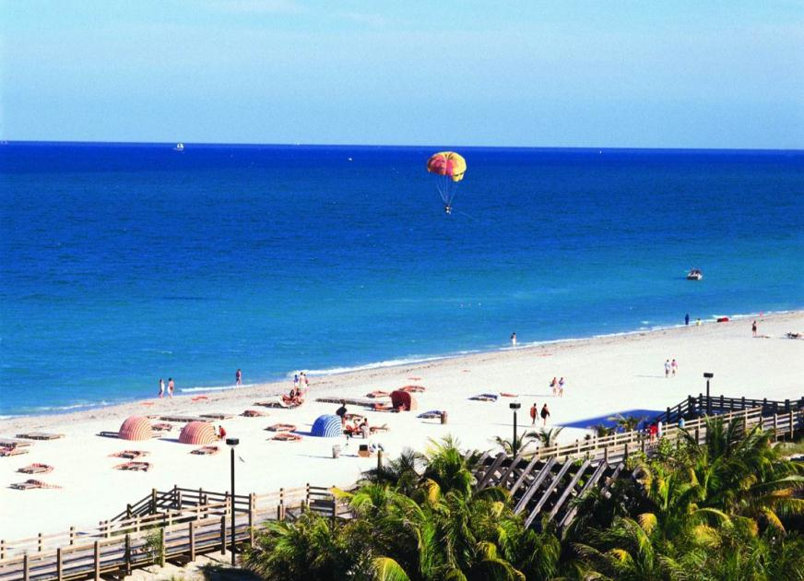
PPT模板：www.1ppt.com/moban/ PPT素材：www.1ppt.com/sucai/
PPT背景：www.1ppt.com/beijing/ PPT图表：www.1ppt.com/tubiao/
PPT下载：www.1ppt.com/xiazai/ PPT教程： www.1ppt.com/powerpoint/
资料下载：www.1ppt.com/ziliao/ 范文下载：www.1ppt.com/fanwen/
试卷下载：www.1ppt.com/shiti/ 教案下载：www.1ppt.com/jiaoan/
PPT论坛：www.1ppt.cn PPT课件：www.1ppt.com/kejian/
语文课件：www.1ppt.com/kejian/yuwen/ 数学课件：www.1ppt.com/kejian/shuxue/
英语课件：www.1ppt.com/kejian/yingyu/ 美术课件：www.1ppt.com/kejian/meishu/
科学课件：www.1ppt.com/kejian/kexue/ 物理课件：www.1ppt.com/kejian/wuli/
化学课件：www.1ppt.com/kejian/huaxue/ 生物课件：www.1ppt.com/kejian/shengwu/
地理课件：www.1ppt.com/kejian/dili/ 历史课件：www.1ppt.com/kejian/lishi/
Los Angeles.
Notes:
PPT模板：www.1ppt.com/moban/ PPT素材：www.1ppt.com/sucai/
PPT背景：www.1ppt.com/beijing/ PPT图表：www.1ppt.com/tubiao/
PPT下载：www.1ppt.com/xiazai/ PPT教程： www.1ppt.com/powerpoint/
资料下载：www.1ppt.com/ziliao/ 范文下载：www.1ppt.com/fanwen/
试卷下载：www.1ppt.com/shiti/ 教案下载：www.1ppt.com/jiaoan/
PPT论坛：www.1ppt.cn PPT课件：www.1ppt.com/kejian/
语文课件：www.1ppt.com/kejian/yuwen/ 数学课件：www.1ppt.com/kejian/shuxue/
英语课件：www.1ppt.com/kejian/yingyu/ 美术课件：www.1ppt.com/kejian/meishu/
科学课件：www.1ppt.com/kejian/kexue/ 物理课件：www.1ppt.com/kejian/wuli/
化学课件：www.1ppt.com/kejian/huaxue/ 生物课件：www.1ppt.com/kejian/shengwu/
地理课件：www.1ppt.com/kejian/dili/ 历史课件：www.1ppt.com/kejian/lishi/

Slide 7
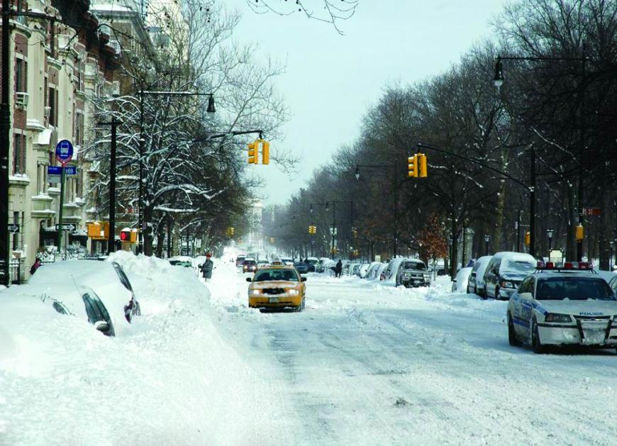
New York or Washington D.C. in winter

Slide 8
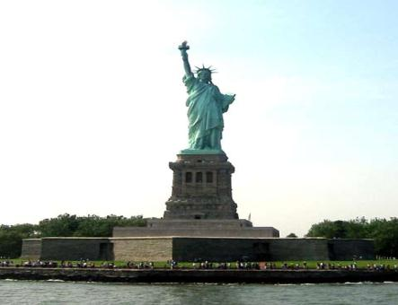
Guessing
1. Where is it ?
2. When is the best time to visit it?
New York

Slide 9
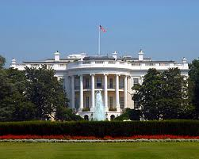
Guessing
1. Where is it ?
2. When is the best time to visit it?
Washington

Slide 10
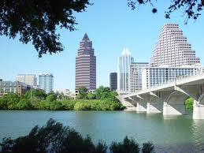
Guessing
1. Where is it ?
2. When is the best time to visit it?
Texas

Slide 11
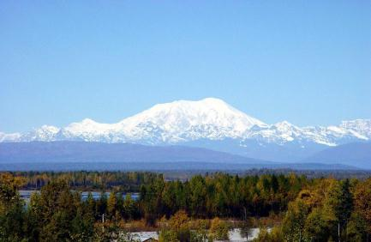
Guessing
1. Where is it ?
2. When is the best time to visit it?
Alaska

Slide 12
3 Complete the table.
Place | Weather | Best time to visit
New York | Winter:
New England
California
Alaska | Summer： Winter：
A lot of snow
In May or October
It gets cooler in September
In September
Fine all year round
All year
Warm day, cool night
In summer
Very cold

Slide 13
Read from Passage 1 and answer the
questions
1.Why do you choose care fully the places to see and the time to go in the US?
Because the US is a large country and it is about 3000 miles from the east coast to the west coast .
2. What do you need to bring if you may want to travel around in the US?
A map

Slide 14
Read from Passage 2-3 and answer the
questions
2.What’s the weather like in New York and
Washington DC in Winter?
It is cold because there is a lot of snow in
Winter.
3.When is the best time to visit New England?
In September

Slide 15

Read from Passage 4 to 6 and answer the
questions
4.Why do you need to take swimming
clothes when you visit California?
Because the weather is fine all year round ,
you might want to go swimming in the sea,
even in December.
5.What do you not forget to bring if you want
to visit Alaska?
A warm sweater.
6.What’s the weather like in Texas ?
It is usually very hot and sunny, there are
Storms from time to time in summer and autumn.

Slide 16
Read the passage complete the table
Place | Weather | Best time to visit
New York | Winter:
New English
California
Alaska | Summer:
 | Winter:
a lot of snow
In May or October
It gets cooler in
September
In September
Fine all the year round
All year
warm day, cool night
In Summer
very cold

Slide 17
Read carefully and finish the form.
Places | Best time to visit | Reason (Why)
New York & Washington DC
advice
May or October
in winter there’s a lot of snow
The weather gets cooler and the green leaves start to go gold, then brown.
bring camera and take photos
New England
September

Slide 18
Places | Best time to visit | Reason (Why)
advice
all the year round
Take swimming clothes
California
The weather is fine all year.
It isn’t very cold but it rains a lot.
Seattle
take an
umbrella

Slide 19
Places | Best time to visit | Reason (Why)
Alaska
Texas
advice
The days are long and warm.
Bring a warm sweater. Don’t do in winter.
Summer
It’s usually very hot and sunny compared to other places. Many storms in summer and autumn.
spring & winter

Slide 20
Retell the passage according to the places.
Seattle
New England
New York
New York
California
Los Angeles
Washington
Washington D.C
Texas
New England
Alaska
California
Alaska
Seattle
Texas

Slide 21
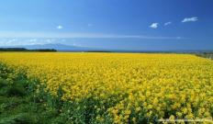
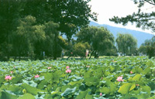
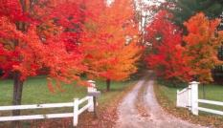
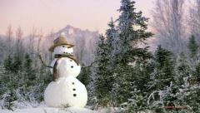
 | Good | Bad | advice
spring
summer
autumn
winter
Warm ,pleasant
fly kites
often rains
windy
bring an umbrella …
sunny swim …
wear a pair of sunglasses …
hot …
cool
red tree leaves…
dry …
drink more water …
cold …
wear some warm clothes …
snowy make a snow man …
It is the best time to visit … in …, but … So it’s a good idea to …

Slide 22
4. Complete the sentences with the
correct form of the words from the box.
brown mile storm sweater umbrella
brown
1 In autumn the leaves turn gold and then ______ .
2 It is about 3,000 ______ from the east coast to the west
coast.
3 You might need a(n) ______ in the evening.
4 Sometimes there are ______ in summer and autumn on
the southeast coast.
5 You will need a(n) ____________ in Seattle because it
rains a lot.
miles
sweater
storms
umbrella

Slide 23
Language points
1. the best time to do sth
干某事的最好时候
e.g. Spring is the best time to plant trees.
2. Take photos of … 给……拍照
e.g. I took a photo of Linda.
She took a lot of photos of kids.

Slide 24
3. compared to/with 和……比较
表达这一意思也可以用compared with
e.g. Compared to our small house, Bill’s house seems like a palace.
4. from time to time 有时，间或
e.g. They are now living in different cities, but they still talk on the phone from time to time.

Slide 25
5. Match the two parts of the sentences.
a) …it will soon become cold.
b) …there are lots of things to see.
c) … the best time to visit England is in
spring.
d) …it is a good idea to bring an umbrella.
e) …wear comfortable shoes.
f) …we will find our way with a good map.
1 You can come any
time you like, but…
2 It often rains in
spring, so…
3 Bring a coat
because…
4 Our plan is to walk in
the countryside, so…
5 Sydney is a big city,
but…
6 Let’s stay for a long
time because…

Slide 26
Have a try!
1.The car don’t move at all. There ____ be
something wrong with it.
A. maybe B. possible C. may
2. -_____________? - It’s sunny and hot.
A. What is the weather like?
B. How is the weather like?
C. What is the weather?
3. It’s interesting ______ games with the children.
A. play B. to playing C. to play

Slide 27
Complete the sentences.
1. 他有时给我发电子邮件。
from time to time
He sends me emails _______________.
2. 照些动物的相是一个好主意。
It’s a good idea to _____________
animals.
take photos of
3. 比起其它城市，住在珠海很舒适。
It’s pleasant to live in Zhuhai ___________ other cities.
compared to

Slide 28
Complete the sentences.
Example:
The good places to visit in May or October are New York and Washington D.C.
1. September is _____________________
to New England.
2. It's __________________________
your camera.
the best time to go
a good idea to bring

Slide 29
3. A good reason to visit California in
December is ____________________
the Sun.
4. Alaska is __________________ in July
and August.
5. In the evening it's _________________
some warm clothes.
6. _______________________ the USA is
any time you like!
that it's nice to see
pleasant to visit
a good idea to wear
The best time to visit

Slide 30
Read the advice and explain why.
camera; map; swimsuit; umbrella Example:
Bring an umbrella. Because it might rain .
1. Wear warm clothes.
2. Buy a good map.
3. Bring a swimsuit.
4. Bring your camera.
Because it might be cool in the evening.
Because you may want to travel around.
Because you might want to swim in the sea.
Because you may want to take photos of the autumn leaves.

Slide 31
writing
Write some advice for visiting your town and give the reasons . Use because , so and but .
The best time to visit my town is in …because the weather is …

Slide 32
达标学习 A. 单词拼写
1. It might rain , so bring an __________
(雨伞) with you .
2. The war between the two__________
(国家)ended ten years later .
3. Digital _________(相机)are getting cheaper
and cheaper .
4. The weather in Kunming is _________
(舒适的) .
5. Today he is _________ (戴)sunglasses .
umbrella
countries
cameras
pleasant
wearing

Slide 33
B．完成句子
1．他有时给我发电子邮件。
He sends me emails _________________________ .
2．什么时候是这儿放风筝的最佳时间？
When is the best time ___________________ here ?
3．留下来喝杯咖啡是个好主意。
It is a good idea ____________________________ .
4．住在珠海舒适吗？
Is it pleasant ___________________Zhuhai ?
5．我们要现在就走，否则他要生气了。
We have to ______________ , or he’ll __________ .
from time to time
to fly kites
to stay for a cup of coffee
to live in
go now get angry

Slide 34
语法小结
动词不定式做主语
1．It's easy (for me) to do that.我做这事太容易了。（常用的形容词有：easy, difficult, hard, important, possible,
impossible, comfortable, necessary, better; the first, the next, the last,
the best, too much, too little, not enough）例句:
2．It's so nice to hear your voice.听到你的声音真高兴。

Slide 35
3．It's necessary for you to lock the car when you do not use it.
当你不用车的时候，锁车是有必要的。
4．It's very kind of you to help us. 他帮助我们，他真好。
（常用的形容词有：kind, nice, stupid, rude, clever, foolish, brave, silly）例句:
5．It was silly of us to believe him. 我们真愚蠢，竟然相信了他。
6．It seemed selfish of him not to give them anything.
他不给他们任何东西，这显得太自私了。

Slide 36
注意：
1) 其他系动词如，look，appear等也可用于此句型。 2) 不定式作为句子成分时，动词用单数形式。
3) 当不定式做主语的句子中又有一个不定式作表语时，不能用It is… to…的句型
(对)To see is to believe. 百闻不如一见。
(错)It is to believe to see.

Slide 37
1. Conclusion
2. Wb. Ex. 4 , 5 , 6&7

