Slide 1
Module 11 Way of life
Unit 1 In China, we open a gift later.
Notes:
Good afternoon, everyone. In Grade Seven, we learnt some bodies languages. Let’s look and compare. When they meet, they

Slide 2
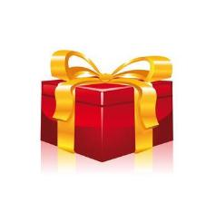
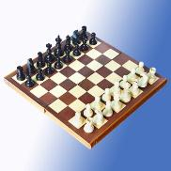
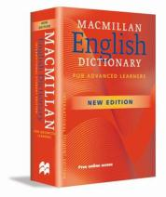
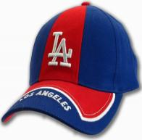
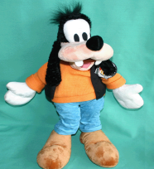

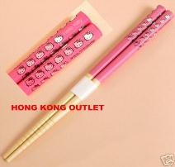
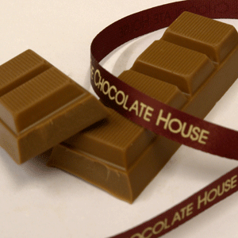

Free talk.
1. What presents do you often get on your birthday?
[i'mi:diətli]
immediately
2. When do you open your present? At once or later?
[tʃes]
[set]
chess set
dictionary
baseball cap
toy
……
[‘tʃɔpstɪks]
chopsticks
chocolate

Slide 3
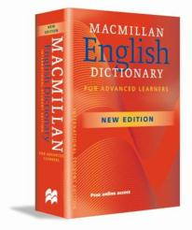
Listen and number the words and
expressions as you hear them.
baseball cap chess set
chocolate chopsticks
dictionary toy
video game
6
2
3
4
7
1
5
What present do they want to buy for Lingling?
An English dictionary

Slide 4
Listen and answer.
Why does Lingling receive a gift?
Do people open gift in the US immediately or later?
What is bad luck at the Spring Festival?
Because it’s her birthday.
Immediately.
Break something.

Slide 5
Read and find.
In China, what traditions do you know?
1. We open a gift later.
2. You accept a gift with both hands.
3. People say you mustn’t do any cleaning on the first day of the Spring Festival.
4. You mustn't break anything.
5. You must only use red paper for hongbao because red means luck.
6. You’d better not have your hair cut during the Spring Festival month.
7. In the north of China, people eat lots of jiaozi !

Slide 6
What’s the tradition in the West?
In the US, we open a gift immediately.
In the West, we usually don’t pay much attention to that.

Slide 7
Now check what you usually do in China.
(√)
1. Open a present immediately when you receive it.
2. Accept a present with both hands.
3. Use red paper for hongbao.
4. Do cleaning on the first day of the Spring Festival.
5. Break something during the Spring Festival.
6. Have your hair cut during the Spring Festival month.
later
√
√
Mustn’t do

Slide 8
Everyday English
Enjoy reading.
Oh, you remembered!
What a surprise!
It’s bad luck!
You can’t be serious!
Perfect!
PPT模板：www.1ppt.com/moban/ PPT素材：www.1ppt.com/sucai/
PPT背景：www.1ppt.com/beijing/ PPT图表：www.1ppt.com/tubiao/
PPT下载：www.1ppt.com/xiazai/ PPT教程： www.1ppt.com/powerpoint/
资料下载：www.1ppt.com/ziliao/ 范文下载：www.1ppt.com/fanwen/
试卷下载：www.1ppt.com/shiti/ 教案下载：www.1ppt.com/jiaoan/
PPT论坛：www.1ppt.cn PPT课件：www.1ppt.com/kejian/
语文课件：www.1ppt.com/kejian/yuwen/ 数学课件：www.1ppt.com/kejian/shuxue/
英语课件：www.1ppt.com/kejian/yingyu/ 美术课件：www.1ppt.com/kejian/meishu/
科学课件：www.1ppt.com/kejian/kexue/ 物理课件：www.1ppt.com/kejian/wuli/
化学课件：www.1ppt.com/kejian/huaxue/ 生物课件：www.1ppt.com/kejian/shengwu/
地理课件：www.1ppt.com/kejian/dili/ 历史课件：www.1ppt.com/kejian/lishi/
Notes:
PPT模板：www.1ppt.com/moban/ PPT素材：www.1ppt.com/sucai/
PPT背景：www.1ppt.com/beijing/ PPT图表：www.1ppt.com/tubiao/
PPT下载：www.1ppt.com/xiazai/ PPT教程： www.1ppt.com/powerpoint/
资料下载：www.1ppt.com/ziliao/ 范文下载：www.1ppt.com/fanwen/
试卷下载：www.1ppt.com/shiti/ 教案下载：www.1ppt.com/jiaoan/
PPT论坛：www.1ppt.cn PPT课件：www.1ppt.com/kejian/
语文课件：www.1ppt.com/kejian/yuwen/ 数学课件：www.1ppt.com/kejian/shuxue/
英语课件：www.1ppt.com/kejian/yingyu/ 美术课件：www.1ppt.com/kejian/meishu/
科学课件：www.1ppt.com/kejian/kexue/ 物理课件：www.1ppt.com/kejian/wuli/
化学课件：www.1ppt.com/kejian/huaxue/ 生物课件：www.1ppt.com/kejian/shengwu/
地理课件：www.1ppt.com/kejian/dili/ 历史课件：www.1ppt.com/kejian/lishi/

Slide 9
Complete the passage with the words in the box.
accept attention surprise taste traditions
It is always a(n) (1) ________ to receive gifts from family members and friends. In China, we usually (2)_______ a gift with both hands and open it later. But in the West, people usually do not pay much (3) __________ to that. During the Spring Festival, there are many (4) _________. For example, people in the north of China eat lots of jiaozi. They (5) _______ great.
surprise
accept
attention
traditions
taste

Slide 10
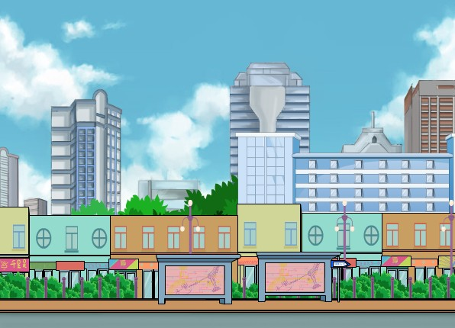
Enjoy watching.

Slide 11
Think about what you must and mustn't/can't
do in the situations. Write notes.
 | Must | Mustn’t /Can’t
At school | put up your hand before you talk
At the dining table |  | talk with food in your mouth
eat during the class
wait for others to start the meal
Now work in pairs. Say what you must and mustn’t/ can’t do.

Slide 12
Grammar
must 的用法
1) 表示主观的义务和必要，主要用于肯定句和疑问句，意思为 “必须……，得……，要……”；由must引起的疑问句，肯定回答要用must，否定回答要用needn’t，意思是“不必”；must的否定形式mustn’t表示禁止，意思是“不能，不许”。

Slide 13
e.g.
—Must I finish the task right now?
—No, you needn’t.
我必须现在就完成任务吗？
不，你不需要。
You mustn’t come here without permission.
没有允许你不准来这。

Slide 14
2) 表示肯定的猜测，常用于肯定句中，
意为 “一定是，必然……”。
e.g. Your sister must be a doctor in this hospital. ( 现在的猜测 ) 你的妹妹现在一定在这家医院当医生。
He must be reading newspapers in the reading room now.（正在进行的猜测）他现在肯定正在阅读室看报纸。

Slide 15
have to 与must的区别
两都都表示“必须”，但must侧重于说话者的主观看法，认为有必要或有义务去做某事；have to侧重于客观需要，含有“不得不，被迫”之意。
e.g. All passengers must wear seat belts.
所有乘客都要系安全带。
My bike was broken yesterday, so I
had to walk to school. 昨天我的自行
车坏了，所以我只能走路去学校。

Slide 16
can 的用法
can的否定形式为cannot，缩写为can't。
1) 表示能力
e.g. I can’t swim. 我不会游泳。
Can you drive？ 你会开车吗？

Slide 17
注意：
can表示能力可与be able to互换使用，且后者有更多的时态，be able to常被用来表示can所不能表示的将来或完成的概念。
e.g. They will be able to run this machine
on their own in three months.
他们将在未来的三个月自己操作这
个机器。

Slide 18
2) 表示可能性，意思是：可以，可能。
e.g. That big cinema can seat 2,000 people.
那个大影院可以坐2000人。
He can be very friendly at times.
他有时可能非常友善。

Slide 19
3) 表示允诺，意思是：可以，能够。
e.g. You can have the book when I have finished it.
在我读完这本书后，你可以看。
Can I use your pen?
我能用下你的笔吗？

Slide 20
4) 表示惊异、不相信、猜测等（用于疑问句、否定句或感叹句中），意思是:会，可能。
e.g. This can’t be true.
这不可能是真的。
Can it be true？
这能成真吗？

