Slide 1

Module 12 Help
Unit 1 What should we do before help arrives?

Slide 2

Lead-in
Look at the pictures and fill in
what we can do when we see someone in danger.
We can _______ for help.
shout

Slide 3
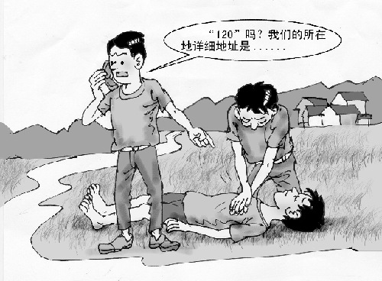
We can ________ 120 for help.
call

Slide 4
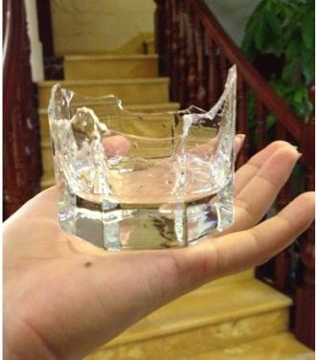

When something is broken, can you use it again?
No
What is a window made of?
glass

Slide 5
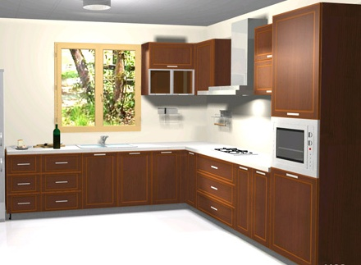
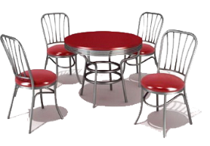
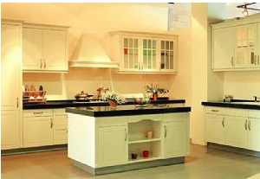
What do you call a table, chairs, cupboard, etc ?
furniture
a set of furniture
PPT模板：www.1ppt.com/moban/ PPT素材：www.1ppt.com/sucai/
PPT背景：www.1ppt.com/beijing/ PPT图表：www.1ppt.com/tubiao/
PPT下载：www.1ppt.com/xiazai/ PPT教程： www.1ppt.com/powerpoint/
资料下载：www.1ppt.com/ziliao/ 范文下载：www.1ppt.com/fanwen/
试卷下载：www.1ppt.com/shiti/ 教案下载：www.1ppt.com/jiaoan/
PPT论坛：www.1ppt.cn PPT课件：www.1ppt.com/kejian/
语文课件：www.1ppt.com/kejian/yuwen/ 数学课件：www.1ppt.com/kejian/shuxue/
英语课件：www.1ppt.com/kejian/yingyu/ 美术课件：www.1ppt.com/kejian/meishu/
科学课件：www.1ppt.com/kejian/kexue/ 物理课件：www.1ppt.com/kejian/wuli/
化学课件：www.1ppt.com/kejian/huaxue/ 生物课件：www.1ppt.com/kejian/shengwu/
地理课件：www.1ppt.com/kejian/dili/ 历史课件：www.1ppt.com/kejian/lishi/
In which room do we cook and eat foods?
The kitchen
Notes:
PPT模板：www.1ppt.com/moban/ PPT素材：www.1ppt.com/sucai/
PPT背景：www.1ppt.com/beijing/ PPT图表：www.1ppt.com/tubiao/
PPT下载：www.1ppt.com/xiazai/ PPT教程： www.1ppt.com/powerpoint/
资料下载：www.1ppt.com/ziliao/ 范文下载：www.1ppt.com/fanwen/
试卷下载：www.1ppt.com/shiti/ 教案下载：www.1ppt.com/jiaoan/
PPT论坛：www.1ppt.cn PPT课件：www.1ppt.com/kejian/
语文课件：www.1ppt.com/kejian/yuwen/ 数学课件：www.1ppt.com/kejian/shuxue/
英语课件：www.1ppt.com/kejian/yingyu/ 美术课件：www.1ppt.com/kejian/meishu/
科学课件：www.1ppt.com/kejian/kexue/ 物理课件：www.1ppt.com/kejian/wuli/
化学课件：www.1ppt.com/kejian/huaxue/ 生物课件：www.1ppt.com/kejian/shengwu/
地理课件：www.1ppt.com/kejian/dili/ 历史课件：www.1ppt.com/kejian/lishi/

Slide 6
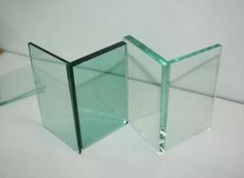

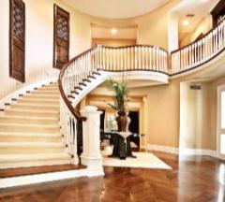
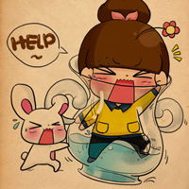
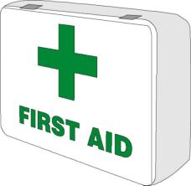

MORE WORDS
glass
broken
stairs
aid
first aid
medical

Slide 7



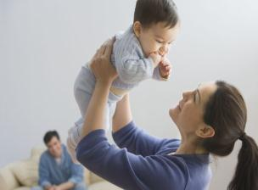
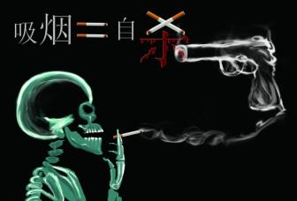
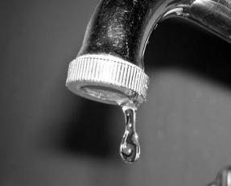
bottom
wrong
trouble
lift
harmful
drop

Slide 8
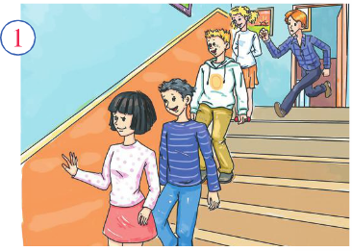
Match the sentence with the picture:
It’s dangerous to run down the stairs

Slide 9
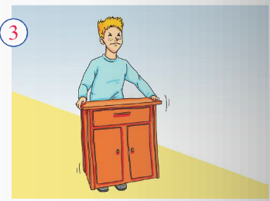
The piece of furniture is heavy and the boy cannot lift it.

Slide 10
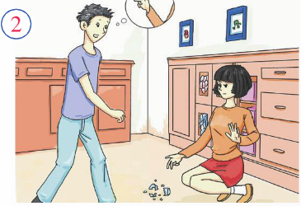
There’s some broken glass in the kitchen.

Slide 11

3. Watch and read
Everyday English
What can we do to…?
How we do that? How can we do that?

Slide 12
Answer the questions.
1. Where is the boy lying?
He is lying at the bottom of the stairs.
2. Do they lift him up?
No, they don’t.

Slide 13
Read the dialogue and answer the questions.
1. Could he have trouble hearing or speaking?
Yes, he could.
2. Is it good idea to shout for help or call 120?
Yes, it is.
3. How does Betty cover the boy?
She covers him with a coat.

Slide 14
Now read these first aid suggestions and
decide if they are good ideas(√) or bad ideas(×).
1. Ask the boy what is wrong.
2. Get help.
3. Shout so the boy can hear you.
4. Move the boy to a more comfortable place.
5. Make sure the boy is warm.
√
√
×
×
√

Slide 15
4 Complete the passage
bottom Cover drop harmful imagine lift
medical pain
Let’s (1) _______ you see a boy lying at the(2)________ of the stairs. What should you do? Call for (3) ________ help immediately. Do not (4)_____ the boy up and sit him on a chair. This could be (5) ________ for him! Even worse, you might (6)______ him while you are moving him! That would cause a lot of (7)_____. (8)______ him with a coat and make sure he is warm. Then wait for the doctors to arrive.
imagine
bottom
medical
lift
harmful
drop
pain
Cover

Slide 16
Language points
1. He is in pain.他很疼。
in pain的意思是“处在疼痛之中”。如：
Are you still in pain?
你还疼吗？
2. But he could have trouble hearing you or speaking to you.但是他有可能无法听到你或者和你说话。
句中的could表示推测。如：
You could be right.
你可能是对的。

Slide 17
have trouble doing sth./have trouble with sth
的意思是“做…有困难”。
如：
We have trouble speaking English.
我们说英语有困难。
We have trouble with spoken English.
我们口语有困难。

Slide 18
3. Make sure he’s warm.
确保他不受凉。
make sure的意思是“确保，保证”。如：
Make sure you turn off all the lights before you go out.
在出门之前一定要把所有的灯都关掉。

Slide 19
4. That’s such good advice that you could be a doctor, 这个建议非常好，你都可以当医生了！
Such+(a/an)n.+that...这个句型表达“如此…以至于…”的意思，such后面接名词，名词前可以有形容词修饰。如果只有形容词或副词，则要使用so+adj.+that...这一句型。如:
It is such a tiny kitchen that only one person can cook in it.
这个厨房很小，只能容下 一个人在里面做饭。
It is a kitchen so tiny that only one person can cook in it.

Slide 20

5 Listen and underline the words the speaker stresses.
1 Let’s imagine an accident.
2 What can we do to help him?
3 Find out what’s wrong with him.
4 Make sure he’s warm.
5 Cover him with a coat.

Slide 21
6 Work in pairs. Ask and answer questions .
Student A: You are a teacher of basic medical training.
Student B: You are a student of basic medical traning.
—What do you do if someone’s hurt?
— Ask him/her what happened…

Slide 22
情态动词must, can, could表示推测
我们学习过情态动词can和could表示“能够”，表示对现在或将来的推测，意为“会，可能”，往往用于否定句和疑问句。用于疑问句时，can比could表示的“可能性”要大；用于否定句时，cannot (can’t) 表示“不可能”。如：
You can’t be serious!
你不是认真的吧！
could则可用于肯定句、否定句和疑问句。在以下例句中，can和could均表示可能：
He could be in pain.他可能很疼。
That could be harmful!那可能有害！
Can/Could this be true?这有可能是真的吗？

Slide 23
情态动词must也可以表示猜测，意思为“一定，准是”，通常只用于肯定句。如课文中的 例子：
Betty, you must know!贝蒂，你肯定知道！
请仔细对比下列一组句子：
Who sent the present? Can it be your brother?
是谁送来的礼物啊？会是你哥哥吗？ （询问 可能性）
It must be your brother. I saw him in your room just now.
肯定是你哥哥，我刚才看见他在 你的房间里。
（语气强烈，表示非常肯定）
It can't be my brother. He is still in France.
不可能是我哥哥，他还在法国呢。（表示不可能）

Slide 24
Grammar
祈使句
一、定义：
祈使句表达说话人对对方的叮嘱、劝告、希望、禁止、建议、请求或命令等。
二、祈使句的特征：
以动词原形开头，无时态和数的变化。

Slide 25
三、祈使句的句型：
1. 动词原形构成的祈使句
通常省略主语 you，谓语动词用原形。否定句由 don’t 或 never 开头。祈使句的句首或句末有时加 please。
2. let 构成的祈使句
由“Let + me/us/him/her + 动词原形”构成。这类祈使句往往用于请求允许（let us）或提出建议（let’s）。

Slide 26
例如：
Let’s spend this weekend in the countryside.
Let him be here by ten o’clock.
3. 无动词祈使句
在请求，命令和口号中，常用无动词祈使句，它实际上是省略了动词，从而使语句更简洁有力。

Slide 27
例如：
Just a minute, please!
在一些指示牌上，常用“No + 动名词/名词”构成省略的否定祈使句。
例如：No smoking!

Slide 28

Listen and underline
the words the speaker stresses.
1. Let’s imagine an accident.
2. What can we do to help him?
3. Find out what’s wrong with him.
4. Make sure he’s warm.
5. Cover him with a coat.

Slide 29
Now listen again and repeat.
1. Let’s imagine an accident.
2. What can we do to help him?
3. Find out what’s wrong with him.
4. Make sure he’s warm.
5. Cover him with a coat.

Slide 30
Work in pairs. Ask and answer questions.
Student A: You are a teacher of basic medical training.
Student B: You are a student of basic medical training.
-- What do you do if someone’s hurt?
-- Ask him/her what happened …

Slide 31
本课小结
重点短语、句型
first aid at the bottom of
lift up make sure
What’s wrong with …?
祈使句的用法

Slide 32
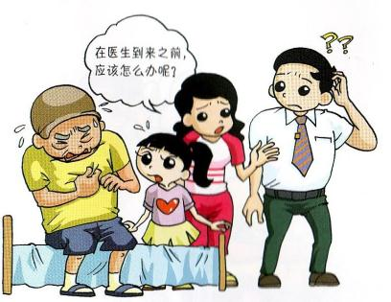
Homework
编写一个关于 first aid 的对话，字数不少于50字。

Slide 33
Thank you!

