Slide 1
Module 12 Help
Unit 2 Stay away from windows and heavy furniture.

Slide 2
Words
1.earthquake
2.prepare for
3.warn
4.inside
5.window
6.keep
7.brave
8.clear
9.power
10.in short
地震
为……做准备
警告
在……里面
窗户
保持，留在
勇敢的
不和……接触的;不挨……太近的
电，电力
总之；简言之

Slide 3
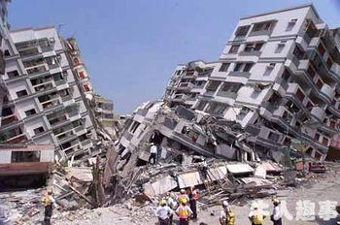
Lead-in
earthquake
What happened in the picture?

Slide 4
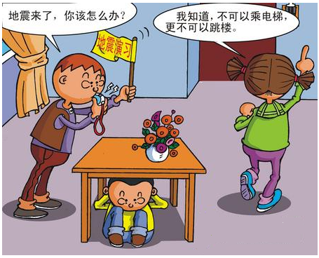
Look at the title of the passage and think about what to do in an earthquake.

Slide 5
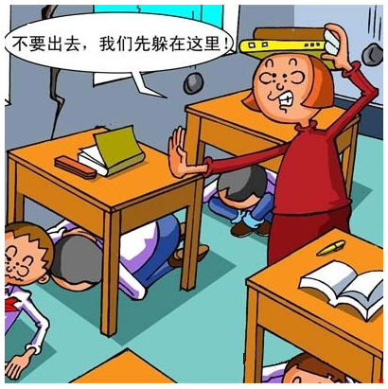

PPT模板：www.1ppt.com/moban/ PPT素材：www.1ppt.com/sucai/
PPT背景：www.1ppt.com/beijing/ PPT图表：www.1ppt.com/tubiao/
PPT下载：www.1ppt.com/xiazai/ PPT教程： www.1ppt.com/powerpoint/
资料下载：www.1ppt.com/ziliao/ 范文下载：www.1ppt.com/fanwen/
试卷下载：www.1ppt.com/shiti/ 教案下载：www.1ppt.com/jiaoan/
PPT论坛：www.1ppt.cn PPT课件：www.1ppt.com/kejian/
语文课件：www.1ppt.com/kejian/yuwen/ 数学课件：www.1ppt.com/kejian/shuxue/
英语课件：www.1ppt.com/kejian/yingyu/ 美术课件：www.1ppt.com/kejian/meishu/
科学课件：www.1ppt.com/kejian/kexue/ 物理课件：www.1ppt.com/kejian/wuli/
化学课件：www.1ppt.com/kejian/huaxue/ 生物课件：www.1ppt.com/kejian/shengwu/
地理课件：www.1ppt.com/kejian/dili/ 历史课件：www.1ppt.com/kejian/lishi/
Help
Notes:
PPT模板：www.1ppt.com/moban/ PPT素材：www.1ppt.com/sucai/
PPT背景：www.1ppt.com/beijing/ PPT图表：www.1ppt.com/tubiao/
PPT下载：www.1ppt.com/xiazai/ PPT教程： www.1ppt.com/powerpoint/
资料下载：www.1ppt.com/ziliao/ 范文下载：www.1ppt.com/fanwen/
试卷下载：www.1ppt.com/shiti/ 教案下载：www.1ppt.com/jiaoan/
PPT论坛：www.1ppt.cn PPT课件：www.1ppt.com/kejian/
语文课件：www.1ppt.com/kejian/yuwen/ 数学课件：www.1ppt.com/kejian/shuxue/
英语课件：www.1ppt.com/kejian/yingyu/ 美术课件：www.1ppt.com/kejian/meishu/
科学课件：www.1ppt.com/kejian/kexue/ 物理课件：www.1ppt.com/kejian/wuli/
化学课件：www.1ppt.com/kejian/huaxue/ 生物课件：www.1ppt.com/kejian/shengwu/
地理课件：www.1ppt.com/kejian/dili/ 历史课件：www.1ppt.com/kejian/lishi/

Slide 6
Read the sentences. Decide if the following actions are right(√ ) or wrong(× ).
When the earthquake started…
1…I hid under a table. ( )
2…Sam sat on his desk. ( )
3…Alice ran out of the building. ( )
4…Peter and Helen stayed in their car. ( )
5...my family and I moved away from the beach. ( )
√
×
×
√
√

Slide 7
Language points
stay away from
warn sb. about
jump out of
keep calm
keep clear of fire
be careful of
think about
stop doing sth.
远离
警告某人注意……
跳出……
保持冷静
不接触火
小心……
考虑
停止做某事

Slide 8
1.It’s difficult to warn people about them.
提醒人们注意它们是很困难的。
It’s +形容词+to do sth. 意为“做某事怎么样”。
2.Usually people have little or no idea about what to do during an earthquake.通常人们在地震时不知道该做什么。
3.If you are in a bus or car, stay in it.
如果你在公共汽车上或者车上，就待在里面。

Slide 9
Exercises
根据汉语意思完成句子
1.我们没有机会赢这场比赛。
We ____ ____ ______ ____ win the match.
2.学生们正在为考试做准备。
The students ____ _________ ____the test.
3.远离火灾。
_____ _____ _____ fire.
4.停止说话，该上课了。
It’s time for class. ______ _______.
have no chance to
are preparing for
Stay away from
Stop talking

Slide 10
Homework
Write some instructions about what to do
in an earthquake.

