Slide 1
Module 1 How to learn English
Unit 1
Let’s try to speak English as much as possible.

Slide 2
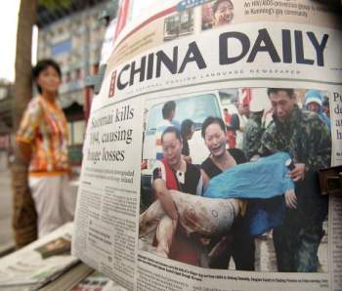
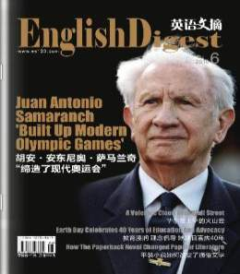
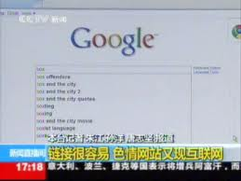
--Where can we see English in our daily life?
newspaper
magazine
internet
/´nju:zpeipə/
杂志
互联网
报纸
2

Slide 3
Words and expressions
/peə/
/kə'rekt//
/'spelIŋ/
/'præktIs/
/mætʃ/
/'mi :nIŋ/
/ kəm'pli : t/
/'sentəns/
两个人，一对 n.
pair
改正；纠正 v.正确的 adj.
correct
拼写 n.
spelling
练习 v.
practise
使相配 v.
match
意义；意思 n.
meaning
把……填完整 v.
complete
句子 n.
sentence

Slide 4
/'dIkʃənərI/
/'græmə/
/'letə/
/mI'steIk/
/‚ʌndə'stænd/
/əd'vaIs/
/ʃʊd/
dictionary
字典 n.
grammar
语法 n.
字母 n.
letter
查找
look up
错误，过错 n.
mistake
PPT模板：www.1ppt.com/moban/ PPT素材：www.1ppt.com/sucai/
PPT背景：www.1ppt.com/beijing/ PPT图表：www.1ppt.com/tubiao/
PPT下载：www.1ppt.com/xiazai/ PPT教程： www.1ppt.com/powerpoint/
资料下载：www.1ppt.com/ziliao/ 范文下载：www.1ppt.com/fanwen/
试卷下载：www.1ppt.com/shiti/ 教案下载：www.1ppt.com/jiaoan/
PPT论坛：www.1ppt.cn PPT课件：www.1ppt.com/kejian/
语文课件：www.1ppt.com/kejian/yuwen/ 数学课件：www.1ppt.com/kejian/shuxue/
英语课件：www.1ppt.com/kejian/yingyu/ 美术课件：www.1ppt.com/kejian/meishu/
科学课件：www.1ppt.com/kejian/kexue/ 物理课件：www.1ppt.com/kejian/wuli/
化学课件：www.1ppt.com/kejian/huaxue/ 生物课件：www.1ppt.com/kejian/shengwu/
地理课件：www.1ppt.com/kejian/dili/ 历史课件：www.1ppt.com/kejian/lishi/
犯错误
make a mistake
理解；明白 v.
understand
advice
意见；建议 n.
应该 v. aux.
should

Slide 5
/'pɒsəbl /
/'nəʊt,bʊk /
/fə'get/
/prə'naʊns/
/ə'laʊd/
/'reIdIəʊ /
/prə‚nʌnsI'eIʃn/
possible
可能的 adj.
写下；记下
write down
笔记本 n.
notebook
PPT模板：www.1ppt.com/moban/ PPT素材：www.1ppt.com/sucai/
PPT背景：www.1ppt.com/beijing/ PPT图表：www.1ppt.com/tubiao/
PPT下载：www.1ppt.com/xiazai/ PPT教程： www.1ppt.com/powerpoint/
资料下载：www.1ppt.com/ziliao/ 范文下载：www.1ppt.com/fanwen/
试卷下载：www.1ppt.com/shiti/ 教案下载：www.1ppt.com/jiaoan/
PPT论坛：www.1ppt.cn PPT课件：www.1ppt.com/kejian/
语文课件：www.1ppt.com/kejian/yuwen/ 数学课件：www.1ppt.com/kejian/shuxue/
英语课件：www.1ppt.com/kejian/yingyu/ 美术课件：www.1ppt.com/kejian/meishu/
科学课件：www.1ppt.com/kejian/kexue/ 物理课件：www.1ppt.com/kejian/wuli/
化学课件：www.1ppt.com/kejian/huaxue/ 生物课件：www.1ppt.com/kejian/shengwu/
地理课件：www.1ppt.com/kejian/dili/ 历史课件：www.1ppt.com/kejian/lishi/
忘记 v.
forget
发……的音 v.
pronounce
大声地 adv.
aloud
电台；广播 n.
radio
pronuciation
发音 n.
Notes:
PPT模板：www.1ppt.com/moban/ PPT素材：www.1ppt.com/sucai/
PPT背景：www.1ppt.com/beijing/ PPT图表：www.1ppt.com/tubiao/
PPT下载：www.1ppt.com/xiazai/ PPT教程： www.1ppt.com/powerpoint/
资料下载：www.1ppt.com/ziliao/ 范文下载：www.1ppt.com/fanwen/
试卷下载：www.1ppt.com/shiti/ 教案下载：www.1ppt.com/jiaoan/
PPT论坛：www.1ppt.cn PPT课件：www.1ppt.com/kejian/
语文课件：www.1ppt.com/kejian/yuwen/ 数学课件：www.1ppt.com/kejian/shuxue/
英语课件：www.1ppt.com/kejian/yingyu/ 美术课件：www.1ppt.com/kejian/meishu/
科学课件：www.1ppt.com/kejian/kexue/ 物理课件：www.1ppt.com/kejian/wuli/
化学课件：www.1ppt.com/kejian/huaxue/ 生物课件：www.1ppt.com/kejian/shengwu/
地理课件：www.1ppt.com/kejian/dili/ 历史课件：www.1ppt.com/kejian/lishi/

Slide 6
/k i：/
/meIn /
/'eksələnt/
/ə'g i： /
key
关键性的 adj.
主要的 adj.
main
极好的；优秀的 adj.
excellent
agree
赞同 v.
同意某人
agree with sb.

Slide 7
correct the spelling. 改正拼写
correct 用作及物动词，意为”改正；纠正“。 你必须改正这些坏习惯。
You must ________________.
你能纠正我的发音吗？
correct the bad habits
Can you correct my pronunciation?
【品味教材】 And don’t forget to write down the correct answers next to the mistakes.
adj.正确的

Slide 8
3.Practise saying the words.
Practise 用作vt, 意为”练习“。Practise doing sth “ 练习做某事”
How can I practise speaking English?
【拓展】
Practice makes perfect.熟能生巧。
不可数名词/u/ n
finish , miss , mind , avoid , imagine，enjoy, keep ， give up…

