Slide 1


Module2 My home town and my country
Unit1 It’s taller than many other buildings.

Slide 2

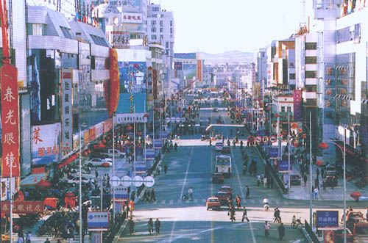
The buildings are new.

Slide 3
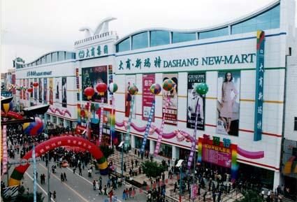
The buildings are newer than those buildings.

Slide 4
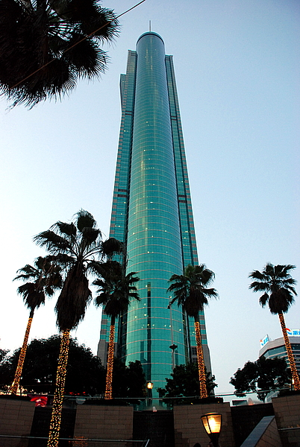
Diwang Tower is tall.

Slide 5
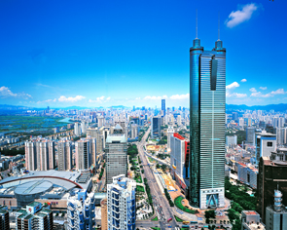
Diwang Tower is taller than many other buildings

Slide 6
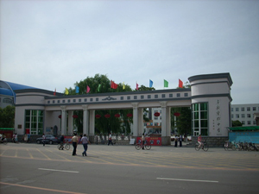
PPT模板：www.1ppt.com/moban/ PPT素材：www.1ppt.com/sucai/
PPT背景：www.1ppt.com/beijing/ PPT图表：www.1ppt.com/tubiao/
PPT下载：www.1ppt.com/xiazai/ PPT教程： www.1ppt.com/powerpoint/
资料下载：www.1ppt.com/ziliao/ 范文下载：www.1ppt.com/fanwen/
试卷下载：www.1ppt.com/shiti/ 教案下载：www.1ppt.com/jiaoan/
PPT论坛：www.1ppt.cn PPT课件：www.1ppt.com/kejian/
语文课件：www.1ppt.com/kejian/yuwen/ 数学课件：www.1ppt.com/kejian/shuxue/
英语课件：www.1ppt.com/kejian/yingyu/ 美术课件：www.1ppt.com/kejian/meishu/
科学课件：www.1ppt.com/kejian/kexue/ 物理课件：www.1ppt.com/kejian/wuli/
化学课件：www.1ppt.com/kejian/huaxue/ 生物课件：www.1ppt.com/kejian/shengwu/
地理课件：www.1ppt.com/kejian/dili/ 历史课件：www.1ppt.com/kejian/lishi/
Zhonghua Road is a wide road.
Notes:
PPT模板：www.1ppt.com/moban/ PPT素材：www.1ppt.com/sucai/
PPT背景：www.1ppt.com/beijing/ PPT图表：www.1ppt.com/tubiao/
PPT下载：www.1ppt.com/xiazai/ PPT教程： www.1ppt.com/powerpoint/
资料下载：www.1ppt.com/ziliao/ 范文下载：www.1ppt.com/fanwen/
试卷下载：www.1ppt.com/shiti/ 教案下载：www.1ppt.com/jiaoan/
PPT论坛：www.1ppt.cn PPT课件：www.1ppt.com/kejian/
语文课件：www.1ppt.com/kejian/yuwen/ 数学课件：www.1ppt.com/kejian/shuxue/
英语课件：www.1ppt.com/kejian/yingyu/ 美术课件：www.1ppt.com/kejian/meishu/
科学课件：www.1ppt.com/kejian/kexue/ 物理课件：www.1ppt.com/kejian/wuli/
化学课件：www.1ppt.com/kejian/huaxue/ 生物课件：www.1ppt.com/kejian/shengwu/
地理课件：www.1ppt.com/kejian/dili/ 历史课件：www.1ppt.com/kejian/lishi/

Slide 7
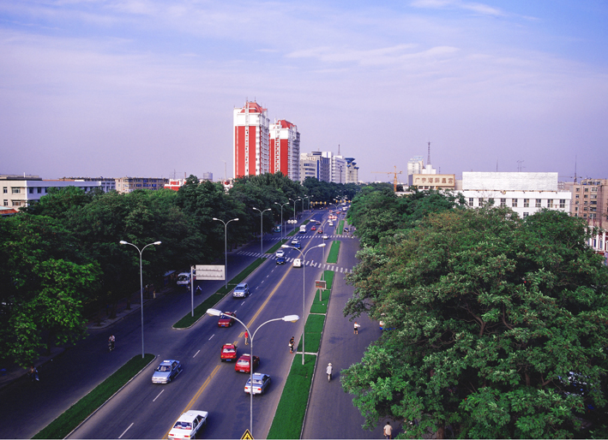
This road is a wider road than Zhonghua Road.

Slide 8
观察一下，他们有什么区别呢？
The buildings are new.
The buildings are newer than those buildings.
Diwang Tower is tall.
Diwang Tower is taller than many other buildings
Zhonghua Road is a wide road.
This road is a wider road than Zhonghua Road.
表语
表语
定语

Slide 9
四原则
比较级的一般形式是在单词结尾+er
以不发音的e结尾，单个字母e结尾，+r
重读闭音节结尾的单词，要双写再+er
以辅音+y结尾的，去y为i+er

Slide 10
形容词变比较级练习：
tall -- ________ cool--________
strong--________ cold-- ________
warm--_______ young--________
deep --_______ light -- _______
large--_______ big-- _______
thin-- _______ fat -- _______
hot -- ______ wet -- ______
sad -- ______ nice --_______
fine --_______ heavy--_______
funny--______ happy--_______
taller
cooler
stronger
colder
warmer
younger
deeper
lighter
larger
bigger
thinner
fatter
hotter
wetter
sadder
nicer
finer
heavier
funnier
happier

Slide 11
形容词比较级填空练习：
Shanghai is ______ than Hangzhou.
上海比杭州繁华。
London is _____ than Cambridge.
伦敦比剑桥大。
Shanghai is an _____ city than Shenzhen.
上海比深圳的历史悠久。
Tom is a ______ boy than my son.
汤姆比我儿子高。
busier
bigger
older
taller

Slide 12
形容词比较级练习：
1.昨天比今天暖和。
2.她的头发比我的短。
3.沈阳比阜新繁华。
Yesterday is warmer than today.
Her hair is shorter than mine (my hair).
Shenyang is busier than Fuxin.
Shenyang is a busier city than Fuxin.

Slide 13
同级比较句式：
I am as happy as John.
我和约翰一样高兴。
Shenzhen is as busy as Hong Kong.
深圳和香港一样繁忙。

Slide 14
A+be+ as+形容词原型+as +B
否定形式为：not as/so+形容词原型+as

Slide 15
同级比较练习：
1.贝蒂和你一样开心。
2.大明和汤姆一样大。
Betty is as happy as you.
Betty is not as/so happy as you.
Daming is as old as Tom.
Daming is not as/so old as Tom.

