Slide 1
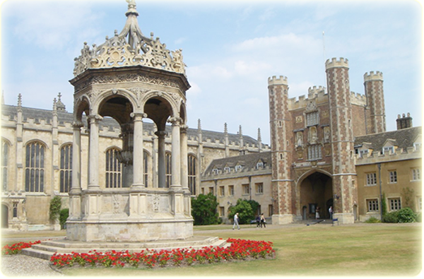
Cambridge is a beautiful city
in the east of England.

Slide 2
Revision
完成下列句子
1、中国的人口是多少?
__________________of China? 2、香港比上海热。
Hong Kong ___________Shanghai. 3、上海比香港繁忙吗?
__ Shanghai __________ Hong Kong? 4、上海不比香港新。
Shanghai _____________ Hong Kong.
What’s the population
is hotter than
Is busier than
isn’t newer than

Slide 3
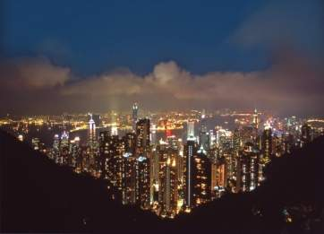
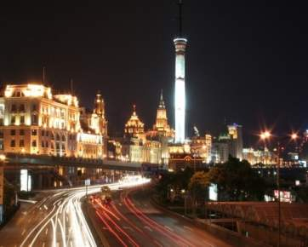
Make sentences with the comparison.
Hong Kong
7 million people
Hong Kong is big.
Shenzhen
10 million people
Shenzhen is bigger than Hong Kong.

Slide 4
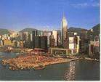
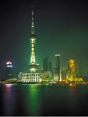
Hong Kong
about 150 years old
Hong Kong is old.
Shanghai
700 years old
Shanghai is older than Hong Kong.

Slide 5
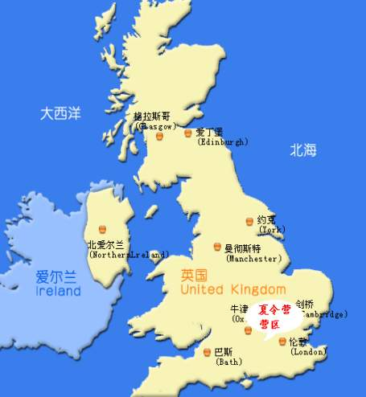
Lead-in
Where is it?
PPT模板：www.1ppt.com/moban/ PPT素材：www.1ppt.com/sucai/
PPT背景：www.1ppt.com/beijing/ PPT图表：www.1ppt.com/tubiao/
PPT下载：www.1ppt.com/xiazai/ PPT教程： www.1ppt.com/powerpoint/
资料下载：www.1ppt.com/ziliao/ 范文下载：www.1ppt.com/fanwen/
试卷下载：www.1ppt.com/shiti/ 教案下载：www.1ppt.com/jiaoan/
PPT论坛：www.1ppt.cn PPT课件：www.1ppt.com/kejian/
语文课件：www.1ppt.com/kejian/yuwen/ 数学课件：www.1ppt.com/kejian/shuxue/
英语课件：www.1ppt.com/kejian/yingyu/ 美术课件：www.1ppt.com/kejian/meishu/
科学课件：www.1ppt.com/kejian/kexue/ 物理课件：www.1ppt.com/kejian/wuli/
化学课件：www.1ppt.com/kejian/huaxue/ 生物课件：www.1ppt.com/kejian/shengwu/
地理课件：www.1ppt.com/kejian/dili/ 历史课件：www.1ppt.com/kejian/lishi/
It’s England.

Slide 6
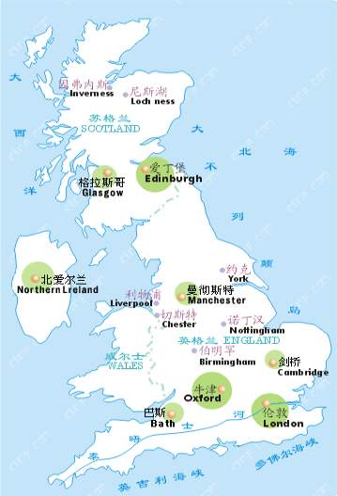
Which country is it?
Britain
England
PPT模板：www.1ppt.com/moban/ PPT素材：www.1ppt.com/sucai/
PPT背景：www.1ppt.com/beijing/ PPT图表：www.1ppt.com/tubiao/
PPT下载：www.1ppt.com/xiazai/ PPT教程： www.1ppt.com/powerpoint/
资料下载：www.1ppt.com/ziliao/ 范文下载：www.1ppt.com/fanwen/
试卷下载：www.1ppt.com/shiti/ 教案下载：www.1ppt.com/jiaoan/
PPT论坛：www.1ppt.cn PPT课件：www.1ppt.com/kejian/
语文课件：www.1ppt.com/kejian/yuwen/ 数学课件：www.1ppt.com/kejian/shuxue/
英语课件：www.1ppt.com/kejian/yingyu/ 美术课件：www.1ppt.com/kejian/meishu/
科学课件：www.1ppt.com/kejian/kexue/ 物理课件：www.1ppt.com/kejian/wuli/
化学课件：www.1ppt.com/kejian/huaxue/ 生物课件：www.1ppt.com/kejian/shengwu/
地理课件：www.1ppt.com/kejian/dili/ 历史课件：www.1ppt.com/kejian/lishi/
England is
a region
of Britain.
Cambridge
London
Notes:
PPT模板：www.1ppt.com/moban/ PPT素材：www.1ppt.com/sucai/
PPT背景：www.1ppt.com/beijing/ PPT图表：www.1ppt.com/tubiao/
PPT下载：www.1ppt.com/xiazai/ PPT教程： www.1ppt.com/powerpoint/
资料下载：www.1ppt.com/ziliao/ 范文下载：www.1ppt.com/fanwen/
试卷下载：www.1ppt.com/shiti/ 教案下载：www.1ppt.com/jiaoan/
PPT论坛：www.1ppt.cn PPT课件：www.1ppt.com/kejian/
语文课件：www.1ppt.com/kejian/yuwen/ 数学课件：www.1ppt.com/kejian/shuxue/
英语课件：www.1ppt.com/kejian/yingyu/ 美术课件：www.1ppt.com/kejian/meishu/
科学课件：www.1ppt.com/kejian/kexue/ 物理课件：www.1ppt.com/kejian/wuli/
化学课件：www.1ppt.com/kejian/huaxue/ 生物课件：www.1ppt.com/kejian/shengwu/
地理课件：www.1ppt.com/kejian/dili/ 历史课件：www.1ppt.com/kejian/lishi/

Slide 7
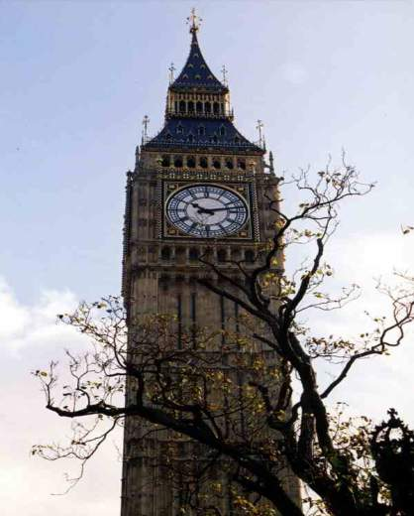
What is it famous for?
It’s famous for Big Ben.

Slide 8
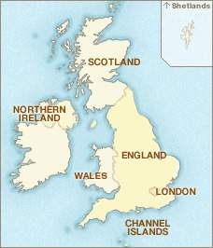
What is the capital of England?
It is London.

Slide 9
Learn new words.
north n. 北；北方
adj. 在北方的；朝北的
e.g. Japan lies to the north of Philippines.
日本位于菲律宾岛的北面。
Is your home town in North China?
你的家乡在中国的北方吗？

Slide 10
south n. 南；南方
adj. 在南方的；朝南的
e.g. She works on the south coast.
她在南方沿海地区工作。
North is the opposite direction to the
south. 北是南的反方向。
west n. 西，西方；
adj. 在西方的；朝西的
e.g. This country opens out to the west.
这个国家对西方国家开放。

Slide 11
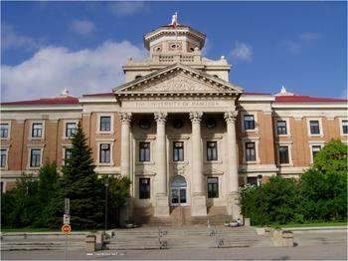
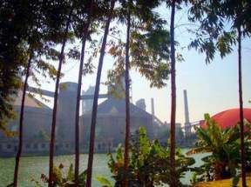
university n. 大学
e.g. What is your major
in university?
在大学你主修什么科目？
island n. 岛，岛屿
e.g. There are some banana
trees on that island over there.
那边小岛上有几棵香蕉树。

Slide 12
countryside n. 农村地区；乡下
e.g. The young people from the
countryside are honest.
这些乡下来的年轻人都很老实。
area n. 地区；区域
e.g. Earthquakes occur frequently in
this area.
这一地区经常发生地震。

Slide 13
mountain n. 山；山丘
e.g. The mountain is 3500 meters high. 这座山有3500米高。
low adj. 矮的；低的
e.g. The office is in a low building.
办公室设在一幢低矮的房子里。

Slide 14

especially adv. 尤其
e.g. I love reading, especially novel.
我喜欢阅读，尤其是小说。
especially&specially
在表示“特意地”“尤其”时，especially指某事超乎一般的重要，不寻常，强调“超过其他”，而毫无“目的性”可言。例如:

Slide 15
I like maple tree, especially in autumn.
我喜欢枫树，尤其是秋天的枫树。
specially则表示为了某一特定目的而“特意”“专门”采用某一方式做某事。例如:
The meeting is specially arranged for you.
这次会见是特意为你安排的。
安排

Slide 16

umbrella n. 雨伞
e.g. I left my umbrella on the car.
我把雨伞落在车里了。

Slide 17
Words and expressions
/nɔ:θ/
/sauθ/
/west/
/ i'speʃəli /
北；北方 n.
在北方的；朝北的 adj.
north
南；南方n.
在南方的；朝南的 adj.
south
西；西方n.
在西方的；朝西的 adj.
west
home town
故乡
尤其 adv.
especially

Slide 18
be famous for
因…而闻名
/'ju:nI'və:səti/
/'aIlənd/
/'εəriə/
/ləu/
/'mauntIn/
/'kʌntri'saId/
/ʌm'brelə/
大学 n.
university
岛；岛屿 n.
island
地区；区域 n.
area
矮的；低的 adj.
low
山；山岳 n.
mountain
农村地区；乡下 n.
countryside
雨伞 n.
umbrella

Slide 19


请说出下面的方位词。
N(north)
北方
W(west)
西方
东方
E(east)
南方
S(south)

Slide 20
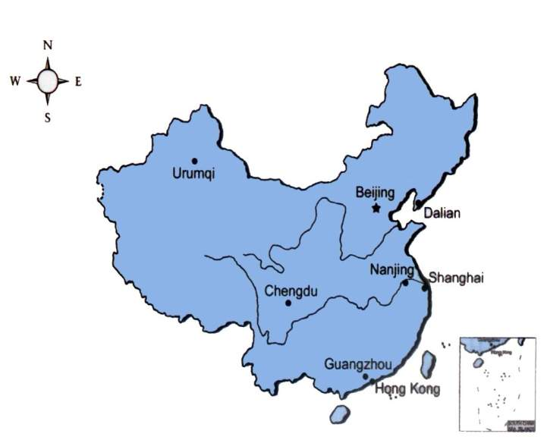
Work in pairs. Where are these cities in China?
Beijing
Guangzhou
Nanjing
Urumqi
Dalian
Chengdu
Hong Kong

Slide 21
Answers:
Beijing is in the north of China.
Guangzhou is in the south of China.
Nanjing is in the east of China.
Urumqi is in the west of China.
Dalian is in the northeast of China.
Chengdu is in the southwest of China.
Hong Kong is in the southeast of China.

Slide 22
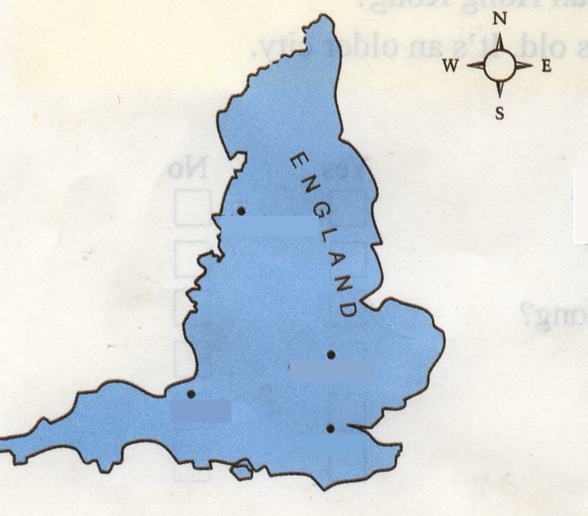
Look at the map of England and answer.
east north south west
— Where is Manchester?
— It is in the north of
England.
Manchester
— Where is London?
— It is in the south of
England.
London

Slide 23
east north south west
— Where is Cambridge?
— It is in the east of
England.
— Where is Bristol?
Cambridge
— It is in the west of
England.
Bristol

Slide 24
Read the sentences.
east north south west
1. Cambridge is in the east of England.
2. London is in the south
of England.
3. Bristol is in the west
of England.
4. Manchester is in the
north of England.
Manchester
Cambridge
Bristol
London

Slide 25
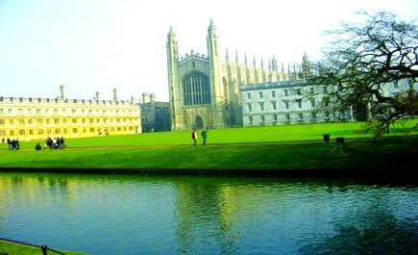
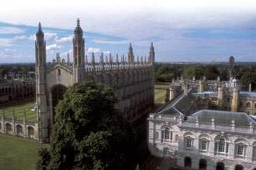
Do you know these places?
Cambridge University
Cambridge University is a famous university.
Cambridge University is near the River Cam.

Slide 26
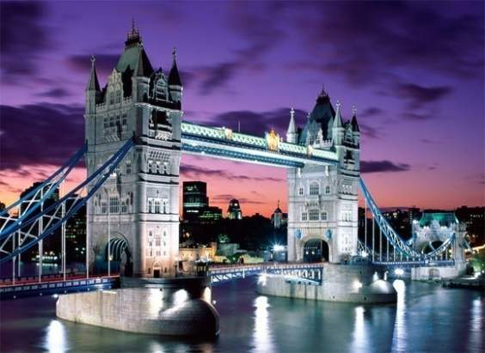
Tower Bridge
Tower Bridge is above the River Thames.
Tower Bridge is in London.

Slide 27
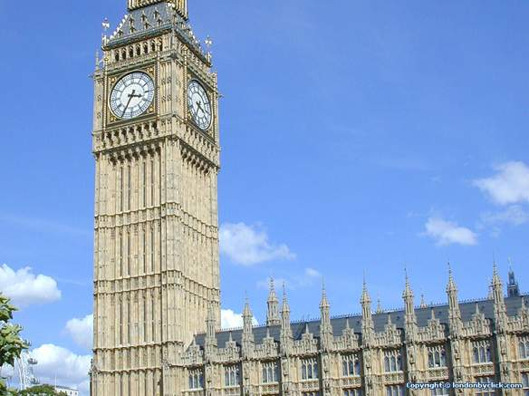
Big Ben
London is famous for Big Ben.

Slide 28
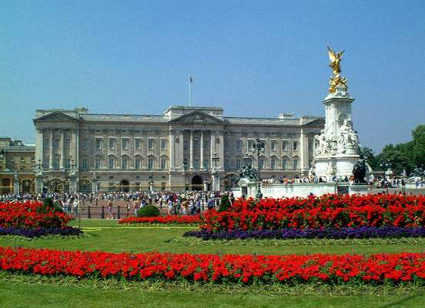
Buckingham Palace
Buckingham Palace is in London.

Slide 29

Listen and answer the questions.
1. Where is Cambridge?
It is in the east of England.
2. What’s the capital of England?
London.

Slide 30
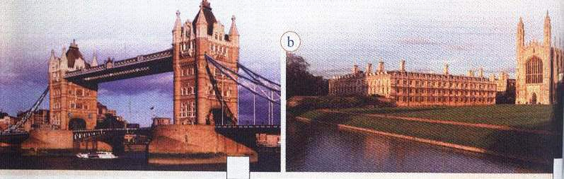
Skimming
Read the passage and choose a title for each picture below.
1. Tower Bridge and the River Thames
2. Cambridge University and the River Cam
a
a._______
b._______
1
2

Slide 31
What’s the main idea of each part?
Part 1 (para_1_)_____
Part 2(para_2_) _____
Part 3(paras_3-4_) _____
B
A
C
Introduction about London.
B. Introduction about Cambridge
C. Introduction about England.

Slide 32
Read the passage again and answer the questions.
1. What’s its population of Cambridge?
It is about 120,000.
2. What’s Cambridge famous for?
Cambridge University.
3. How old is London?
It’s about 2,000 years old.
4. What’s the weather like in England?
It is never very hot in summer or very cold in winter.

Slide 33
Scanning
Complete the table comparing Cambridge with London.
 | Cambridge | London
Location
Population
Famous places
River
In the east of
England
In the south of
England
About 7.5
million
120,000
University, old buildings and churches
Big Ben,
Buckingham
Palace,
Tower Bridge
River Cam
River Thames

Slide 34
Further reading
1. What is Cambridge famous for?
2. 翻译：第二段：It has a population of about seven and a half million, so it’s bigger and busier than Cambridge.
3. 从文中找出下句的同义句：
It is known for Big Ben.___________________
4. ____________- and_______________ in the north of England.
5. When can you visit England?
It’s famous for (Cambridge )University.
它有大约7500000人口，因此它比剑桥更大更繁华.
It is famous for Big Ben.
Low mountains beautiful lakes
You can visit England any time of the year.

Slide 35
单项选择
The table is __.
A. long 2 meters B. 2 meter long C. two meters long
2. China is famous ____ the Great Wall.
A. at B. for C. as
3. Britain is _____ island. A. a B. an C. /
4. ___is the population of Foshan?
A. How many B. How much C. What
5. The population of this village ____ only nine hundred, it is very small。
A. are B. has C. is
6. China is a great country, it _____1.3 billion people.
A. are B. has C. is
7. China is a great country ___ a long history.
A. in B. From C. With
C
B
__B_
C
C
B
C

Slide 36
完成句子
1）Hong Kong is hot. Shanghai is hotter. (用比较级把两个句子合并成一句)
Shanghai _____________ Hong Kong.
2）The population of Shanghai is 13 million.( 就划线部分提问)
______________________Shanghai ?
3）大连约有三百五十万人口。
Dalian ______________________5.3 millionpeople.
4）这条河长达五十公里。
This river is 50______________________.
5）香港位于中国的南部。
Hong Kong is ____________________China.
hotter than
What is the population of
has a population of about
kilometers long.
in the south of

