Slide 1
Module 3 Sports
Unit 2 This year we are trainning more carefully.

Slide 2

Guessing Game

Slide 3
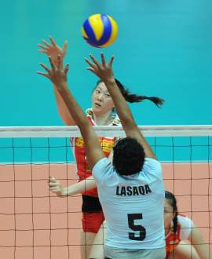
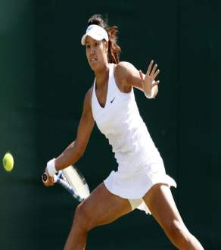
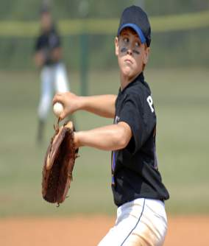
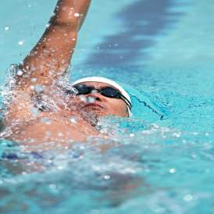
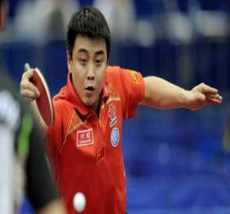
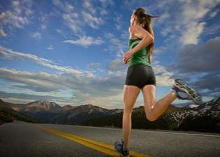

Slide 4
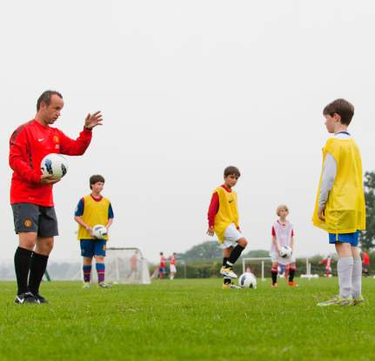
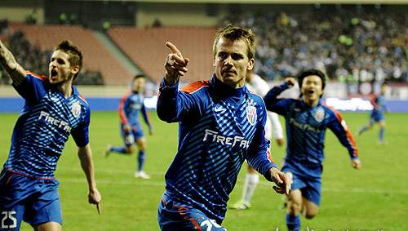
Presentation
train v.（体育）训练，操练
beat v. 打败；战胜

Slide 5
train作动词，表示“训练，操练”；
作名词，表示“火车”。
e.g. We’re training harder than usual because the other school beat us last year.
我们比平时更努力训练，因为去年别的学校打败了我们。
His father goes to Shanghai by train.
他父亲坐火车去上海。

Slide 6
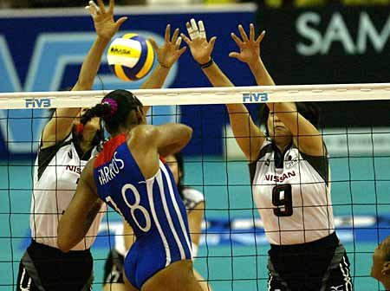
against
prep.（在比赛或战斗中）对（某人或某物）

Slide 7
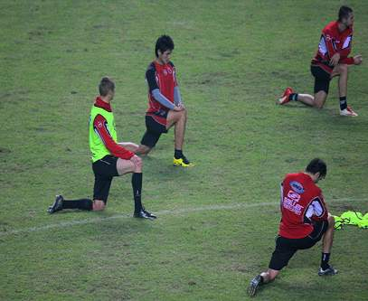
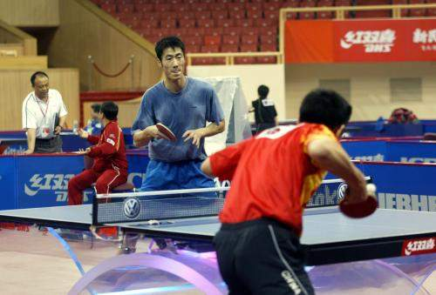
warm v. 使暖和；使温暖
warm up 热身；做准备活动
practice n. 练习

Slide 8
例如：
The runners _______________ before the race.
赛跑选手正在做赛前热身。
are warming up

Slide 9
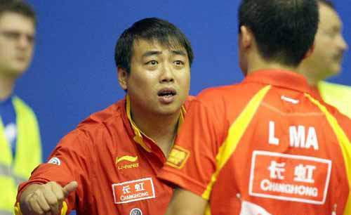
coach n. 教练

Slide 10
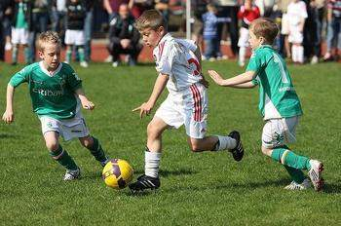
careless adj. 粗心的；疏忽的
pass v. 传递；传送
e.g. Last year we were careless when we passed the ball and we lost to the other team. So this year we train more carefully.

Slide 11
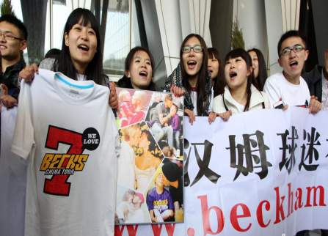
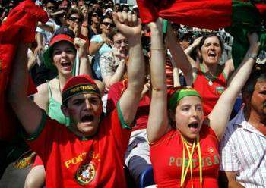
fan club 球迷（或影迷，歌迷）俱乐部
cheer…on 用欢呼声激励；为……加油

Slide 12


loudly adv. 响亮地；大声地
quiet adj. 寂静的；安静的

Slide 13
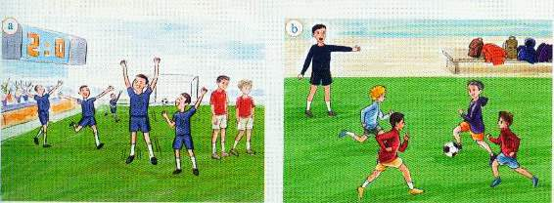
Reading and vocabulary
Work in pairs. Talk about the pictures. Use the words and expressions in the box to help you.
beat careless cheer…on coach fan club play against train

Slide 14
Listen and read

Slide 15
Complete the table.
What | Why
1. We arrive ________________.
2. We’re training _________ than _______.
So we have time to warm up.
as early as we can
The other team beat us last year. This year we want to do better.
harder usual

Slide 16
What | Why
3. It’s _________ ___________ to practice in winter.
4. Our coach is ________.
more difficult
The days are short and the weather is cold.
We are playing better as a team now.
pleased

Slide 17
Complete the passage with the words in the box.
against chance coach practice short usual
practice
We all know (1) __________ makes perfect. But it is more difficult to practise in winter because the days are (2) _________ and it is cold.
short

Slide 18
The team is training harder than (3) _________. Their (4) _________ is pleased with them. They are going to play (5) _________ a team from another school next week, and they have a good (6) ___________ of winning.
usual
coach
against
chance

Slide 19
Put the words in the box into pairs with opposite meanings.
badly carefully carelessly difficult early easy late quickly slowly well
carefully — carelessly
difficult — easy early — late
quickly — slowly
badly — well

Slide 20
1.
win与beat
这两个词都有“获胜, 打败”的意思, 但其后宾语不同。beat是“打败, 优于”的意思, 后面接人或队。如:
We beat them. 我们打败了他们。
win 指“赢, 获胜”, 后面接比赛、名次。如:
We won the match/game/race/the first place. 我们赢了这场比赛/获得了第一名。

Slide 21
2. I am in our school team and we are going to play against another school next week.
我是校队成员，我们（队）下周将要和另一学校比赛。
against 为介词，表示“反对，与……对抗” 。例如：

Slide 22
playing against
1) Germany are _______________ Brazil in the World Cup final tonight.
今晚德国将与巴西争夺世界杯冠军。
2) We will ____________ the enemy.
我们将与敌人交战。
3) They are strongly ________ the idea.
他们强烈反对这个主意。
4) Are you for or _______ my proposal?
你们是同意还是反对我的计划？
fight against
against
against

Slide 23
3. That means we have a better chance of winning. 这就意味着我们获胜的机会更大。
have a chance of doing sth. 表示“有做某事的机会” 。例如：
1) You will __________________________
the exams if you work harder.
如果你们再用功一点，通过考试的机会
就更大一点。
have a better chance of passing

Slide 24
2) If we hurry up, there’s still
________________________ the plane.
要是我们抓紧点，赶上飞机的机会还是
很大的。
a good chance of catching

Slide 25
4. It is good to have our fans around. They cheer us on loudly and we feel more confident to win the game.
有我们的球迷在周围真好，因为他们为我们欢呼加油。
cheer sb. on 的意思是“为……欢呼加油” 。例如：

Slide 26
1) The crowd _________ their favourite singers _____.
观众为他们最喜欢的歌手喝彩加油。
2) They gathered round the swimming pool and _______________.
他们在游泳池周围，给她加油。
cheered
on
PPT模板：www.1ppt.com/moban/ PPT素材：www.1ppt.com/sucai/
PPT背景：www.1ppt.com/beijing/ PPT图表：www.1ppt.com/tubiao/
PPT下载：www.1ppt.com/xiazai/ PPT教程： www.1ppt.com/powerpoint/
资料下载：www.1ppt.com/ziliao/ 范文下载：www.1ppt.com/fanwen/
试卷下载：www.1ppt.com/shiti/ 教案下载：www.1ppt.com/jiaoan/
PPT论坛：www.1ppt.cn PPT课件：www.1ppt.com/kejian/
语文课件：www.1ppt.com/kejian/yuwen/ 数学课件：www.1ppt.com/kejian/shuxue/
英语课件：www.1ppt.com/kejian/yingyu/ 美术课件：www.1ppt.com/kejian/meishu/
科学课件：www.1ppt.com/kejian/kexue/ 物理课件：www.1ppt.com/kejian/wuli/
化学课件：www.1ppt.com/kejian/huaxue/ 生物课件：www.1ppt.com/kejian/shengwu/
地理课件：www.1ppt.com/kejian/dili/ 历史课件：www.1ppt.com/kejian/lishi/
cheered her on
Notes:
PPT模板：www.1ppt.com/moban/ PPT素材：www.1ppt.com/sucai/
PPT背景：www.1ppt.com/beijing/ PPT图表：www.1ppt.com/tubiao/
PPT下载：www.1ppt.com/xiazai/ PPT教程： www.1ppt.com/powerpoint/
资料下载：www.1ppt.com/ziliao/ 范文下载：www.1ppt.com/fanwen/
试卷下载：www.1ppt.com/shiti/ 教案下载：www.1ppt.com/jiaoan/
PPT论坛：www.1ppt.cn PPT课件：www.1ppt.com/kejian/
语文课件：www.1ppt.com/kejian/yuwen/ 数学课件：www.1ppt.com/kejian/shuxue/
英语课件：www.1ppt.com/kejian/yingyu/ 美术课件：www.1ppt.com/kejian/meishu/
科学课件：www.1ppt.com/kejian/kexue/ 物理课件：www.1ppt.com/kejian/wuli/
化学课件：www.1ppt.com/kejian/huaxue/ 生物课件：www.1ppt.com/kejian/shengwu/
地理课件：www.1ppt.com/kejian/dili/ 历史课件：www.1ppt.com/kejian/lishi/

Slide 27
中考链接
1. — What’s wrong with you today?
— I am quite upset.
— Cheer up! The more you smile, the
_______ you will feel. (2012广东湛江)
A. happy B. happier
C. happily D. More happily

Slide 28
2. — Do you know sound travels very fast?
— Yes. But light travels ________ sound.
(2012湖北荆州)
A. as fast as B. a little faster than
C. much faster than D. slower than
3. — Your room is very dirty. You should
keep it ________. (2012湖北襄阳)
— OK. I’ll sweep it right away.
A. clean B. dry
C. quiet D. warm

Slide 29
4. — Would you mind staying in such a
noisy room?
— No, but my son needs a _________ place to study in. (2011宁波)
A. cleaner B. quieter
C. safer D. smaller

Slide 30
5. Some students are so _______ that
they often make mistakes in their
homework. (2011聊城)
A. careful B. serious
C. careless D. successful
6. My sister has practiced tennis for a
long time. She plays tennis _____ you.
(2011德阳)
A. as good as B. so well as C. as well as

Slide 31
7. The smile on his teacher’s face
shows that she was ________ with
my work. (2007佛山)
A. angry B. pleased C sad

Slide 32
Complete the sentences so they are true for your school basketball team.
1. It is … and the basketball team …
2. The practice starts at … but they …
3. Last year …

Slide 33
4. This year …
5. The coach is pleased / is not pleased
with them because …
6. So they now have a better/poor
chance of …

Slide 34
It is Saturday and the school basketball team arrives to practice / train with the coach.
2. The practice starts at 9 o’clock but they arrived early to warm up.
3. Last year they were careless / lost all the matches.

Slide 35
4. This year they are playing well.
5. The coach is pleased because they are training hard.
The coach is not pleased because they are not playing well.
6. So they now have a better/worse chance of winning.

Slide 36
Learning to learn
You can use at that time / yesterday/ last week / last month/ last year … to talk what people did in the past; and use now / today / this week / this month / this year … to talk about what they do now.

Slide 37
Homework
Add some more details about your school basketball team. Write a passage.

