Slide 1
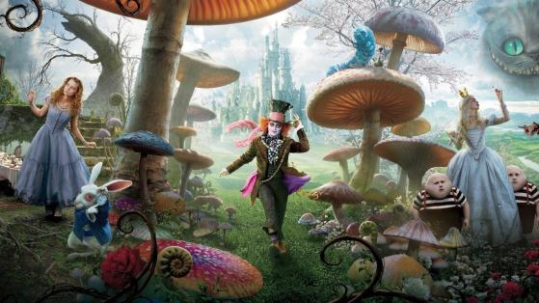
Module 7 A famous story
Unit 1 Alice was sitting with her sister by the river.

Slide 2
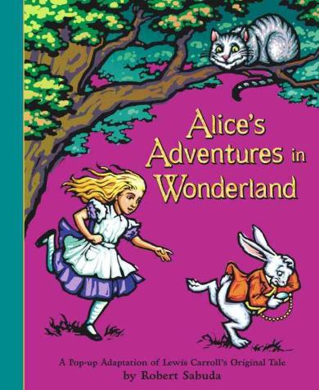
Have you read this story-book?
What's its name?
Alice’s Adventures in Wonderland

Slide 3
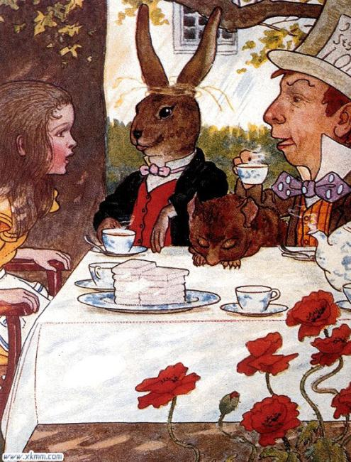
The list of characters
Alice
the Mad Hatter 疯帽匠
hatter n. 帽子制造者, 帽商
the March Hare三月兔

Slide 4
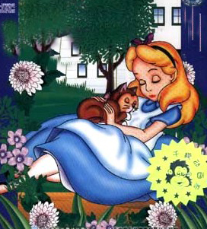
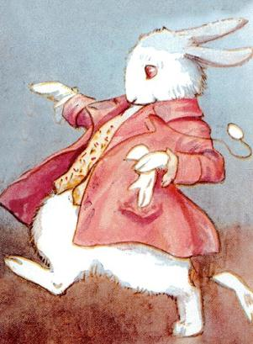
Alice
The White Rabbit
the Cheshire Cat

Slide 5
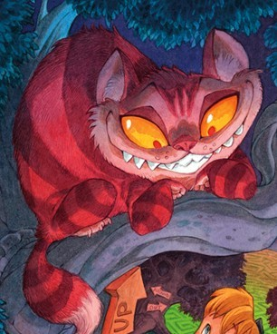
the Cheshire Cat 柴郡猫

Slide 6
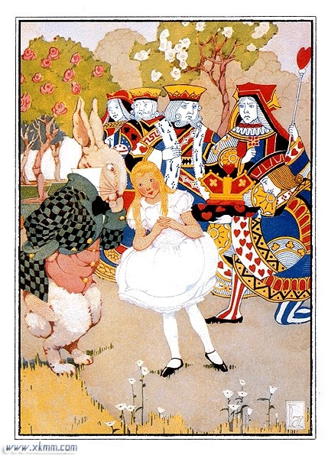
The Queen of Hearts
PPT模板：www.1ppt.com/moban/ PPT素材：www.1ppt.com/sucai/
PPT背景：www.1ppt.com/beijing/ PPT图表：www.1ppt.com/tubiao/
PPT下载：www.1ppt.com/xiazai/ PPT教程： www.1ppt.com/powerpoint/
资料下载：www.1ppt.com/ziliao/ 范文下载：www.1ppt.com/fanwen/
试卷下载：www.1ppt.com/shiti/ 教案下载：www.1ppt.com/jiaoan/
PPT论坛：www.1ppt.cn PPT课件：www.1ppt.com/kejian/
语文课件：www.1ppt.com/kejian/yuwen/ 数学课件：www.1ppt.com/kejian/shuxue/
英语课件：www.1ppt.com/kejian/yingyu/ 美术课件：www.1ppt.com/kejian/meishu/
科学课件：www.1ppt.com/kejian/kexue/ 物理课件：www.1ppt.com/kejian/wuli/
化学课件：www.1ppt.com/kejian/huaxue/ 生物课件：www.1ppt.com/kejian/shengwu/
地理课件：www.1ppt.com/kejian/dili/ 历史课件：www.1ppt.com/kejian/lishi/
Notes:
PPT模板：www.1ppt.com/moban/ PPT素材：www.1ppt.com/sucai/
PPT背景：www.1ppt.com/beijing/ PPT图表：www.1ppt.com/tubiao/
PPT下载：www.1ppt.com/xiazai/ PPT教程： www.1ppt.com/powerpoint/
资料下载：www.1ppt.com/ziliao/ 范文下载：www.1ppt.com/fanwen/
试卷下载：www.1ppt.com/shiti/ 教案下载：www.1ppt.com/jiaoan/
PPT论坛：www.1ppt.cn PPT课件：www.1ppt.com/kejian/
语文课件：www.1ppt.com/kejian/yuwen/ 数学课件：www.1ppt.com/kejian/shuxue/
英语课件：www.1ppt.com/kejian/yingyu/ 美术课件：www.1ppt.com/kejian/meishu/
科学课件：www.1ppt.com/kejian/kexue/ 物理课件：www.1ppt.com/kejian/wuli/
化学课件：www.1ppt.com/kejian/huaxue/ 生物课件：www.1ppt.com/kejian/shengwu/
地理课件：www.1ppt.com/kejian/dili/ 历史课件：www.1ppt.com/kejian/lishi/

Slide 7

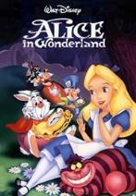
Listen and number the words as you hear them.
fall follow
hole rabbit
strange
4
2
5
3
1

Slide 8
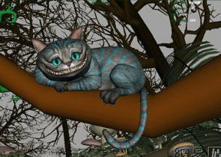
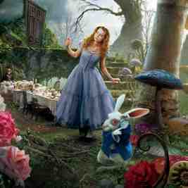
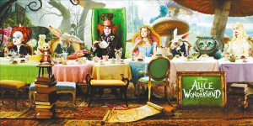
Listen again and number the pictures.
2
sees the Cheshire Cat
1
follows a white rabbit
3
has a tea party at the March Hare’s house

Slide 9
Read and answer the questions.
1. What was Lingling doing?
She was reading Alice’s Adventures in Wonderland.

Slide 10
2. What did Alice see when she fell down the hole in the ground?
She saw the Cheshire Cat. The Cat was sitting in a tree and smiling at everyone.
3. What was the Queen of Hearts doing when Alice met her?
She was playing a strange game.

Slide 11
1.Alice was________ with her_______ by the river.
2.The white rabbit with a _________ ran past.
3.The Mad Hatter, the March Hare and a mouse were having a ______ party.
4.The Queen of Hearts was ________ a strange game.
sitting
sister
watch
tea
playing

Slide 12
Complete the sentences with words in the box.
fall hole smile strange watch
strange
1. Something is ________ if it is not usual.
2. You _______ when you are happy.
3. You can carry a ________. It tells you the time.
4. A rabbit ________ is a place where rabbits live.
5. You ________ when you move down quickly to the ground.
smile
watch
hole
fall

Slide 13
Read the conversation and complete the passage. Then, act the conversation out with your partners.
Alice’s Adventures in Wonderland
One day, Alice ___ ________ by the river with a book, but she______ _________it. Suddenly, a white rabbit ran past her. It ____ ________ at its watch. It ____ _______ because it was late.
The white rabbit _____ ________ to a tea party with the Mad Hatter, the March Hare and a mouse.
was sitting
wasn’t reading
was looking
was running
was going

Slide 14
Oh, there were already a lot of people there . They were the March Hare, the Mad Hatter, a mouse, the Red Queen and the Cheshire Cat. The Queen ______ _______ a strange game. The Cheshire Cat _____ ________ at everyone.
was
playing
was smiling

Slide 15
Read the following sentences and pay attention to the tense of them.
One day she was sitting by the river with a book, but she wasn’t reading it.
It was looking at its watch.
Why was it running?
Where was it going?
A cat was sitting in a tree.

Slide 16
过去进行时
过去进行时表示过去某一时刻或某段时间正在进行的动作。过去进行时由"was / were + 动词-ing形式"构成。

Slide 17
1. 过去进行时的各种句式:
肯定句: 主语+ was / were + 动词-ing形式。如:
I was reading at this time yesterday. 昨天这个时候我正在看书。
否定句:主语+ was / were + not + 动词-ing形式。如：
I wasn’t reading at this time yesterday. 昨天这个时候我没在看书。

Slide 18
疑问句: (1)一般疑问句: was / were + 主语+ 动词-ing形式。肯定回答: Yes, 主语+ was / were.否定回答: No, 主语+ wasn’t / weren’t. 如：
—Were you reading at this time yesterday?
— 昨天这个时候你在看书吗？
— Yes, I was. / No, I wasn’t.
— 是的, 我在看。/ 不, 我没在看。

Slide 19
(2)特殊疑问句: 疑问词+ was / were + 主语+ 动词-ing形式。如：
What were you doing at this time yesterday?
昨天这个时候你在做什么？
What was he researching all day last Sunday?
上周日他一整天都在研究什么？

Slide 20
2. 过去进行时的用法基本用法:
(1)表示过去某一时刻或某一段时间内正在进行的动作, 常与时间状语at that time, at that moment, at this time yesterday, at ten o’clock yesterday等连用。如：
Were you playing basketball at four yesterday afternoon?
昨天下午四点你们在打篮球吗?

Slide 21
(2)表示在过去一段时间内持续进行的动作(有时也可以有间歇)。如：
We were watching TV from seven to nine last night.
昨天晚上七点到九点的时候我们在看电视。
She was singing from 7:00 to 7:30 last night.
她昨晚七点至七点半在唱歌。

Slide 22
特殊用法:
(1)常用于介绍故事的背景。如:
Once an Arab was traveling in the desert.
从前,有个阿拉伯人在沙漠中旅行。
(2)when引导的从句表示一个短暂的时间点,谓语动词用一般过去时, 主句用一般过去时或过去进行时； while引导的从句表示一段持续的时间, 主句为一般过去时, 从句谓语动词用过去进行时。如：

Slide 23
I was writing a letter when he came in.
当他进来时,我正在写信。
The telephone rang while she was washing.
当她正在洗衣服时, 电话响了。
(3)过去进行时常与always, continually等连用, 表示过去反复发生的行为动作, 带有赞美、厌烦等感情色彩。如：
He was continually asking her questions.
他一直在问她问题。

Slide 24
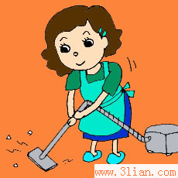
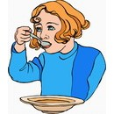
Ask and answer.
What were you doing at 7 o’clock last night?
I was doing some housework.
I was having dinner.

Slide 25

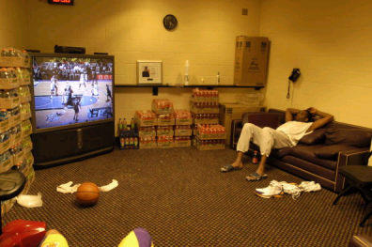
What were you doing between 7o’clock and 9 o’clock yesterday?
I was doing my homework.
I was watching TV.

Slide 26
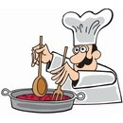
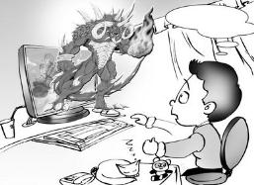
What was your father doing when you
came back home yesterday?
He was cooking.
What was your brother doing when
you saw him half an hour ago?
He was playing computer games.

Slide 27
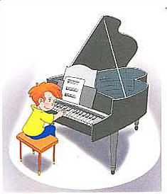
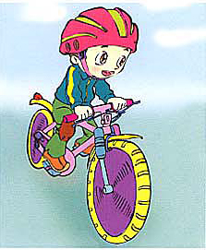
What was Tom doing at that time last Sunday?
He was playing the piano.
How about David?
He was riding a bike.

Slide 28

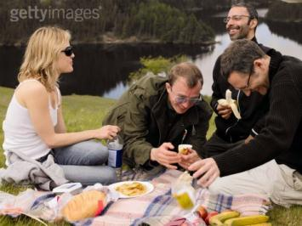
What were they doing at that time last week?
How about them?
They were having a picnic.
They were shopping.

Slide 29
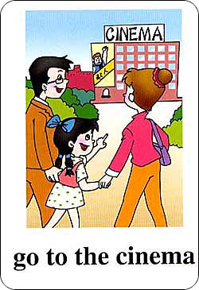
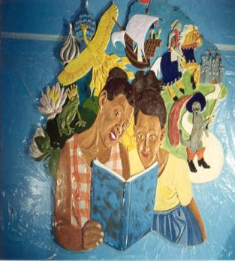
What were they doing at 9 o’clock last night?
How about Tan Mei’s family?
They were going to the cinema.
They were reading.

Slide 30
Listen and number the words the speaker stresses.
--- The Cheshire Cat was sitting on the
grass.
--- No, it wasn’t. It was sitting in a tree.
2. --- The White Rabbit was looking at its
watch.
--- Yes, it was.

Slide 31
Do an interview.
Tom: Hello, Dave.
Dave: Hello, Tom.
Tom: What were you doing at 7:00p.m. last Saturday?
Dave: I was watching TV.
Tom: That sounds relaxing. What was your mother doing?
Dave: She was cleaning the house.
…
Name | Activity

Slide 32
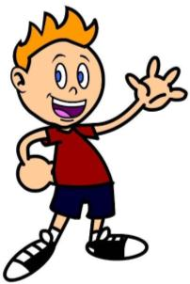
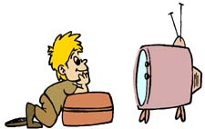
This is my friend Dave. At 7:00 p.m. last Saturday, he was watching TV,
his mother was cleaning the house,
…

