Slide 1
Module
7
A famous story
Unit 2 She was thinking about her cat.

Slide 2
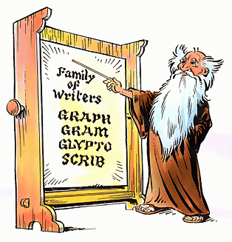
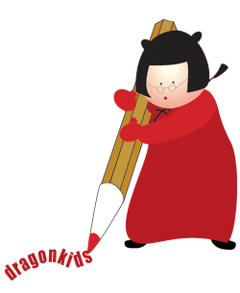
Mr Magic ____________ us something useful.
was teaching
Miss Betty __________ at this time yesterday
was writing

Slide 3

Mike ___________ yesterday morning.
was running
Mr Fox ____________ the mountain.
was climbing

Slide 4
The smurf (蓝精灵) ____________ at ten o’clock last night.
was sleeping

Slide 5
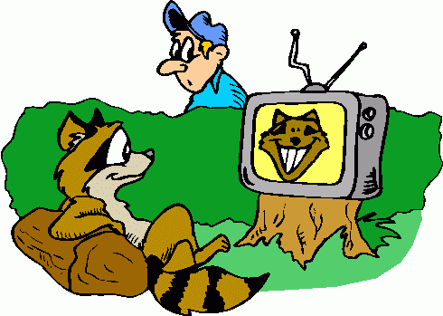
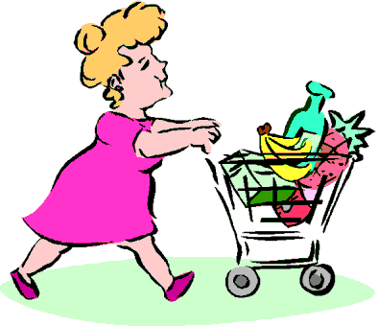
Cheshire Fox ___________ TV.
was watching
Mrs James ____________ in the supermarket.
was shopping

Slide 6
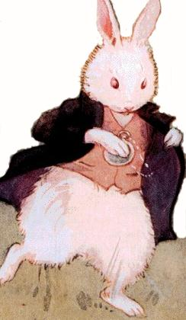
1 look at the picture in Activity 2 and
say what you think is strange.
↘
looking at a pocket watch
↘
PPT模板：www.1ppt.com/moban/ PPT素材：www.1ppt.com/sucai/
PPT背景：www.1ppt.com/beijing/ PPT图表：www.1ppt.com/tubiao/
PPT下载：www.1ppt.com/xiazai/ PPT教程： www.1ppt.com/powerpoint/
资料下载：www.1ppt.com/ziliao/ 范文下载：www.1ppt.com/fanwen/
试卷下载：www.1ppt.com/shiti/ 教案下载：www.1ppt.com/jiaoan/
PPT论坛：www.1ppt.cn PPT课件：www.1ppt.com/kejian/
语文课件：www.1ppt.com/kejian/yuwen/ 数学课件：www.1ppt.com/kejian/shuxue/
英语课件：www.1ppt.com/kejian/yingyu/ 美术课件：www.1ppt.com/kejian/meishu/
科学课件：www.1ppt.com/kejian/kexue/ 物理课件：www.1ppt.com/kejian/wuli/
化学课件：www.1ppt.com/kejian/huaxue/ 生物课件：www.1ppt.com/kejian/shengwu/
地理课件：www.1ppt.com/kejian/dili/ 历史课件：www.1ppt.com/kejian/lishi/
↗
wearing clothes
standing up on its back legs
Notes:
PPT模板：www.1ppt.com/moban/ PPT素材：www.1ppt.com/sucai/
PPT背景：www.1ppt.com/beijing/ PPT图表：www.1ppt.com/tubiao/
PPT下载：www.1ppt.com/xiazai/ PPT教程： www.1ppt.com/powerpoint/
资料下载：www.1ppt.com/ziliao/ 范文下载：www.1ppt.com/fanwen/
试卷下载：www.1ppt.com/shiti/ 教案下载：www.1ppt.com/jiaoan/
PPT论坛：www.1ppt.cn PPT课件：www.1ppt.com/kejian/
语文课件：www.1ppt.com/kejian/yuwen/ 数学课件：www.1ppt.com/kejian/shuxue/
英语课件：www.1ppt.com/kejian/yingyu/ 美术课件：www.1ppt.com/kejian/meishu/
科学课件：www.1ppt.com/kejian/kexue/ 物理课件：www.1ppt.com/kejian/wuli/
化学课件：www.1ppt.com/kejian/huaxue/ 生物课件：www.1ppt.com/kejian/shengwu/
地理课件：www.1ppt.com/kejian/dili/ 历史课件：www.1ppt.com/kejian/lishi/

Slide 7
Read the phrases and find them in the book.
1.have nothing to do
2.once or twice
3.look into (out of )
4.what……for
5. run by = run past
6.run across
7.go down
8.think about =think of
9.too……to
10. land on
无事可做
一两次，偶尔
朝……里(外)看
为什么……，做什么用的？
从......旁边跑过
跑过......穿过......
钻进，跳进
考虑做某事
太......以致不能
(降)落到……上,着陆

Slide 8

Watch and read

Slide 9
Fast-reading
Number the events in the order they
happened.
a) Alice landed on some dry leaves.
b) Alice was sitting by the river with her sister.
c) Alice fell down a hole.
d) A rabbit ran by.
e) Alice ran across the field after the rabbit.
5
1
4
2
3

Slide 10
Careful-reading:
Pare. 1
1.What was her sister doing?
1.What was her sister doing?
She was reading a book.
2.Was Alice interested in her sister’s book? How do you know?
No,she wasn't.
Because in the story Alice thought “… what is a book for without pictures or conversations?”
3. What colour were the rabbit’s eyes?
The rabbit’s eyes were pink.

Slide 11
Para. 2
1. Where was the rabbit’s watch before he took it out?
2. What did Alice run across after the rabbit?
3.Where did the rabbit go?
It was in his pocket.
She ran across a field.
It went down a large rabbit hole in the ground.

Slide 12
Para. 3
1. What did she fall down?
2.Did she think about how to get out again.
3. Where did she land?
She fell down a very deep hole.
No,she didn't
She landed on some dry leaves.

Slide 13
Translate the sentences into Chinese .
Alice had nothing to do.
2.Once or twice she looked into her sister’s book.
3.What is a book for.
4.Suddenly a white rabbit with pink eyes ran by.
5.Alice got up and ran across the field after it.
6.There was nothing strange about that.
7.She saw it go down a large rabbit hole.
8.She never thought about how she was going to
get out again.
9.It was too dark for her to see anything.
10.Suddenly she landed on some dry leaves…

Slide 14
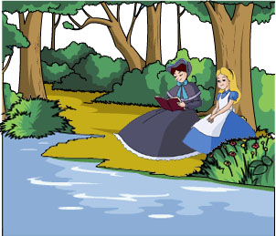
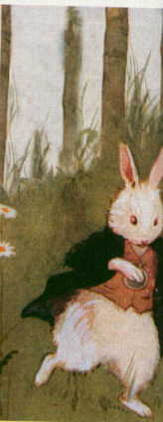
Read the passage and check what we have learn.
Alice
Alice was sitting with her sister by the river and her sister was reading a book. Alice had nothing to do. Once or twice she looked into her sister’s book. “And what is a book for,” thought Alice, “without pictures or conversations?” Suddenly a white rabbit with pink eyes ran by.

Slide 15
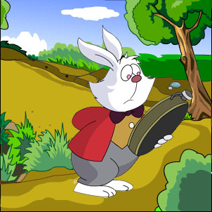
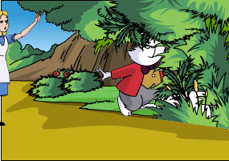
There was nothing strange about that. She heard the rabbit say, “Oh dear! Oh dear! I’ll be late!” and she did not think it was strange. Then the rabbit took a watch out of its pocket and looked at it. A rabbit with a pocket and a watch? Alice got up and ran across the field after it. She saw it go down a large rabbit hole in the ground.

Slide 16
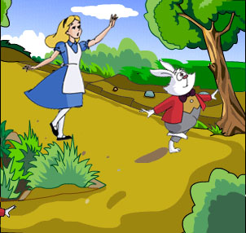
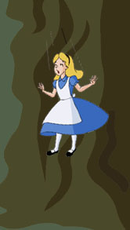
Then Alice went down after it, but never thought about how she was going to get out again. She found that she was falling down a very, very deep hole. It was too dark for her to see anything. She was falling for a long time. While she was falling, she was thinking about her cat, Dinah. Suddenly she landed on some dry leaves…

Slide 17
Fill in the blanks:
Alice and her sister were sitting 1) ______
the river. Her sister was 2)________ but
Alice had 3) _______ to do. Suddenly a
white rabbit 4) _____ pink eyes 5) _____
past her. Alice felt very 6) _______ when
she saw the rabbit 7) ______ out a watch
from its pocket. Alice ran quickly 8) ______ the field 9) _____ the rabbit. The rabbit went into a rabbit 10) _______and Alice followed.
by
reading
nothing
with
ran
strange
take
across
after
hole

Slide 18
Writing

Slide 19
5 Match the answers with the questions.
( ) 1 What did Alice find on a table?
( ) 2 What did Alice do with the key?
( ) 3 What did Alice find next?
( ) 4 What happened to Alice when she drank from
the bottle?
a) She became very small.
b) Alice found a small key on a table.
c) She found a bottle with the words “DRINK ME”
on it.
d) She opened a small door with the key and saw a
beautiful garden.
b
d
c
a

Slide 20
6 Write what happened to Alice after she
found a small key on a table. Use the
answers in Activity 5 to help you.
After Alice found a small key on a table, she
opened a small door…
Now imagine what will happen next.
After Alice found a small key on a table, she opened a small door with it and saw a beautiful garden. Next, she found a bottle with “DRINK ME” on it. Then she drank from the bottle and became very small.

Slide 21
Exercise

Slide 22
单项选择
A
1.–Is there ________ in today’s menu?
–Yes, we have Beijing Duck.
A. anything special B. special anything
C. nothing special D. special nothing
（2009烟台中考）
2. --- It seems that Peter has nothing to do at the moment.
--- Let me give him ____ to read.
A. anything B. something
C. everything D. nothing （ 2010浙江宁波市 )
B

Slide 23
C
3. –Is there ____ in today’s newspaper?
–Yes. Shenzhou VI will be sent up into space in
the near future.
A. nothing new B. new nothing
C. anything new D. new anything
（2009中考真题）
4. A: How often does Lara play the trumpet?
B: ____ once or ____ a week, I’m not sure.
A. May be, twice B. Maybe, twice
C. Maybe, two times D. May be, two time
B

Slide 24
5. When she heard the news ,she was __ angry __a
word .
A too; to B too; to say
C too; say D very; to
B
6.The missing boy was last seen ___ near the river.
A. playing B. to be playing
C. play D. to play
A

Slide 25
Homework
Try to know more about the details of Alice’s Adventures in Wonderland by watching the movie.

Slide 26



