Slide 1
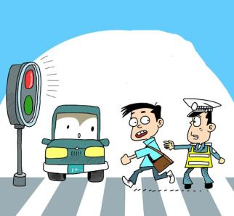
Module 8 Accidents
Unit 1 While the lights were changing to red, a car suddenly appeared.

Slide 2

Read the words and expressions loudly.

Slide 3
Words and expressions
pale
appear
round
corner
hit
glad
adj.（肤色）苍白的
v. 出现，显露
prep. 转到（某物的）另一边
n. 拐角，街角
v. （使）碰撞
adj. 高兴的，欢喜的

Slide 4
Words and expressions
risk
attention
side
in time
fall off
pay attention
side by side
n. 危险，风险
n. 注意力
n. （物体或形状的）侧面
及时
从……跌落
注意，留心
并排地，肩并肩地

Slide 5

Objectives：
To listen and understand the conversation about advice on riding
2.To learn some key words and useful expressions
3.To understand the way of talking about what was happening at a specific time
4.To read the sentences correctly
PPT模板：www.1ppt.com/moban/ PPT素材：www.1ppt.com/sucai/
PPT背景：www.1ppt.com/beijing/ PPT图表：www.1ppt.com/tubiao/
PPT下载：www.1ppt.com/xiazai/ PPT教程： www.1ppt.com/powerpoint/
资料下载：www.1ppt.com/ziliao/ 范文下载：www.1ppt.com/fanwen/
试卷下载：www.1ppt.com/shiti/ 教案下载：www.1ppt.com/jiaoan/
PPT论坛：www.1ppt.cn PPT课件：www.1ppt.com/kejian/
语文课件：www.1ppt.com/kejian/yuwen/ 数学课件：www.1ppt.com/kejian/shuxue/
英语课件：www.1ppt.com/kejian/yingyu/ 美术课件：www.1ppt.com/kejian/meishu/
科学课件：www.1ppt.com/kejian/kexue/ 物理课件：www.1ppt.com/kejian/wuli/
化学课件：www.1ppt.com/kejian/huaxue/ 生物课件：www.1ppt.com/kejian/shengwu/
地理课件：www.1ppt.com/kejian/dili/ 历史课件：www.1ppt.com/kejian/lishi/
Notes:
PPT模板：www.1ppt.com/moban/ PPT素材：www.1ppt.com/sucai/
PPT背景：www.1ppt.com/beijing/ PPT图表：www.1ppt.com/tubiao/
PPT下载：www.1ppt.com/xiazai/ PPT教程： www.1ppt.com/powerpoint/
资料下载：www.1ppt.com/ziliao/ 范文下载：www.1ppt.com/fanwen/
试卷下载：www.1ppt.com/shiti/ 教案下载：www.1ppt.com/jiaoan/
PPT论坛：www.1ppt.cn PPT课件：www.1ppt.com/kejian/
语文课件：www.1ppt.com/kejian/yuwen/ 数学课件：www.1ppt.com/kejian/shuxue/
英语课件：www.1ppt.com/kejian/yingyu/ 美术课件：www.1ppt.com/kejian/meishu/
科学课件：www.1ppt.com/kejian/kexue/ 物理课件：www.1ppt.com/kejian/wuli/
化学课件：www.1ppt.com/kejian/huaxue/ 生物课件：www.1ppt.com/kejian/shengwu/
地理课件：www.1ppt.com/kejian/dili/ 历史课件：www.1ppt.com/kejian/lishi/

Slide 6


Words:
accident, appear, pale, hit, risk, attention
Phrases:
in time, fall off…, pay attention,
side by side
Patterns:
Are you all right?
That’s very dangerous.
That’s too bad.
Anything else?

Slide 7
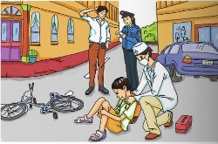
Look at the picture and say what is happening. Use the words and expressions in the box to help you.
accident driver happen mobile phone policewoman road

Slide 8

Listen and underline the correct words.
1. The driver was/was not going fast.
2. The driver was/was not looking.
3. The driver was/was not talking on his mobile phone.

Slide 9

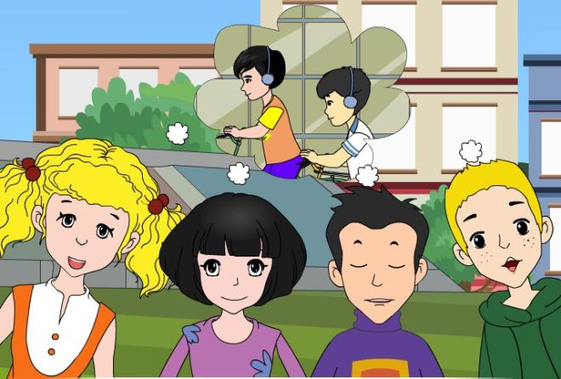
Listen and read.

Slide 10
Complete the following advice.
When you are riding a bike, think about the risk of an accident!
Pay ________ and stop at ____________.
Don’t ____ too fast.
Don’t ride __________ with your friends!
Don’t _____________.
attention
the red lights
ride
side by side
listen to music

Slide 11
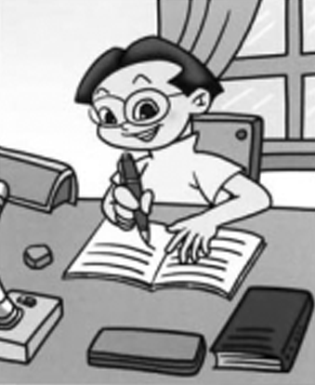
Complete the passage with the words in the box.
appear attention glad hit side
Accidents do not happen very often, I am (1) ____ to say.
glad

Slide 12
However, when you are riding your bike, pay (2) ________ all the time, especially on the corner of the road and at traffic lights. Do not ride side by (3) ____ with your friends. Sometimes cars (4) ______ round the corner and do not stop. They may (5) ___ you.
attention
side
appear
hit

Slide 13


Speaking

Slide 14

Pronunciation
在说英语时，如果想要清晰，流利地表达你的意思，运用好停顿是非常关键的。同时，在朗读英语时养成良好的停顿习惯，可以慢慢培养一种英语逻辑思维，从而更容易接受英语，掌握英语，并运用好英语。

Slide 15

Listen and mark when the speaker pauses.
1. While the lights were changing to red, a car suddenly appeared round the corner.
2. When I was waiting to cross the road, the accident happened.

Slide 16


Quiz
注: word 文档
点击此处链接
一、根据句意及首字母提示，写出相应的单词。
1. She suddenly noticed how p____ he looked.
2. Two faces a________ at our window.
pale
appeared

Slide 17
3. The driver was drunk and h___ three stationary(停着的) cars.
4. We were all g___ to hear you passed your exams.
5. Smoking can increase the r___ of developing heart disease.
hit
glad
risk

Slide 18
二、根据汉语提示完成下列句子，每空一词。
1. 她可以步行去，就在附近。
She could walk; it’s only _____ ___ ______.
2. 布莱恩通常会及时赶回家里给孩子们洗澡。
Brain usually gets home __ ____ to bath the children.
round the corner
in time

Slide 19
3. 门把手总是掉下来。
The door handle keeps _____ ____.
4. 当我不专心听讲时，老师很生气。
The teacher got angry with me when I didn’t ___ _________.
falling off
pay attention

Slide 20
5. 我已经说过对不起了，我还能做什么呢？
I’ve said I’m sorry. _____ ____ can I do?
6. 我们并肩沿着海滨走。
We walked along the beach, ____ __ ____.
What else
side by side

Slide 21
Homework
Read the passage again and review
the words and expressions.
2. 发挥想象，连词成文(50-70字)。
accident, appear, pale, hit, risk, attention, in time, fall off…, pay attention, side by side

Slide 22

Preview
1. To preview Unit 2;
2. To practise the new vocabulary.

