Slide 1
Module 8 Accidents
Unit 2
I was trying to pick it up when it bit me again.
第一PPT模板网-WWW.1PPT.COM

Slide 2
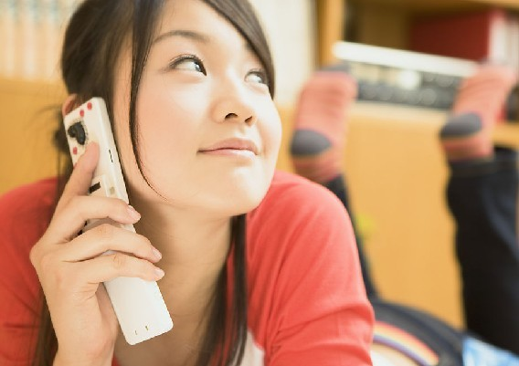
Lead-in
What was she doing?
She was using a mobile phone to call.

Slide 3
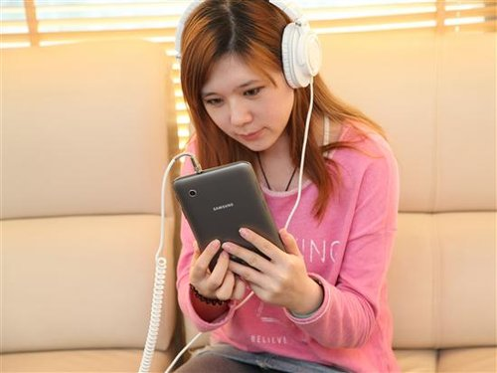
What was she doing?
She was using a mobile phone to listen to
music.

Slide 4
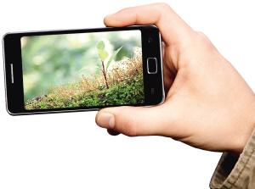
What was he doing?
He was using a mobile phone to take photos.

Slide 5
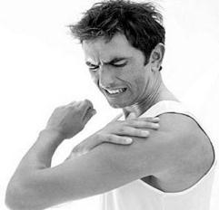
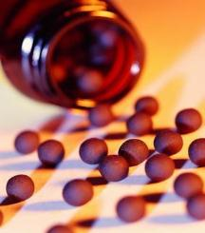
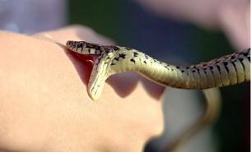
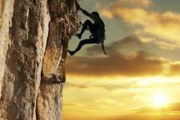
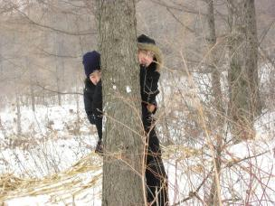
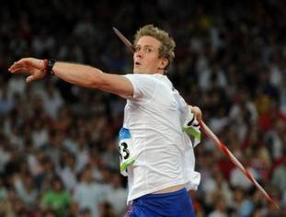
比一比，看谁能快速说出下面的单词。
pain
medicine
bite
climb
hide
throw

Slide 6
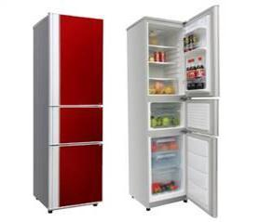
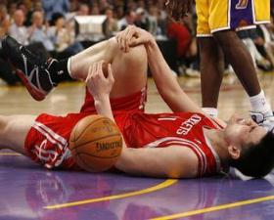
PPT模板：www.1ppt.com/moban/ PPT素材：www.1ppt.com/sucai/
PPT背景：www.1ppt.com/beijing/ PPT图表：www.1ppt.com/tubiao/
PPT下载：www.1ppt.com/xiazai/ PPT教程： www.1ppt.com/powerpoint/
资料下载：www.1ppt.com/ziliao/ 范文下载：www.1ppt.com/fanwen/
试卷下载：www.1ppt.com/shiti/ 教案下载：www.1ppt.com/jiaoan/
PPT论坛：www.1ppt.cn PPT课件：www.1ppt.com/kejian/
语文课件：www.1ppt.com/kejian/yuwen/ 数学课件：www.1ppt.com/kejian/shuxue/
英语课件：www.1ppt.com/kejian/yingyu/ 美术课件：www.1ppt.com/kejian/meishu/
科学课件：www.1ppt.com/kejian/kexue/ 物理课件：www.1ppt.com/kejian/wuli/
化学课件：www.1ppt.com/kejian/huaxue/ 生物课件：www.1ppt.com/kejian/shengwu/
地理课件：www.1ppt.com/kejian/dili/ 历史课件：www.1ppt.com/kejian/lishi/
fridge
hurt
Notes:
PPT模板：www.1ppt.com/moban/ PPT素材：www.1ppt.com/sucai/
PPT背景：www.1ppt.com/beijing/ PPT图表：www.1ppt.com/tubiao/
PPT下载：www.1ppt.com/xiazai/ PPT教程： www.1ppt.com/powerpoint/
资料下载：www.1ppt.com/ziliao/ 范文下载：www.1ppt.com/fanwen/
试卷下载：www.1ppt.com/shiti/ 教案下载：www.1ppt.com/jiaoan/
PPT论坛：www.1ppt.cn PPT课件：www.1ppt.com/kejian/
语文课件：www.1ppt.com/kejian/yuwen/ 数学课件：www.1ppt.com/kejian/shuxue/
英语课件：www.1ppt.com/kejian/yingyu/ 美术课件：www.1ppt.com/kejian/meishu/
科学课件：www.1ppt.com/kejian/kexue/ 物理课件：www.1ppt.com/kejian/wuli/
化学课件：www.1ppt.com/kejian/huaxue/ 生物课件：www.1ppt.com/kejian/shengwu/
地理课件：www.1ppt.com/kejian/dili/ 历史课件：www.1ppt.com/kejian/lishi/

Slide 7

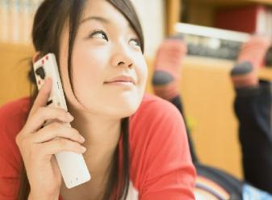
Work in pairs.
Talk about what you can do with a mobile phone.
I can use a mobile phone to call people/play music/take photos…

Slide 8
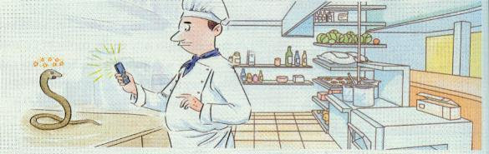
Look at the picture and
say what's happening.

Slide 9

Listen and answer the questions.
1. Where did the accident happened?
In a restaurant.
2. When did he leave hospital?
The next day.

Slide 10
Read the passage and answer the questions.
1. Where did the snake bite him?
2. When did Jackson pick up his mobile
phone?
3. Why couldn’t the doctor help him at
first?
The snake bit his hand.
While the snake was lying on the
table, he quickly picked up his mobile phone.
Because they didn’t know what kind of snake bit him.

Slide 11
Choose the correct answer.
1. The snake bit Mr Jackson again when
_______.
a) he was throwing it across the kitchen
b) he was trying to pick it up
c) it was climbing out of a box
b

Slide 12
2. When Henry was trying to find the
snake, _____.
a) he could take a photo
b) the snake became cool
c) his hand began to hurt badly
c

Slide 13
3. Henry hurried to hospital because
________.
a) his hand was hurting
b) he had a photo of the snake
c) the doctors called him on his
mobile phone
a

Slide 14
4. The doctors gave Henry the right
medicine after _______.
a) they knew what kind of snake bit
him
b) they saw the snake in the photo
c) he left hospital the next day
a

Slide 15
Complete the passage with the correct form of the words in the box.
climb hide hurt medicine pain throw
climbed
A snake (1) _______ out of a box of bananas and (2) ____ somewhere. When Henry was working, the snake bit him. He (3) _______ the snake on a table and took its photo. When he was trying to find the snake, his hand began to (4) ______ badly.
hid
threw
hurt

Slide 16
climb hide hurt medicine pain throw
At the hospital the (5) ______ got worse. The doctors sent the photo to a zoo. After they found out what kind of snake bit him, they gave him the right (6) _________.
pain
medicine

Slide 17
Language points
1. It climbed out and hid somewhere.
climb out 表示“爬出来”。
climb out of …表示“从…爬出来”。
e.g. The cat couldn’t climb out of the
hole.
那只猫没法从洞里 爬出来。

Slide 18
2. I was trying to pick it up when it bit me again.
be doing …when …表示一个动作正在进行的时候另一个动作突然发生了。
此句强调“蛇又咬了我一口”这个动作。
e.g. They were working in the fields
when it began to rain. 他们正在田
里干活儿，突然下起雨了。

Slide 19
pick sth. up表示“捡起某物”，代词要放在中间。
pick sb. up 表示“接某人”。
e.g. He picked up his knife and fork. 他捡起了刀叉。
The next morning, my mum came to
pick me up. 第二天早上, 妈妈来接我。

Slide 20
3. I threw it across the kitchen, and it
landed on a table.
across是介词，在本句的意思是“从……的一边到另一边”， across还可以表示“对面，穿过”等。
e.g. The children ran across the street in
front of our car. 这些孩子在我们的
汽车前横冲过马路。
My best friend lives across the road.
我最好的朋友住在马路对面。

Slide 21
4. While the snake was lying on the table, Henry quickly picked up his mobile phone and took a photo with it.
while引导的时间状语从句用进行时。
当主句的时态是现在时，while引导的从句用现在进行时; 当主句的时态是过去时，while引导的从句用过去进行时。
e.g. While the boy was reading the book
he found a secret. 男孩读书的时
侯，他发现了一个秘密。

Slide 22
5. As the doctors were checking him, the pain get worse.
句中的as表示当…的时候，用来引导时间状语从句。
get worse表示“变得更糟”。
worse是bad的比较级，worst是最高级。
e.g. As time goes by, my memory seems
to get worse. 随着时间的流逝，我
的记忆力似乎越来越差。

Slide 23
6. As he was lying there in great pain, …
in pain表示“疼痛”
in great pain表示“极其疼痛”

Slide 24
Learning to learn
When you write, make sure you use the correct tense. Underline the time and the verb, and check if they agree.
For example:
I was having breakfast at seven o’clock yesterday morning.
I took a photo in the park yesterday.

Slide 25
本课小结
While, when, as引导的时间状语从句。
重点短语:
bite one’s hand pick up
get worse in great pain
give sb. the right medicine

Slide 26
练一练
1. The girl ____ a kite when I was riding a bike in the ground.
A. flying B. was flying C. is flying
2. The car came out suddenly ____ I was walking.
A. so B. while C. but
B
B

Slide 27
3. The children ran _____ the street to catch the early bus.
A. across B. cross C. through
4. The policeman was hurt in _____, so he was sent to hospital at once.
A. pain B. medicine C. plate
A
A

Slide 28
中考链接
1. —What were you doing this time
yesterday?
—I ____ on the grass and drawing a
picture. 【2011北京】
A. sit B. sat
C. am sitting D. was sitting
D

Slide 29
2. While I _____ TV, the bell rang. 【2011广西北海】
A. watch B. watched
C. am watching D. was watching
3. —Why didn’t you answer my
telephone yesterday?
—Sorry. I ____ a bath. 【2011山东
淄博】
A. took B. take
C. am taking D. was taking
D
D

Slide 30
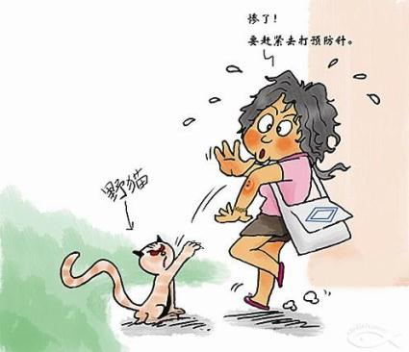
Homework
Write a passage to tell about your experience when you were in danger.

Slide 31
Useful expressions for you:
One day…
A few days earlier…
…when …
While …
When…was…
As …
As soon as…

