Slide 1
Module 9 Population
Unit 2 Arnwick was a city with 200,000 people

Slide 2
学习目标：
1.掌握本课单词和短语：
flat rubbish local …
2.灵活运用下列句型：
a. IT is very crowded.
b. It also needs more buses…
3.学会从文章中提取信息，谈论城市问题。
4.学会针对问题提出合理化建议。。

Slide 3
100 1000 1,000,000 1,000,000,000 1,370,000,000 200,000
我会读，我真棒！
one hundred
one thousand
one million
one billion
one billion three hundred and seventy million
two hundred thousand

Slide 4
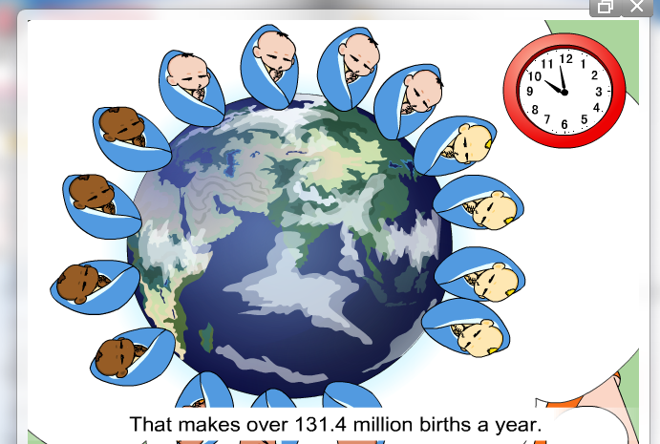
Warming up !
The increasing population

Slide 5

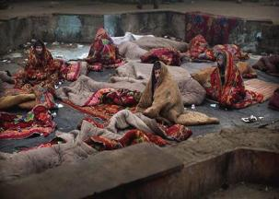
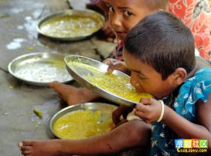
Population problems
Food shortage(短缺)
Flats shortage
Water shortage
Pollution
PPT模板：www.1ppt.com/moban/ PPT素材：www.1ppt.com/sucai/
PPT背景：www.1ppt.com/beijing/ PPT图表：www.1ppt.com/tubiao/
PPT下载：www.1ppt.com/xiazai/ PPT教程： www.1ppt.com/powerpoint/
资料下载：www.1ppt.com/ziliao/ 范文下载：www.1ppt.com/fanwen/
试卷下载：www.1ppt.com/shiti/ 教案下载：www.1ppt.com/jiaoan/
PPT论坛：www.1ppt.cn PPT课件：www.1ppt.com/kejian/
语文课件：www.1ppt.com/kejian/yuwen/ 数学课件：www.1ppt.com/kejian/shuxue/
英语课件：www.1ppt.com/kejian/yingyu/ 美术课件：www.1ppt.com/kejian/meishu/
科学课件：www.1ppt.com/kejian/kexue/ 物理课件：www.1ppt.com/kejian/wuli/
化学课件：www.1ppt.com/kejian/huaxue/ 生物课件：www.1ppt.com/kejian/shengwu/
地理课件：www.1ppt.com/kejian/dili/ 历史课件：www.1ppt.com/kejian/lishi/
Notes:
PPT模板：www.1ppt.com/moban/ PPT素材：www.1ppt.com/sucai/
PPT背景：www.1ppt.com/beijing/ PPT图表：www.1ppt.com/tubiao/
PPT下载：www.1ppt.com/xiazai/ PPT教程： www.1ppt.com/powerpoint/
资料下载：www.1ppt.com/ziliao/ 范文下载：www.1ppt.com/fanwen/
试卷下载：www.1ppt.com/shiti/ 教案下载：www.1ppt.com/jiaoan/
PPT论坛：www.1ppt.cn PPT课件：www.1ppt.com/kejian/
语文课件：www.1ppt.com/kejian/yuwen/ 数学课件：www.1ppt.com/kejian/shuxue/
英语课件：www.1ppt.com/kejian/yingyu/ 美术课件：www.1ppt.com/kejian/meishu/
科学课件：www.1ppt.com/kejian/kexue/ 物理课件：www.1ppt.com/kejian/wuli/
化学课件：www.1ppt.com/kejian/huaxue/ 生物课件：www.1ppt.com/kejian/shengwu/
地理课件：www.1ppt.com/kejian/dili/ 历史课件：www.1ppt.com/kejian/lishi/

Slide 6
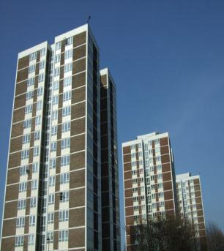
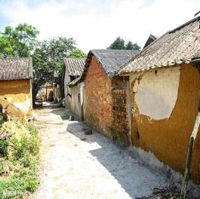
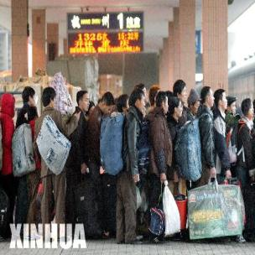
Why do they move to cities ?
Many people move to cities to find jobs .
Then what do they need ?

Slide 7


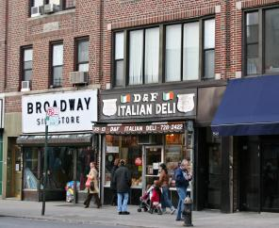
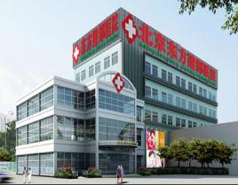

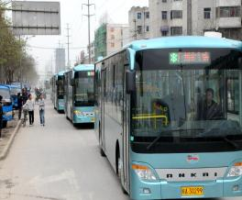
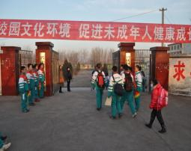
hospitals
shops
flats(套房）
They need more …
buses
schools
policemen

Slide 8
看图学单词。

Slide 9
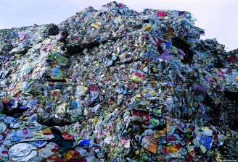
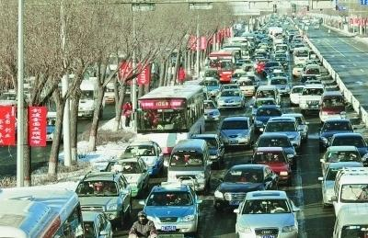
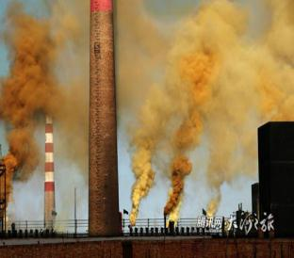

Let’s learn these words?
flat
rubbish
pollution
solve
too much traffic

Slide 10


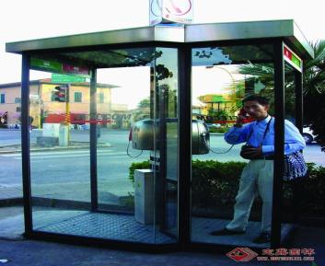

pupil
quiet
public
service
phone

Slide 11
你学会了吗？
flat
quiet
rubbish
close down
local
pupil
Pollution
public
service
solve
n. 套房；公寓
adj. 寂静的，安静的
n. 垃圾，废弃物
（永久） 关闭，关停
adj. 本地的
n. 学生，小学生
n. 污染
adj. 公共的；公众的
n. 公共服务；服务
v. 解决问题

Slide 12

Listen and answer the questions.
1. Was Parkvill a city or a viallage years ago?
It was a village.
2. What is the population of Arnwick first ?
It has a population of 200,000 .

Slide 13
Fast reading!
Read the passage and match the headings with the paragraphs
Para 1
Para2
Para 3
Para 4
Para5
a) Arnwick has too many pupils, too
much traffic and pollution.
b) Arnwick needs more things.
c) Arnwick is a delegate of cities, it
describes what is happening in the world .
e) Parkvill was a small village.

Slide 14
Read quickly and answer the questions.
1.Why do people move to Arnwick?
2. What dose Arnwick need now ?
They moved to Arnwick to find jobs.
It needs more schools ,buses ,hospitals,fresh air , clean water and better public services.
It also needs more police

Slide 15
Careful reading
Then check the true sentences.
√
1. Parkville was a quiet village.
2. Arnwick was a city with 20,000 people.
3. Arnwick now has a population of more
than one million.
4. The local school in Parkville has 2,000
pupils.
5. Big cities need more money for public
services.
×
√
×
√

Slide 16
Air pollution
Water pollution
Too much rubbish
1.Need more schools and buses；
2.Need better public services
3.Need more police to protect its people
not
enough hospitals
Environmental problems(环境问题)
Problems for the goverment
（政府困难）
Health problems
（健康问题）
城市人口增长问题
Do you have good suggestions?

Slide 17
Language points
It is very crowded.
crowded为形容词，
它的动词形式为crowd。crowd round 的意思是“围观”

Slide 18
2. It’s clear that Arnwick needs more schools, buses and hospitals.
It’s clear that … 表示“很清楚…...”。
e.g. It’s clear that building the new schools needs much money.
很明显,建造那座新学校需要很多钱。

Slide 19
3. The small local school in Parkville closed down five years ago.
close down 表示“（永久性地）停工，关闭”。
此处 close为动词。
e.g. The company closed down last year.
去年那家公司关闭.
4..They had a small house ,close to fields and hills.
close to 意为“靠近”,此处close为形容词。
e.g. The school is close to a hospital

Slide 20
5 There is a lot of traffic and pollution.
pollution n. 污染
pollute v. 污染
e.g. Noise pollution is more serious in the
city.
噪音污染是城市中更为严重的问
题。

Slide 21
用所给词的适当形式填空：
Exercises
1. There is much traffic and ______ (pollute)
in the city.
2.The room is ______ (crowd).
3.The factory ______(close) down last week.
4.The cinema is _____(close) to my home.
5.It takes an hour______(do) my homework every day.
6.Can money help solve all these ______ (problem)?
pollution
crowded
closed
close
to do
problems

Slide 22
Exercises
Complete the passage with the correct form of the words in the box.
flat local pollution rubbish service thousand
Many towns and cities have the same problems as
Arnwick. People need places to live, so the(1)_____
government has to build more (2)______. People need
better bus and train(3)_______.They also produce
more(4)_________, so the government has to make
more efforts to protect the city against (5)_________. As
we say, a hundred people make a (6)________ problems！
local
flats
services
rubbish
pollution
thousand

Slide 23


Writing

Slide 24
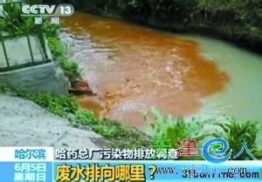
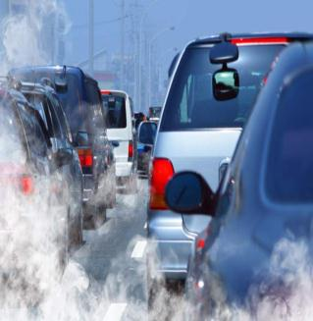

Write down your suggestions to solve the problems in your home town.
These words can help you:
Let’s… ; Don’t… ; We should…;
stop …from …; pour (倾倒） ; throw about …(乱扔）…
ride a bike to work …

Slide 25
Summary
巩固英语大数字的表达法。
会概括段落大意，会从文章中提取信息。
谈论城市问题, 会提建议。。
掌握重点短语：
move to some day
close to in fact
close down public services
be crowded protect…against/ from
…

Slide 26

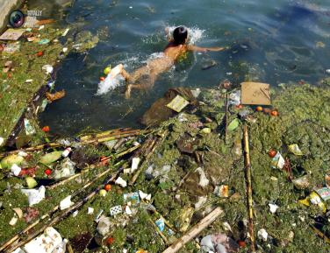

Write a passage to tell about the problems of your hometown.

Slide 27
Thank you.

