Slide 1
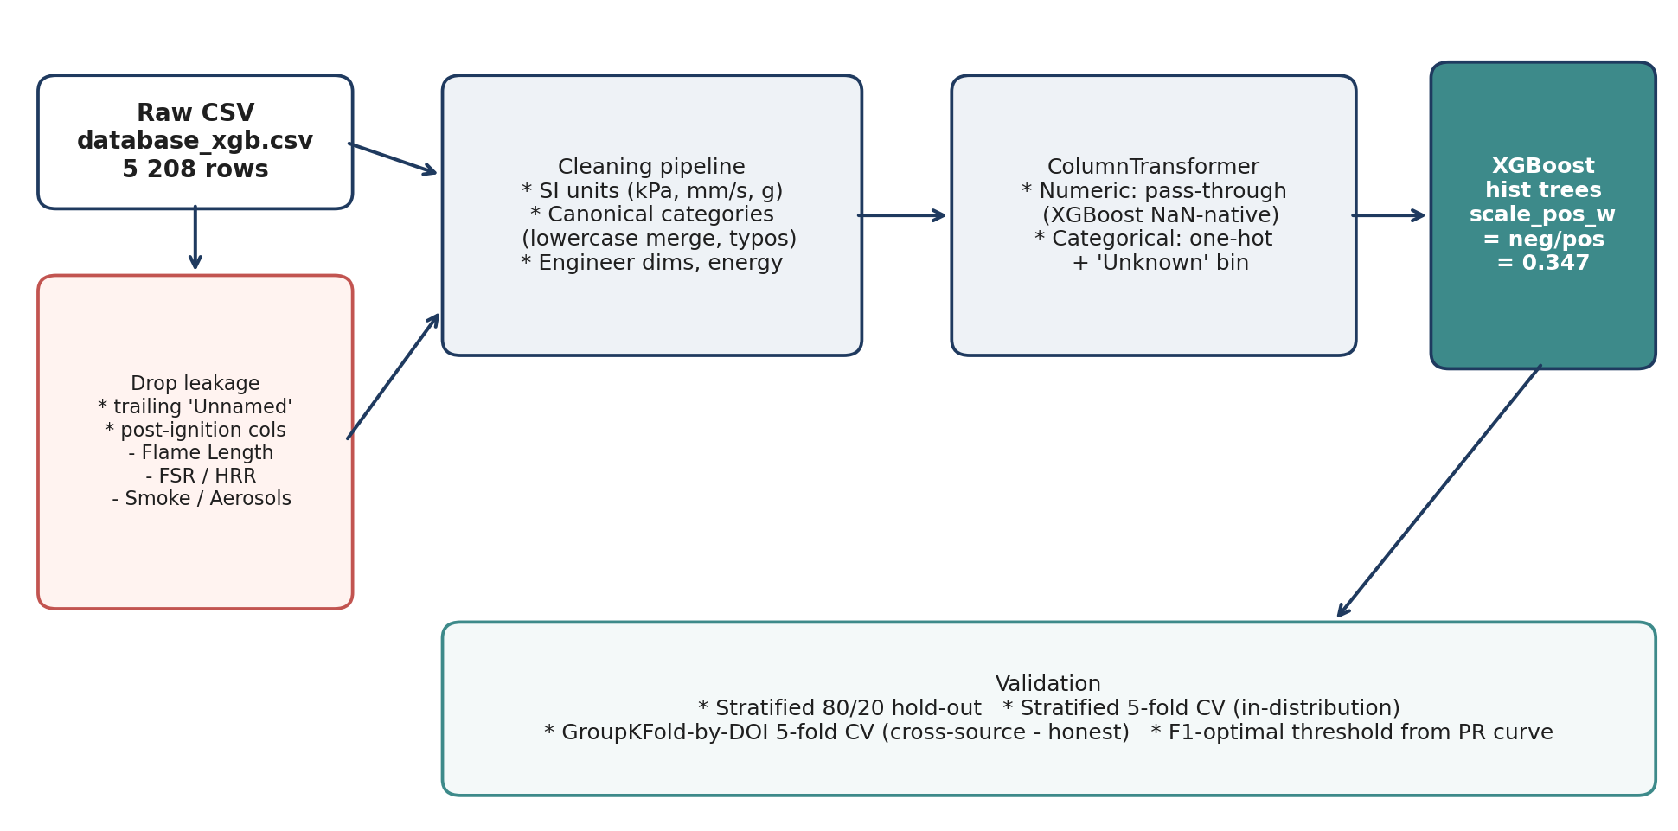
Model architecture and design choices
Why XGBoost on a literature-aggregated combustion database
Justifications
* Tabular + non-linear interactions (O2, pressure,
gravity, flow, material) -> gradient-boosted trees
dominate this regime.
* Native NaN handling lets predictors that are
physically inapplicable (e.g. core_diameter on a flat
sample) be 'missing' = information, not noise.
* Tree splits are scale-invariant -> we only need
consistent units across rows, no log / standardise.
* L1/L2 + row/col subsampling + scale_pos_weight
= neg/pos = 0.347 controls overfitting on ~4.5k rows
while focusing gradient on the minority no-ignition
class (24 % of data).
* Post-ignition columns (Flame Length, FSR, HRR,
Smoke) dropped -> no target leakage.
* DOI kept as a grouping key so we can validate on
unseen experimental campaigns, not just unseen rows.
* Cleaning collapses unit / case / typo variants:
'21%' = '0.21', 'Flat' = 'flat',
'Open Flame' = 'open flame'.
XGBoost ignition classifier - database_xgb.csv (4 449 clean rows)
1 / 6

Slide 2
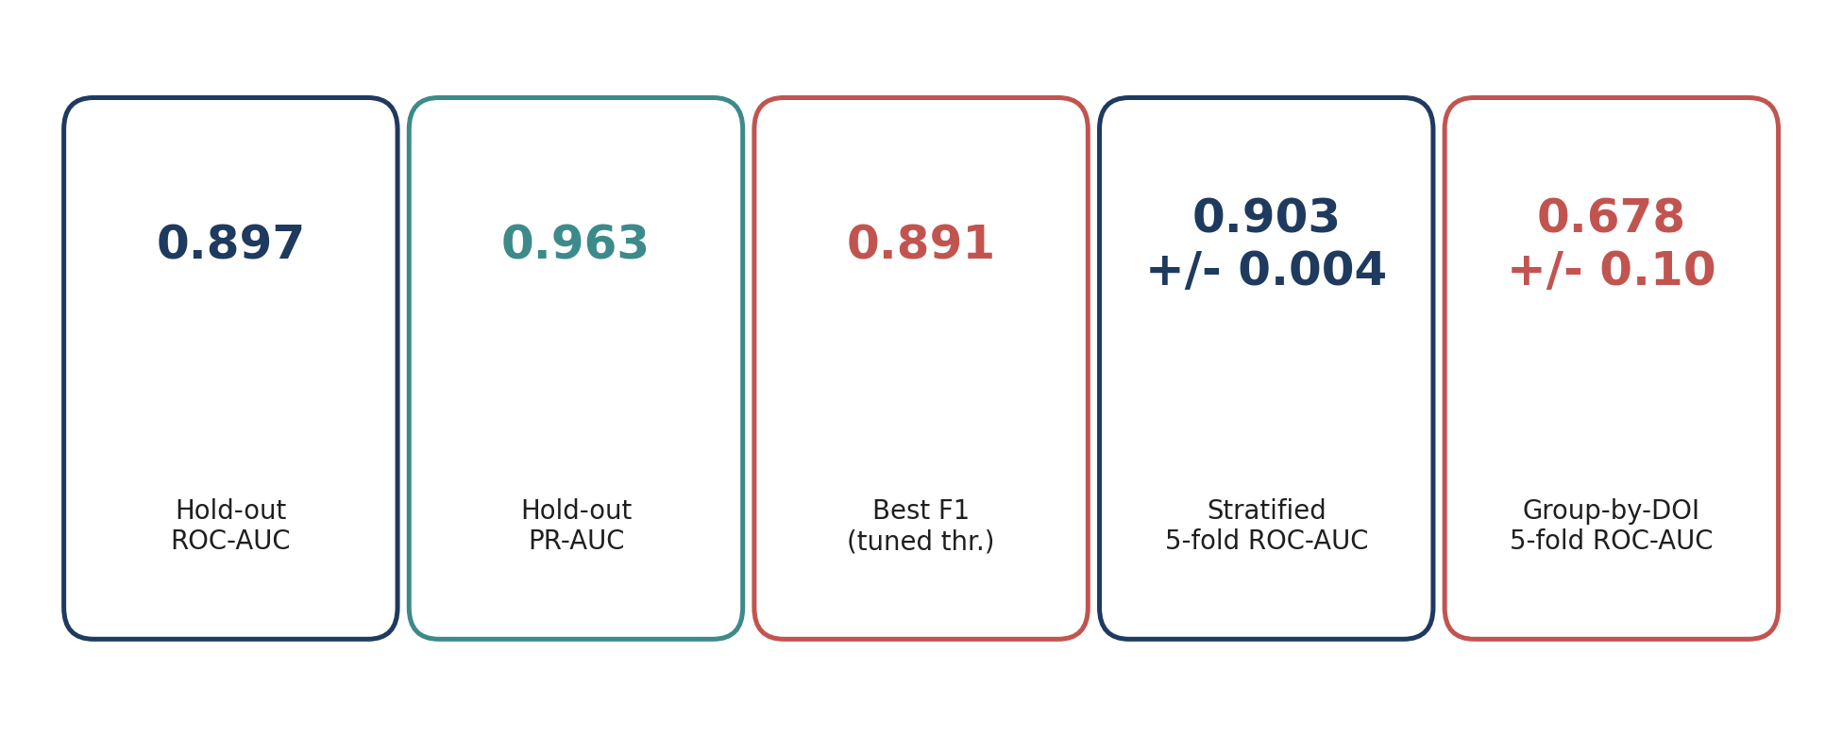
Headline performance
80/20 stratified hold-out + 5-fold cross-validation
Reading the numbers
* ROC-AUC = 0.90 on a stratified hold-out -> for ~9 out of 10 randomly chosen (ignition, no-ignition) pairs the model
scores the igniting case higher. Stratified 5-fold CV confirms it (0.903 +/- 0.004), so the hold-out result is not lucky.
* PR-AUC = 0.96 is the more honest figure under our 74/26 class imbalance: even when we slide along the precision/recall
curve, average precision stays near-perfect because true ignitions are densely concentrated at high model scores.
* Default-threshold F1 = 0.87 jumps to 0.89 once we move the decision boundary from 0.5 to 0.25, which is exactly what
we expect after down-weighting the majority class (scale_pos_weight = 0.347 deflates positive scores).
* Over v1 (database.csv) every metric improves and the stratified-CV std halves, consistent with ~60 % more clean rows.
XGBoost ignition classifier - database_xgb.csv (4 449 clean rows)
2 / 6

Slide 3
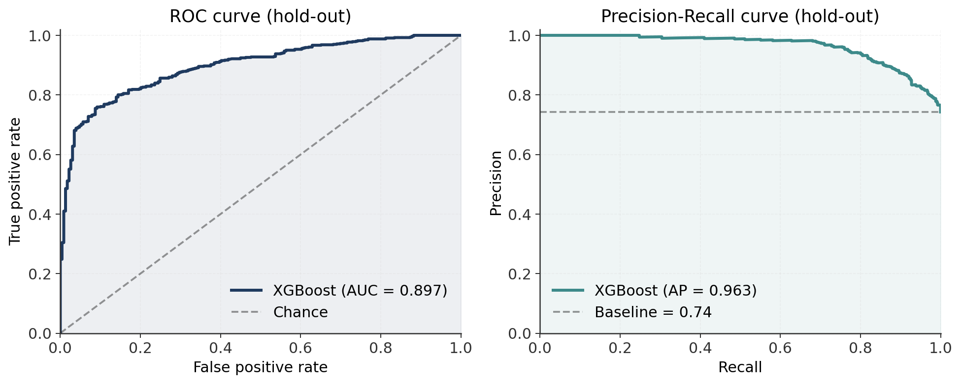
Ranking quality: ROC and Precision-Recall curves
How discriminative is the predicted probability?
Interpretation
ROC curve
* Hugs the top-left corner: at 80 % recall
on ignition the false-positive rate on
no-ignition stays under ~20 %.
* The curve is symmetric: the model is
equally good at ranking ignitions up and
no-ignitions down - no class is being
ignored.
PR curve
* Average precision = 0.96, well above the
baseline 0.74 (positive prevalence).
* Precision stays >= 0.90 up to recall ~0.90,
which is the operating regime we care
about: avoid false 'ignites' in safety-
critical screening.
* The PR view is the right one here because
ROC-AUC over-rewards rejecting easy
negatives when the positive class is the
majority - PR is the realistic metric.
XGBoost ignition classifier - database_xgb.csv (4 449 clean rows)
3 / 6

Slide 4
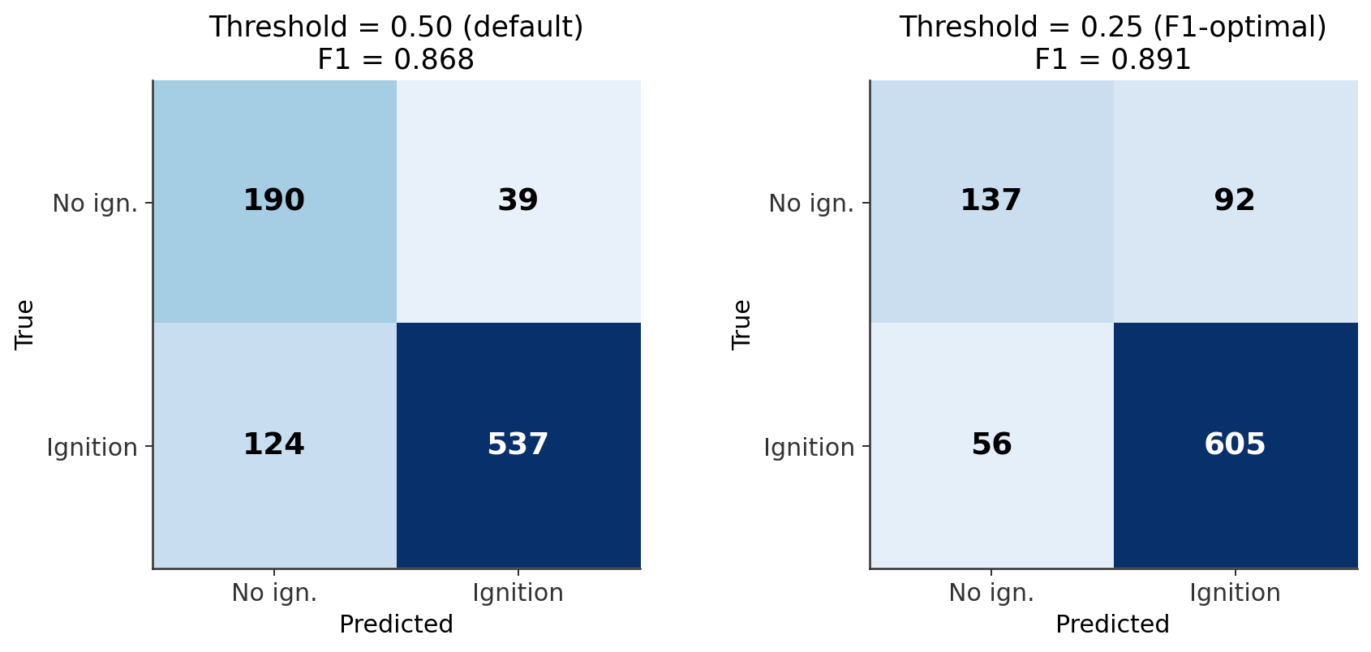
Operating point: confusion matrices and threshold tuning
Default 0.5 vs F1-optimal 0.25 -- precision/recall trade-off
Why two thresholds?
Threshold 0.50 (default)
* Recall on no-ignition = 0.83 (190/229),
recall on ignition = 0.81 (537/661).
* Accuracy 82 %, F1 = 0.87.
* Bias caused by scale_pos_weight: the
model deflates positive scores, so 0.5 is
too conservative for the majority class.
Threshold 0.25 (F1-optimal)
* Ignition recall jumps to 0.92 (605/661);
no-ignition recall drops to 0.60 (137/229).
* Best F1 = 0.89, accuracy 83 %.
Pick the threshold to your cost:
* Safety screening: keep a low threshold ->
high ignition recall, accept some false
positives.
* Material-down-selection: raise the
threshold to maximise precision on the
'no-ignition' (safe) class.
XGBoost ignition classifier - database_xgb.csv (4 449 clean rows)
4 / 6

Slide 5
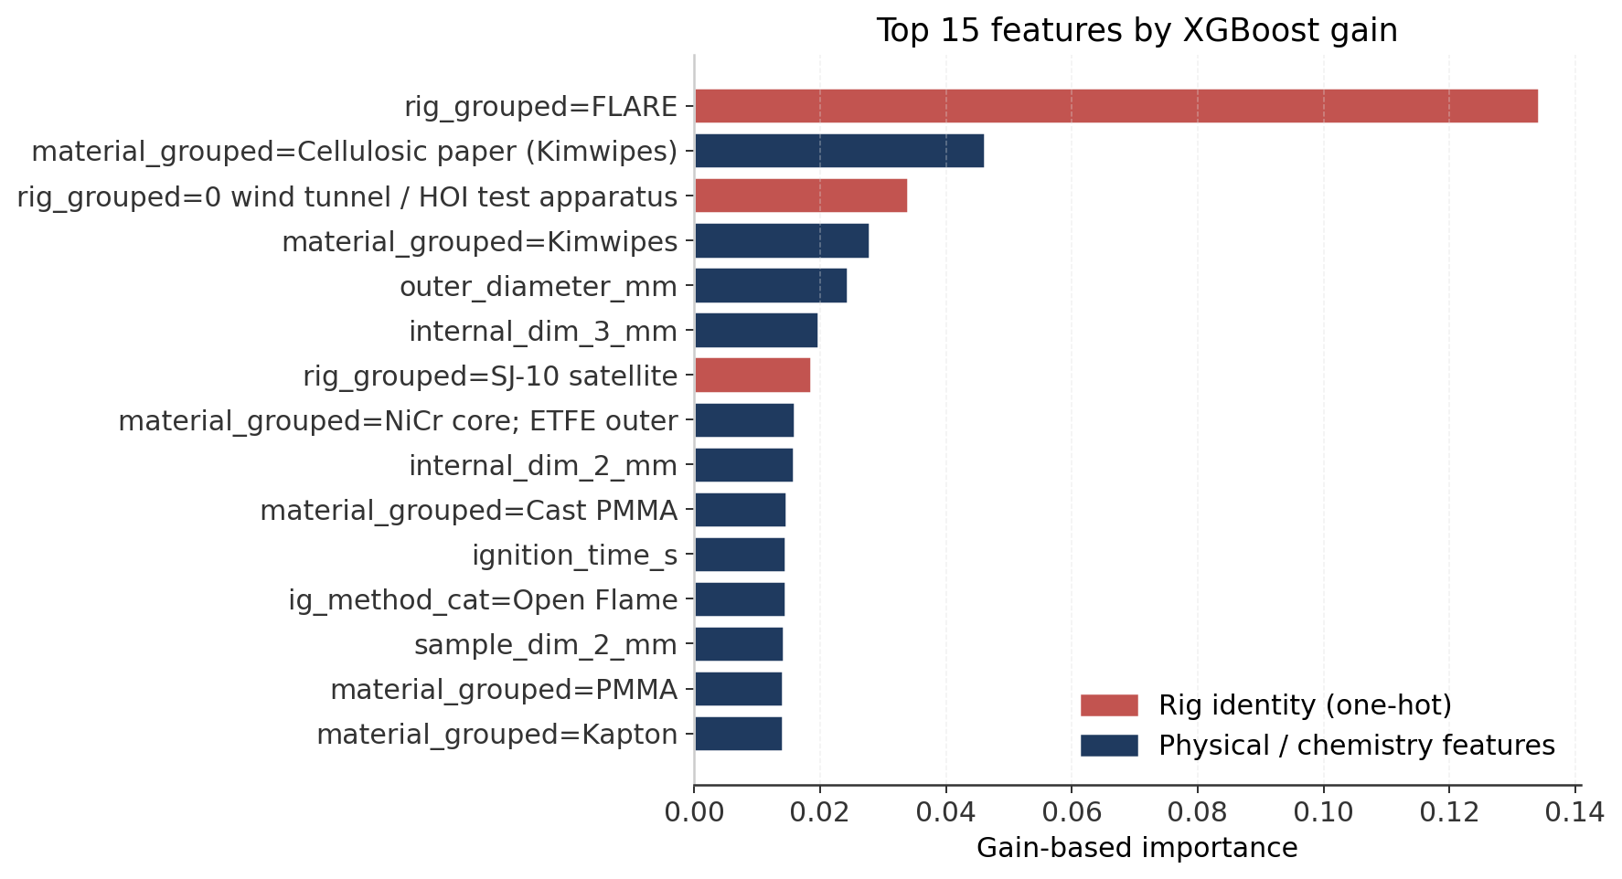
Feature importance: physics vs memorisation
Gain-based importances on the one-hot expanded feature space
What the model is using
Rig identity dominates (red bars)
* FLARE, GIFFTS, HOI test apparatus, SJ-10
satellite, NASA Glenn ZGF together
account for ~25 % of total gain.
* This is partly real (each rig has its own
flow / radiative environment) and partly
memorisation of campaign-specific
conditions -> see slide 6.
Physical drivers (blue bars)
* Material family: Kimwipes (cellulosic),
PMMA, PDMS, Kapton, NiCr/ETFE wire
composites - matches combustion intuition.
* Geometry = Flat is a strong split (flat
samples behave differently than wires).
* outer_diameter_mm, sample_dim_mean_mm,
ignition_time_s - all are first-order
ignition-energy proxies.
* flow_direction = Quiescent captures the
no-flow micro-g regime where opposed-
flow ignition rules don't apply.
XGBoost ignition classifier - database_xgb.csv (4 449 clean rows)
5 / 6

Slide 6
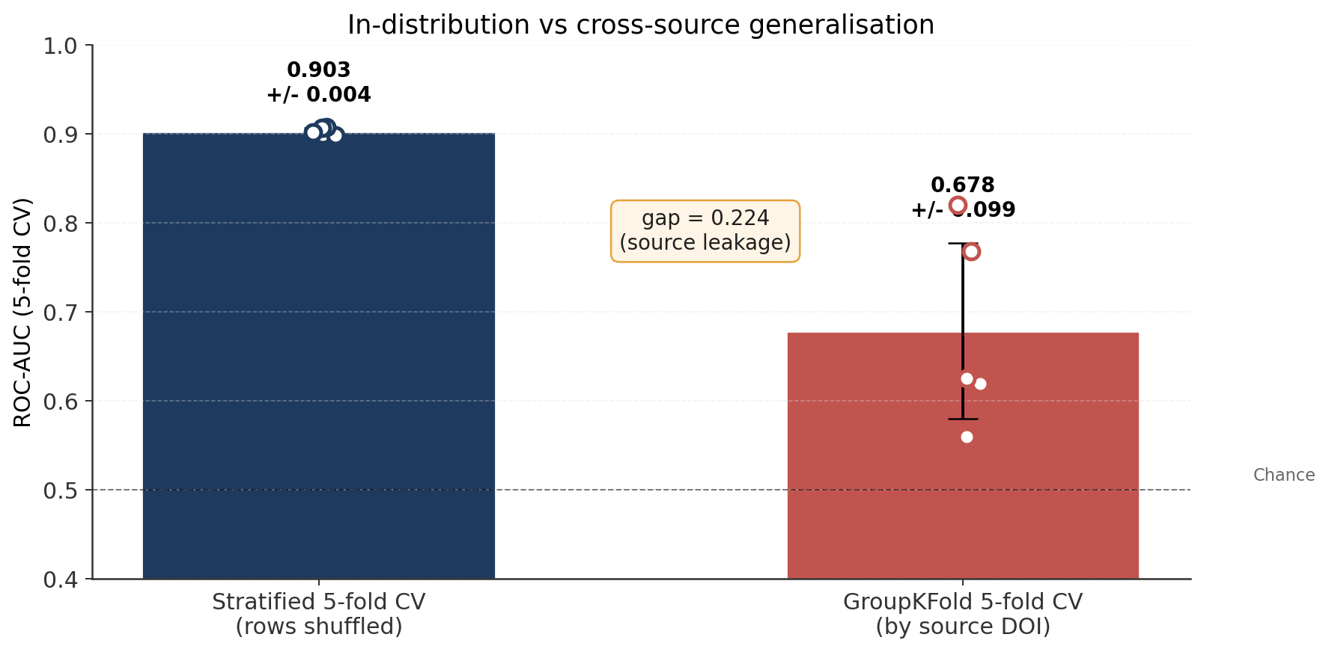
The honest generalisation gap
Random folds (0.90) vs Group-by-DOI folds (0.68)
Why the gap matters
Gap = 0.22 ROC-AUC
* Stratified random CV mixes rows from the
same paper across train and test folds.
XGBoost can latch onto rig-specific
fingerprints (rare flow speeds, fixed
ignition powers, characteristic material
cocktails) and 'memorise' them.
* GroupKFold holds out entire papers/DOIs:
this rig-fingerprint shortcut disappears,
exposing how much true physics the model
learnt.
What to quote
* For a NEW row from a KNOWN rig: 0.90
ROC-AUC is realistic.
* For a NEW rig / NEW campaign: 0.68 +/-
0.10 ROC-AUC is the honest expectation.
Paths to close the gap
* Collect more diverse sources (more rigs).
* Per-rig calibration / mixed-effects layer.
* Domain-adversarial training to make
representations rig-invariant.
XGBoost ignition classifier - database_xgb.csv (4 449 clean rows)
6 / 6

