Slide 1


Welcome to Juzt Play
Welcome to E-sports Community
juZt Play
Welcome to E-Sports Community

Slide 2
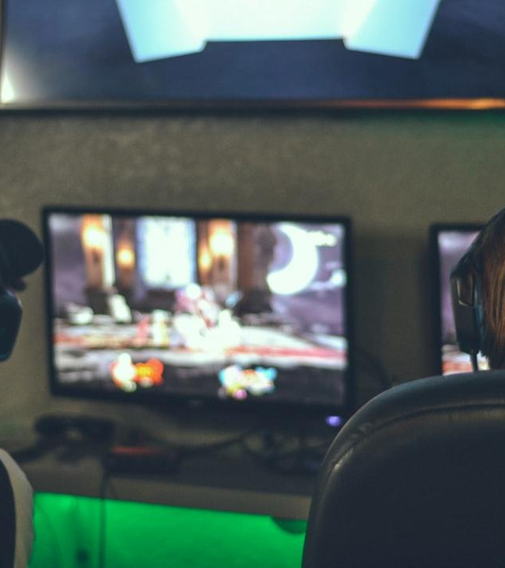
About juZt Play
Organization that provides gaming platform and gamers community for scrims .
juZtplay is independent live scrims platform made specifically for the passionate gaming community. Now you can play your favorite games all at one place weather it is a mobile games or pc or on Xbox , etc. . On juZtplay app , you can play best upcoming and top games live in Lan games and scrims . You can follow, support, and engage with us
Photo: selective focus photography of two persons playing game in front of monitors
Photo by Alex Haney
Powered by Unsplash

Slide 3
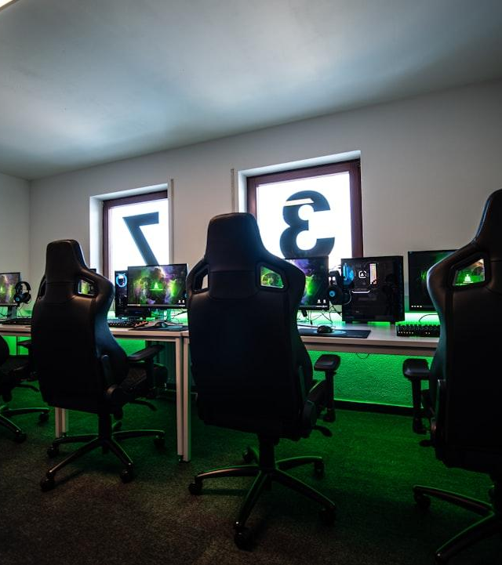
Team Members
Ayush Pant | Group Leader | 21EARCS031 | CS-A
Sushant Natani | Team Member | 21EARAD109 | AIDS
Aman Mehta | Team Member | 21EARCS012 | CS-A
Harshit Agarwal | Team Member | 21EARCS059 | CS-A
Photo: black office rolling chair near black flat screen computer monitor
Photo by ELLA DON
Powered by Unsplash

Slide 4
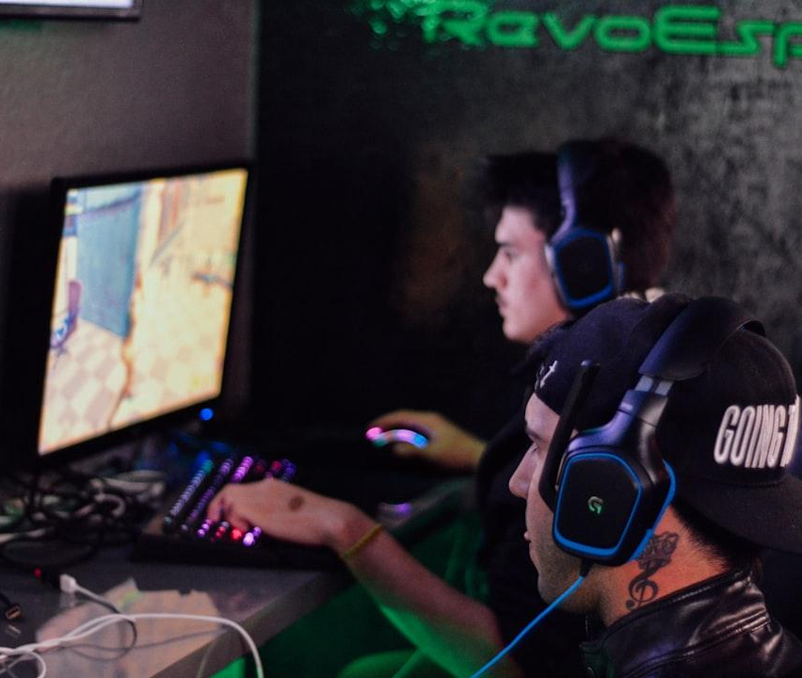
PROBLEM STATEMENT
For better future of Gamers and gaming community , we provide a gaming community with platform where all the gamers showcase their talent and make community energetic source for income and fulfill their dream to be upcoming esport player , Caster , Game Developer, Coach , etc.
Photo: two men playing PC games
Photo by Alex Haney
Powered by Unsplash

Slide 5
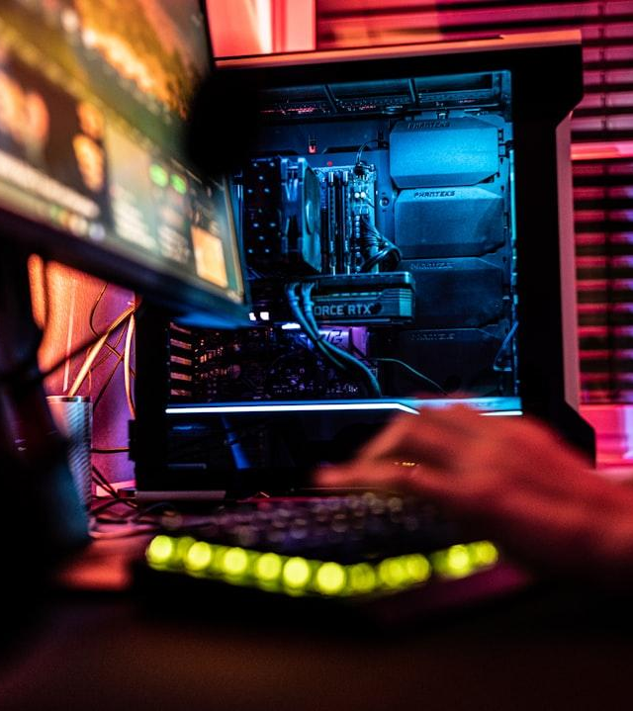
Project Development Roadmap
In this year we are about to create the platforms where we provide resources and data to the gamers.
PROGRESS TILL NOW
We have created platform via discord where we build our gaming community to more than 50+ members and in upcoming months we reach more 100+ members after starting screams to bring enthusiasm among gamers and we have created the Design of our Website.
Photo: a person sitting in front of a computer monitor
Photo by ELLA DON
Powered by Unsplash

Slide 6

Target users of different applications
Gaming industry is resounding through YouTube, loco, rooter, twitch, and discord. juZtPlay combines all their games and management in a single solution through a portal.
Gaming challenges organizers.
School and college students.
Co-orporate professionals.
Video game streamers.
Gaming content viewers and creator
Photo: people sitting on red chair watching tv
Photo by Emanuel Ekström
Powered by Unsplash

Slide 7
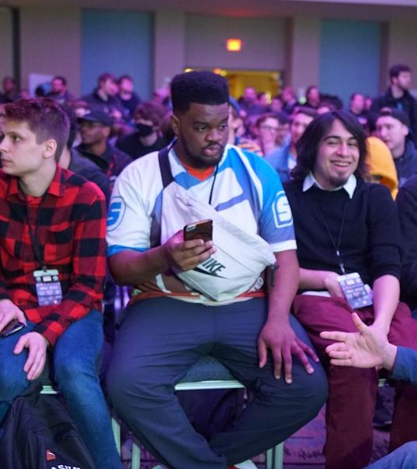
Future of JuZtPlay
juZtPlay can bring live scores and stats of players, better opportunity to collaborate with creators and gamers, and live game broadcasting can be introduced.
Website (in 2 months max.)
Screams(after reaching community of 100+ members )
E-Sports Org. Soon (roughly planned).
Photo: people sitting on chairs inside building
Photo by Stem List
Powered by Unsplash

Slide 8
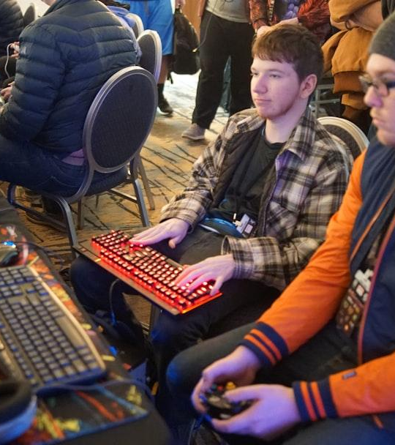
FINANCIAL ASSESSMENT
Item Wise Amount of Expenditure : According to our project we are starting our community on the basis of screams and tournaments which doesn’t require high amount , so for a start up for our project we claim 5-10 thousand (per month for tournament price money ) which further can be 100% minimal amount as we gain from tournament or scream fees .
Photo: man using video game control pad beside man using computer keyboard sitting and playing video games
Photo by Stem List
Powered by Unsplash

Slide 9
REVENUE FORCAST

Slide 10
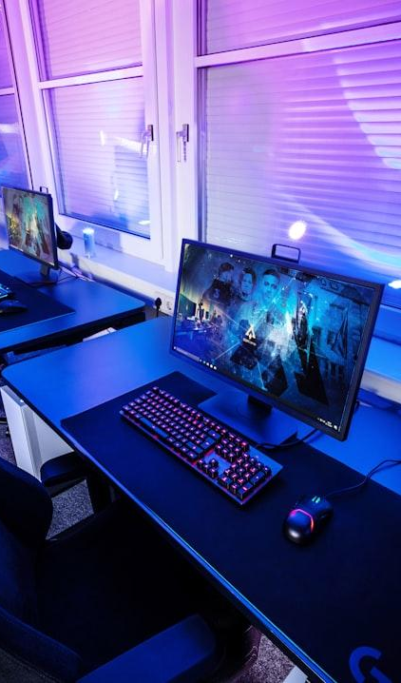
Join the juZt Play Revolution!
Be part of the fastest-growing esports platform.
Ayush Pant pantayush92@gmail.com
Sushant Natani sushantnatani007@gmail.com
Aman Mehta itsamanmehta2524@gmail.com
Photo: a computer desk with a monitor and keyboard on it
Photo by ELLA DON
Powered by Unsplash

