Slide 1
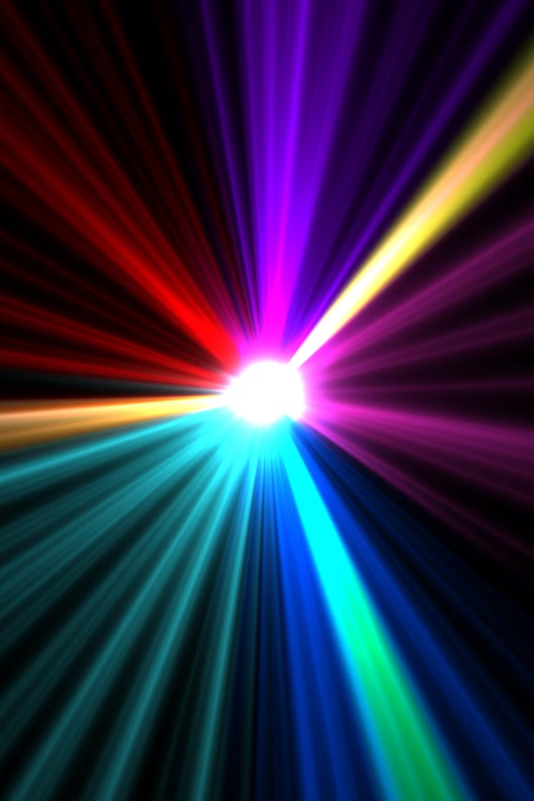
Introduction to Laser Technology
Lasers are powerful devices that emit highly focused, coherent beams of light. They have revolutionized numerous industries and applications, from communication to medical treatments. This presentation will explore the fundamentals of laser operation and its diverse real-world uses.

Slide 2
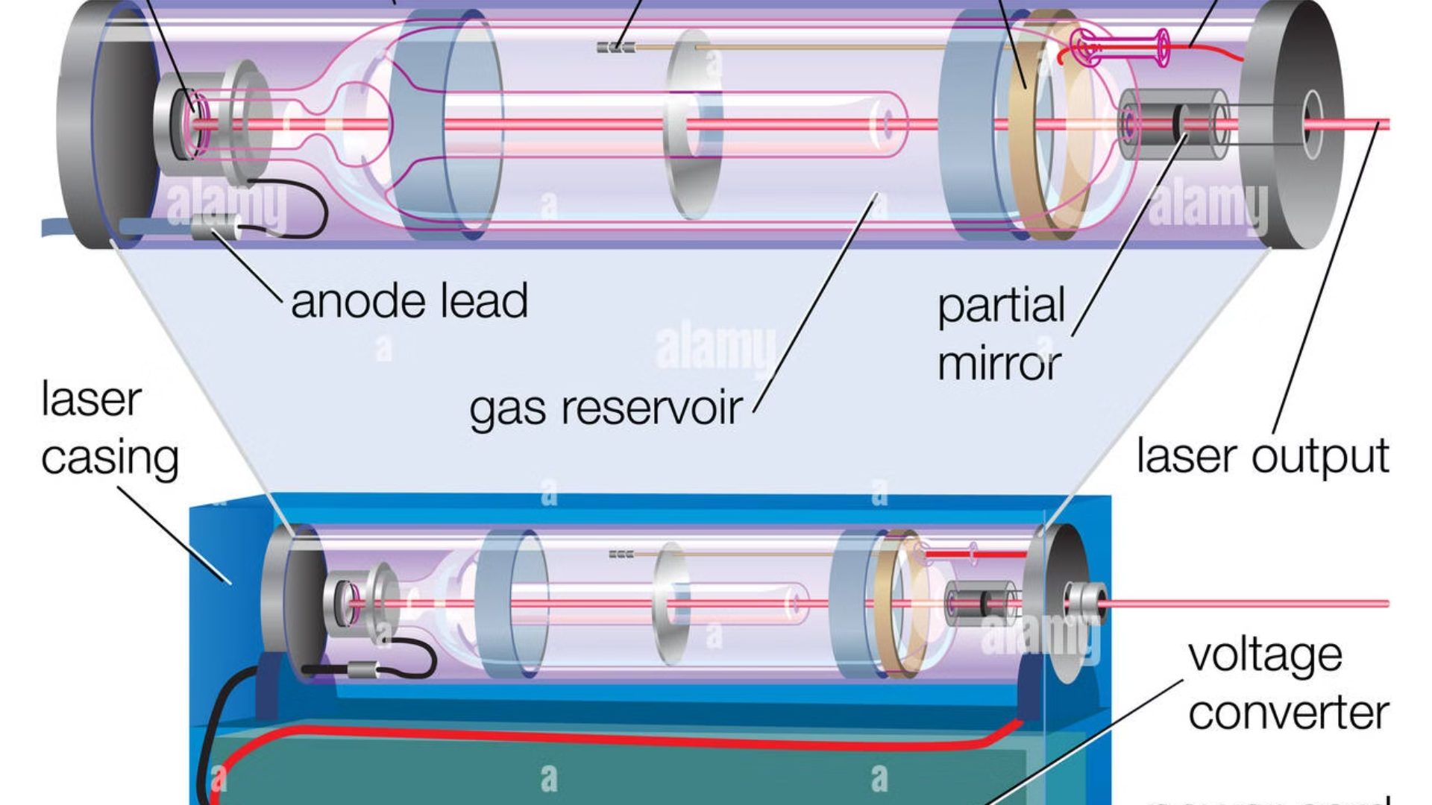
Fundamentals of Laser Operation
Stimulated Emission
Optical Resonator
Lasers work by stimulating the emission of photons from energized atoms, creating a highly focused, monochromatic beam of light.
The optical resonator, consisting of mirrors, helps to sustain and amplify the laser beam by reflecting the light back and forth.
1
2
3
Population Inversion
Lasers require a population inversion, where more atoms are in an excited state than in the ground state, to amplify the light signal.

Slide 3
Types of Lasers and Their Characteristics
Gas Lasers
Solid-State Lasers
Semiconductor Lasers
Gas lasers, such as helium-neon and carbon dioxide lasers, are known for their high efficiency and reliability.
Solid-state lasers, including ruby and neodymium-doped lasers, offer high power and versatility in various applications.
Semiconductor lasers, or diode lasers, are compact, cost-effective, and widely used in consumer electronics and telecommunications.

Slide 4
Laser Beam Properties and Manipulation
1
Collimation
2
Monochromaticity
Lasers produce highly collimated beams, meaning the light waves travel in parallel, enabling long-distance applications.
Lasers emit light at a single, specific wavelength, providing precise control and applications in spectroscopy and metrology.
3
Directionality
4
Coherence
Lasers can focus their energy into a narrow beam, allowing for high-precision cutting, welding, and targeting applications.
The high degree of coherence in laser light enables interference patterns, holography, and advanced communication systems.

Slide 5
Industrial Applications of Lasers
Precision Cutting and Welding
Additive Manufacturing
Lasers are used for highly precise, clean, and efficient cutting and welding of materials in manufacturing and fabrication.
Laser-based 3D printing, or additive manufacturing, allows for the creation of complex, customized parts and prototypes.
Laser Machining
Laser Metrology
Lasers are employed for precise material removal, drilling, and surface treatment in various industrial processes.
Laser-based measurement techniques, such as interferometry and LIDAR, enable highly accurate and non-contact inspections.

Slide 6




Medical Applications of Lasers
Surgical Procedures
Therapeutic Applications
Diagnostic Imaging
Dental Applications
Laser-based imaging techniques, like optical coherence tomography (OCT), provide high-resolution, non-invasive diagnostics.
Lasers are used in dentistry for tooth whitening, cavity removal, and soft tissue treatments.
Lasers are used for precise, minimally invasive surgical procedures, including eye corrections, tumor removal, and skin treatments.
Lasers are employed in various therapeutic treatments, such as pain management, wound healing, and tumor destruction.

Slide 7
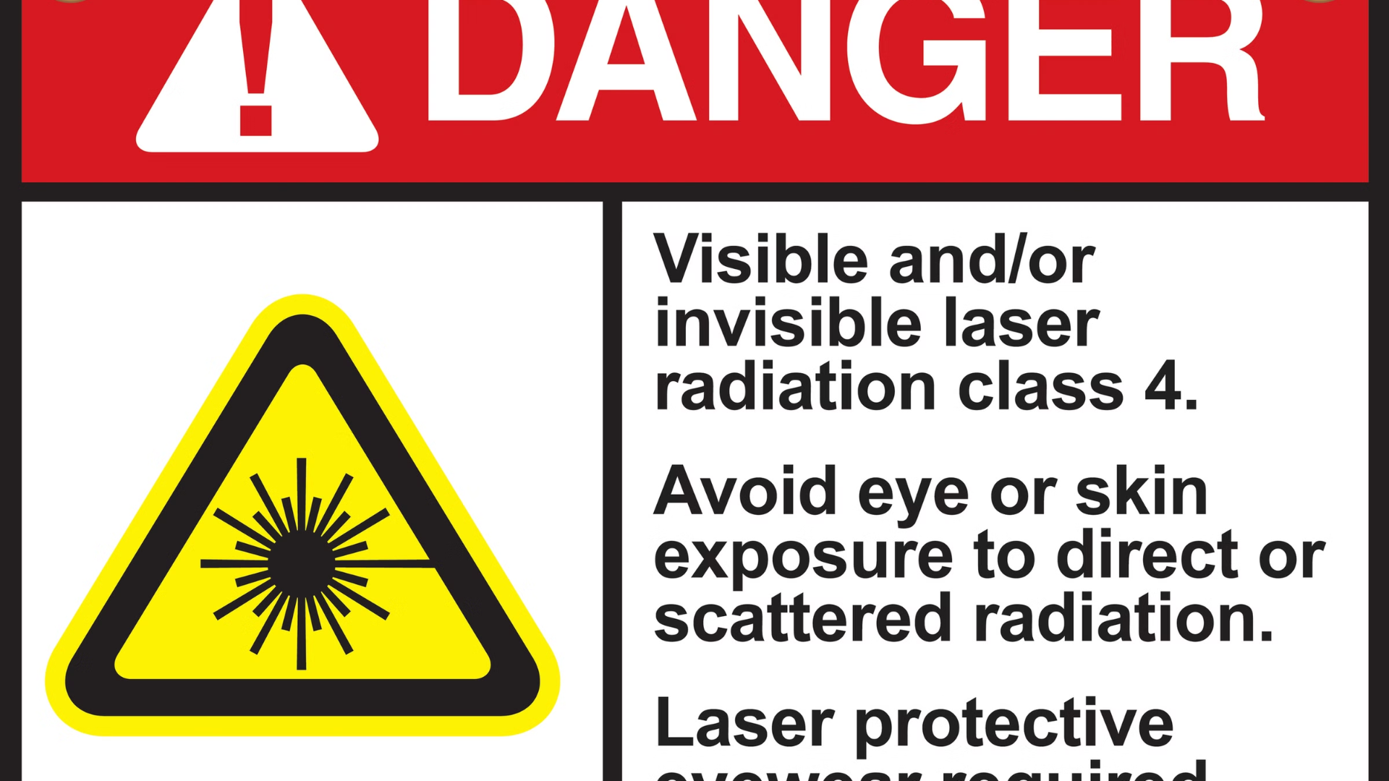



Laser Safety and Regulations
Laser Classification
Protective Measures
Regulatory Compliance
Lasers are classified based on their power output and potential hazards, with strict safety protocols for each class.
Proper safety equipment, engineering controls, and administrative procedures are essential to mitigate the risks of laser use.
Laser users must adhere to national and international safety standards and regulations to ensure the safe operation of lasers.

Slide 8
Emerging Trends and Future Developments in Laser Technology
Ultrafast Lasers
Generating pulses in the femtosecond and picosecond ranges, enabling new applications in materials processing and scientific research.
High-Power Lasers
Advancements in laser power and efficiency are leading to increased use in industrial, defense, and fusion energy applications.
Integrated Photonics
The integration of lasers with other photonic components on a single chip is paving the way for miniaturized, low-cost devices.
Quantum Optics
Harnessing the properties of quantum mechanics, lasers are enabling breakthroughs in quantum computing, cryptography, and sensing.

Slide 9
Information of student:
Name:- Narola Yagnesh Jagdishbhai
Enrollment number :- 236470316068
Branch :- IT
Class Code :- 2321
Subject :- Physics
THANK YOU!!!

