Slide 1
Hand-written Digits Classification and Letter Recognition
Group 10
Sixiang Ma, Yuan Xiao, Xiaokuan Zhang

Slide 2
Problem Description
Classifying hand-written digits (0-9)
Classifying black-and-white rectangular pixel displayed capital letters (A-Z)
Two datasets retrieved from UCI ML repository

Slide 3
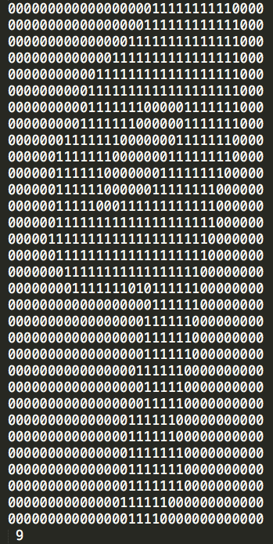
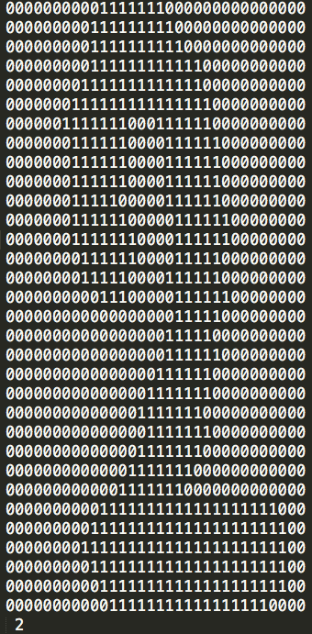
Hand-written Digits Dataset
Number of instances: 5620
Number of attributes: 1024 (32x32)
Attribute info: 0 / 1
Class: 0 ~ 9

Slide 4
Hand-written Digits Dataset
Transformation: 32x32 → 8x8
Number of attributes: 64
Attribute info: 0 ~ 16
Class: 0 ~ 9

Slide 5
Capital Letter Dataset
Number of instances: 20000
Number of attributes: 16
Attribute info: 0 ~ 15
Class: A ~ Z

Slide 6
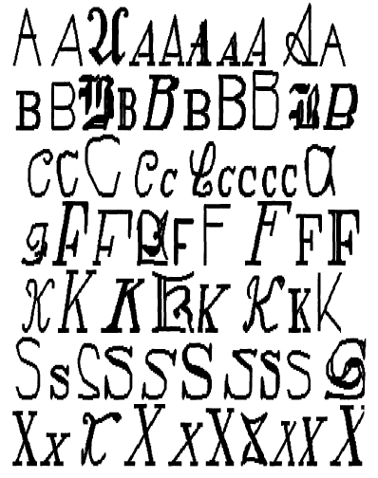
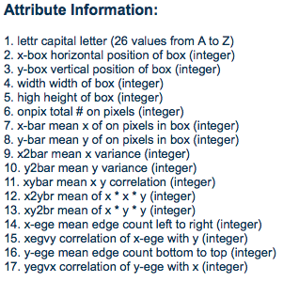
Capital Letter Dataset
Notes:
Source: 20 fonts

