Slide 1
Hand-written Digits Classification and Letter Recognition
Group 10
Sixiang Ma, Yuan Xiao, Xiaokuan Zhang

Slide 2
Problem Description
Classifying hand-written digits (0-9)
Classifying black-and-white rectangular pixel displayed capital letters (A-Z)
Two datasets retrieved from UCI ML repository

Slide 3
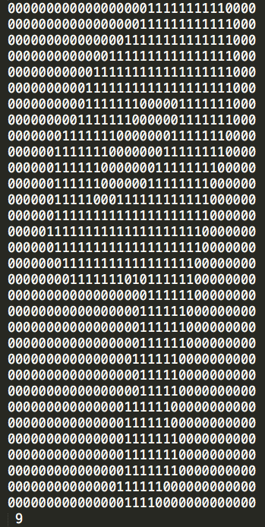
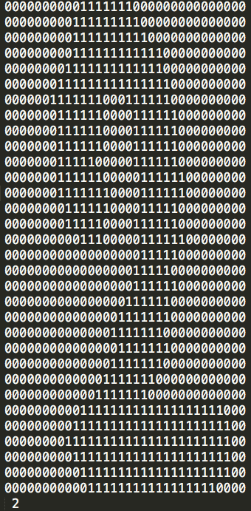
Hand-written Digits Dataset
Number of instances: 5620
Number of attributes: 1024 (32x32)
Attribute info: 0 / 1
Class: 0 ~ 9

Slide 4
Hand-written Digits Dataset
Transformation: 32x32 → 8x8
Number of attributes: 64
Attribute info: 0 ~ 16
Class: 0 ~ 9

Slide 5
Capital Letter Dataset
Number of instances: 20000
Number of attributes: 16
Attribute info: 0 ~ 15
Class: A ~ Z

Slide 6
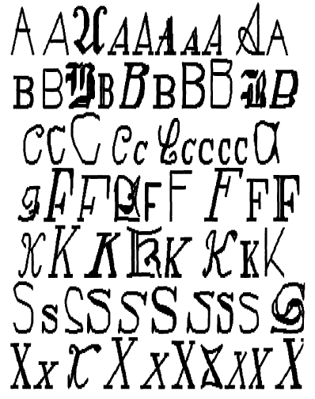
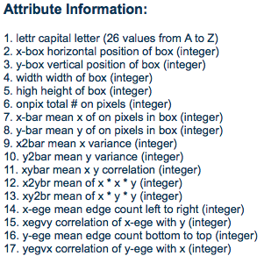
Capital Letter Dataset
Notes:
Source: 20 fonts

Slide 13
Test result analysis

Slide 14
Multilayer Perceptron
-L 0.3 -M 0.2 -N 500 -V 0 -S 0 -E 20 -H a
-L 0.6 -M 0.2 -N 500 -V 0 -S 0 -E 20 -H a
-L 0.3 -M 0.2 -N 200 -V 0 -S 0 -E 20 -H a
-L 0.3 -M 0.2 -N 500 -V 0 -S 0 -E 10 -H a
-L 0.3 -M 0.2 -N 500 -V 0 -S 0 -E 30 -H a

Slide 15
Test Results w/ Different Parameters

Slide 16
Least Correct Class
Parameters | Class (character) | Correctness
Default | G | 69%
 | H | 64.4%
 | S | 65%
L=0.6 | G | 68.2%
 | H | 69.1%
 | S | 64%
N=200 | G | 69.3%
 | H | 65.1%
 | S | 64.4%

Slide 17
Test Results w/ Different Parameters

Slide 18
Special case: L=0.6 (Digit)

