Slide 1
Web Development Training
kick-off
March 2014

Slide 2
Agenda
Purpose
Procedure
Next steps
Discussion

Slide 3
Purpose

Slide 4
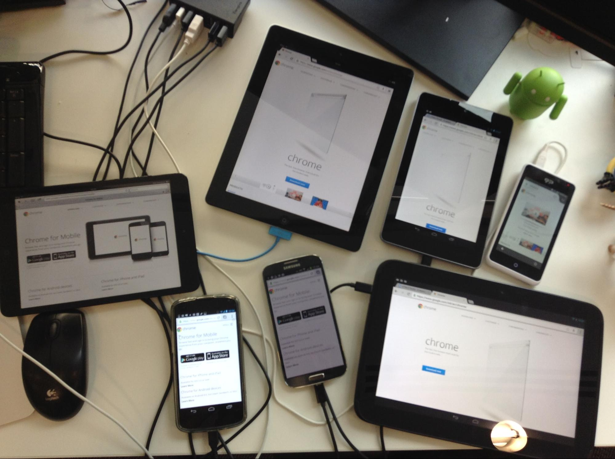
Addy Osmani´s desk…

Slide 5

So many different platforms…

Slide 6
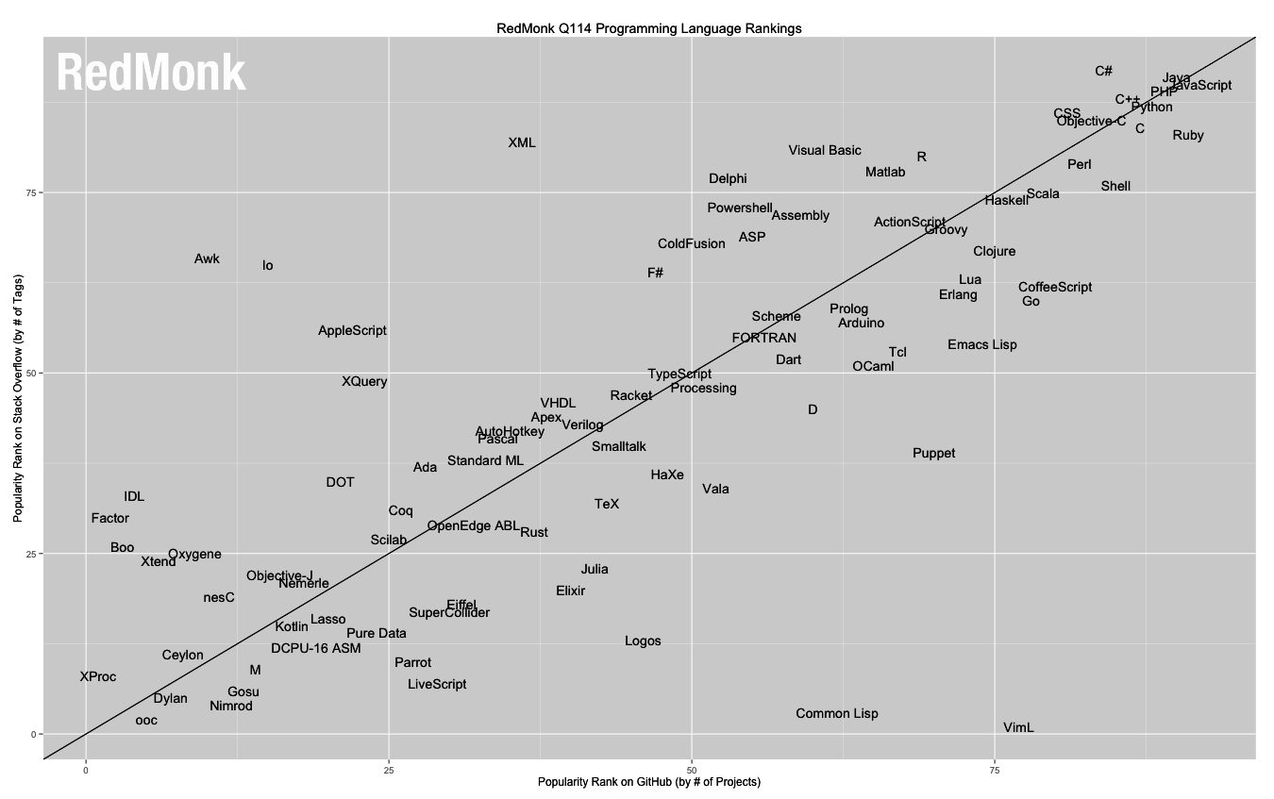
And the winner is…

Slide 7
Procedure

Slide 8
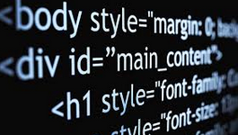


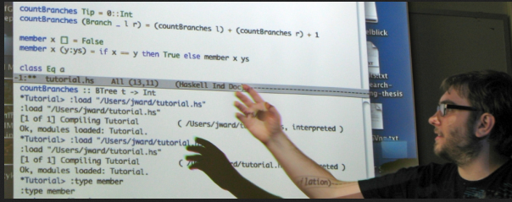


Time management
self-study once a week
Meetup´s biweekly
~30% on top in your spare time
Notes:
8
8

Slide 9
Content
CSS
JavaScript
HTML5
Web Developer
Unit Testing
WebApps
Web Components
Notes:
9
9

Slide 10
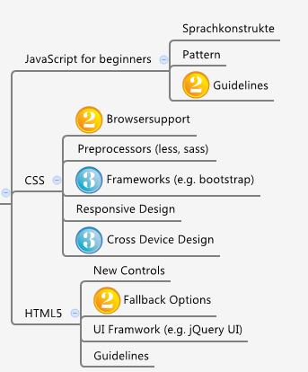
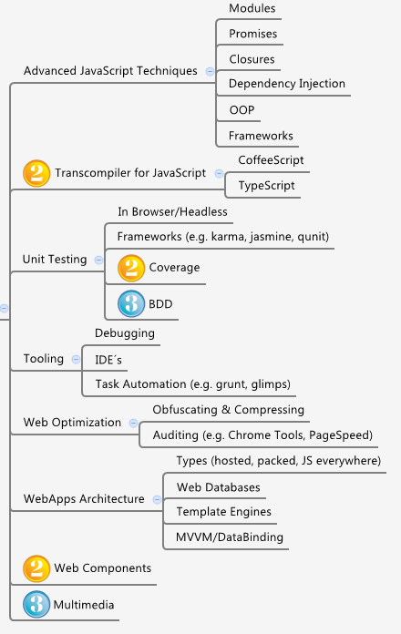
Skills
Basic
Advanced

Slide 11



Different knowledge in Teams
Interview: Who needs what (CSS, JavaScript, HTML5 u.s.w.)?
Study plan

Slide 12


Roadmap
Placeholder
Placeholder
Placeholder
Place
Mär
Apr
Mai
Jun
Jul
Aug
Feb
Initialise
Kick Off
JS Course 1
HTML
JS Course 2
CSS
JS
Course 3
Assembling SASS
jQuery
SPA-Framework
Workshop Unit Testing
Workshop Architecture
Coding
Review
Notes:
12
12

Slide 13

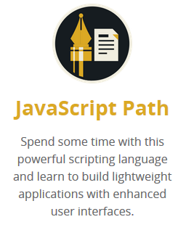
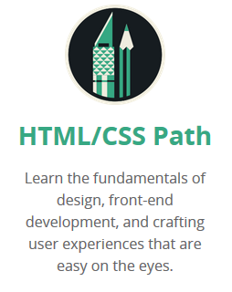
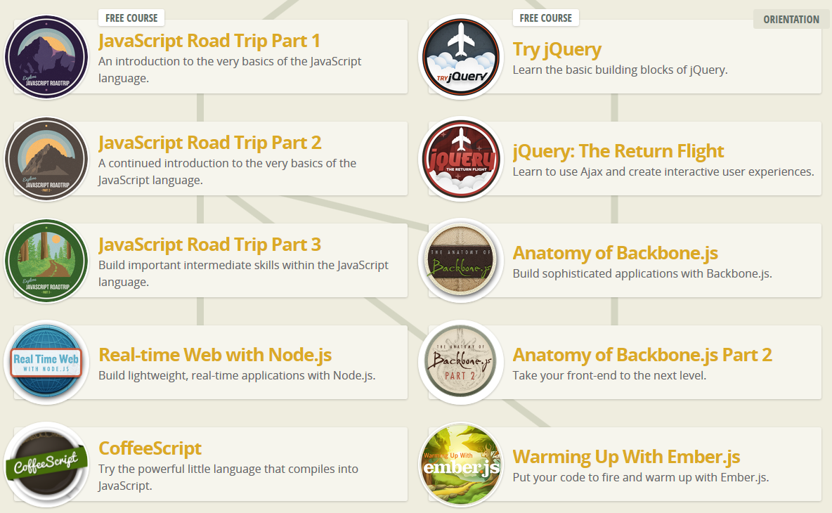
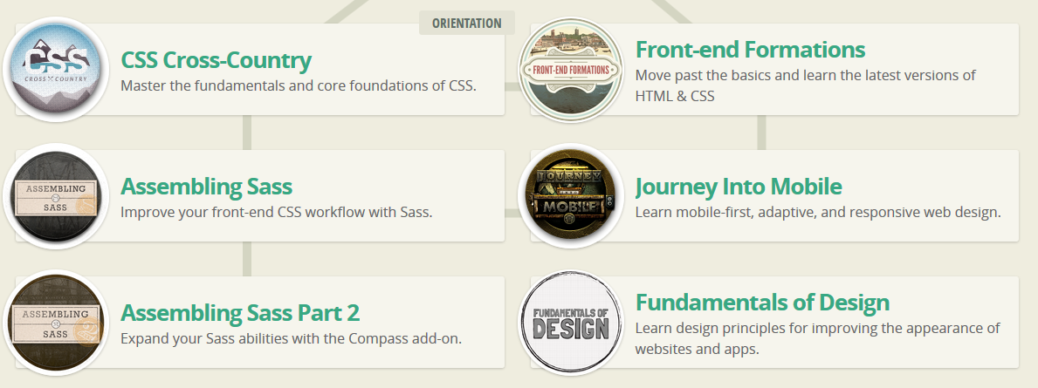
www.codeschool.com

Slide 14
Next steps

Slide 15
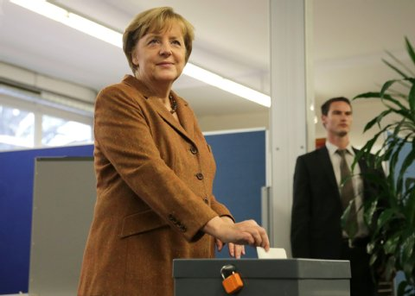
Ideas for coding project are welcome...

Slide 16
What´s coming up next…
Tell us if you do want to join on codeschool.com (07.03.)
Offline vote about the coding project and the technology stack we will send you an e-mail till 14.03.
You will get some invitations for our meetup´s

Slide 17
discussion

