Slide 1
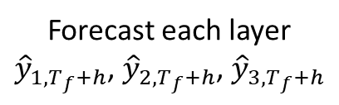
Rolling training window
Raw ITS returns
Step 1
ISVD decomposition
Step 2
VC-ACI forecasting
Step 3
Weighted ensemble
Final
forecast
Three ITS sub-returns
Layer 1, Layer 2, Layer 3
Forecast each layer
${\hat{y}}_{1,T_{f}+h}$, ${\hat{y}}_{2,T_{f}+h}$, ${\hat{y}}_{3,T_{f}+h}$
Combine layer forecasts using variance-based weights
Move the rolling window forward and repeat Steps 1-3

