Slide 1

Overview
The aim of this application is to help landlords find their new clients and home-seekers find their new (and forever) home.
What makes this application unique is that no agencies, no commissions and no extra fees are involved.
Anyone who wants to move out of his current home, has the option to create an account, where he can post information and photos of it
Landlords can create an account and advertise their properties
Everyone will able to browse a list of houses according to the specifications he has provided
Users with registered accounts will have access to contact information of landlords so they can reach them for further discussion

Slide 2


Requirements
Users must be able to create/edit/delete account
Users must be able to sign in to and log out of their accounts
Users must be able to choose the type of their account (Landlord/Client)
Users must be able to upload information and images
Anyone must be able to browse through a list of houses by giving specifications (Region, No of bedrooms, No of bathrooms, Rent Range etc.)
Users could sign in using Facebook/Twitter
Users must be able to find a map/address/directions for each house using Google Maps

Slide 3

Persona One
This is Brendan, 32. Things are going well for Brendan lately, as he got a promotion 3 months ago, followed by a respectful raise in his salary. He is now the Project Manager of one of the UK’s biggest Software houses. Brendan has already arranged his wedding with Janice and they are now waiting for Brendan Jr who is on his way.
Brendan and his family can not live in a single bedroom apartment in Coatbridge anymore and he decided to move in a luxurious Penthouse in Glasgow. He needs somewhere to check for his options

Slide 4

Persona Two
This is Martha, undefined. In contrast to Brendan, things for her are not so good at this point. Martha lost her husband lately but never her class. She is the owner of two vintage cottage houses that are located just outside Edinburgh. She lives in one of them but the other one has remained empty since her daughter moved to London and it is available for renting.
Martha hates agencies because they keep traffic away from her property by demanding unreasonable commissions. She believes that she can achieve a better deal between her and her client without them but she needs some space to advertise her property.

Slide 5
System Architecture
Database
Client
Middleware
Django | CSS
Python | JS
HTML | Ajax
User
Google Maps API
Login API: Google, Twitter, Facebook

Slide 6
Site Map
Home(Index)
Login
Estate
Sign up
Implicit Search
My Account
Explicit Search
Recommendation
Shortlist
About Us

Slide 7
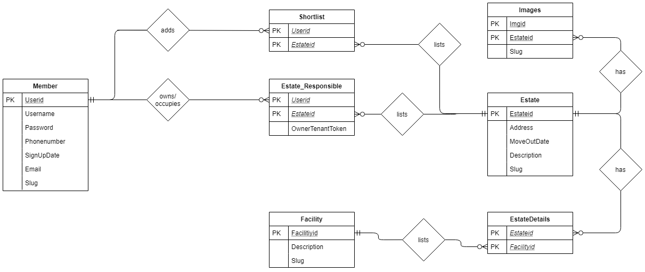
E-R Diagram

Slide 8
E-R Attribute
 | Member |  |  | Estate Responsible |  |  |  | Estates
 | Userid | CharField |  | Userid |  | CharField |  | Estateid | CharField
 | Username | CharField |  | Estateid |  | CharField |  | Address | CharField
 | Password | CharField |  | Owner_Tenant_Token |  | CharField |  | MoveOutDate | DateField
 | Phonenumber | FloatField |  |  |  |  |  | Description | CharField
 | Signupdate | DateField |  |  |  |  |  | Slug | SlugField
 | Email | EmailField
 | Slug | SlugField
 | EstateDetails |  |  | Facilities |  |  |  | Shortlist |  |  | Images
 | Estateid | CharField |  | Facilityid |  | CharField |  | Userid | CharField |  | Imgid | ImageField
 | Facilityid | CharField |  | Description |  | CharField |  | Estateid | CharField |  | Estateid | CharField
 |  |  |  | Slug |  | SlugField |  |  |  |  | Slug | SlugField

Slide 9
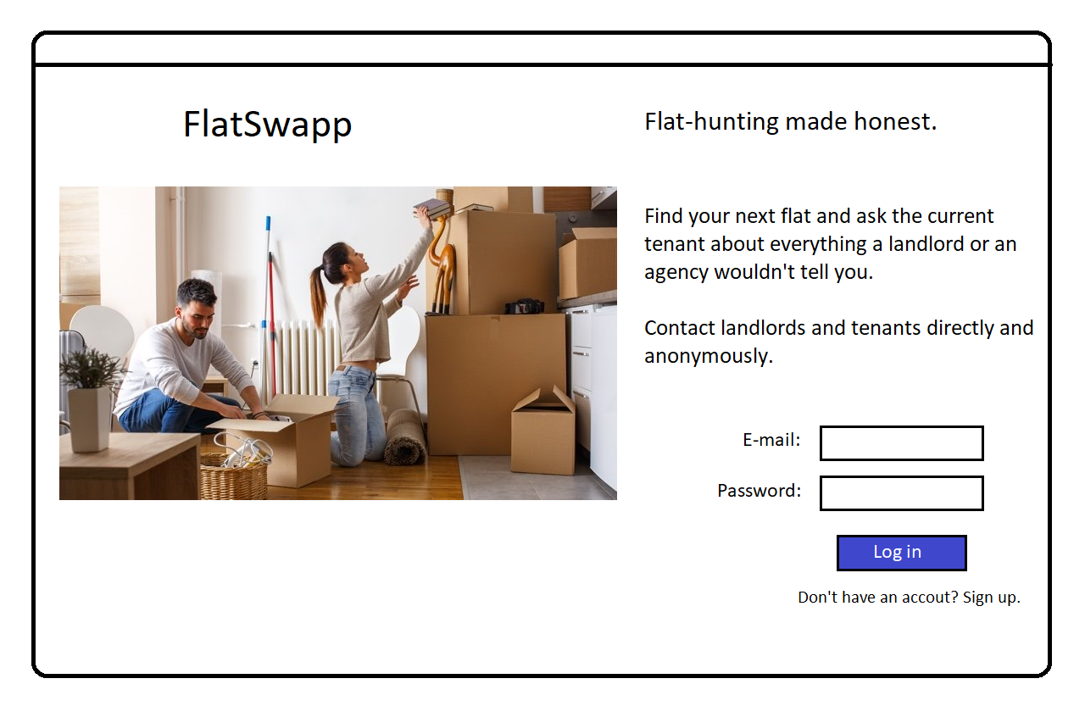

Slide 10
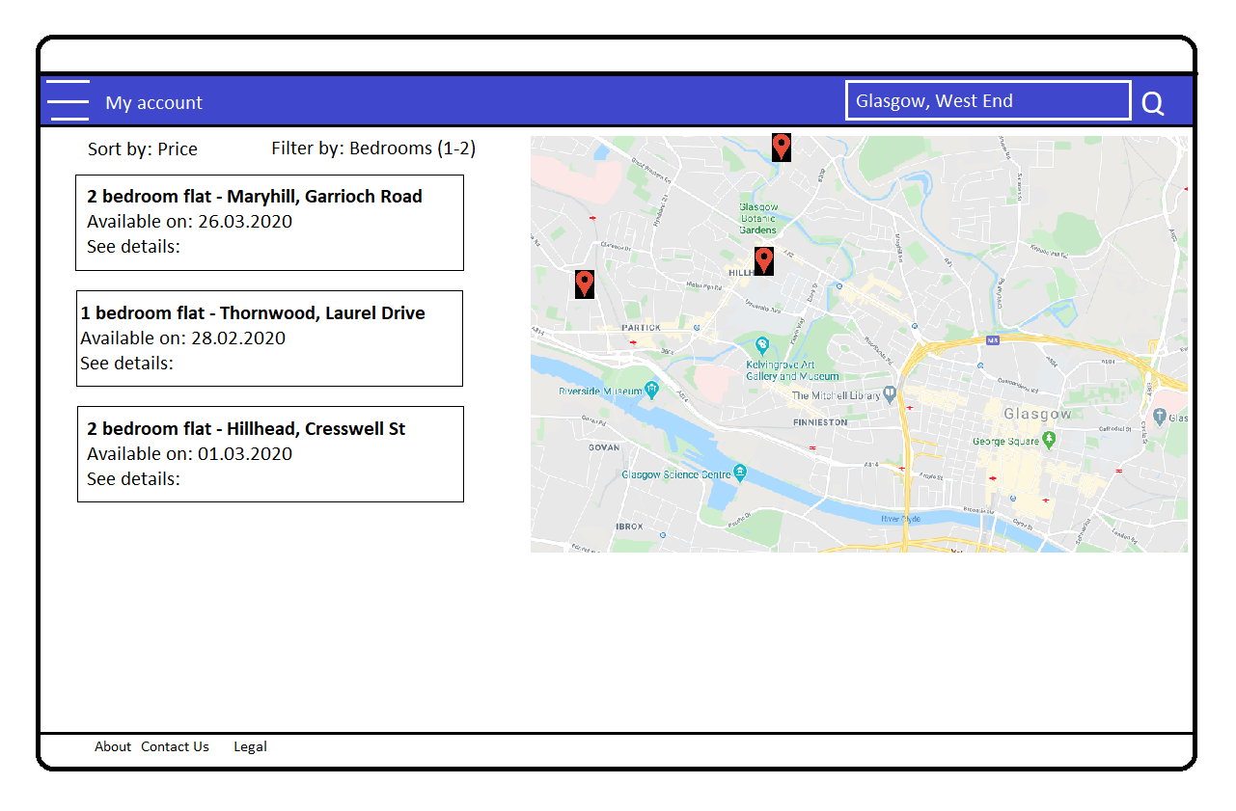

Slide 11
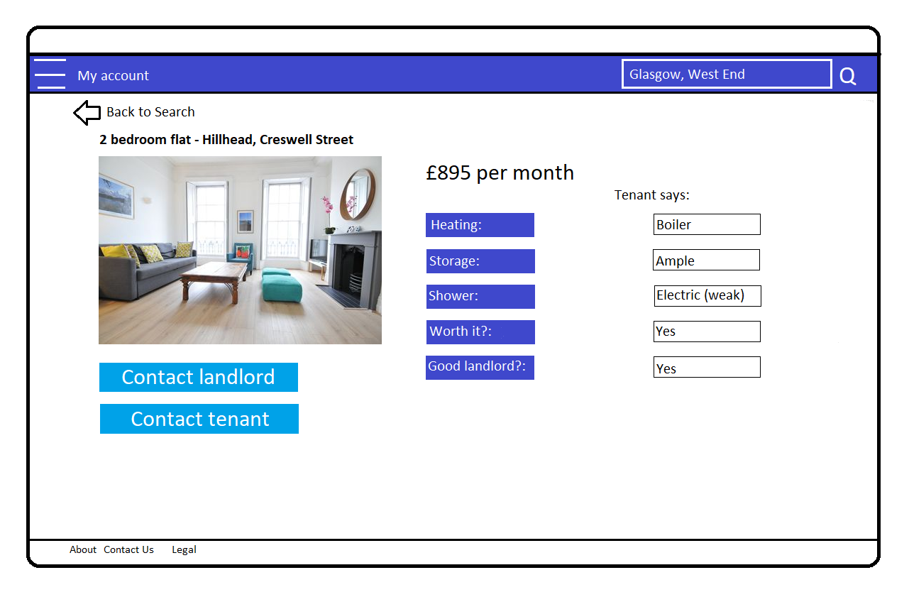

Slide 12

URLS
/Home
/AboutUs
/SignUp
/Login
/Login/MyAccount
/Login/Search
/Login/MyAccount/Shortlisted
/Login/MyAccount/Recommendations
/SearchEstate
/Estate

