Slide 1
SELF-PRESENTATION

Slide 2
My name is DangXing
from Zhengjiang , China
A single dog
Like reading fiction , playing games , watching anime…
Glad to see you!

Slide 3
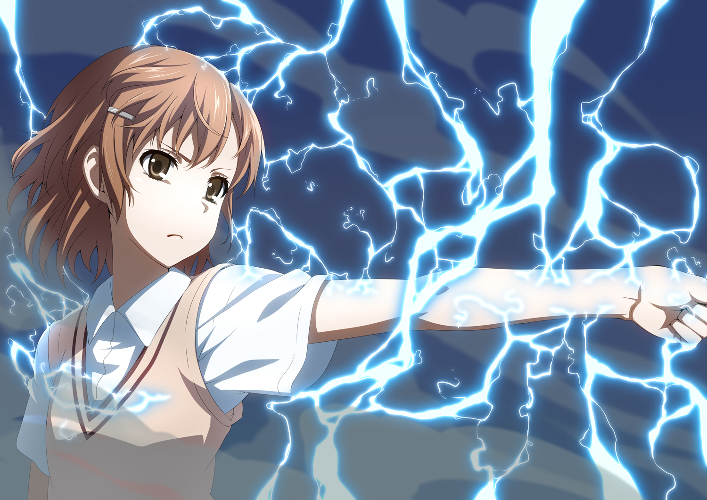
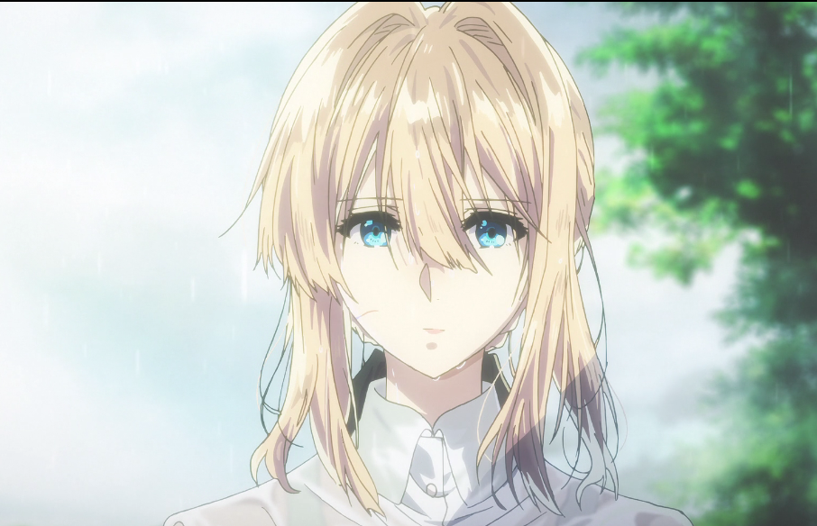
A crazy fan of ACG
Favourite
character
Misaka Mikoto
And
Violet Evergarden

Slide 4
Thank you

