Slide 1
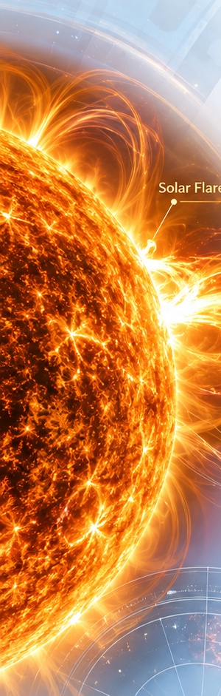

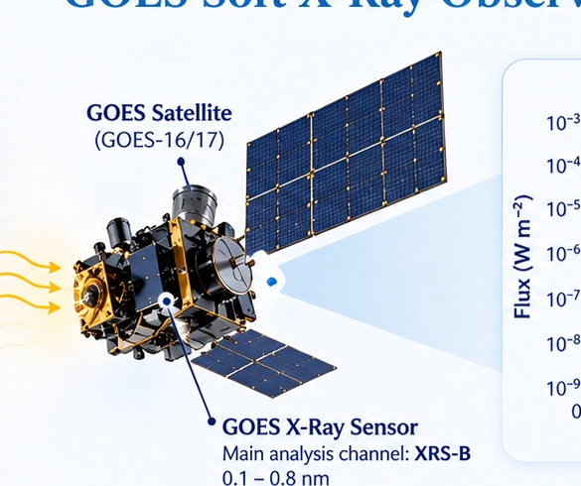
Geethanjali College of Engineering and Technology (Autonomous)
Department of Computer Science and Engineering (Artificial Intelligence and Machine Learning)
Statistical Detection and Classification
of Solar Activity
Using Real-Time X-Ray Time-Series Data
GOES XRS-B
SML — Statistics for Machine Learning | PBL
observed X-ray flux
SUN
X-RAYS
GOES
TIME SERIES
Team Members
24R11A6670
—
Metri Naveen Kumar
24R11A6690
—
Shaik Zaheer Abbas
24R11A6687
—
Sahit Kumar Yadav
25R15A6610
—
A. Sai Eshwar
Notes:
Presenter: Member 1
Approx. speaking time: 30–35 sec
Speaker explanation:
Introduce the project as a statistical investigation of real GOES X-ray measurements. Do not lead with machine learning. Explain that the deck follows the signal from the Sun, through observation and statistics, into event classification.
Likely viva question:
Is this a forecasting project?
Short answer:
No. We detect observed flare-like activity and perform severity nowcasting at the observed peak; we do not predict a future flare before its signature appears.

Slide 2
What Exactly Are We Trying to Do?
Detection, severity nowcasting and forecasting are different tasks
NOAA flare classes (0.1–0.8 nm peak flux)
B
C
M
X
higher peak flux →
10⁻⁷
10⁻⁶
10⁻⁵
10⁻⁴
DETECTION
CLASSIFICATION / NOWCASTING
FORECASTING
Did something unusual happen?
At the observed peak, is the event B or C+?
Will a flare happen before its observed signature?
B
C+
Statistical event detection
t_pred = t_peak
Not the task in this project
Stage 8: Impulsive-Phase Flare Severity Nowcasting • Target: B vs C+ • C+ = NOAA C or M
Notes:
Presenter: Member 1
Approx. speaking time: 35 sec
Speaker explanation:
Define the three tasks before any algorithm discussion. Detection asks whether observed behavior is unusual. Nowcasting asks the class at the observed peak. Forecasting asks about the future and is explicitly outside the project. Briefly introduce B/C/M/X as peak-flux classes so later B vs C+ has context.
Likely viva question:
What does C+ mean?
Short answer:
C+ combines NOAA C and M events in our supervised target. U/undefined events are excluded.

Slide 3
Why Solar X-Rays Matter
Flare intensity is encoded in the observed soft X-ray peak
NOAA flare classes
Why this signal is useful
Defined using peak 0.1–0.8 nm X-ray flux
GOES provides continuous, quantitative X-ray measurements.
Flare activity appears as rapid increases above a changing background.
Peak levels provide an official severity reference through NOAA classes.
The same time series can support statistical detection before event-level classification.
B
10⁻⁷ W m⁻²
minor / weak
C
10⁻⁶ W m⁻²
small
M
10⁻⁵ W m⁻²
moderate / strong
X
10⁻⁴ W m⁻²
extreme
B
C
M/X
≥10⁻⁷
≥10⁻⁶
≥10⁻⁵
Peak flux defines the label → it must not become a primary predictor later.
Our supervised task later collapses C and M into C+ because the sample is small.
Notes:
Presenter: Member 1
Approx. speaking time: 30 sec
Speaker explanation:
Explain that flare classes are not arbitrary labels: they are defined from peak soft X-ray flux. This motivates both the B/C+ target and the later decision to exclude peak_flux from predictors.
Likely viva question:
Why are B, C, M and X ordered this way?
Short answer:
They represent progressively higher peak soft X-ray flux, with each class threshold increasing by roughly one order of magnitude.

Slide 4
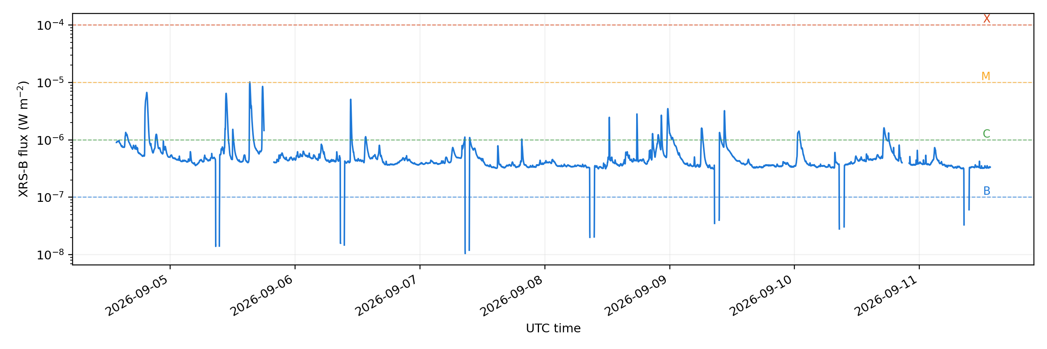
How Do We Observe Solar Activity?
GOES soft X-ray observations
SUN
Actual cleaned GOES XRS-B time series
soft X-rays
0.1–0.8 nm
GOES XRS
Main analysis channel
XRS-B
One observation
one measured flux value
Cadence
≈ 1 minute
Reference
NOAA flare records
Flux = measured X-ray power per unit area
Each spike is an observation pattern to investigate — not automatically an official flare.
Notes:
Presenter: Member 1
Approx. speaking time: 35 sec
Speaker explanation:
Explain the measurement chain: solar soft X-rays reach GOES, XRS-B records flux repeatedly, and the ordered values become the time series. Emphasize that NOAA records are an external event reference, not part of our detector.
Likely viva question:
Why use XRS-B?
Short answer:
It is the GOES long soft X-ray channel used for NOAA flare classification and it is the main signal in our analysis.

Slide 5
What Does the Time Series Actually Represent?
From raw one-minute observations to an analysis-ready signal
1. Time-ordered observations
2. Preprocessing
3. Why this matters statistically
time
flux
Raw rows
quality checks
Rolling baselines assume a known time cadence.
Derivatives and slopes are sensitive to gaps.
Interpolation can change peak, ROC and duration measurements.
We therefore keep the original/segment metadata for auditability.
13:22
x₁
13:23
x₂
Sentinels / invalid
→ NA
13:24
x₃
≤3 min gaps
log-space interpolation
…
…
>3 min gaps
remain missing
Time order is part of the science.
1-min grid
reindexed
Nearby observations provide context.
Missing/gap information is preserved.
Small gaps are handled conservatively; long gaps remain missing.
segments
preserved
≈1 min
XRS-B
cadence
main band
Preprocessing is part of the model’s evidence chain — not a cosmetic step.
Notes:
Presenter: Member 1
Approx. speaking time: 35 sec
Speaker explanation:
Explain that we are not classifying raw rows. Preprocessing makes the time axis and missingness explicit so later rolling statistics, ROC and duration calculations are meaningful.
Likely viva question:
Why interpolate only short gaps?
Short answer:
Short interpolation preserves continuity for small missing stretches; long gaps are kept missing because inventing a long signal could distort event timing and shape.

Slide 6
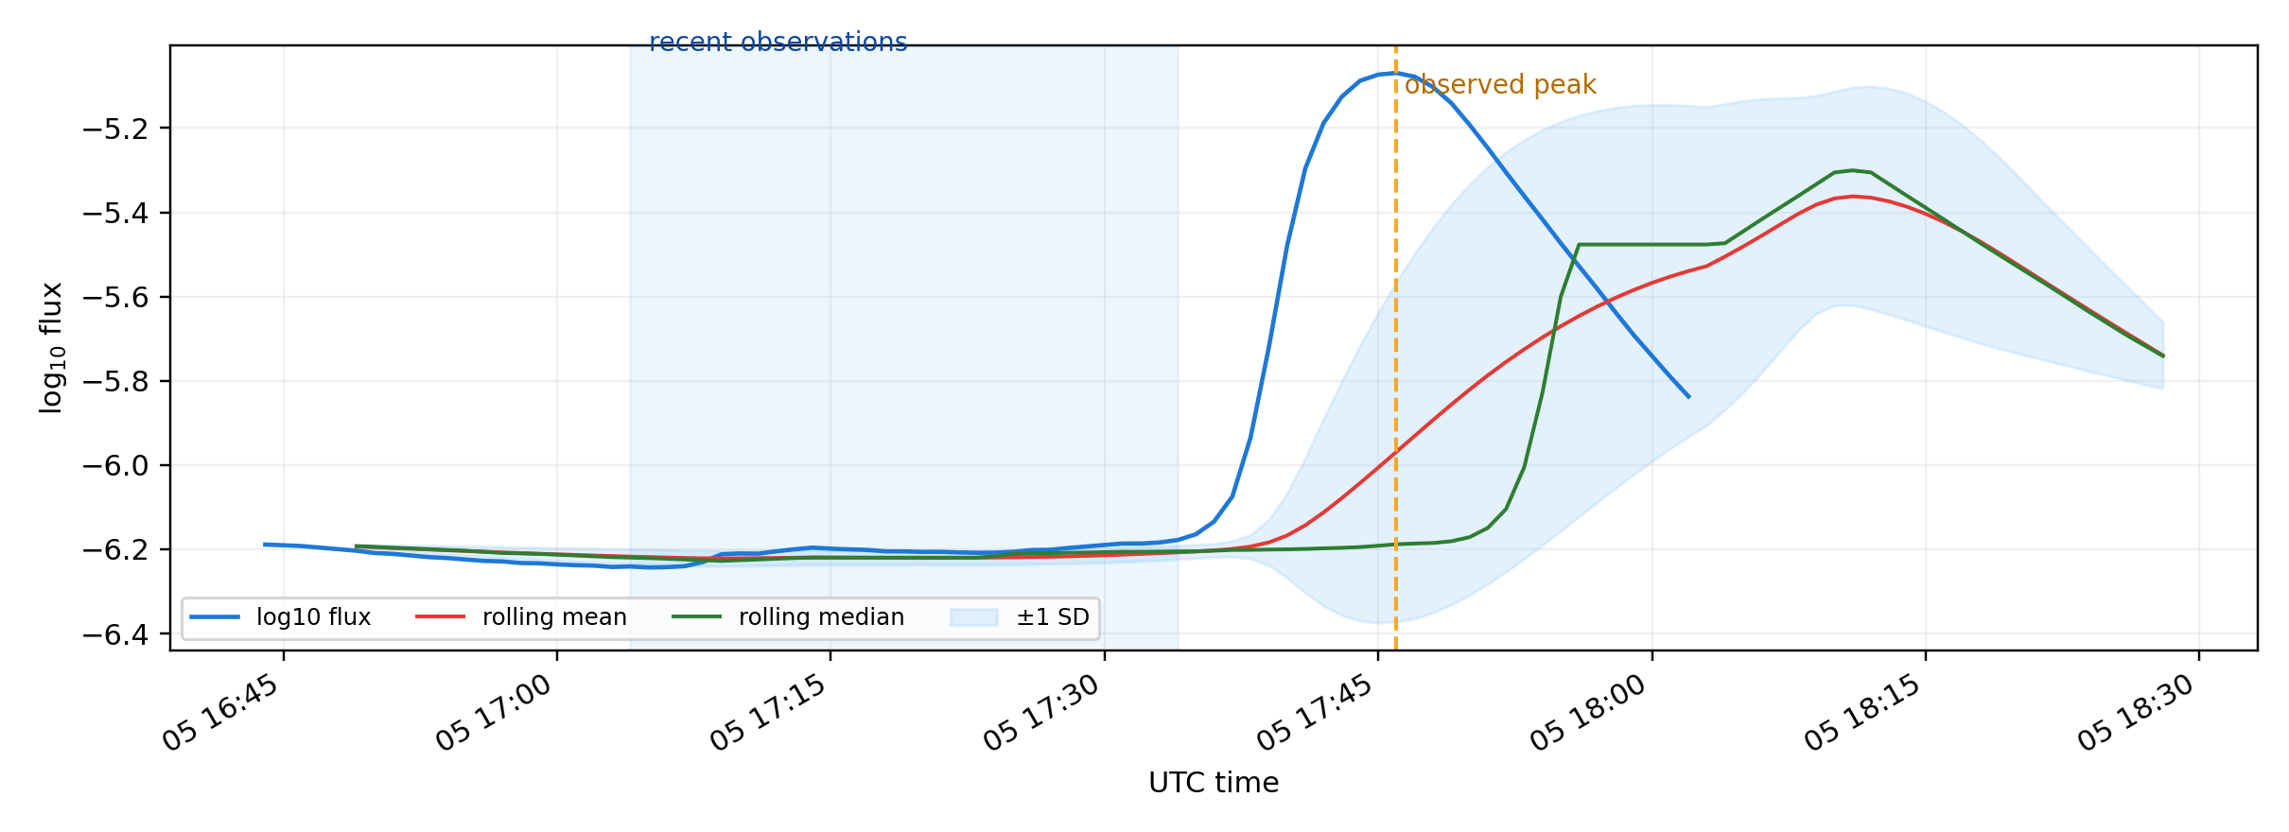
Before “Unusual,” We Need “Normal”
Local statistical background estimation
What we need to estimate
CENTER
mean / median
Where is the recent background?
SPREAD
SD / MAD
How much does it normally vary?
CONTEXT
recent window
What is normal right now?
Current point excluded from its own trailing baseline.
“Normal” is estimated locally — not from one average over the entire dataset.
Notes:
Presenter: Member 2
Approx. speaking time: 35 sec
Speaker explanation:
Start with the question: how can we call something unusual before defining normal? Solar background drifts, so we estimate center and spread from recent earlier observations rather than one global average.
Likely viva question:
Why exclude the current observation from its own baseline?
Short answer:
Otherwise an impulsive flare can raise its own mean/spread and make itself look less anomalous.

Slide 7
Center, Spread and Robustness
Mean, standard deviation, median and MAD answer different questions
MEAN
STANDARD DEVIATION
Where is the recent level centered?
How much does recent background normally fluctuate?
x̄ = Σxᵢ / n
s = √[Σ(xᵢ−x̄)²/(n−1)]
Conventional estimator
Conventional estimator
MEDIAN
MAD
What is the middle recent value?
How much does it vary without being dominated by extremes?
middle of sorted observations
median(|xᵢ−median(x)|)
Robust estimator
Robust estimator
Scaled MAD = 1.4826 × raw MAD (applied once)
Notes:
Presenter: Member 2
Approx. speaking time: 40 sec
Speaker explanation:
Keep the formulas secondary. Mean and SD are familiar center/spread measures, while median and MAD are robust alternatives that move less when flare values are extreme. Mention that the MAD scaling factor is applied exactly once.
Likely viva question:
Why do you calculate both SD and MAD?
Short answer:
SD is conventional but sensitive to extremes; MAD gives a robust spread estimate. Comparing both helps detect anomalies without letting flare points dominate the baseline.

Slide 8
Why Statistics Must Move With Time
Rolling statistics estimate what is normal right now
At each minute
30-min trailing window
1
look back
recent earlier points
2
estimate
mean / median / spread
3
compare
current observation
4
advance
window moves forward
Current observation is not allowed to redefine its own background.
Notes:
Presenter: Member 2
Approx. speaking time: 35 sec
Speaker explanation:
Explain the moving window: for each minute, use the previous 30 minutes to estimate recent background. Then move forward and repeat. This adapts to a background that changes through the day.
Likely viva question:
What is the rolling window size in the detector?
Short answer:
The current R detector uses a 30-minute trailing baseline, with an uncontaminated rule that lags the current point out of its own baseline.

Slide 9
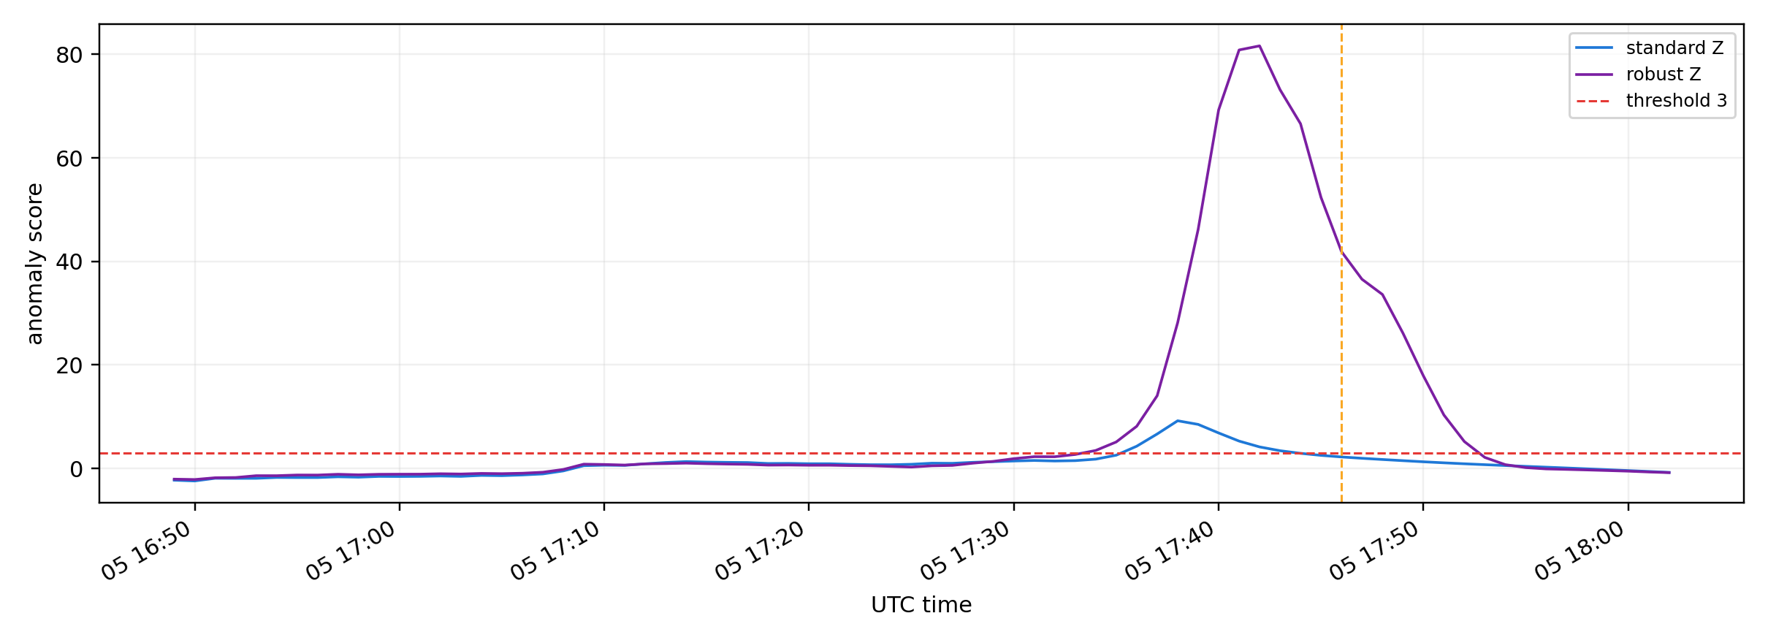
How Unusual Is This Measurement?
Standard and robust statistical anomaly scores
Z-score intuition
Actual project anomaly scores
distance from recent normal
z = (x − μ) / σ
x = current measurement
μ = recent background average
σ = recent background spread
Standard Z
Robust Z
mean + SD
median + MAD
Z-score = distance from recent normal behavior, measured in standard-deviation units.
Anomaly score ≠ formal Z-test with a p-value.
Notes:
Presenter: Member 2
Approx. speaking time: 40 sec
Speaker explanation:
First explain the ruler idea: a Z-score says how many normal-spread units the current observation sits above the recent background. Then show the formula. Our robust version swaps mean/SD for median/MAD.
Likely viva question:
Is your Z-score a hypothesis test?
Short answer:
No. It is a standardized anomaly score used in sequential detection; we do not report a Z-test p-value.

Slide 10
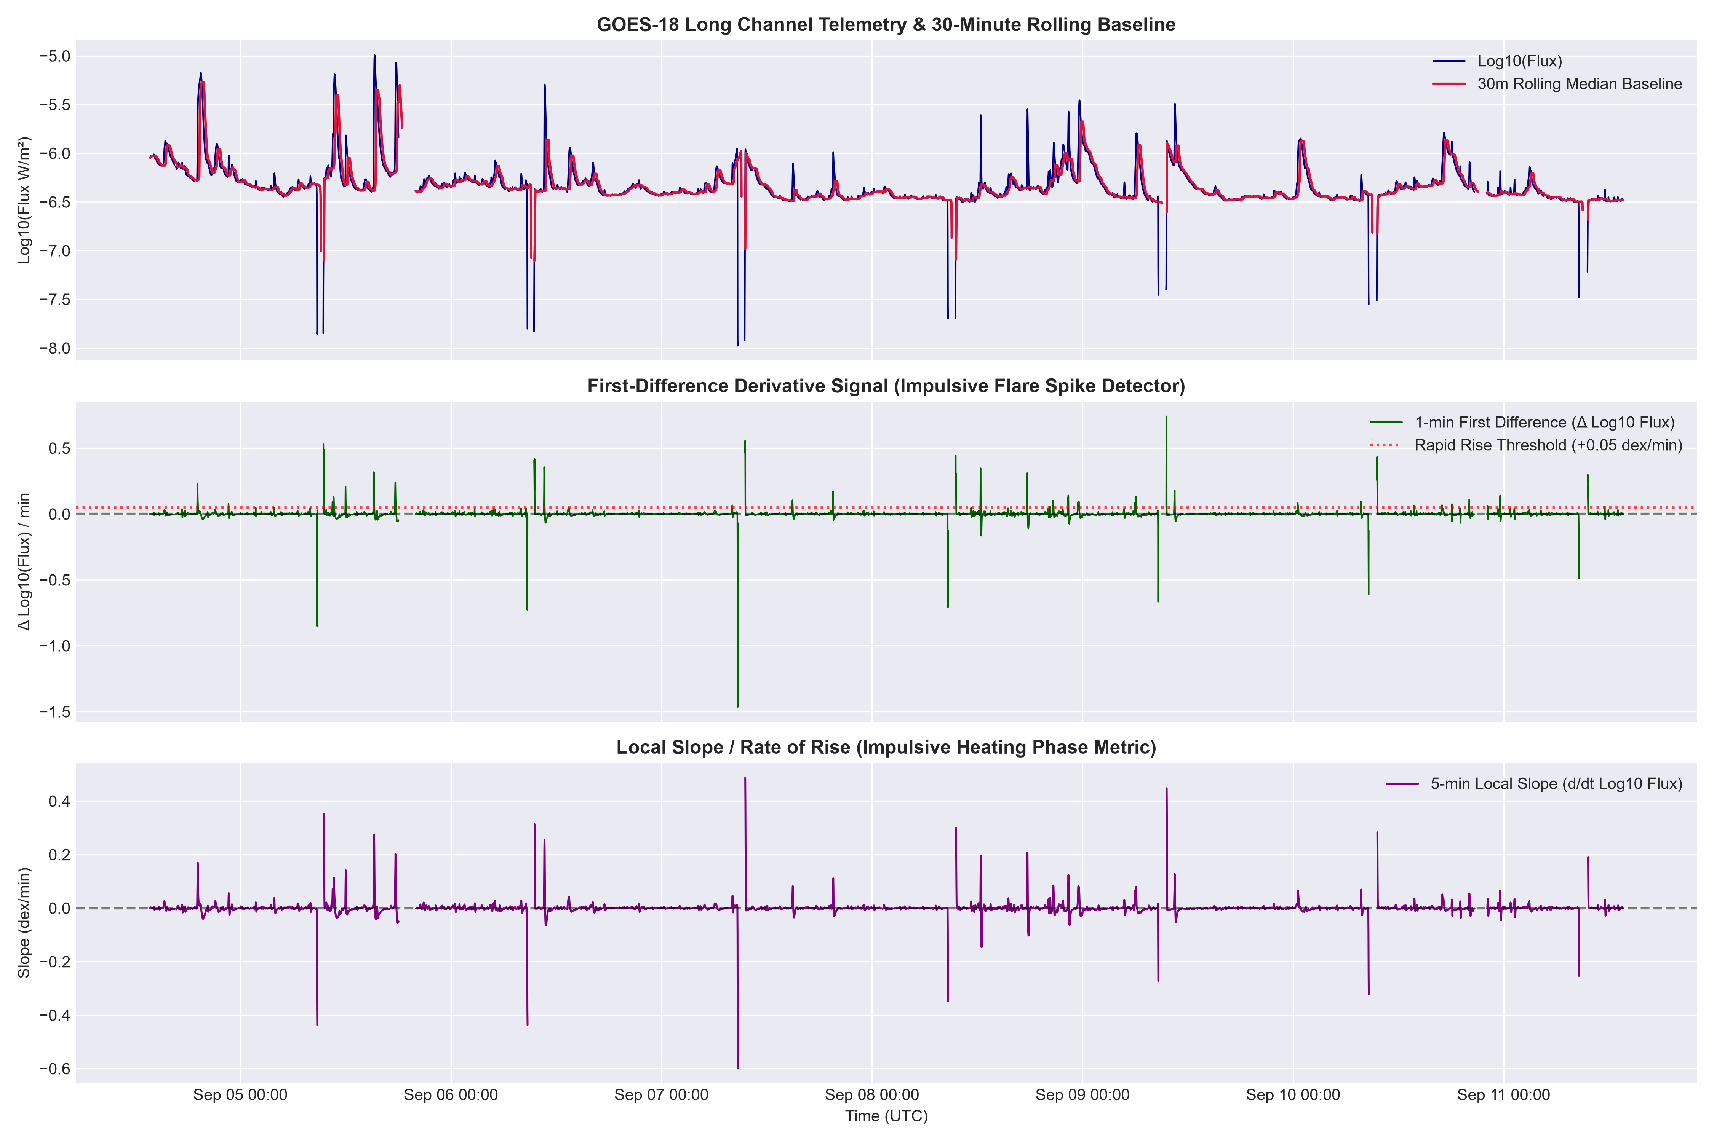
From Unusual Observations to an Event
Thresholds, rate of change, persistence and segmentation
ANOMALY SCORES
RAPID CHANGE
PERSISTENCE
SEGMENTATION
z_mean / z_mad
ROC / local slope
≥3 consecutive points
START / PEAK / END
Frozen detector configuration
Z mean threshold
3.0
Robust Z threshold
3.0
ROC threshold
0.05
Persistence
3 points
Rolling window
30 min
One unusual point may be noise. An event requires sustained evidence.
Notes:
Presenter: Member 2
Approx. speaking time: 40 sec
Speaker explanation:
Explain the detector as sequential statistical logic, not a black box. It combines standard and robust Z scores with rate of change, then requires persistence. Segmentation converts the resulting point-wise signal into discrete event intervals.
Likely viva question:
Why use persistence after thresholding?
Short answer:
To reduce false detections from isolated noisy points. A candidate event must persist for multiple consecutive observations.

Slide 11
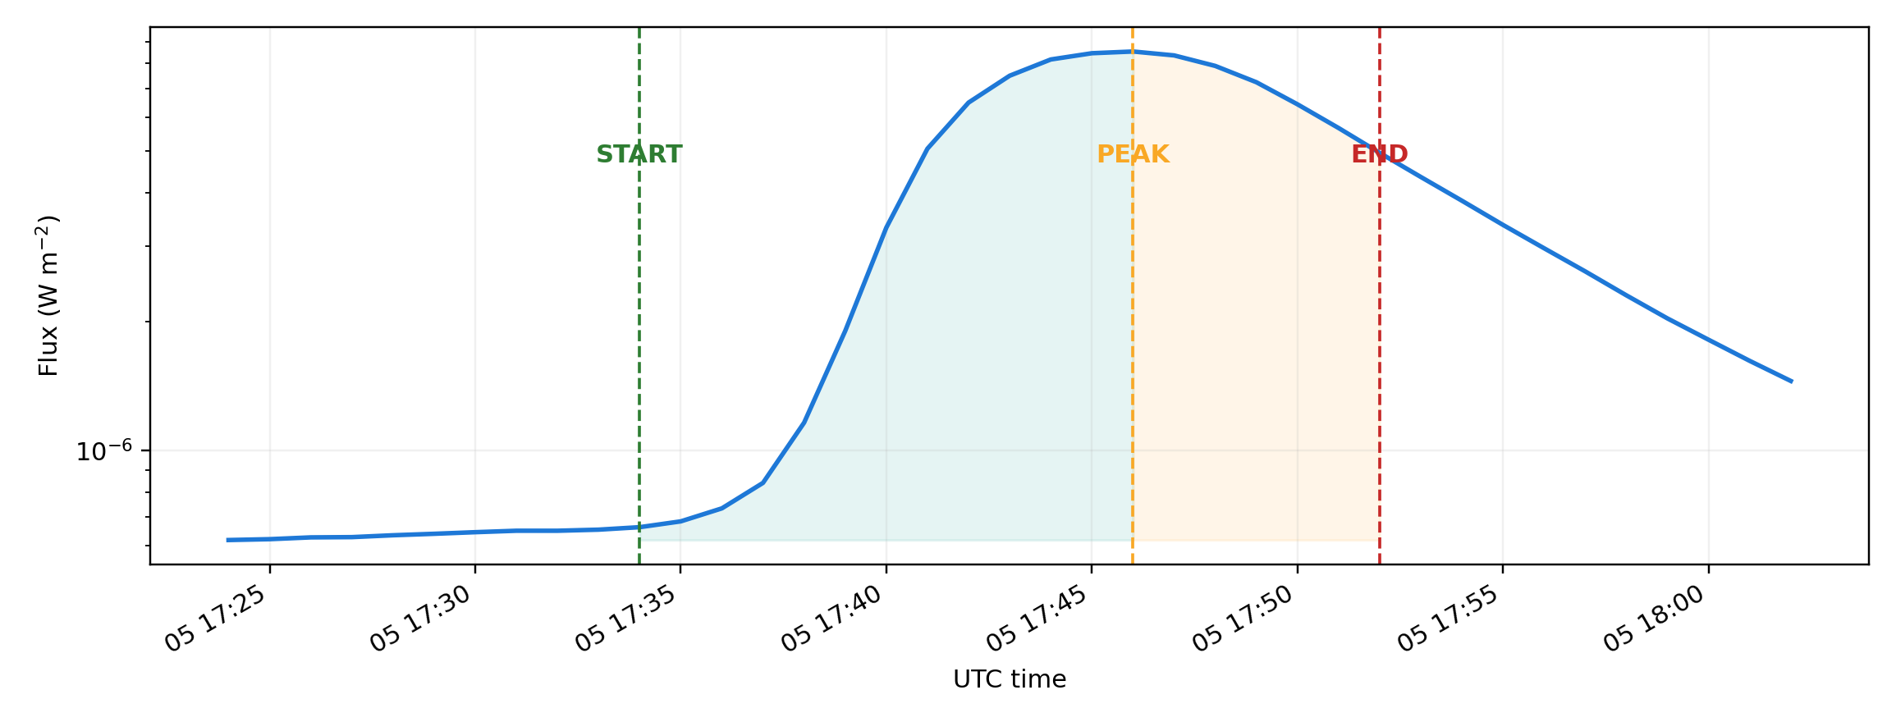
An Event Has a Shape
START → RISE → PEAK → DECAY → END
START
detected onset
RISE
impulsive increase
PEAK
maximum observed level
DECAY
post-peak decrease
END
event termination
For the primary nowcast, predictor information stops at PEAK.
Notes:
Presenter: Member 3
Approx. speaking time: 30 sec
Speaker explanation:
Move from point-wise detection to one physical interval. The event lifecycle provides interpretable geometry: start, rise, peak, decay and end. The nowcasting model later uses only information available through the peak.
Likely viva question:
What is the unit of classification?
Short answer:
One independent physical solar event, not an individual one-minute sample.

Slide 12
Did Our Statistical Detector Find a Real NOAA Event?
Event alignment against an independent official record
OUR DETECTOR
Stage 5 alignment
NOAA records
35
valid peaks
34
detected events
115
matches
32
absolute peak timing error
unmatched detections
80
NOAA RECORD
unmatched NOAA
3
official peak
mean peak error
1.76 min
median peak error
0.00 min
Unmatched ≠ automatically “false flare”: it may be sub-B activity or noise.
Notes:
Presenter: Member 3
Approx. speaking time: 40 sec
Speaker explanation:
NOAA alignment compares two independent timelines: our statistically detected event and an official event catalog. Matching is based on timing. Emphasize that unmatched detections are not automatically proven false physical events.
Likely viva question:
Why is NOAA called ground truth here?
Short answer:
It is the external official reference used to assign supervised event labels and check timing correspondence; our detector itself is independent of those labels.

Slide 13
What Did the Detection Stage Produce?
High recall, modest precision and accurate peak timing in this proof-of-concept
115
32
80
3
detected events
matched detections
unmatched detections
unmatched NOAA
How to interpret this honestly
The detector recovered most valid NOAA events (high recall).
Many statistical detections had no NOAA match (low precision).
Peak timing was close when matches occurred.
Detector selection influences which events reach later supervised stages.
Event-level detector summary
Precision
0.2857
How many detections matched NOAA?
Recall
0.9143
How many NOAA events were recovered?
F1
0.4354
Balance of precision and recall
1.76 min
0.00 min
mean peak error
median peak error
Detector performance is part of the scientific limitation chain — not something to hide.
Notes:
Presenter: Member 3
Approx. speaking time: 40 sec
Speaker explanation:
Do not oversell the detector. Recall is high but precision is modest. The key scientific point is that matching and detector selection shape the event population that later reaches supervised ML.
Likely viva question:
Why can precision be low while recall is high?
Short answer:
The detector is sensitive and captures most NOAA events, but it also flags additional sub-B activity or noise that may not have NOAA records.

Slide 14
Why Event Shape Matters
Feature engineering turns a flare curve into measurable numbers
From shape → measurements
steepness
rise slope
fastest change
max ROC
average positive change
mean +ROC
time to peak
rise duration
The classifier does not receive the plotted curve as a picture.
starting context
background flux
We summarize physically meaningful rise-phase behavior into event-level measurements.
One row per independent physical event.
Notes:
Presenter: Member 3
Approx. speaking time: 35 sec
Speaker explanation:
Feature engineering is measurement, not magic. We replace the visual event shape with a compact set of interpretable quantities that can be used by classical models.
Likely viva question:
Why not feed the raw time series directly into a neural network?
Short answer:
With only 31 independent ML events, an interpretable event-level feature approach is more defensible and better matched to the SML project.

Slide 15
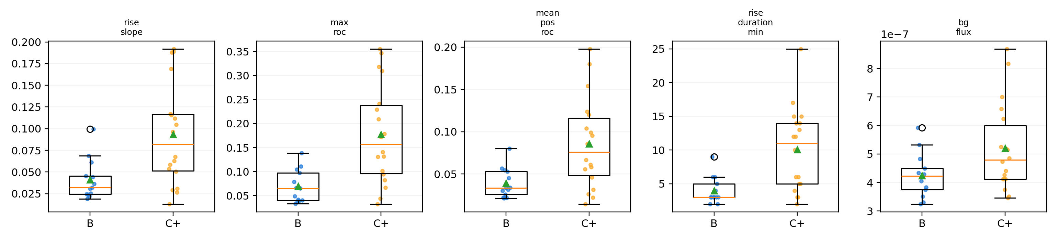
The Five Primary Predictors
All represent information available through the observed peak
1
2
3
4
5
rise_slope
max_roc
mean_pos_roc
rise_duration_min
bg_flux
How steeply is the event rising?
What is the fastest observed rise?
How strongly does it rise on average?
How long does the rise take?
What was the background level?
Observed B vs C+ morphology in the current 31-event dataset
Important overlap
rise_slope, max_roc and mean_pos_roc are strongly correlated.
Primary predictor count = 5. peak_flux is intentionally excluded.
Notes:
Presenter: Member 3
Approx. speaking time: 40 sec
Speaker explanation:
Explain each feature using the human question shown on the slide. Mention that the three rise-rate features are related and later produce high multicollinearity, which is reported transparently.
Likely viva question:
What is bg_flux?
Short answer:
It is the pre-event background X-ray flux level, giving context for the event without directly supplying the target-defining peak flux.

Slide 16
What Is the Model Allowed to Know?
Prediction-time integrity and target-leakage prevention
t_pred = t_peak
AVAILABLE TO THE NOWCAST
NOT AVAILABLE
PEAK
RISE
DECAY
START
END
Allowed primary inputs (START → PEAK)
peak_flux — NOT A PRIMARY PREDICTOR
rise_slope
max_roc
mean_pos_roc
rise_duration_min
bg_flux
NOAA class is defined from peak X-ray flux.
peak flux → target class
max_roc + mean_pos_roc are computed from START → PEAK only.
giving peak_flux to the model would expose the answer definition
Notes:
Presenter: Member 4
Approx. speaking time: 45 sec
Speaker explanation:
This is the key scientific-integrity slide. The task is defined at the observed peak, so post-peak values are forbidden. Stage 8.5 corrected max_roc and mean_pos_roc to use START→PEAK only. Peak_flux is also excluded because NOAA class itself is defined from peak flux.
Likely viva question:
Is information at the peak leakage?
Short answer:
Not temporal leakage, because the task is explicitly nowcasting at the observed peak. However, we still report a target-proxy concern because rise-phase morphology is physically related to the peak that defines class.

Slide 17
Impulsive-Phase Flare Severity Nowcasting
One independent event → five features → B or C+
PHYSICAL EVENT
5 FEATURES
CLASSIFIER
OUTPUT
START→PEAK
rise morphology
classical ML
B or C+
Independent ML dataset
Why physical-event deduplication matters
32
31
1
The original labeled table contained repeated detections for three NOAA events.
Multiple rows from one physical event are not independent training examples.
Deduplication keeps one row per physical NOAA event before supervised ML.
physical NOAA events
ML eligible
U excluded
Class distribution
B = 13
C+ = 18
One physical event = one supervised row
This is nowcasting at t_pred = t_peak — not future-flare forecasting.
Notes:
Presenter: Member 4
Approx. speaking time: 35 sec
Speaker explanation:
Re-state the unit of analysis before models: one independent physical event becomes one row with five allowed predictors. Explain the 32→31 filtering and class distribution.
Likely viva question:
Why deduplicate before ML?
Short answer:
Because repeated detections of the same physical NOAA event would violate independence and could make performance look artificially strong.

Slide 18
How Did We Test the Classification Experiment?
Chronological train / development / final-test design
31 independent ML events in chronological order
18 TRAIN · 7 B | 11 C+
6 DEVELOPMENT · 1 B | 5 C+
7 FINAL TEST · 5 B | 2 C+
TRAIN
learn parameters
DEVELOPMENT
compare predefined models
FINAL TEST
evaluate after model is frozen
Predefined classical models
Selection rule
Logistic Regression
Decision Tree
Random Forest
Primary: Macro F1
probability gate
if–then splits
many trees vote
Secondary: Balanced Accuracy
The final test is never used to choose the model.
Notes:
Presenter: Member 4
Approx. speaking time: 45 sec
Speaker explanation:
Explain chronology before results. The earliest 18 events train, the next 6 are development, and the final 7 are untouched until the model is frozen. Then introduce the three predefined classical models and the Macro-F1 / balanced-accuracy selection rule.
Likely viva question:
Why not use a random split?
Short answer:
A chronological split better reflects the intended temporal use: learn from earlier events and assess later ones without mixing future and past.

Slide 19
What Did the Models Actually Show?
Development comparison, frozen final test and robustness checks
Development set (6 events)
Final test (7 events)
Interpretation
Model | Macro F1 | Balanced Acc.
Logistic Regression | 1.000 | 1.000
Decision Tree | 0.778 | 0.900
Random Forest | 0.778 | 0.900
 | Pred B | Pred C+
Actual B | 5 | 0
Actual C+ | 0 | 2
Final test N = 7
Observed 7/7 does not establish generalization.
7 / 7 correct
Development procedure froze Logistic Regression.
Supplementary LOOCV
Important statistical warnings
Model | Accuracy | Macro F1 | Bal. Acc.
Logistic Regression | 0.9677 | 0.9665 | 0.9615
Decision Tree | 0.8065 | 0.7961 | 0.7906
Random Forest | 0.9032 | 0.8995 | 0.8953
•
Complete separation
ordinary LR coefficients unstable
•
Convergence warnings
probabilities approach 0 / 1
•
High multicollinearity
VIF ≈ 35.2, 20.4, 19.7
•
No external validation
future population unknown
Comparative observations only — no “best model” ranking.
Notes:
Presenter: Member 4
Approx. speaking time: 55 sec
Speaker explanation:
Show development and final test separately. State the exact 7/7 result, then immediately state test N=7. LOOCV is supplementary. Complete separation and high VIF mean Logistic coefficients are not stable physical effects, even though sample classification is clean.
Likely viva question:
If Logistic Regression has convergence warnings, why keep its result?
Short answer:
Because the experiment was frozen by the predefined development procedure. We report the warning rather than optimize after seeing the outcome; the warning mainly limits coefficient inference and reliability claims.

Slide 20
What Did This Project Actually Demonstrate?
Scientific contribution, limitations and final scope
WHAT WE DEMONSTRATED
WHAT WE CANNOT CLAIM
Real GOES X-ray observations can be processed as a time series.
Rolling statistics can describe a changing solar background.
Statistical anomaly scores can identify unusual observations.
Events can be segmented and aligned with NOAA records.
Event shape can be converted into leakage-controlled predictors.
A B vs C+ nowcasting experiment can be evaluated and replayed in R Shiny.
Operational flare forecasting or early warning.
Production readiness or broad population generalization.
Stable causal interpretation of Logistic coefficients.
Superiority of one algorithm.
Validation across other solar cycles, instruments or populations.
SUN
X-RAYS
DATA
NORMAL
UNUSUAL
EVENT
NOAA
FEATURES
B/C+
TEST
LIMITS
N = 31
final test N = 7
complete separation
high multicollinearity
no external validation
Undergraduate statistical proof-of-concept for solar-event detection and severity nowcasting.
Live demonstration → R Shiny: GOES Data → Statistical Baseline → Event Detection & NOAA → Severity Nowcasting → ML Evaluation
Notes:
Presenter: Member 4
Approx. speaking time: 45 sec
Speaker explanation:
Close by separating contribution from claims. The project demonstrates an auditable statistical workflow and a small-sample classification experiment. It does not establish operational forecasting or generalization. Then move directly into the frozen R Shiny GUI for the live laboratory demonstration.
Likely viva question:
What is the single strongest limitation?
Short answer:
The small number of independent physical events: 31 for ML and only 7 in the final chronological holdout, with no external validation.

