Slide 1
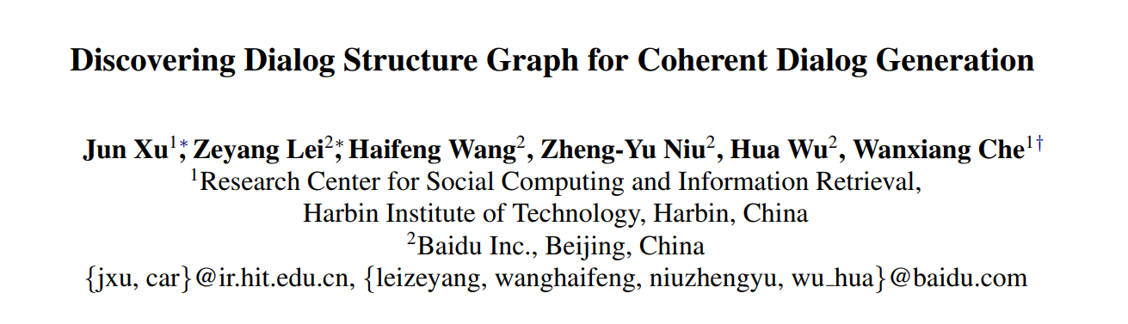
ACL 2021
1

Slide 2
介绍
任务：开放域对话结构探索(open-domain dialog structure discovery)， 多轮对话
动机：
从大量现有的人-人对话数据中无监督地学习对话结构图能够为对话生成提供丰富的先验知识，然而面向开放域的对话结构探索的研究很少。在这篇论文中作者提出将离散变分自编码器和图神经网络结合，通过在开发域语料库上无监督地学习来发现离散的层级对话状态以及对话状态间的转移机制，从而构建对话结构图谱，并借助构建的对话结构图谱来进行多轮对话生成。
2

Slide 3
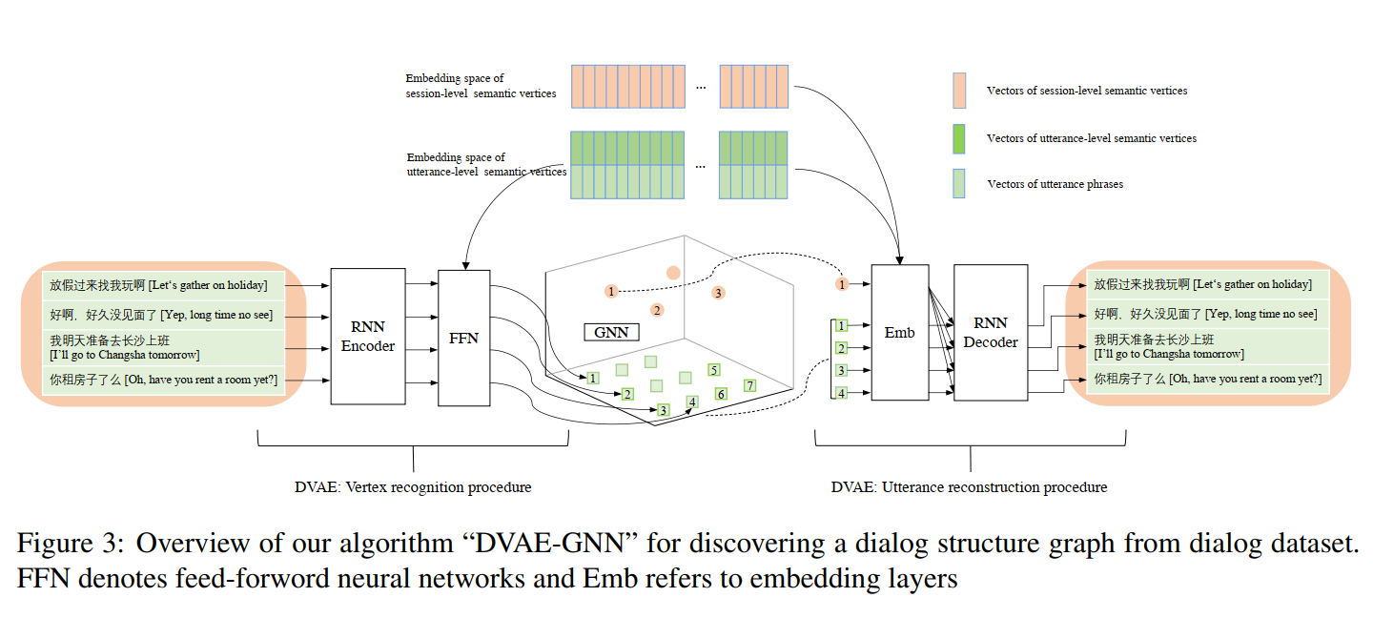
方法
Dialog Structure Discovery
3

Slide 4
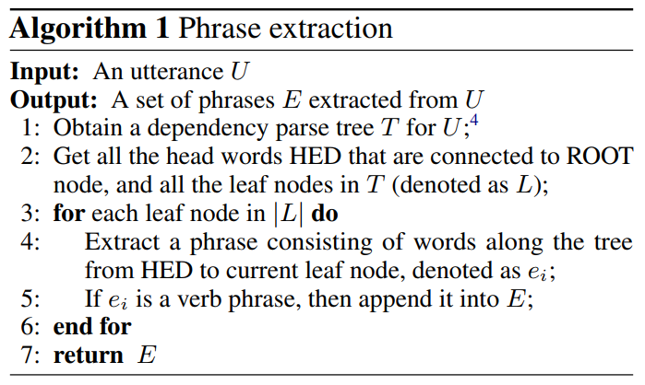
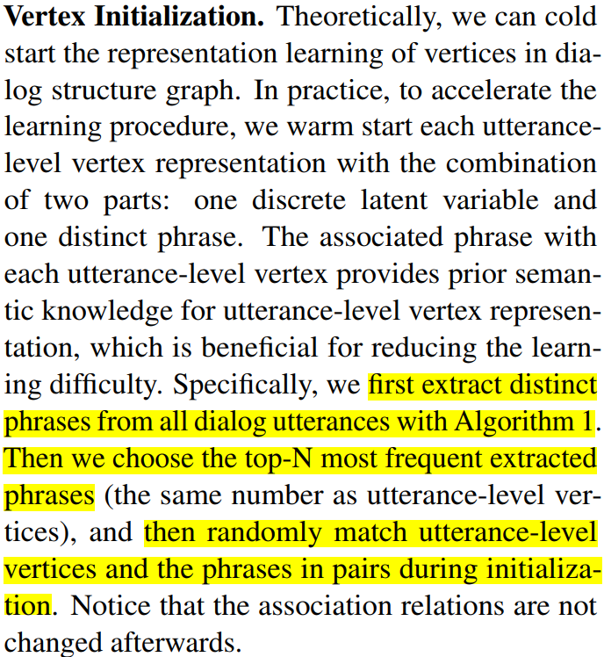

方法
1. Graph Initialization
1.1 Vertex Initialization
Session-level vertex vector
Randomly Initialized
Utterance-level vertex vector
Representation vector of the associated phrase
One-hot vector
4

Slide 5
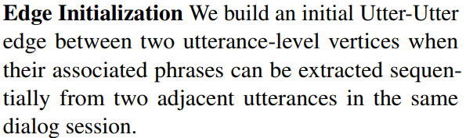
方法
1. Graph Initialization
1.2
5

Slide 6
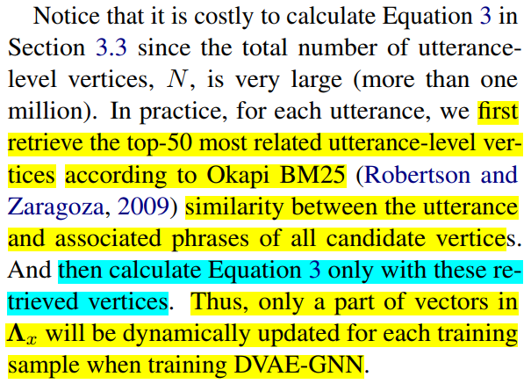

方法
2. Vertex Recognition
2.1
Representation vector of utterance
The mapped utterance-level vertex sampling from the posterior distribution with Gumbel-Softmax
6

Slide 7

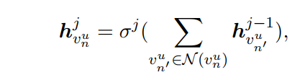

方法
2. Vertex Recognition
2.2
RNN
The j-th layer structure-aware representation of
utterance-level vertex
Structure-aware session representation
The mapped session-level vertex
sampling from the posterior distribution with Gumbel-Softmax
7

Slide 8
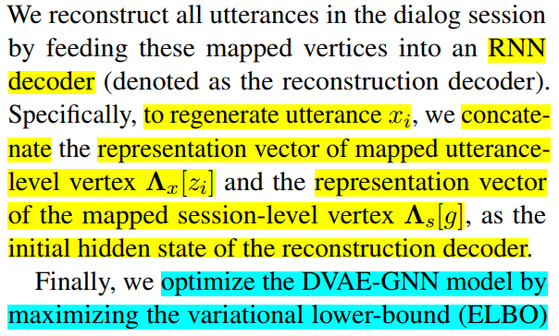
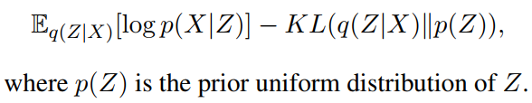
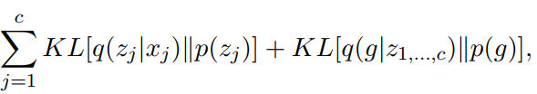
方法
3. Utterance Reconstruction
log-likelihood
8

Slide 9
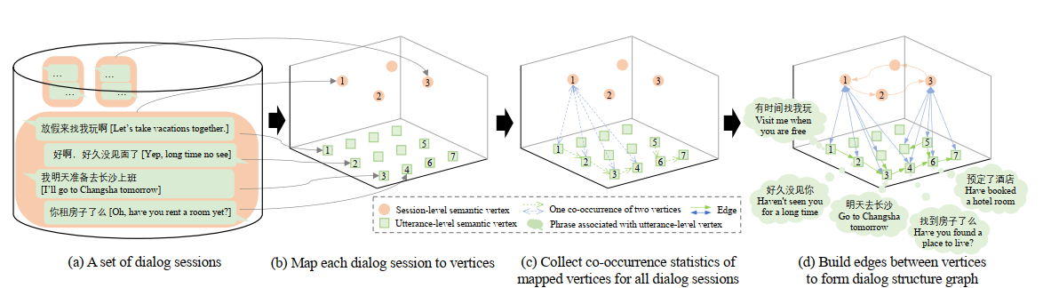
方法
4. Graph Construction
Map all dialog sessions in corpus to vertices
Collect co-occurrence statistics of these mapped vertices
Build edges between vertices based on these co-occurrence statistics

Slide 10
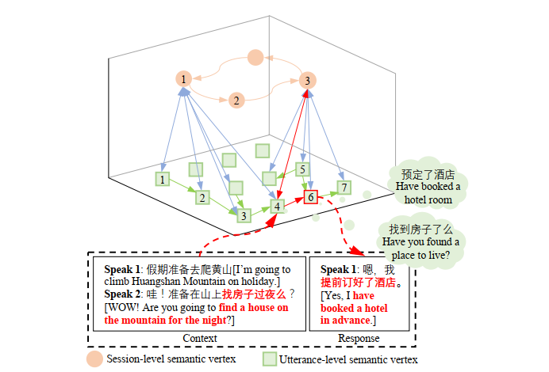
方法
5. Graph Grounded Dialog Generation
Three Modules:
A dialog context understanding module that maps given dialog context (the previous two utterances) to an utterance-level vertex in the graph
A hierarchical policy for two-level vertex selection
A response generator that generate an appropriate response based on the selected utterance-level vertex

Slide 11
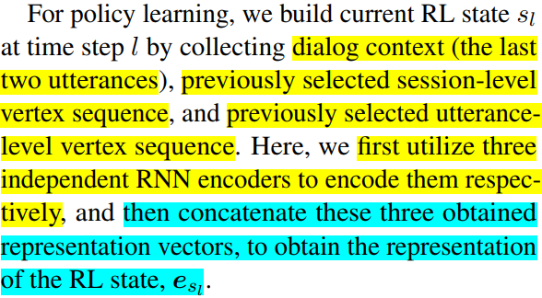
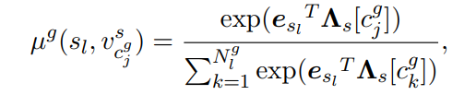
方法
5. Graph Grounded Dialog Generation
A hierarchical policy for two-level vertex selection
Session-level sub-policy
Select a session-level vertex from all parent session-level vertices of current mapped utterance-level vertex

Slide 12
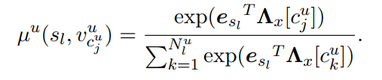
方法
5. Graph Grounded Dialog Generation
A hierarchical policy for two-level vertex selection
Utterance-level sub-policy
Select(sample) an utterance-level vertex from all utterance-level vertices that are connected to the vertex of current dialog topic

Slide 13
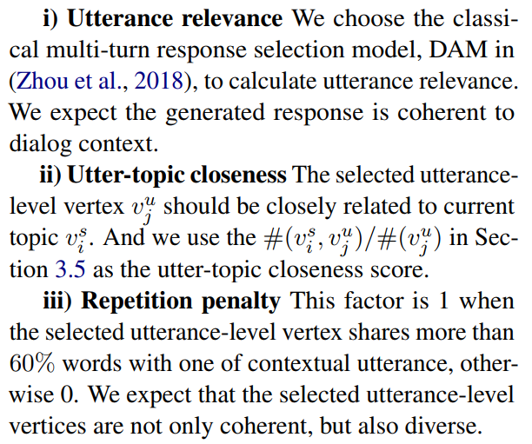
方法
5. Graph Grounded Dialog Generation
A hierarchical policy for two-level vertex selection
RL Rewards
The reward for the utterance-level sub-policy is a
weighted sum of following factors:

Slide 14
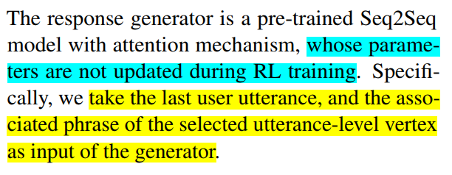
方法
5. Graph Grounded Dialog Generation
Response generator

Slide 15
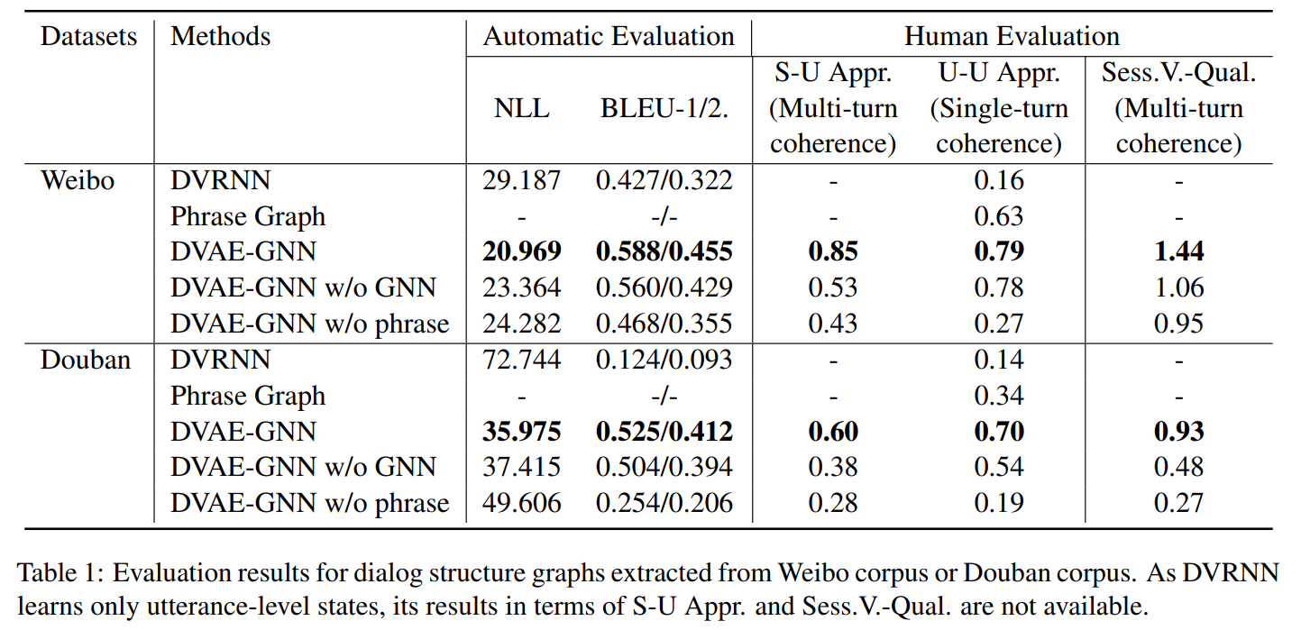
实验结果
Experiments for Dialog Structure Graph Discovery
15

Slide 16
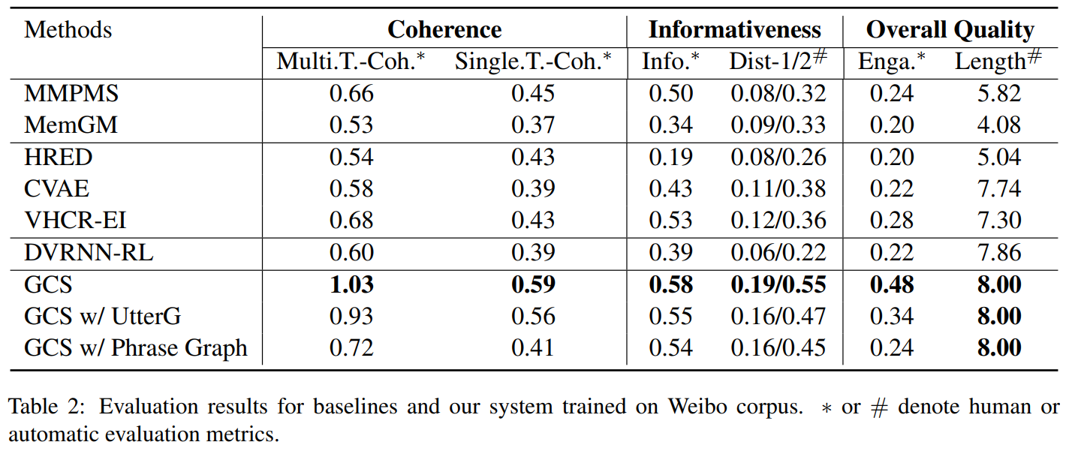
实验结果
Experiments for Graph Grounded Dialog Generation
16

Slide 17
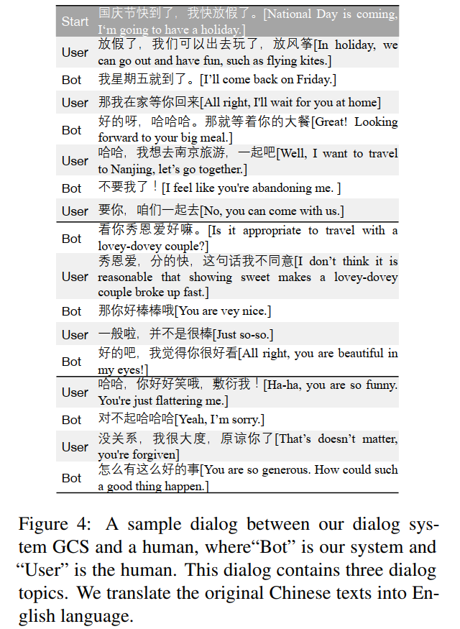
实验结果
Case Study
17

