Slide 1
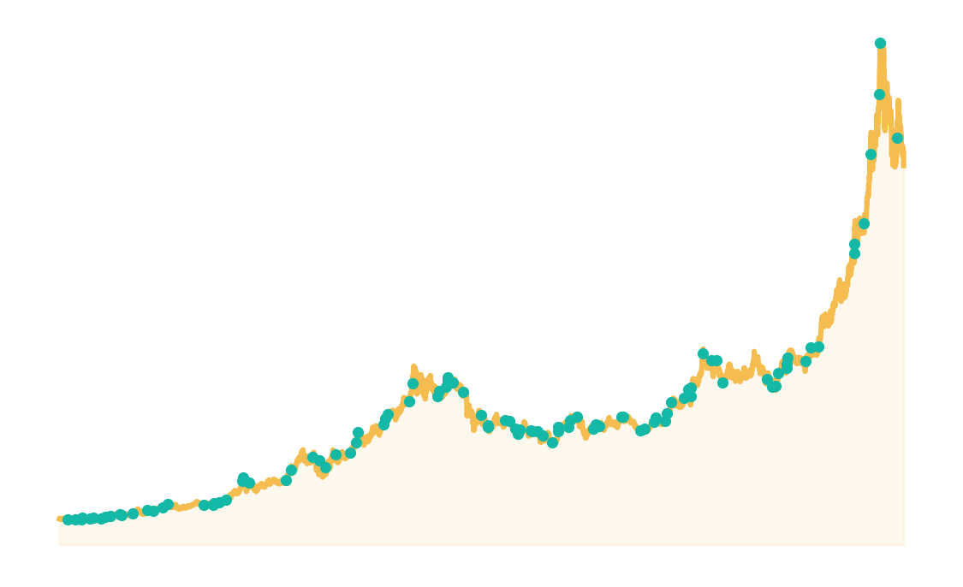
DATA ANALYTICS AND VISUALIZATION · COURSE PROJECT
GoldWatch
Detecting anomalous price spikes in gold futures with rolling statistics
Can price and volume statistics alone flag pump-and-dump-style moves?
MEMBER A
MEMBER B
MEMBER C
[Name]
[Name]
[Name]
Data Collection & Preprocessing
Anomaly Detection & Backtesting
Dashboard & Integration
Notes:
Speaker: any member.
Introduce the team and the project: GoldWatch detects unusual price and volume moves in gold futures using rolling statistics, and tests whether upward spikes are followed by declines.

Slide 2
Agenda
01
Problem & Motivation
05
Backtesting
From crypto pump-and-dumps to gold
Algorithm 3: event study · Algorithm 4: Z-test
02
Dataset & Preprocessing
06
Interactive Dashboard
Yahoo Finance GC=F, 2000–2026
Streamlit + Plotly
03
Exploratory Data Analysis
07
Findings & Limitations
Fat tails, volatility clusters, volume quality
What the data says — and what it can't
04
Anomaly Detection
Algorithm 1: rolling Z-score · Algorithm 2: scoring
GoldWatch · Data Analytics and Visualization
2
Notes:
Speaker: any member. Walk through the structure of the talk in one sentence each.

Slide 3
Problem & Motivation
INTRODUCTION
INSPIRATION: PUMP-AND-DUMP
RESEARCH QUESTION
In small-cap crypto, groups buy a coin together. The price “pumps” on heavy volume, then they sell and the price “dumps”.
Can unusual price and volume moves in gold be detected statistically — and are upward spikes followed by declines?
Price spike
Heavy volume
Crash
PumpWatch idea: flag these spikes using only price and volume statistics.
Our twist: apply the same idea to gold futures.
WHY GOLD?
Huge, liquid market: a tough test for a pattern seen in crypto
26 years of free daily data, and spikes follow real news
Detect
Score
Backtest
Visualize
GoldWatch · Data Analytics and Visualization
3
Notes:
Speaker: Member A or B.
Our starting point was a crypto project idea (PumpWatch): in small coins, groups buy together, the price pumps on heavy volume, then they sell and it dumps. We asked whether the same statistical tools work on gold — a huge, liquid market — and whether upward spikes there are also followed by declines.

Slide 4
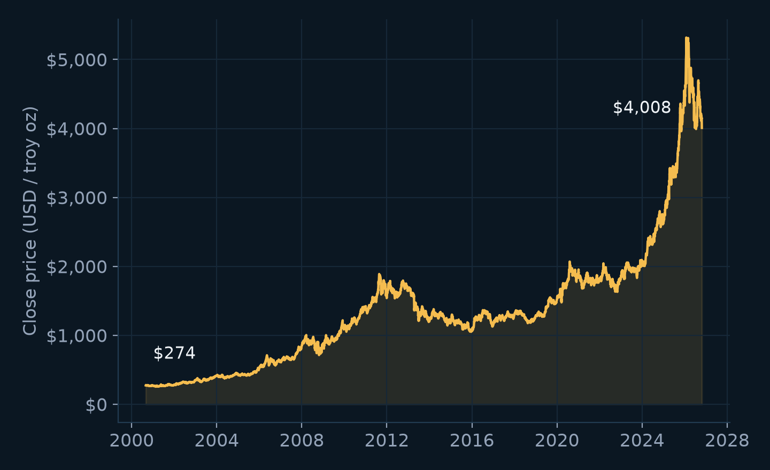
Dataset
DATA
AT A GLANCE
GOLD CLOSE PRICE, 2000–2026
INSTRUMENT
COMEX gold futures (GC=F)
SOURCE
Yahoo Finance via yfinance
PERIOD
30 Aug 2000 – 23 Oct 2026
FREQUENCY
Daily trading sessions
ROWS
6,563 raw → 6,122 clean
FIELDS
Open, High, Low, Close, Volume
Price rose from $274 to $4,008 per ounce, so we analyse % returns, not raw prices.
GoldWatch · Data Analytics and Visualization
4
Notes:
Speaker: Member A.
We use gold futures (ticker GC=F) from Yahoo Finance through the yfinance library: 6,563 daily rows from August 2000 to October 2026. Each row has open, high, low, close and volume. Because the price rose more than tenfold, we analyse percentage returns rather than raw prices.

Slide 5
System Workflow
ARCHITECTURE
SOURCE
MEMBER A
MEMBER B
MEMBER B
MEMBER C
Yahoo Finance
Data Pipeline
Anomaly Detection
Backtest
Dashboard
GC=F daily OHLCV via yfinance
Clean, validate, compute returns
Rolling Z-scores, anomaly score
Spike → forward return vs. baseline
Interactive charts & controls
API download
gold_futures_processed.csv
gold_futures_analysis.csv
gold_futures_backtest.csv
streamlit run app.py
Each stage writes a CSV that the next stage reads, so every step can be run and tested on its own.
TECH STACK
Python
pandas
NumPy
yfinance
Streamlit
Plotly
Matplotlib
pytest
GoldWatch · Data Analytics and Visualization
5
Notes:
Speaker: any member.
The project is a pipeline of independent stages. Each stage writes a CSV that the next stage reads, so every step can be run and checked on its own. Member A builds the data pipeline, Member B the detection and backtest, Member C the dashboard that puts it all together.

Slide 6
Data Collection & Preprocessing
MEMBER A
1
Download
RESULT
yfinance, ticker GC=F, full history
6,563 → 6,122
2
Normalise
441 invalid rows removed
0 duplicate dates · 0 missing closes
Flatten columns, standard dates, sort, remove duplicates
3
Validate
Prices > 0, High ≥ Low, Open/Close inside High–Low, Volume ≥ 0
DAILY RETURN
R_{t} = Close_{t} / Close_{t−1} − 1
4
Missing values
Drop rows without a Close (no forward-fill); keep missing volume as blank
Features
WHY NO FORWARD-FILL?
5
Copying yesterday's price creates fake 0% days and hides real moves.
Daily return, absolute return, intraday price range
GoldWatch · Data Analytics and Visualization
6
Notes:
Speaker: Member A.
Five steps: download, normalise, validate, handle missing values, compute features. Rows with impossible prices (for example High below Low) are removed — 441 rows in total, almost all from early 2000s settlement-price issues. We never forward-fill prices, because copying yesterday's price hides real moves and would distort the anomaly detection.

Slide 7
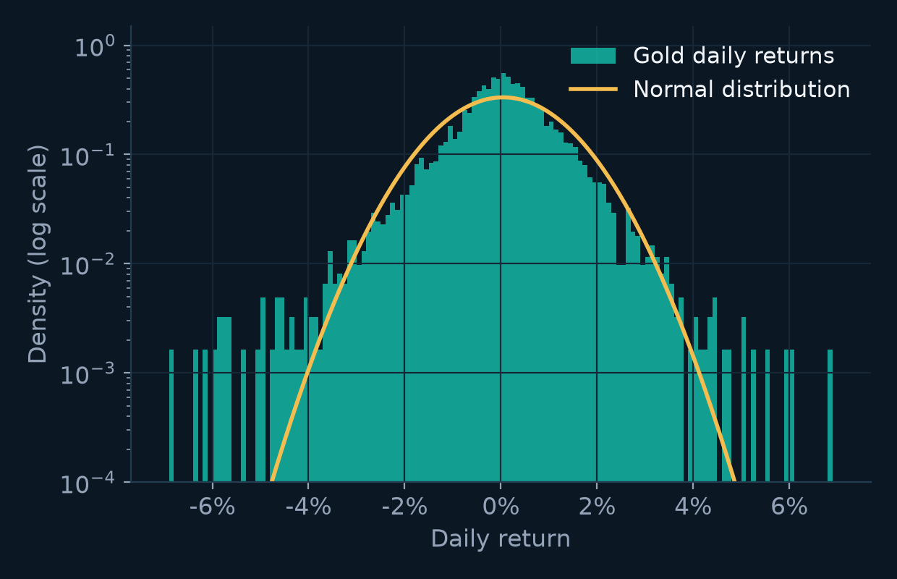
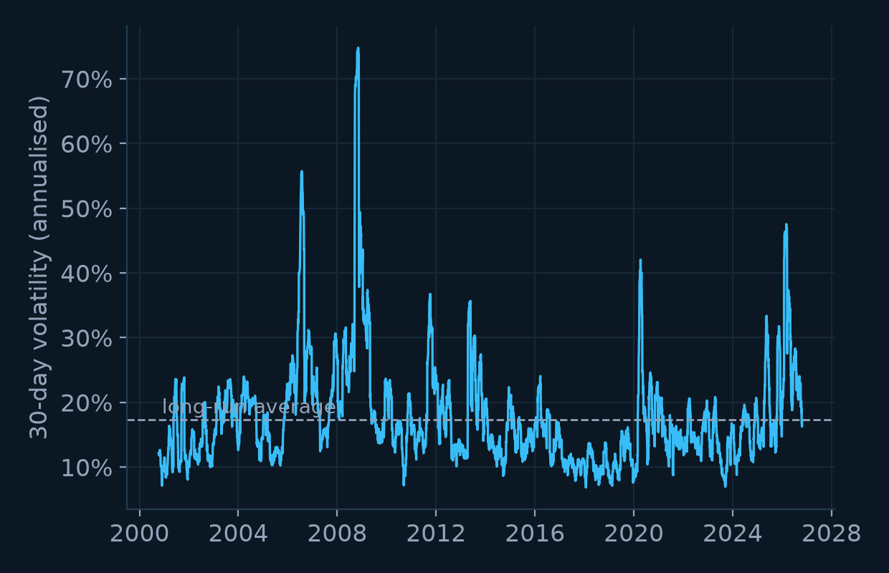
Exploratory Analysis: Returns
EDA
DISTRIBUTION OF DAILY RETURNS
30-DAY ROLLING VOLATILITY
Fat tails: 3.6% of days have |Z| ≥ 2.5, vs. 1.2% for a normal curve
Volatility clusters: calm and turbulent periods alternate → use a rolling window
GoldWatch · Data Analytics and Visualization
7
Notes:
Speaker: Member B.
Left: the histogram of daily returns on a log scale against a normal curve. Gold has fat tails — extreme days happen far more often than a bell curve predicts (excess kurtosis 20.1). Right: volatility comes in clusters (2008, 2013, 2020). So a fixed threshold over the whole history would be wrong; we need a rolling window that adapts to the current regime.

Slide 8
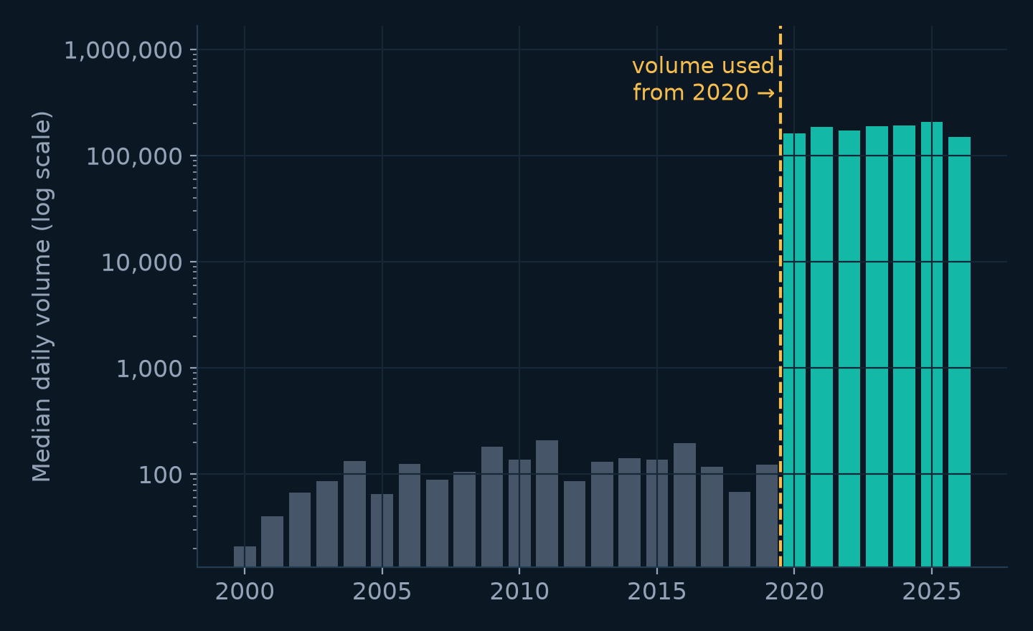
Exploratory Analysis: Volume Quality
EDA
MEDIAN DAILY VOLUME BY YEAR (YAHOO FINANCE GC=F)
WHAT WE FOUND
Before 2020: median ~118 contracts/day and 382 zero days — not real exchange volume
From 2020: median ~180,215/day — real COMEX volume
Decision: volume Z-score only from 2020
Low-volume days are contract rolls at month-end → only HIGH volume is treated as an anomaly
GoldWatch · Data Analytics and Visualization
8
Notes:
Speaker: Member B.
Before 2020, Yahoo reports a median of only about 118 contracts a day for GC=F, with 382 zero-volume days. From 2020 the median is about 180,215 — real exchange volume. So we only compute volume Z-scores from 2020. We also found that very LOW volume days fall at month-end contract rolls, so only HIGH volume counts as an anomaly.

Slide 9
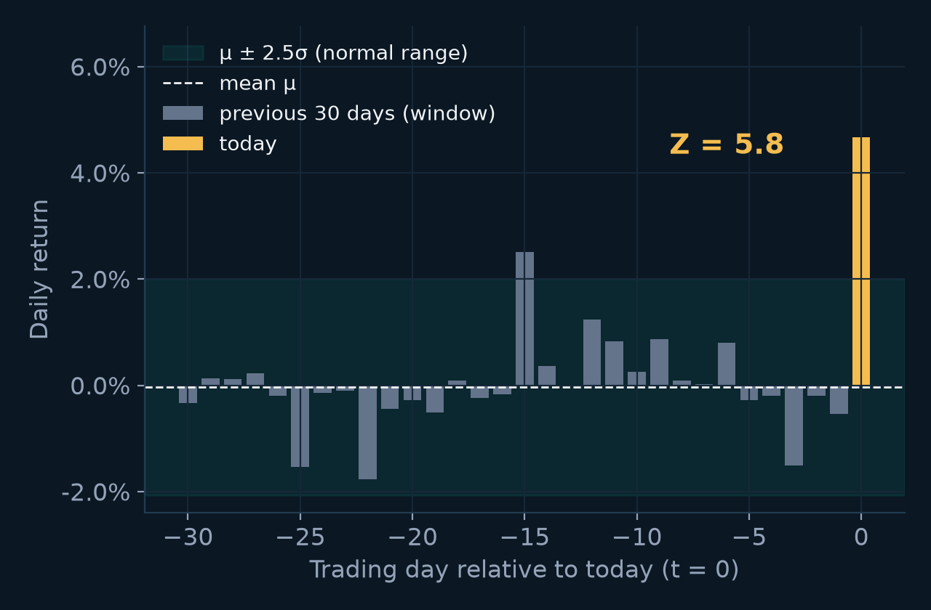
Algorithm 1: Rolling Z-score
MEMBER B · DETECTION
FORMULA
WORKED EXAMPLE: BREXIT VOTE, 24 JUN 2016
Z_{t} = (x_{t} − μ_{t}) / σ_{t}
μ_{t}, σ_{t} = mean and std of the previous 30 days
for each day t:
past = x[t-30 : t] # today excluded
mu = mean(past)
sigma = std(past)
Z[t] = (x[t] - mu) / sigma
No look-ahead: only past data is used
Adaptive: window follows calm vs. volatile periods
Applied to: daily returns and log(volume)
Z = (4.66% − -0.03%) / 0.81% = 5.8 → far outside the normal ±2.5 range
GoldWatch · Data Analytics and Visualization
9
Notes:
Speaker: Member B.
The Z-score measures how unusual today is compared with the previous 30 trading days. We take the mean and standard deviation of those 30 days and see how many standard deviations today is away from the mean. Today is excluded from its own window: otherwise a spike would inflate the mean and std and hide itself, and we would be using information that wasn't available yet.
Example (chart): Brexit vote, 24 June 2016. Gold rose 4.66% while the previous 30 days had mean -0.03% and std 0.81%. Z = (4.66 − -0.03) / 0.81 = 5.8. Complexity is O(n) with a sliding window.

Slide 10
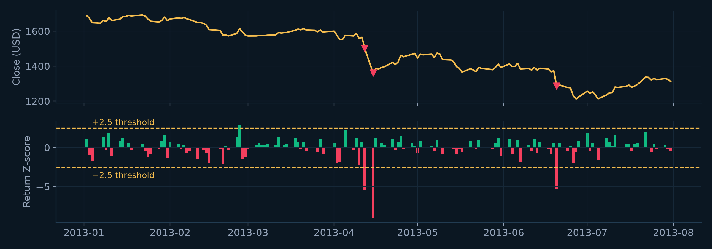
Algorithm 1 in Action: the April 2013 Gold Crash
MEMBER B · DETECTION
GOLD PRICE (TOP) AND RETURN Z-SCORE (BOTTOM), JAN–JUL 2013
12 & 15 Apr 2013 Z = -5.5 and -9.0: both flagged
Threshold ±2.5 only a few days a year cross it
Window adapts after the crash σ is larger, so later moves score lower
GoldWatch · Data Analytics and Visualization
10
Notes:
Speaker: Member B.
Top: gold price in the first half of 2013. Bottom: the rolling Z-score of daily returns, with the ±2.5 thresholds. On 12 and 15 April 2013 gold fell sharply and the Z-score drops far below −2.5, so both days are flagged (red triangles). Note that after the crash the window contains the big moves, so σ is larger and later moves of similar size get smaller Z-scores — the window adapts.

Slide 11
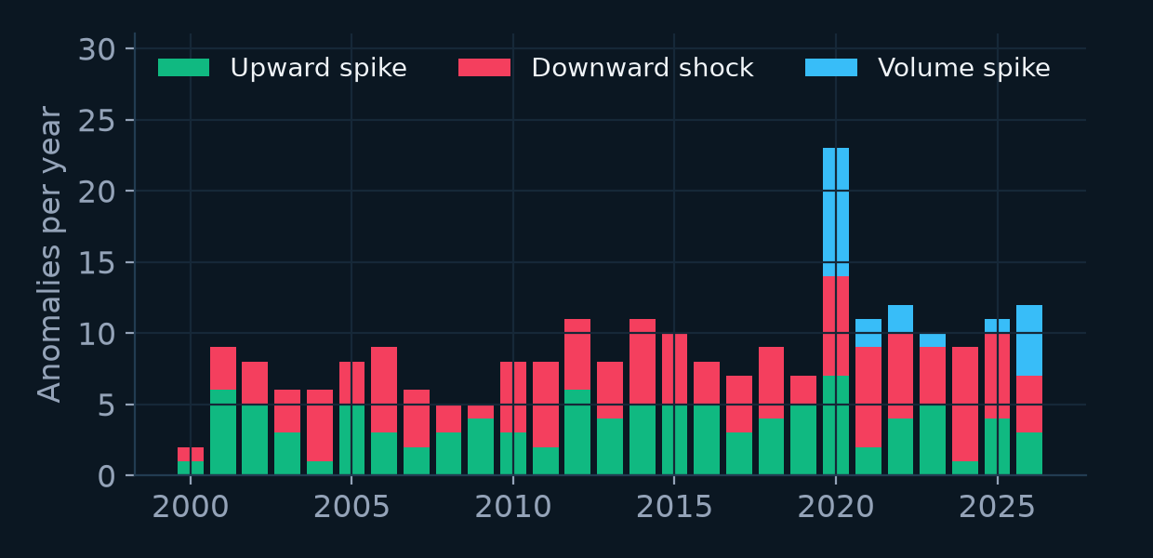
Algorithm 2: Anomaly Scoring & Labelling
MEMBER B · DETECTION
STEPS
239
101
118
20
# 1. cap and scale to 0..1
r = min(|Z_return|, 5) / 5
v = min(max(Z_volume, 0), 5) / 5
# 2. weighted score (w = 0.5)
score = 100 * (r + 0.5*v) / 1.5
# 3. flag
anomaly = |Z_return| >= 2.5 or Z_volume >= 2.5
anomalous days (3.9%)
upward spikes
downward shocks
volume spikes
ANOMALIES PER YEAR
4. LABEL
Z_return ≥ +2.5
Upward spike
Z_return ≤ −2.5
Downward shock
only volume ≥ 2.5
Volume spike
GoldWatch · Data Analytics and Visualization
11
Notes:
Speaker: Member B.
Step 1: cap each Z-score at 5 (twice the threshold) so one extreme day doesn't dominate, and scale to 0–1. Only positive volume Z counts. Step 2: weighted average — volume counts half as much as price — times 100 gives a 0–100 score. Step 3: a day is flagged if either Z crosses 2.5. Step 4: label it.
Result: 239 anomalous days (3.9%): 101 upward spikes, 118 downward shocks, 20 volume spikes.

Slide 12
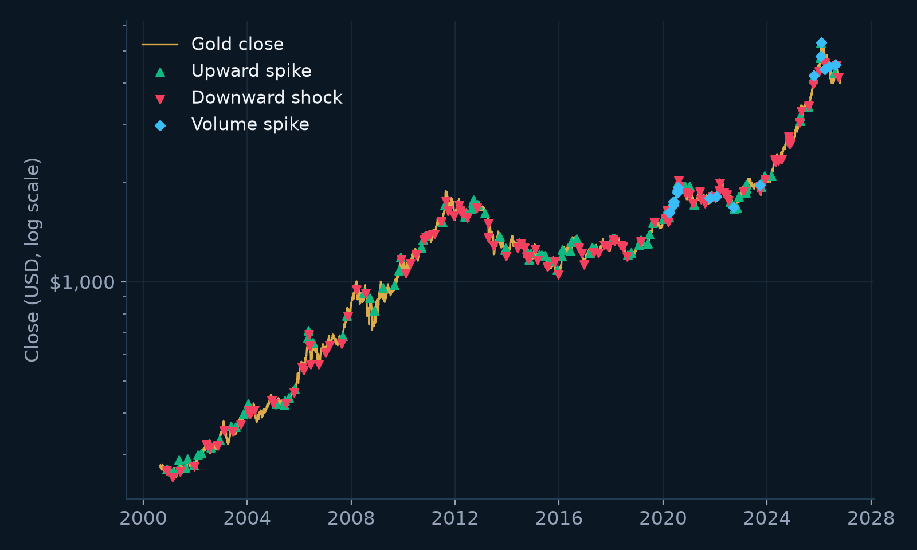
Detected Anomalies Match Real Events
RESULTS
GOLD PRICE WITH FLAGGED DAYS (LOG SCALE)
Date | Move | Z | What happened
14 Sep 2001 | +6.8% | +9.9 | Markets reopen after 9/11
15 Apr 2013 | -9.4% | -9.0 | April 2013 gold crash
24 Jun 2016 | +4.7% | +5.8 | Brexit referendum result
20 Jun 2019 | +3.6% | +5.6 | Fed signals rate cuts
09 Nov 2020 | -5.0% | -5.4 | Covid vaccine announced
The detector only sees numbers, yet its strongest flags line up with major news events.
GoldWatch · Data Analytics and Visualization
12
Notes:
Speaker: Member B.
Left: the whole price history on a log scale with every flagged day. Right: some of the strongest anomalies and the news behind them. The algorithm knows nothing about the news — it only sees numbers — yet the biggest flags line up with 9/11, the 2013 crash, the Brexit vote, the Fed's 2019 turn and the Covid vaccine announcement. This is a good sanity check that the detector finds real events.

Slide 13
Algorithm 3: Event-Study Backtest
MEMBER B · BACKTEST
t − 1
t
t + 1
…
t + h
Spike day
Entry = Close[t]
h days later
Exit = Close[t+h]
ALGORITHM
WHY COMPARE WITH A BASELINE?
for each upward spike day t:
fwd = Close[t+h] / Close[t] - 1
declined = fwd < 0
decline_rate = mean(declined) # spikes
baseline_rate = mean(fwd < 0) # all days
lift = decline_rate - baseline_rate
Gold falls over 5 days about 44% of the time anyway.
So “45% of spikes were followed by a drop” means nothing on its own.
Only the lift over the baseline shows a real effect.
Horizons tested: h = 1, 5, 10, 20 days.
GoldWatch · Data Analytics and Visualization
13
Notes:
Speaker: Member B.
For each upward spike on day t we 'buy' at the close of day t and look at the close h trading days later. The forward return is exit divided by entry minus one; if it's negative the spike was followed by a decline. We do this for h = 1, 5, 10 and 20 days.
The key idea is the baseline: gold falls over a 5-day period about 44% of the time anyway. So we compare the decline rate after spikes with the decline rate over all days. The difference is the lift.

Slide 14
Algorithm 4: One-Proportion Z-test
MEMBER B · BACKTEST
H0 (NULL HYPOTHESIS)
WORKED EXAMPLE: 20-DAY HORIZON
Spikes are followed by drops no more often than a normal day
n
101 spikes, 55 declined
p_spike
55 / 101 = 0.545
H1 (ALTERNATIVE)
Spikes are followed by drops MORE often
p_base
baseline = 0.430
SE
√(0.430 × 0.570 / 101) = 0.0493
TEST STATISTIC
z
(0.545 − 0.430) / 0.0493 = 2.32
z = (p_spike − p_base) / SE
SE = √( p_base(1 − p_base) / n )
p-value = 1 − Φ(z)
p
1 − Φ(2.32) = 0.010
p_spike = decline rate after spikes, p_base = baseline, n = number of spikes, Φ = normal CDF. Reject H0 if p < 0.05.
p = 0.010 < 0.05 → reject H0
GoldWatch · Data Analytics and Visualization
14
Notes:
Speaker: Member B.
The Z-test tells us whether the difference between the decline rate after spikes and the baseline is real or could be luck. H0 says spikes are no different from a normal day; H1 says they are followed by drops more often. We compute how many standard errors the observed rate is above the baseline and convert that to a p-value with the normal distribution. If p < 0.05 we reject H0.
Worked example with our 20-day result: 55 of 101 spikes declined (0.545) vs a baseline of 0.430: z = 2.32, p = 0.010, so it is significant.

Slide 15
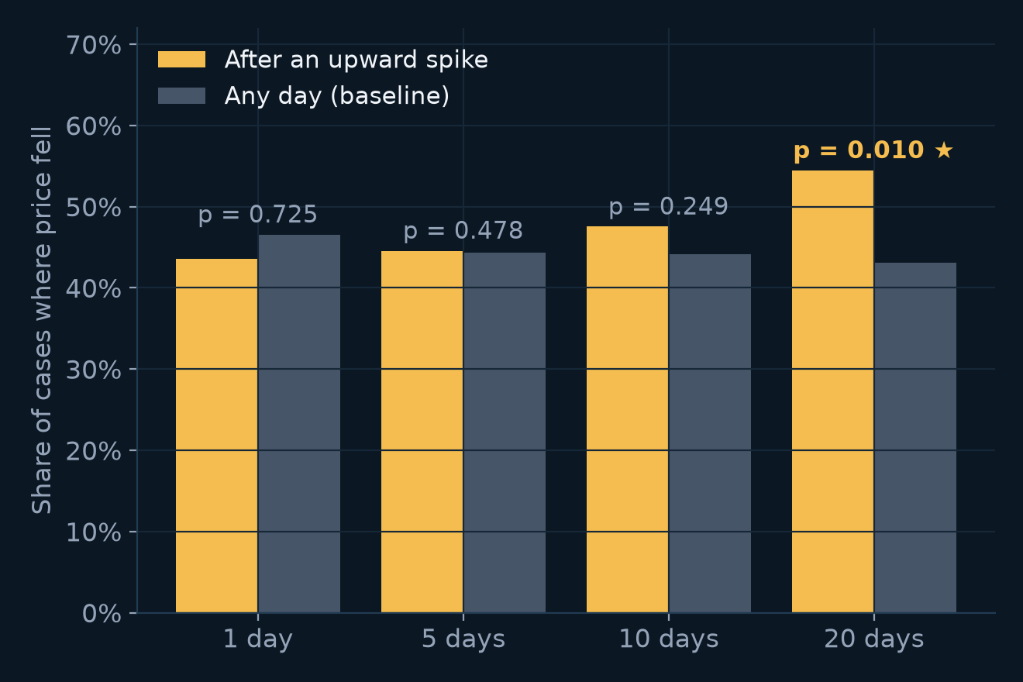
Backtest Results
RESULTS
HOW OFTEN DID THE PRICE FALL AFTER A SPIKE?
Horizon | After spike | Baseline | Lift | p-value
1 day | 43.6% | 46.5% | -3.0% | 0.725
5 days | 44.6% | 44.3% | +0.3% | 0.478
10 days | 47.5% | 44.2% | +3.4% | 0.249
20 days | 54.5% | 43.0% | +11.4% | 0.010
TAKEAWAY
1–10 days: decline rate ≈ baseline → no short-term dump
20 days: 54.5% vs. 43.0%, significant (p = 0.010)
GoldWatch · Data Analytics and Visualization
15
Notes:
Speaker: Member B.
Gold bars: share of upward spikes followed by a decline. Grey bars: the same for any day. After 1, 5 and 10 days the two are almost equal and the p-values are large — no short-term dump. Only at 20 days do spikes decline clearly more often (54.5% vs 43.0%, p = 0.010).

Slide 16
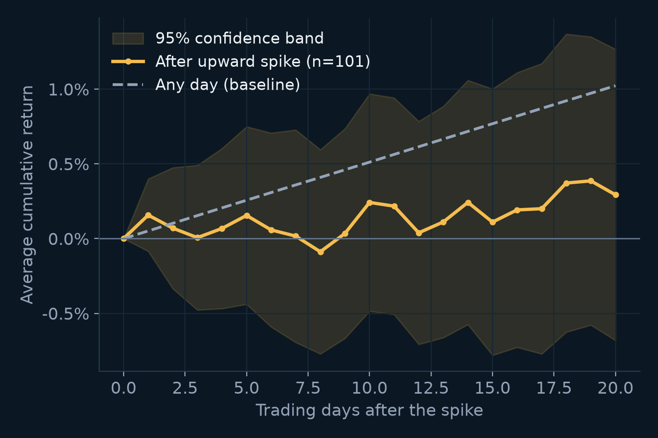
What Happens After a Spike?
RESULTS
AVERAGE CUMULATIVE RETURN AFTER AN UPWARD SPIKE
INTERPRETATION
No crash: the average path stays positive after a spike
Slower growth: +0.29% after 20 days vs. +1.02% for a normal day
Meaning: spikes are news-driven moves that are partly given back over about a month
GoldWatch · Data Analytics and Visualization
16
Notes:
Speaker: Member B.
This chart averages the price path over the 20 trading days after each of the 101 upward spikes, compared with the average path after any day. Spikes do not crash afterwards: the average stays slightly positive. But it grows much more slowly than normal: +0.29% after 20 days vs +1.02% for a normal day. The band shows the 95% confidence interval. So gold spikes look like news-driven repricing that is partly given back over a month, not a pump-and-dump.

Slide 17
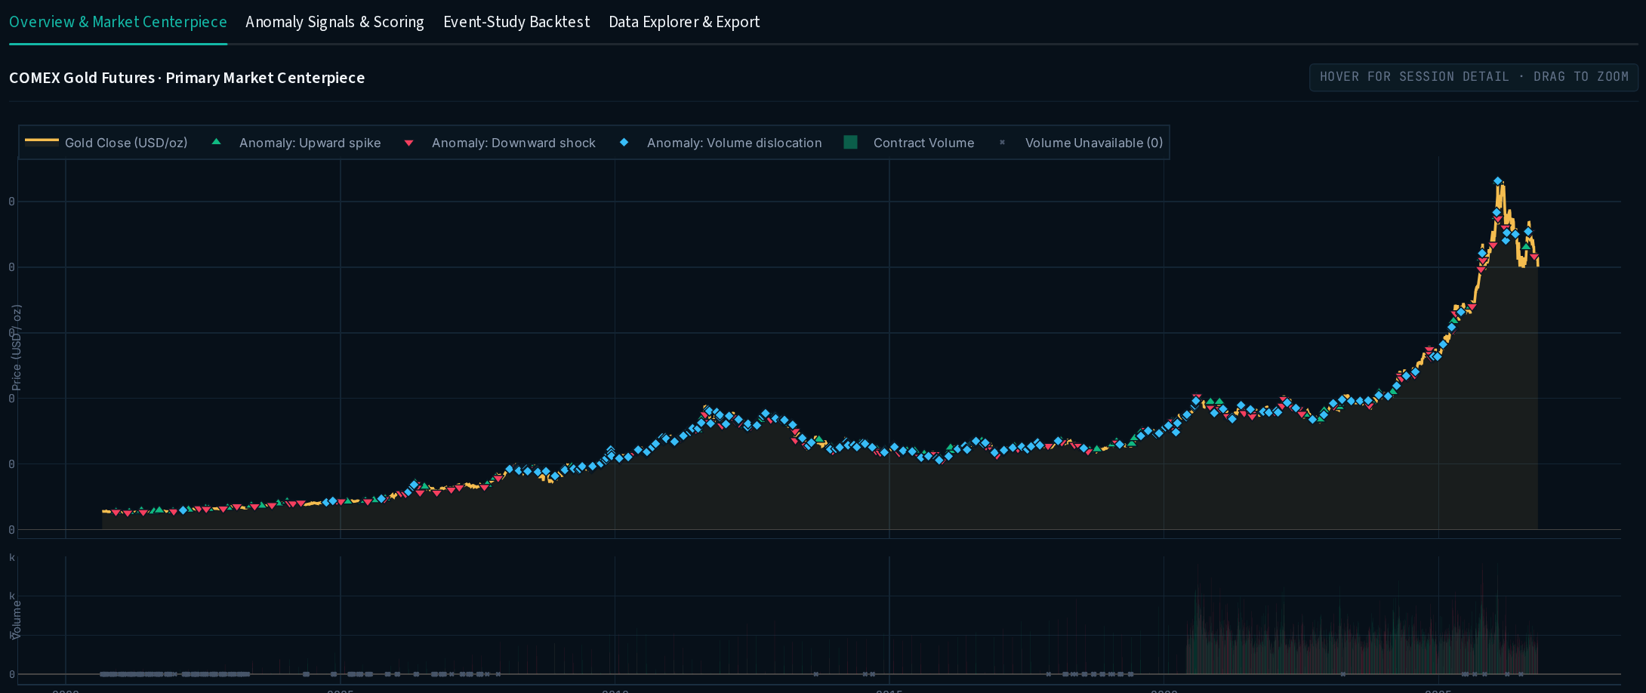
Interactive Dashboard
MEMBER C
OVERVIEW TAB: PRICE, ANOMALY MARKERS AND VOLUME
FEATURES
Date range filter
Area, candlestick or line price chart
Sliders: window, threshold, volume weight
4 tabs: Overview, Signals, Backtest, Data
Ranked anomaly tables
CSV export
GoldWatch · Data Analytics and Visualization
17
Notes:
Speaker: Member C.
The Streamlit dashboard loads the processed data and Member B's analysis and backtest files. The sidebar lets the user pick the date range, chart type and the model parameters — window, threshold and volume weight — and every chart updates immediately. There are four tabs: overview, anomaly signals, the event-study backtest and a data explorer with CSV export. Run it with: streamlit run app.py

Slide 18
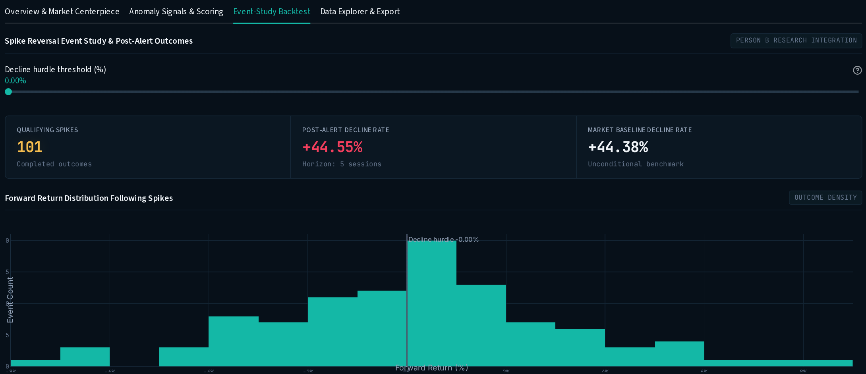
Visualisation Design Choices
VISUALIZATION
BACKTEST TAB
Chart | Question it answers
Price + anomaly markers | When do anomalies happen?
Z-score lines + ±2.5σ band | Why was this day flagged?
Volume bars | Was the move on heavy trading?
Histogram of forward returns | What usually happens next?
Bar chart vs. baseline | Is it better than chance?
KPI cards & ranked tables | Headline numbers, drill-down
KPI cards compare the decline rate after spikes with the market baseline; the histogram shows every outcome, and a slider changes what counts as a decline.
Interactive: Plotly (hover, zoom) · Static charts: Matplotlib
GoldWatch · Data Analytics and Visualization
18
Notes:
Speaker: Member C.
Every chart was chosen to answer a specific question. Price with markers shows when anomalies happen; Z-score lines with threshold bands show the detection rule itself; the forward-return histogram shows the full distribution of outcomes rather than only an average; KPI cards give the headline numbers. The dashboard uses Plotly for interactivity (hover, zoom); the static charts in this deck use Matplotlib.

Slide 19
Conclusions
SUMMARY
Detection works
No short-term dump
239 anomalous days (3.9%); the strongest match real news (9/11, 2013 crash, Brexit, Covid vaccine).
1–10 days after a spike, gold falls about as often as on any day (p > 0.2).
Slow partial reversal
Answer to our question
After 20 days: 54.5% vs. 43.0% declines (p = 0.010).
Gold shows no crypto-style pump-and-dump: spikes are news-driven and partly fade over a month.
GoldWatch · Data Analytics and Visualization
19
Notes:
Speaker: any member.
Four takeaways: the detector works and finds real events; there is no short-term dump in gold; there is a slow partial reversal over about a month; and so the answer to our research question is that gold does not show crypto-style pump-and-dump behaviour.

Slide 20
Limitations & Future Work
SUMMARY
LIMITATIONS
FUTURE WORK
Spikes cluster in time → overlapping windows, p-value somewhat optimistic
4 horizons tested → Bonferroni level 0.0125 (20-day result still passes)
Volume only usable from 2020
Removed rows make a few returns span several days
No trading costs: not a trading strategy
Robust Z-score (median / MAD) and comparison with the standard Z-score
ARIMA forecast errors and seasonal decomposition residuals as extra signals
Extend to silver and other metals
Intraday data for faster detection
Regression of forward return on spike size
GoldWatch · Data Analytics and Visualization
20
Notes:
Speaker: any member.
Limitations: spikes cluster in time, so their outcome windows overlap and the events are not fully independent — the p-value is somewhat optimistic. We tested four horizons; with a Bonferroni correction (0.05 / 4 = 0.0125) the 20-day result still passes. Volume is only usable from 2020. Cleaning removed a few rows, so some returns span several days. And this is not a trading strategy — no costs are modelled.

Slide 21
Thank you
Questions?
REFERENCES & TOOLS
Data: Yahoo Finance, COMEX gold futures (GC=F), via the yfinance Python library
Analysis: pandas, NumPy · Dashboard: Streamlit, Plotly · Charts: Matplotlib · Tests: pytest
GoldWatch · Data Analytics and Visualization
21
Notes:
Speaker: any member. Thank the audience and invite questions.

