Slide 1
Use Case => Event action(eth<x>)
Dispatcher event :
[pre-up]
[down]
NG => OK => NG
!!Recovery
=>
!!Error Log OK(only Link)
Steps success
Carrier 移除
Ethernet 網路流程
0. Carrier Not plugin
Carrier detect
----------------------------
Get_IP_GW
------NM_PRE-UP----
Ping GW IP
Step3 Fail
Link , Internet 燈號 - 0=不亮 - 1=亮 | 乙太網路狀態 | 對應dispatcher event
0,0 | 0. 尚未插入ethernet Cable | [down]
1,1 or 1,0 | 2. Get IP_GW pre-up event activate | [pre-up] => 反映 HMI燈號= 1,0 or 1,1
Notes:
Goal: 判斷出 link lost 與 internet 不通的機制
要通知HMI
記錄 log

Slide 2
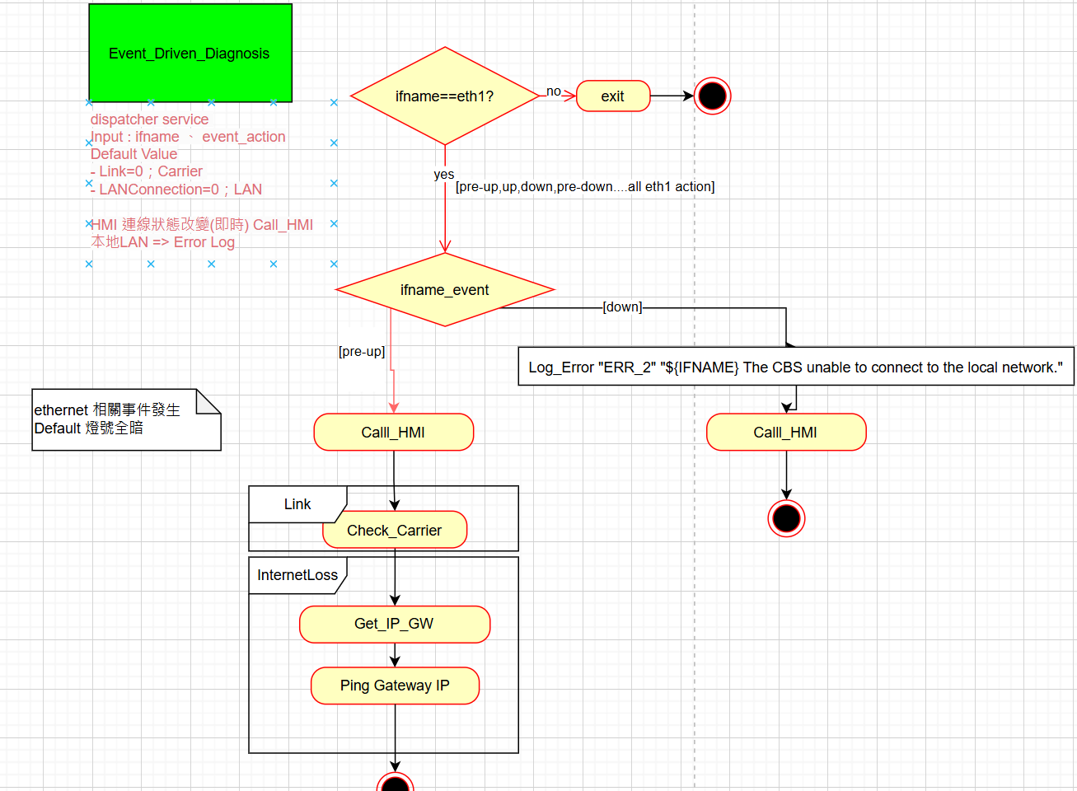
Dispatcher 99-CBSErrorLog.sh

Slide 3
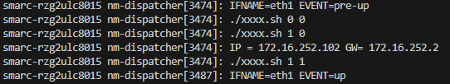
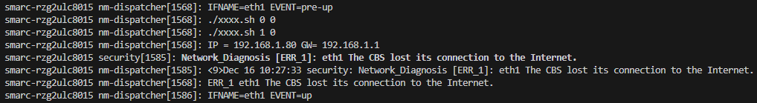
sh執行、Log
[DHCP]正常連線
拔除Ethernet cable，log ERR_2
[Static IP]GW 設定錯誤，Ping不到GW，log ERR_1
故意設定錯誤的GW in config file
Log訊息
./HMI Link Internet

Slide 4
Note : 特定狀況尚無法處理
當RJ45插入，拿不到IP的狀況，如Router-ignore DHCP request，沒辦法呼叫到dispatcher的pre-up/up action；燈號會呈現0,0的顯示狀態，即表示無法從DHCP server取得IP地址

Slide 5
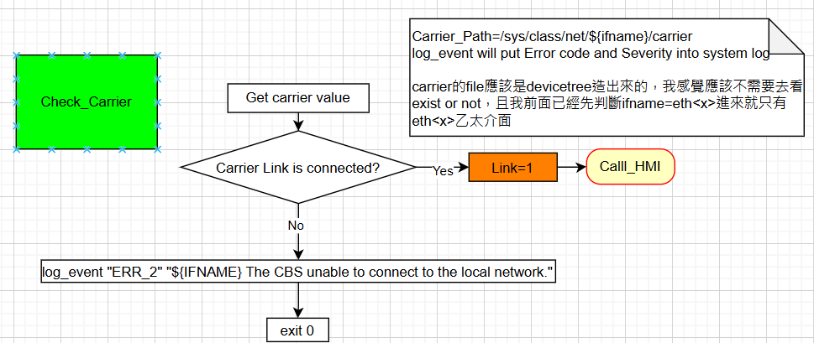
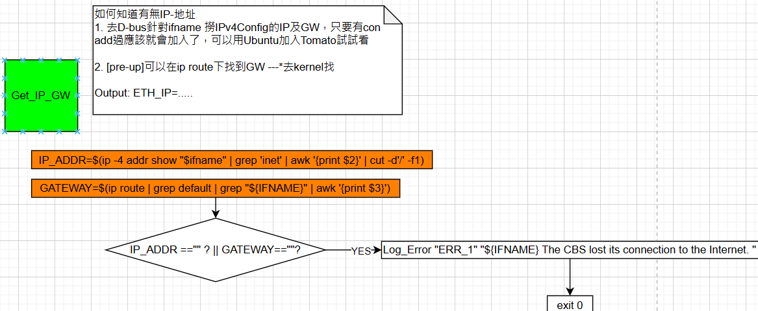
Shell script functions(1/2)

Slide 6
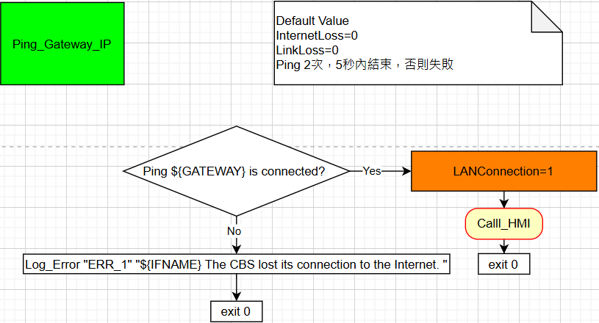
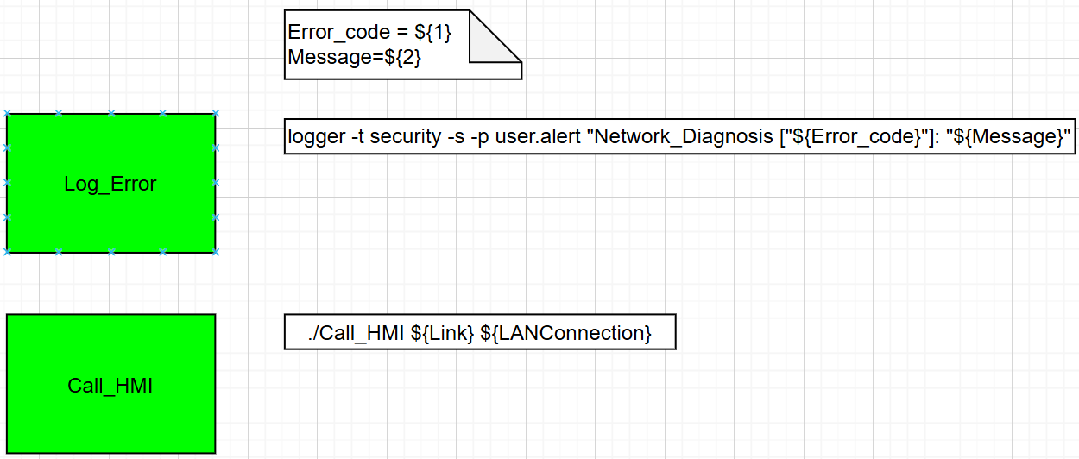
Shell script functions(2/2)

Slide 7
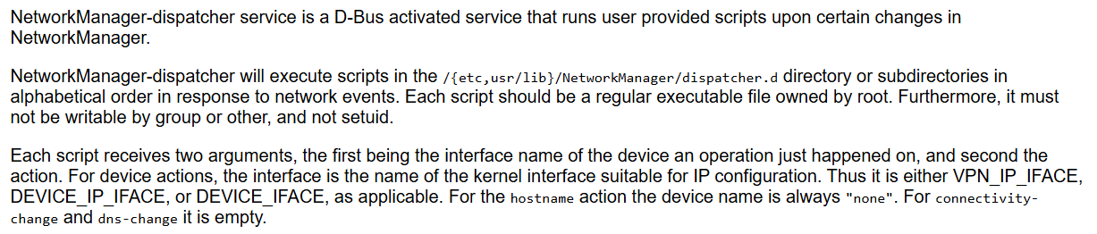
NetworkManager-dispatcher service
Dispatch user scripts for NetworkManager
當NetworkManager出現定義好的網路changes、actions
此service會執行相對應的user-provided scripts
Dispatcher doc

Slide 8
C8015 NetworkManager-Dispatcher Event(action)
Action | Action 描述
pre-up | The interface is connected to the network but is not yet fully activated. Scripts位置 : be placed or symlinked into the /etc/NetworkManager/dispatcher.d/pre-up.d directory Scripts執行時間點 : NetworkManager在通知application啟用前，會先等待這個script執行
up | The interface has been activated.
pre-down | The interface will be deactivated but has not yet been disconnected from the network. Scripts位置 : be placed or symlinked into the /etc/NetworkManager/dispatcher.d/pre-down.d directory Scripts執行時間點:NetworkManager會先等待此script執行完畢，才中斷此網路介面 Note : 不由突發事件所發出，正常disconnection才會發出pre-down 突發事件 : when carrier is lost wireless signal fades. 正常disconnection : 從GUI按下disconnect,中斷網路連結
down | The interface has been deactivated.
connectivity-change | The network connectivity state has changed (no connectivity(none), went online(FULL), etc).

Slide 9
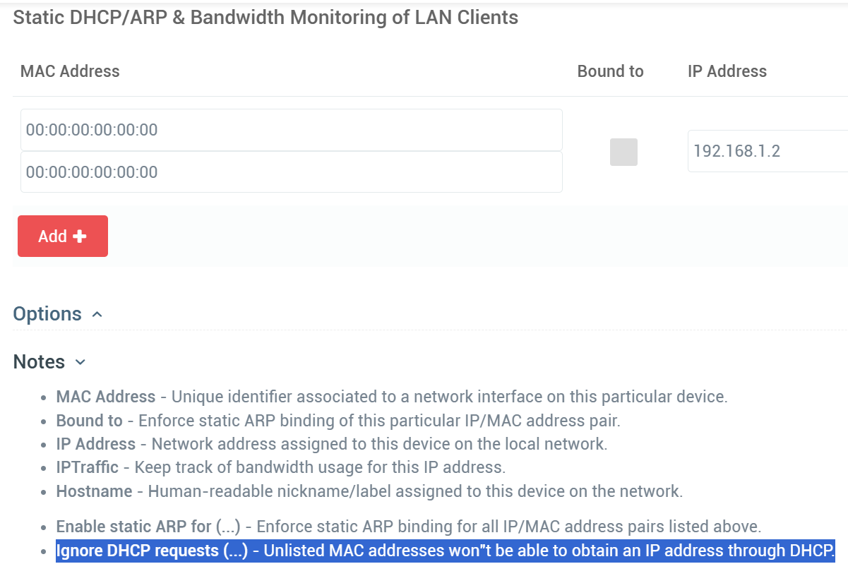
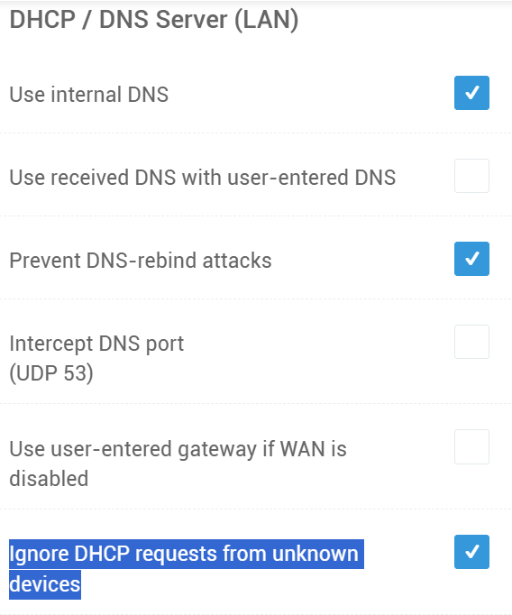
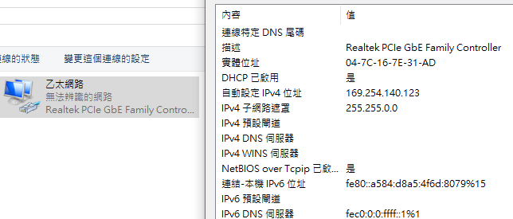
Router Ignore DHCP request
Asus-N18U設定忽略不明MAC address during DHCP-requests
沒有設定任何MAC address
可獲得IP
Step 3 設定完，重開N18U並接上RJ-45 cable to Win10
Step 4

Slide 10
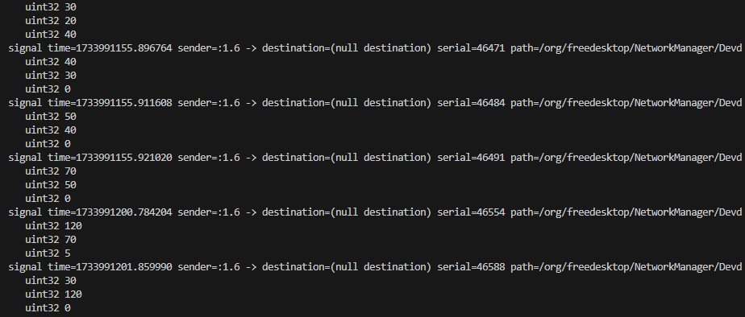
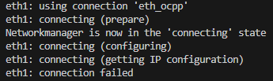
[DHCP]Test C8015-Ethernet can’t get IP
C8015-0B State Change
dbus-monitor --system "interface='org.freedesktop.NetworkManager.Device'"
State 70 = IP-Config
State 120 = Failed
只要Carrier接著就會嘗試連線3~4次，需再次連接Carrier才會再嘗試連線
NM_DEVICE_STATE_REASON_IP_CONFIG_UNAVAILABLE | = 5 | IP configuration could not be reserved (no available address, timeout, etc)
nmcli monitor

Slide 11
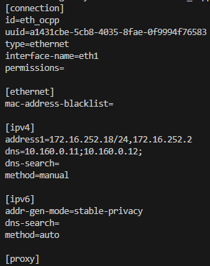
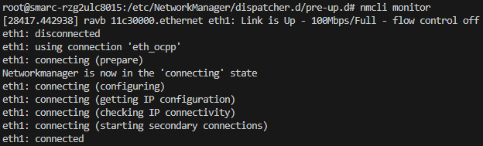
Test Ethernet Static IP
sudo nmcli con add con-name eth_ocpp \ ifname eth1 type ethernet \
ipv4.method manual \ ipv4.addresses 172.16.252.18/24 \ ipv4.gateway 172.16.252.2 \
ipv4.dns 10.160.0.11,10.160.0.12
nmcli monitor Show Ethernet get IP

