Slide 1

IBM HR ANALYTICS
Jasper Hu
wh169
Central Questions: Reducing attrition & notable relationships between variables
Class of 2025

Slide 2
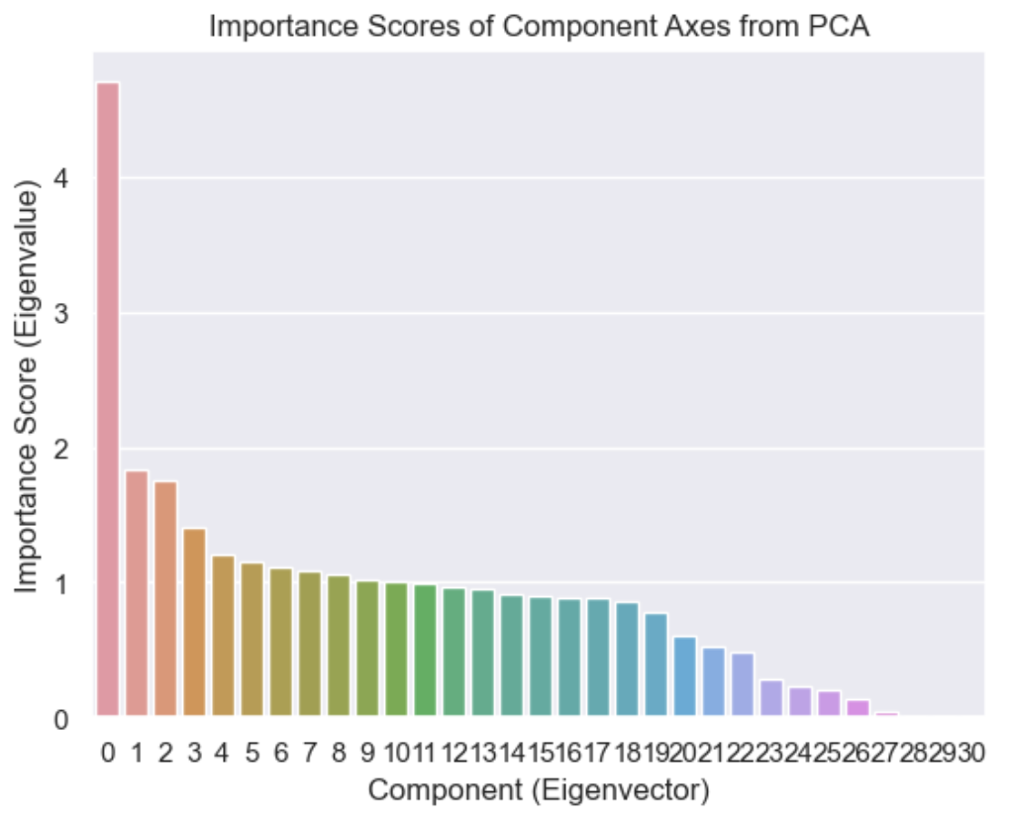
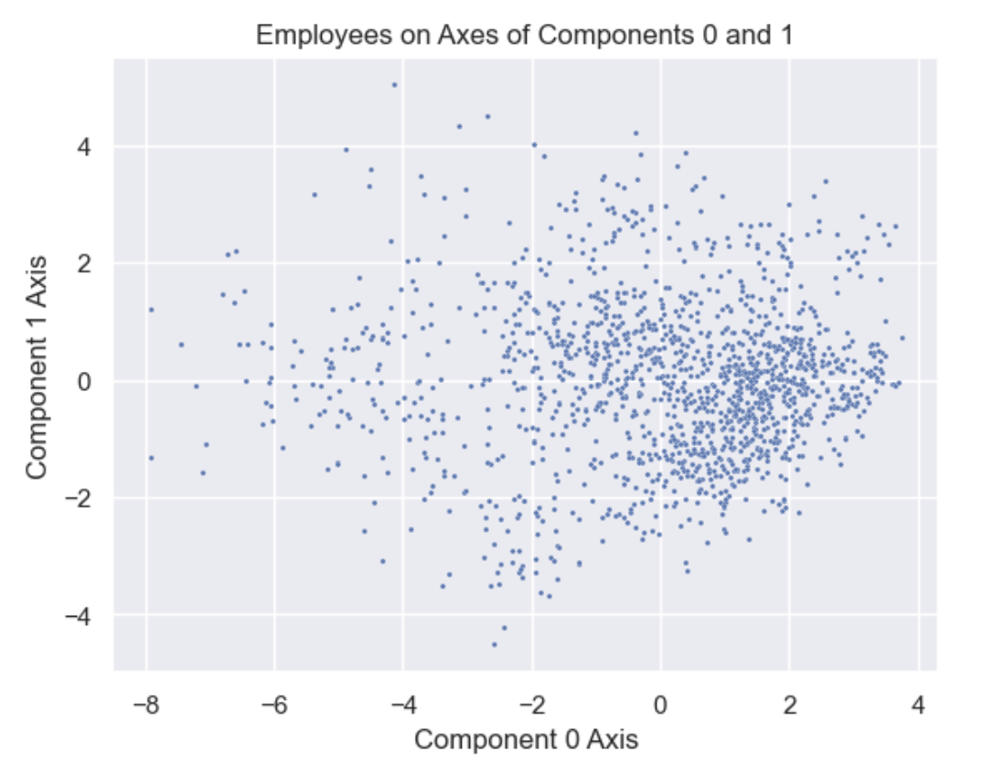
PCA
Cleaned dataset, normalized, and performed Principle Component Analysis
Centered around 0, Standard Deviation at 1
Illustrates significant covariances/relationships between variables on component axes

Slide 3
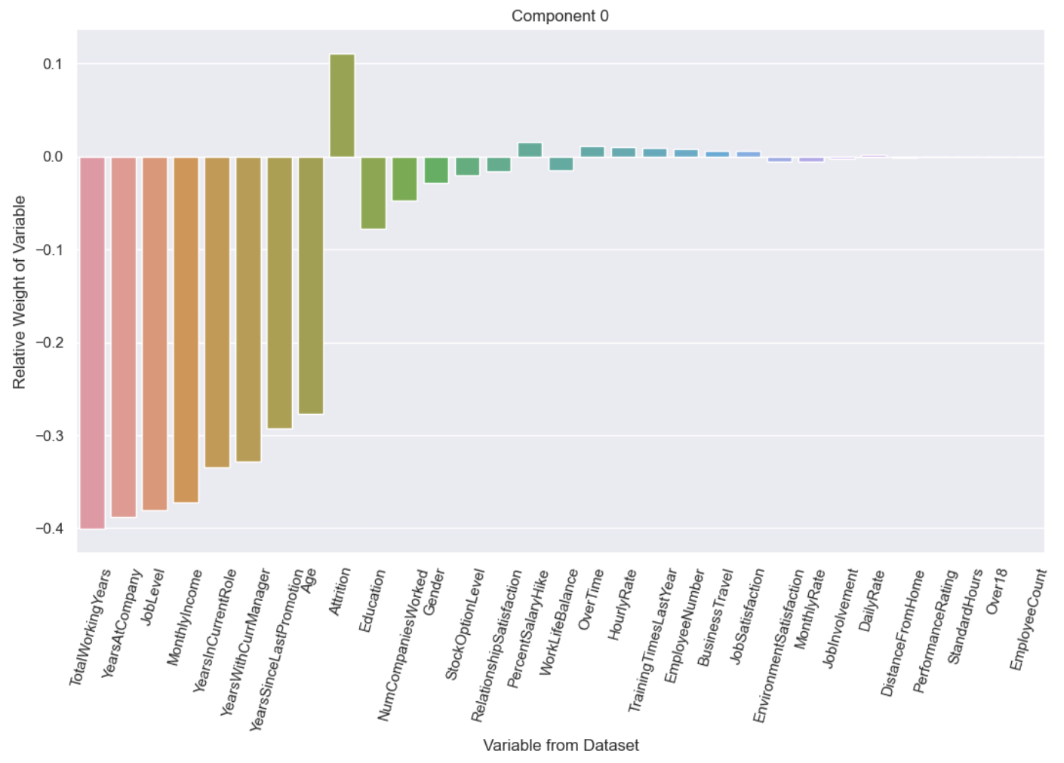
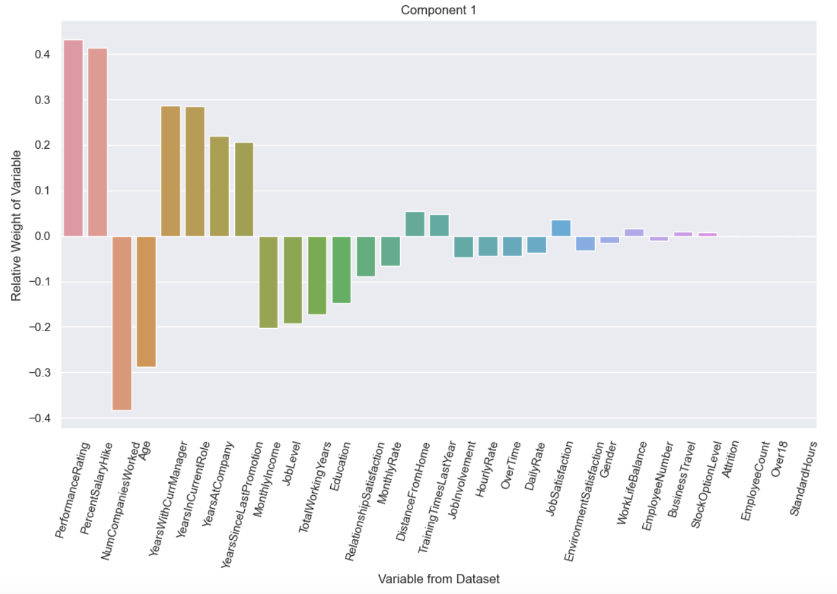
Some Notable Components from PCA

Slide 4
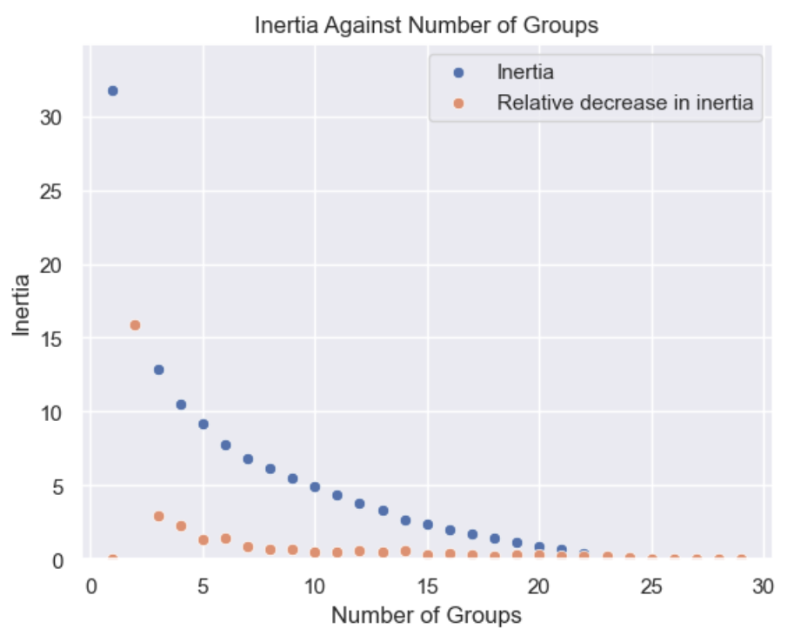
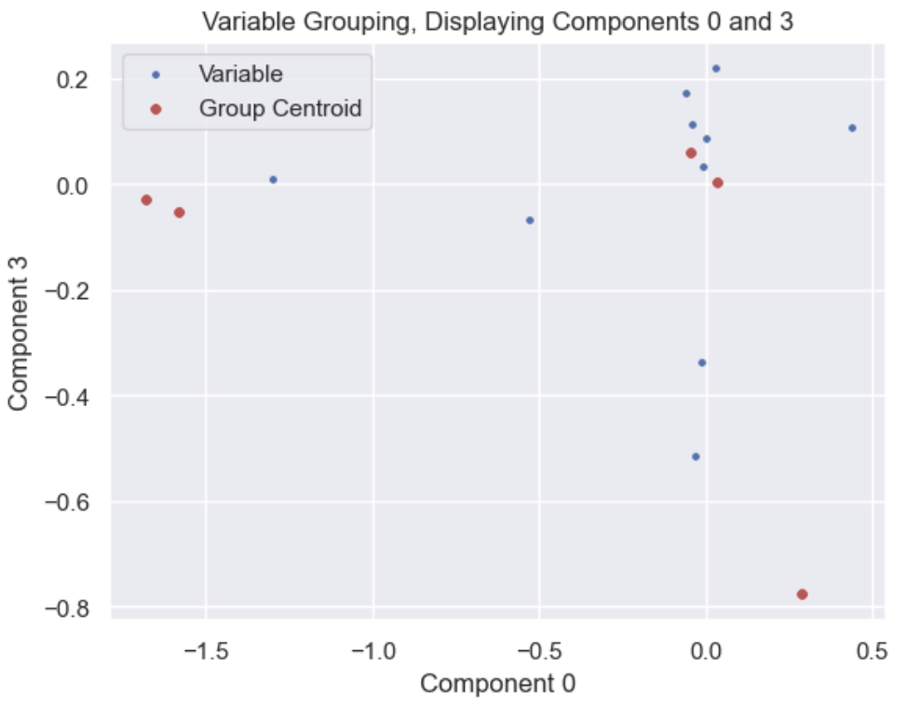
Grouping Variables
Apply K-Means algorithm
Group variables with similar representations on the 10 most significant components
Number of groups?
Minimize “inertia”
Not too fragmented
Number of Groups = 5

Slide 5
Grouping Variables
Group Number | 1 | 2 | 3 | 4 | 5
Variables | Attrition BusinessTravel DistanceFromHome EnvironmentSatis. MonthlyRate OverTime | Age JobLevel MonthlyIncome TotalWorkingYears | PercentSalaryHike PerformanceRating | DailyRate Education EmployeeCount EmployeeNumber Gender HourlyRate JobInvolvement JobSatisfaction NumCompaniesWorked Over18 RelationshipSatisfaction StandardHours StockOptionLevel TrainingTimesLastYear WorkLifeBalance | YearsAtCompany YearsInCurrentRole YearsSinceLastPromotion

Slide 6
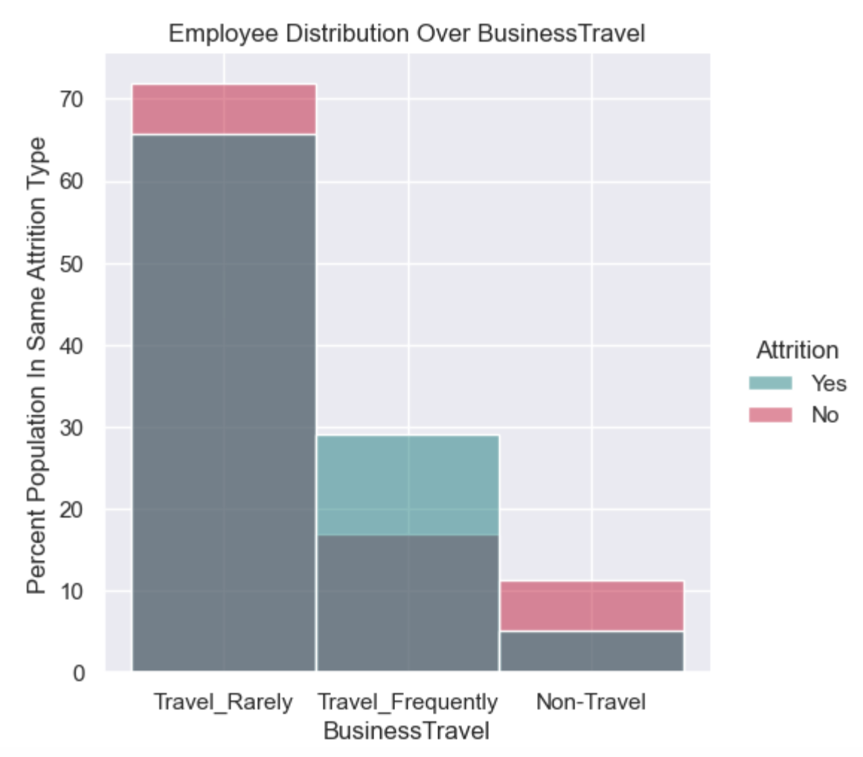
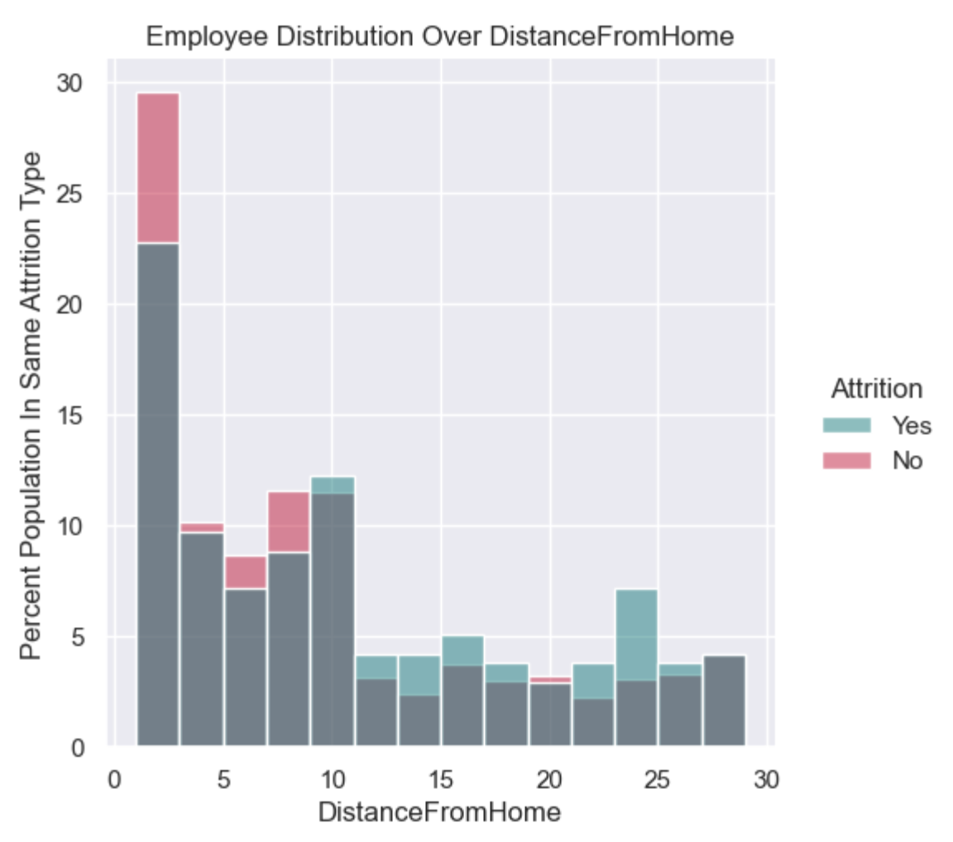
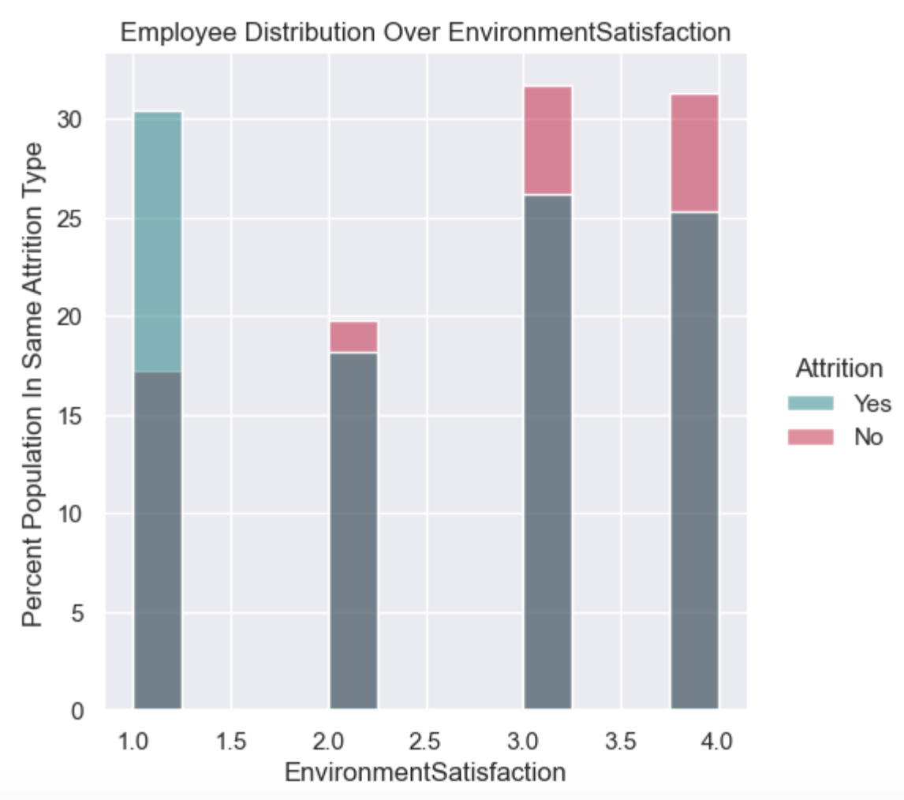
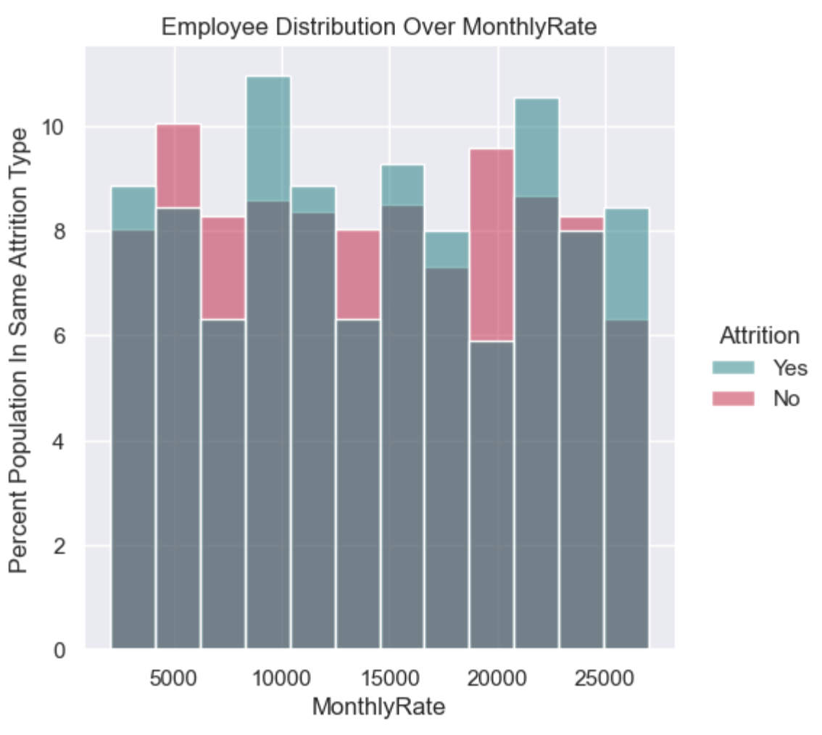
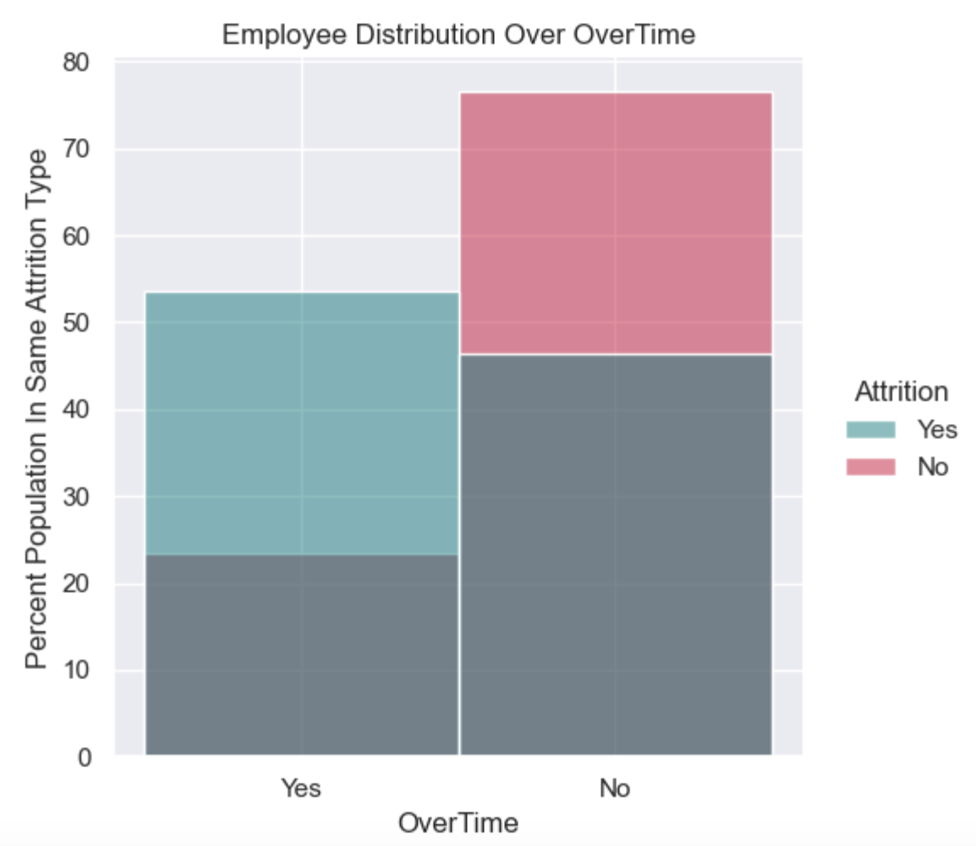
Attrition V.S. Variables Within Group

Slide 7
Findings & Suggestions for Reducing Attrition
Less business travel
Set up offices closer to employees’ homes
Or hire employees closer to offices
Improve working environment
Less overtime

Slide 8
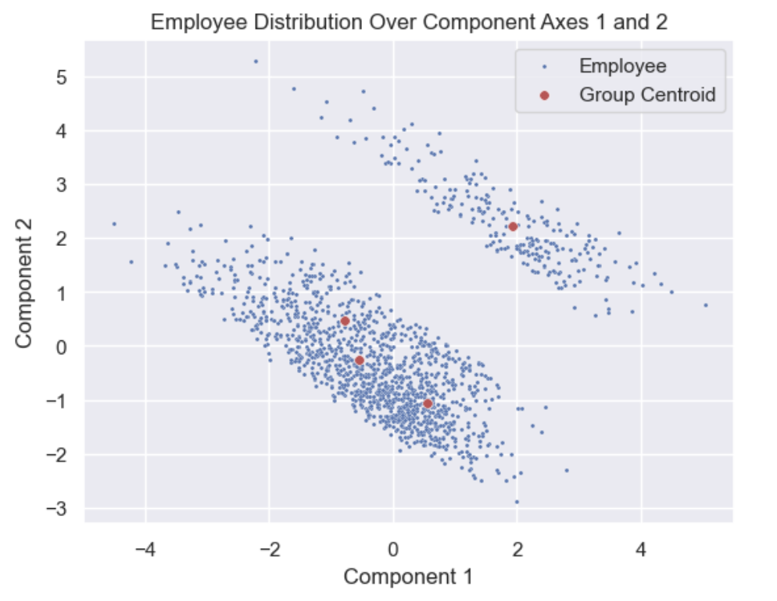
Additional Analysis
Employee grouping
Incorporating more categorical data
EducationField, Department, etc

