Slide 1

Project Title - Seasonal Agriculture Performance Analysis
Student Name: Akshata Chikhale
College Name- Maeers MIT college of railway engineering and research, Barshi
AICTE STU ID : STU6a5f68692f8831784637545

Slide 2

PROBLEM STATEMENT
Agricultural activities are influenced by seasonal variations in environmental conditions, farming practices, resource availability and market conditions. As a result, agricultural performance may differ from one season to another. However, raw agricultural data does not clearly explain how agricultural performance changes across seasons or what patterns can be observed in different seasonal conditions. The problem is to analyze the given agricultural dataset and investigate seasonal differences in agricultural performance by identifying meaningful patterns, trends, relationships and variations within the available data.

Slide 3
Project Description
Seasonal Agriculture Performance Analysis is a data analytics project developed to understand how agricultural performance changes across different seasons and farming conditions.
The project analyzes agricultural data containing crop, season, state, environmental, resource, production, and financial information.
It studies factors such as rainfall, temperature, humidity, soil moisture, fertilizer usage, pesticide usage, and water consumption.
The performance of different crops, states, and seasons is compared using parameters such as yield, production, revenue, cost, and profit.
Data cleaning and statistical analysis are performed to ensure that the dataset is suitable for meaningful analysis.
Univariate, bivariate, and multivariate analysis is used to identify important patterns and relationships within the data.
Data visualization techniques such as bar charts, box plots, scatter plots, histograms, and correlation heatmaps are used to present the findings clearly.
The project identifies high-performing crops, productive regions, profitable seasons, and resource-efficient practices.
Finally, the results are converted into meaningful insights and evidence-based recommendations for better agricultural planning and resource management.

Slide 4

WHO ARE THE END USERS?
Farmers – To understand crop performance, seasonal trends, and resource usage.
Agricultural Planners – To support seasonal planning and crop selection using data-driven insights.
Agricultural Researchers – To study relationships between environmental factors and agricultural performance.
Agriculture Departments/Government Agencies – To evaluate regional and seasonal agricultural performance.
Agribusiness & Farm Managers – To analyze production, profitability, and resource efficiency for better decision-making.

Slide 5

Technology Used
Programming Language: Python
Development Platform: Google Colab
Libraries: Pandas, NumPy, Matplotlib, Seaborn
Data Analysis: Pandas & NumPy
Data Visualization: Matplotlib & Seaborn
Statistical Analysis: Descriptive statistics & Correlation analysis
Dataset: CSV (Agricultural Performance Dataset)
Data Processing: Data cleaning, missing-value checking, duplicate removal, and outlier analysis

Slide 6
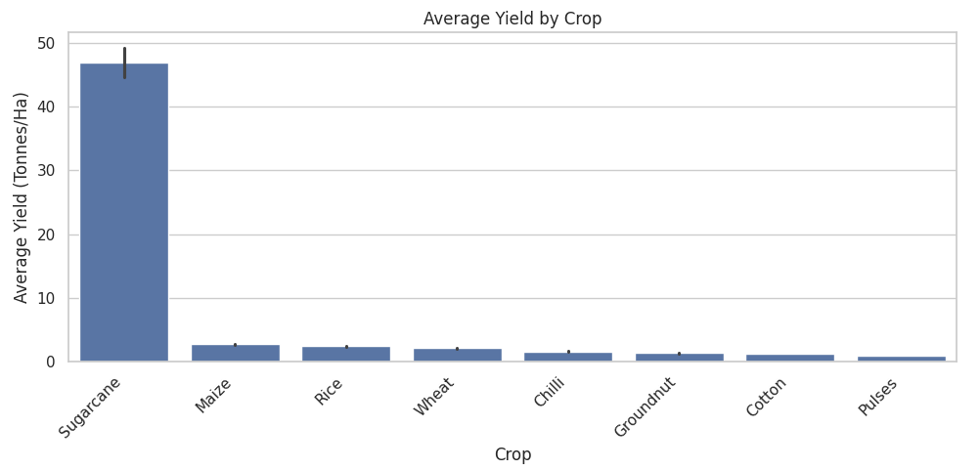
RESULTS
Crop-wise Yield Analysis:
Shows: Average yield of different crops Purpose: Compare crop productivity Result: Identifies high- and low-yielding crops Insight: Crop performance varies across different crop types.

Slide 7
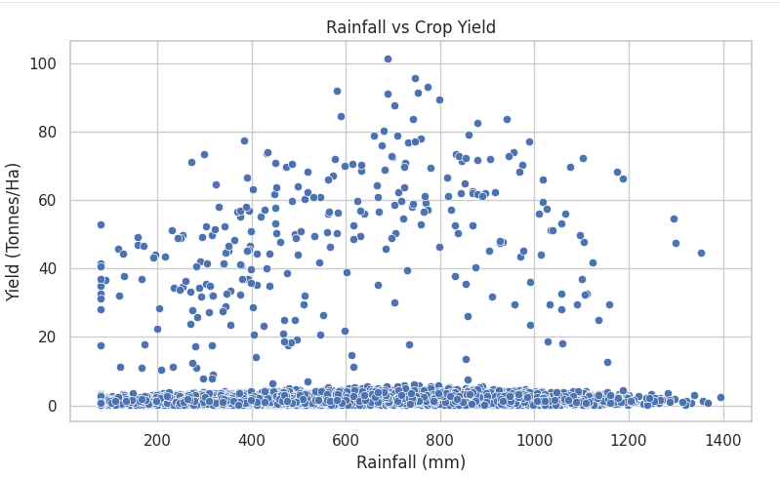
RESULTS
Rainfall vs Yield Analysis
Examines the relationship between rainfall and crop yield.
Shows whether changes in rainfall are associated with yield variations.
Helps identify patterns or trends between rainfall and productivity.

Slide 8
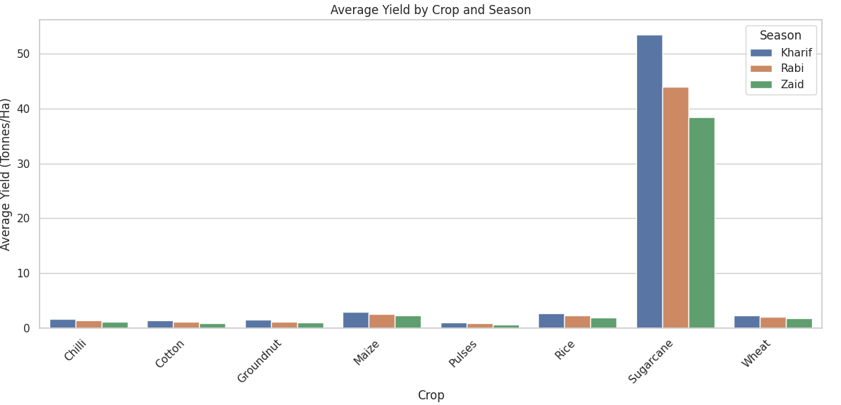
RESULTS
Crop × Season Yield Analysis
Compares average yield of each crop across different seasons.
Highlights how seasonal conditions affect crop productivity.
Helps identify the best-performing crop–season combinations.

Slide 9
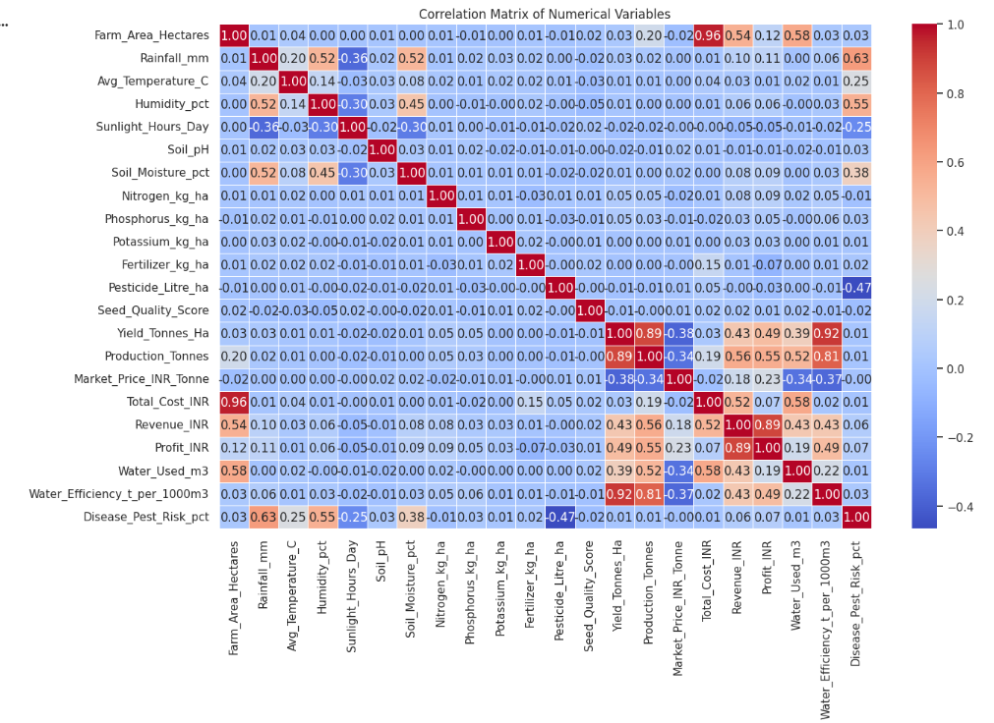
RESULTS
Correlation Heatmap
Shows the relationships between numerical agricultural variables.
Helps identify strong positive and negative correlations.
Highlights factors that are closely related to crop yield and profit.
Supports data-driven interpretation and decision-making.

Slide 10
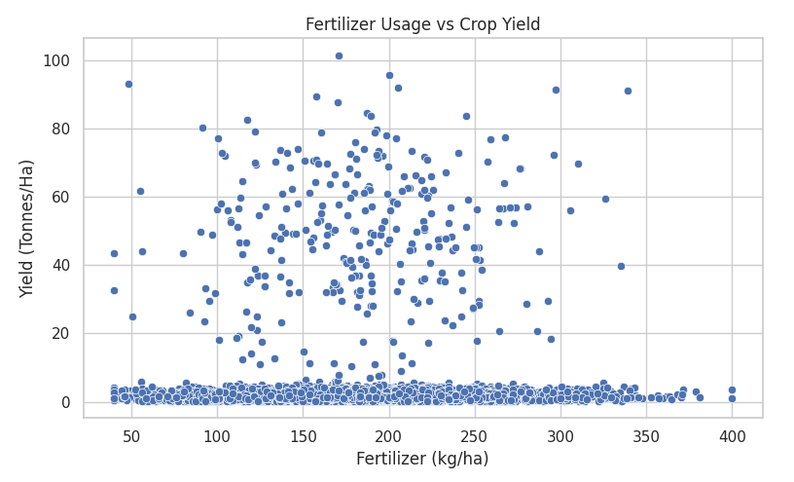
RESULTS
Fertilizer vs Yield — Scatter Plot
Examines the relationship between fertilizer usage and crop yield.
Shows whether higher fertilizer application is associated with changes in yield.
Helps understand the impact of fertilizer usage on agricultural productivity.

Slide 11
Future scope
Develop a real-time agricultural monitoring system using live weather and farm data.
Integrate IoT sensors to collect soil moisture, temperature, humidity, and water-usage data.
Extend the analysis to include weather forecasting and climate-change effects.
Provide crop-specific recommendations based on seasonal and environmental conditions.
Analyze historical data over multiple years to identify long-term agricultural trends.
Develop an interactive web-based dashboard for farmers and agricultural departments.
Integrate market-price data to support better crop planning and profitability analysis.
Expand the system to cover more crops, states, and regions for broader agricultural insights.

Slide 12
GitHub Link
https://github.com/Starfirexai/Seasonal_Agriculture_Performance_Analysis

Slide 13
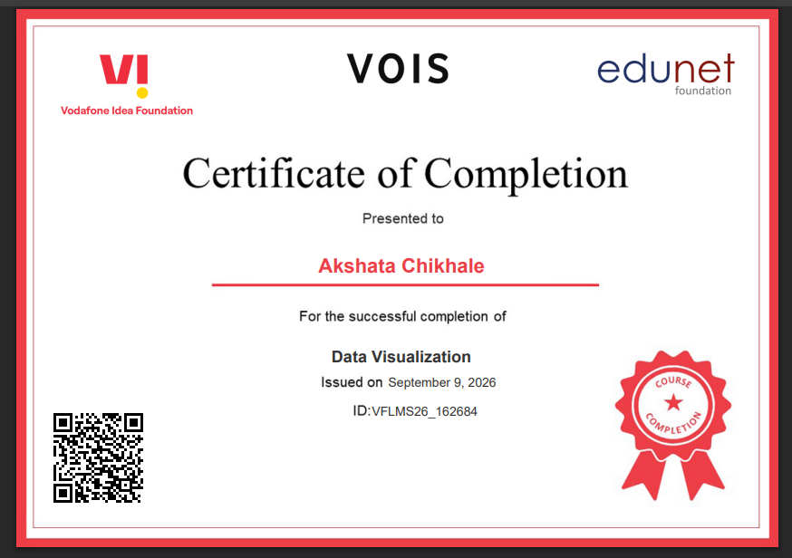
VOIS Course completion certificate - Course name- Data Visualization

Slide 14
Thank you
.
.

