Slide 1

PassPro
Manage passwords like a pro
Ben Kobiske, Evan Hesselink, John Kohnen

Slide 2
Project Overview 1/2
Introduction
PassPro is a simple password managing system that encrypts, stores, and decrypts password entries from the user
Technology Stack (Tools Used)
Git/GitLab
QT Creator & VS Code
CMake
OpenSSL
Catch2
Clang-format
BS::thread_pool
JSON for modern C++
GCC & MinGW
GNU Make

Slide 3
Project Overview 2/2
Primary Objectives
Design a simple user friendly UI
User account creation
Encrypt, Store, and Decrypt user Entries
Add Entries
Delete Entries
Edit Entries

Slide 4
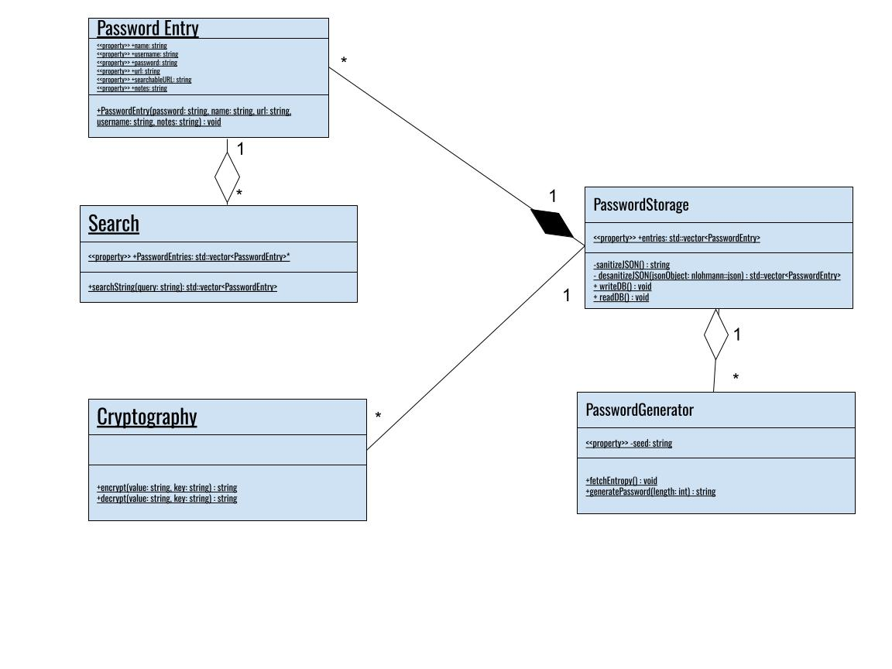
CryptographyStorage
1
<<property>> +user: string
<<property>> +key: secureString
*

Slide 5
Project Status
Version 1.0 (Current/Released)
Version 1.1 (In Development)
Create Personal Account
Encrypt, Save, Decrypt Entries
Edit Entries
Delete Entries
Search Bar
Copy to Clipboard
Timed clipboard support, clearing clipboard after a few (20 or so) seconds (reference)

Slide 6
Requirements
QT 5.15.11
CMake 3.5 or above
OpenSSL
Program uses QT libraries for the GUI
Generates makefiles for GNU Make
Encrypts database on write, decrypts the database on startup
GCC or MinGW
Supporting QT
GNU Make
VSCode w/
C++ Build Extensions
Compiles binaries and lints program
Calls the linker and manages generation of program binaries
Provides a development environment and a debugger. Shows errors generated by the linter and calls clang-format on save.

Slide 7
Build Instructions
QT Creator *
(Recommended)
VS Code
Terminal
Clone the repository
Open QT Creator
Open CMakeLists.txt
Press the run button
Clone the Repository
Open VSCode and navigate to the cloned project
Press build on bottom of VScode
Open the terminal
Clone the repository(git clone)
Navigate to the project root(using cd)
Execute “cmake.” to generate the make file
Execute “make -o PassPro” to generate executable

Slide 8
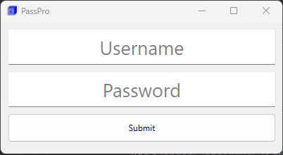
Log-in UI

Slide 9
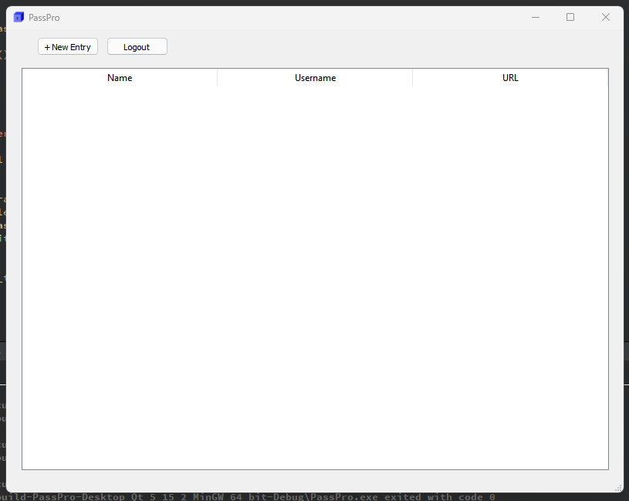
Main Window UI (Blank)

Slide 10
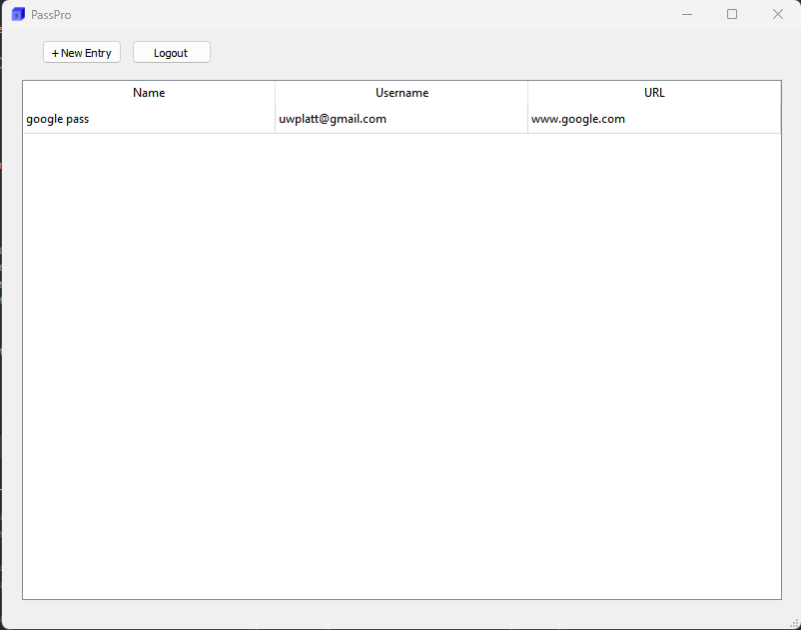
Main Window UI (W/ Entry)

Slide 11
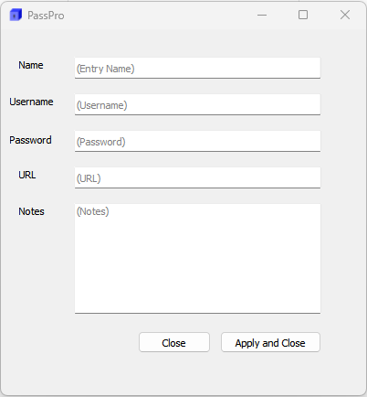
New Entry UI

Slide 12
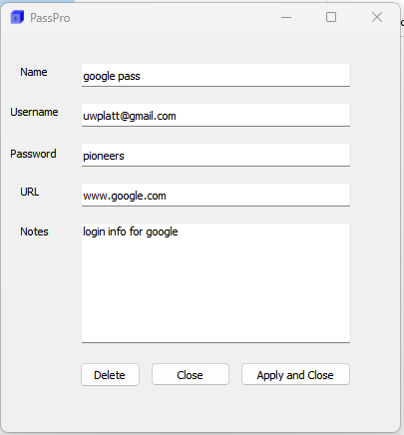
Entry Viewer UI

Slide 13
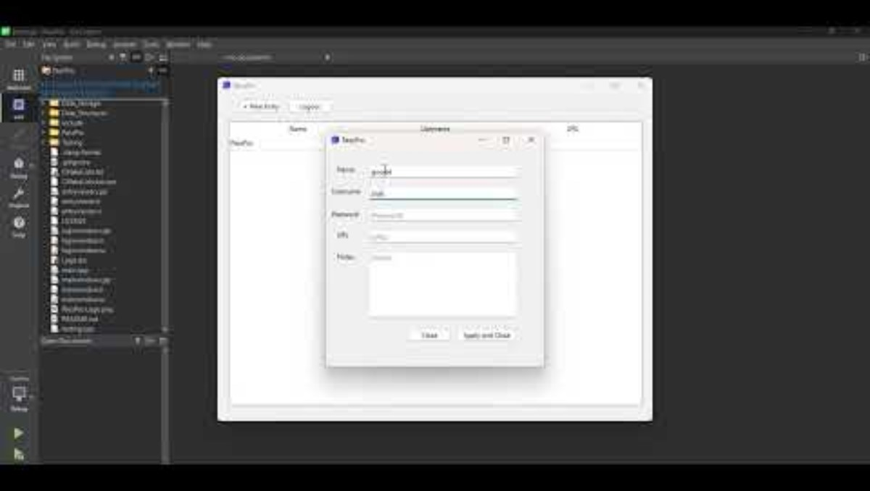
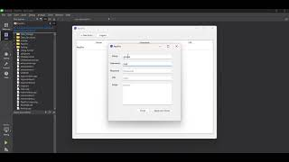
Video

Slide 14
What we learned
Teamwork is critical to successful software projects
The project development process and software development models
The necessity of collaboration tools such as Discord and Gitlab
Resolving merge conflicts
Creating and adjusting milestones
Using OpenSSL in a development context

