Slide 1



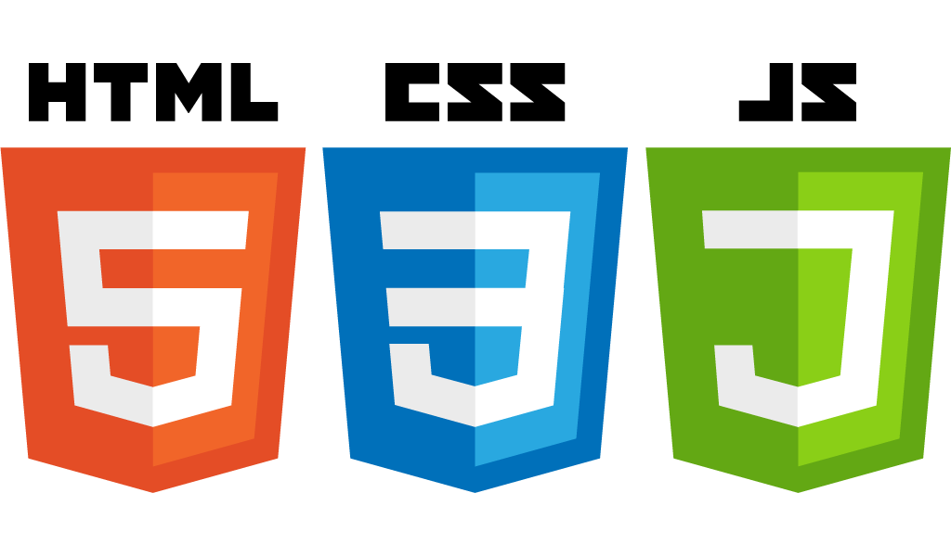
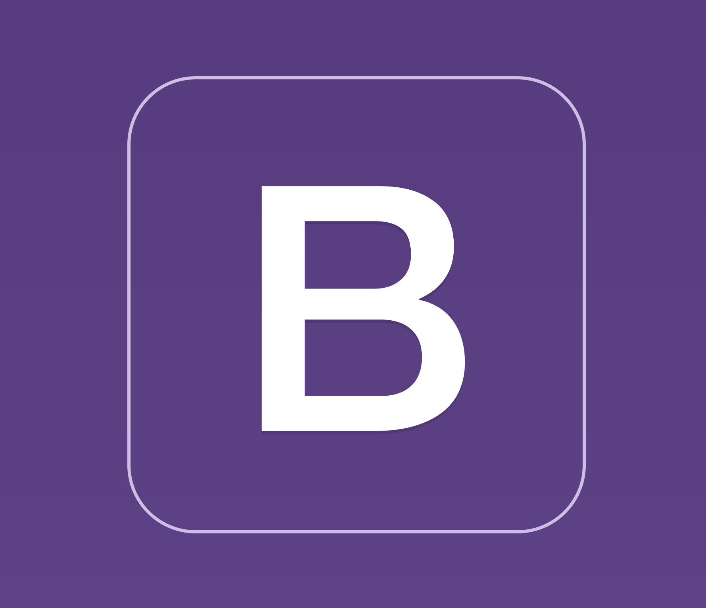

How the Web works
Startup-ready web skeleton with Spring Boot, HTML5, CSS3, Javascript/Jquery, Bootstrap, Stripe and AWS
Notes:
1) Hello and welcome. In this lecture we’ll look at how the web works

Slide 2
The Network Stack
Transmits data
End-user Applications
Email, Web App, Social Networking, etc.
Receives data
Application Layer
HTTP, FTP, DNS
Presentation Layer
Data Representation, Encryption
Session Layer
Sockets
Transport Layer
End-To-End Link, e.g. TCP, UDP
Network Layer
IP, ICMP, ARP, Path determination
Data Link Layer
e.g. MAC, Ethernet, 802.11 a/b/g/n
Physical Layer
e.g. 802.11 PHY, ADSL
Physical Link
010111000101
Notes:
2) - The network is organised as a stack
- At the bottom of this stack we fine the physical link, which is where data travels usually in binary format (e.g. 0s and 1s)
- They Physical Layer represent the networking hardware transmission technology, what most of us understand by “network”
- The Data Link Layer defines how data is transferred between adjacent nodes in a Wide Area Network (WAN) or Local Area Network (LAN)
- The Network layer is responsible for packet forwarding. It defines the connection model (e.g. connectionless communication such as IP), host addressing (IP addresses) and message forwarding (how to forward packets across subnets via routers)
- The Transport layer defines how the data will be transported. The best-known transport protocol is TCP. This layer offers services such as connection-oriented data stream support, reliability, flow control and multiplexing
- The Session layer defines the mechanisms for opening, closing and managing a session between sender and receiver
- The Presentation Layer is responsible for the delivery and formatting of the data transported by previous layers. Data is 0s and 1s and it’d be very difficult for end-users to understand (or work effectively) with data represented in binary. It’s much easier to understand text. This layer is responsible to ensure that bits are formatted according to the target format (e.g. ASCII). Encryption is typically done at this layer too.
- The Application Layer is where applications (typically servers) reside. Examples include HTTP, FTP and DNS servers. It’s an abstraction which defines shared protocols and interface methods. For instance, we know that an HTTP server needs to support GET, POST, PUT, DELETE (and other) request methods and that a request sent to an HTTP server needs to follow a particular format (more on this in the next slide)
- End-user Applications. This is where the application we write live. Unless you’re writing your own HTTP server, typically your application will use the Application Layer to offer some functionality. This layer is also where our web skeleton will reside.

Slide 3
The Client / Server interaction
What happens when we visit http://devopsfolks.com ?

Slide 4
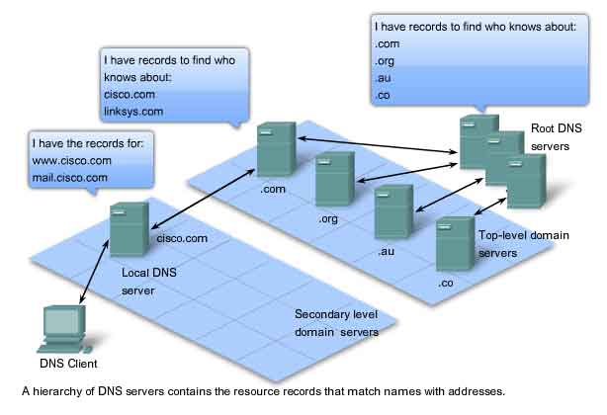
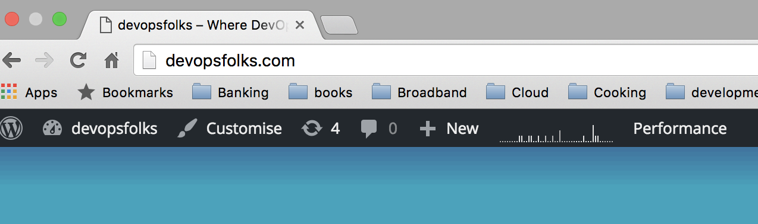
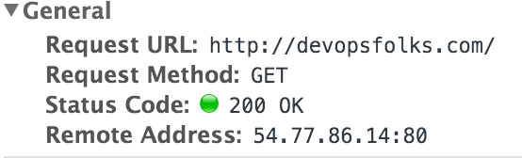
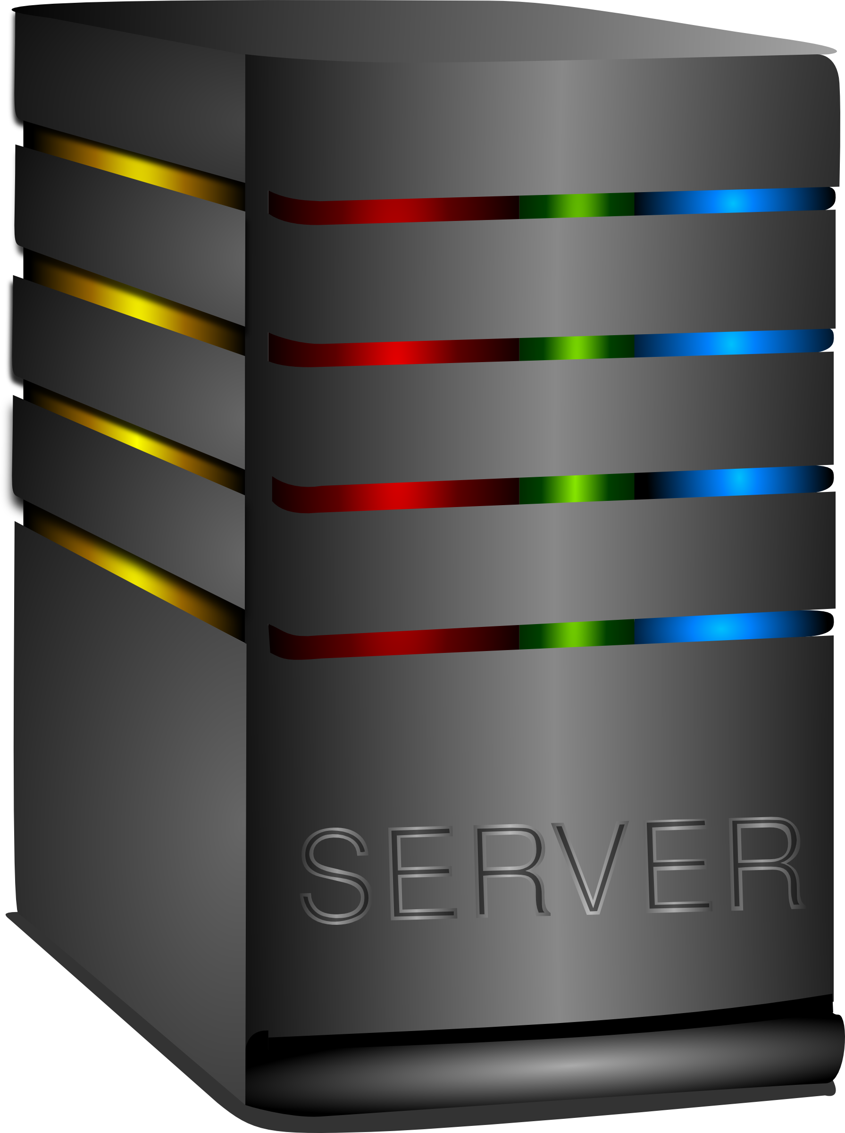

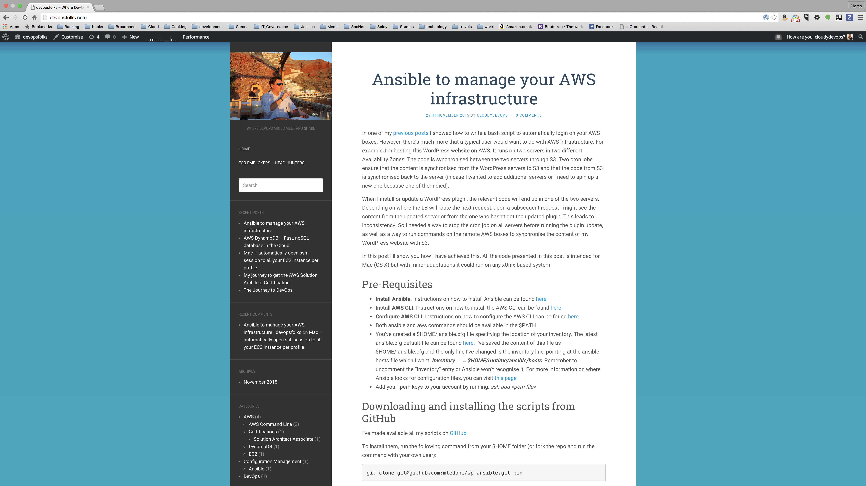


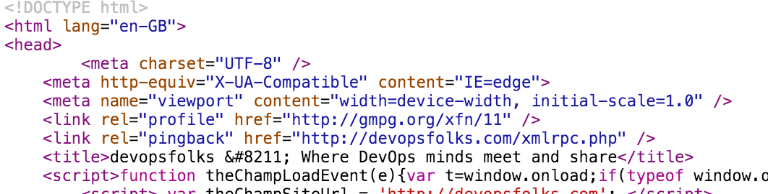

DNS
Client (Browser)
2. DNS Server returns IP address 54.77.86.14
1. Who knows the IP address of devopsfolks.com?
3. Sends HTTP GET request to 54.77.86.14:80
devopsfolks.com
4. Server receives Request
5. Server might execute some process which generates HTML
Server
7. The browser renders HTML and the user sees the web page
6. Server sends HTML back to the browser
Notes:
2) Before delving into the nitty and gritty of the web, I’d like us to have a look at how the network works. It’s important to have an understanding of this because the Web is a giant network and any web application relies on the network to transmit and receive its data
- The network works in layers. At the very bottom there’s the physical link which transmits bits (0s and 1s) either through electric signals or wirelessly
- The Data Link Layer defines how the data is sent, e.g. whether we’re using Ethernet, Wi-Fi, etc
- The Network layer defines the protocol that will be used to send the data, e.g. are we sending packets, and if so how many bits are we sending in each packet, etc.
- The Transport layer defines how the data will be transported, e.g. via TCP, UDP, etc. In order for two end-points to send data, they need to agree on a protocol. For instance, with TCP, a handshake between sender and receiver needs to be established first any data can be transmitted and once the transmission is complete, a connection termination series of messages closes the connection.
- The Session layer defines the mechanisms for opening, closing and managing a session between sender and receiver
- The Presentation Layer is responsible for the delivery and formatting of the data transported by previous layers. Data is 0s and 1s and it’d be very difficult for end-users to understand (or work effectively) with data represented in binary. It’s much easier to understand text. This layer is responsible to ensure that bits are formatted according to the target format (e.g. ASCII). Encryption is typically done at this layer too.
- The Application Layer is where applications (typically servers) reside. Examples include HTTP, FTP and DNS servers. It’s an abstraction which defines shared protocols and interface methods. For instance, we know that an HTTP server needs to support GET, POST, PUT, DELETE (and other) request methods and that a request sent to an HTTP server needs to follow a particular format (more on this in the next slide)
- End-user Applications. This is where the application we write live. Unless you’re writing your own HTTP server, typically your application will use the Application Layer to offer some functionality. This layer is also where our web skeleton will reside.

Slide 5
Introducing the MVC Pattern
Separation of concerns is fundamental to achieve a good architecture

Slide 6
Client
Server
3
HTTP Response
Produces HTML
View
2
HTTP Request
Orchestrates
Might Use
Controller
1
Executes logic
Model
Notes:
The Model-View-Controller patterns. This pattern has the advantage of separating responsibilities. The Model represents the data we want to display / store. The View represents what users will see (typically HTML pages). The Controller is the man-in-the-middle which orchestrates activities between the business logic which retrieves / stores model objects and chooses the view which will display the result to the user.

Slide 7
Introducing Spring MVC
What happens when we visit http://devopsfolks.com and the application is served by Spring MVC?

Slide 8

Provided by Spring
Coded by developers. Contains some Spring Support
Coded / Owned by developers
Client
Spring Web Application
1
Invokes
2
Chooses
3
Might execute
HTTP Request
Dispatcher Servlet
Handler Mapping
Controller
Business Logic
Resolves
7
Returns
6
5
Service
Might use
View Resolver
View Name
8
Repository
Chooses
Produces
10
9
Might use
HTTP Response
View
4
DB
Model
Notes:
7 and 8) MVC served by Spring
All requests are intercepted by the Dispatcher Servlet (Controller) which delegates to the Handler Mapping the decision of which Controller will serve that particular request. The Handler Mapping contains a dictionary of request paths vs methods to execute. For example, we might decide that all requests with path /users will invoke the method listUsers on the UserController. We’ll see how this is implemented later on in the course.
The Controller which has been handled the request might invoke some business logic (typically the route to the some data store, e.g. relational database). Also, typically either the controller or the business logic will manufacture some object Model. Once the Controller has completed processing the request, it returns a view name which the View Resolver uses to decide which HTML page to show next. The View is then prepared and rendered in the response sent to the user.

