Slide 1



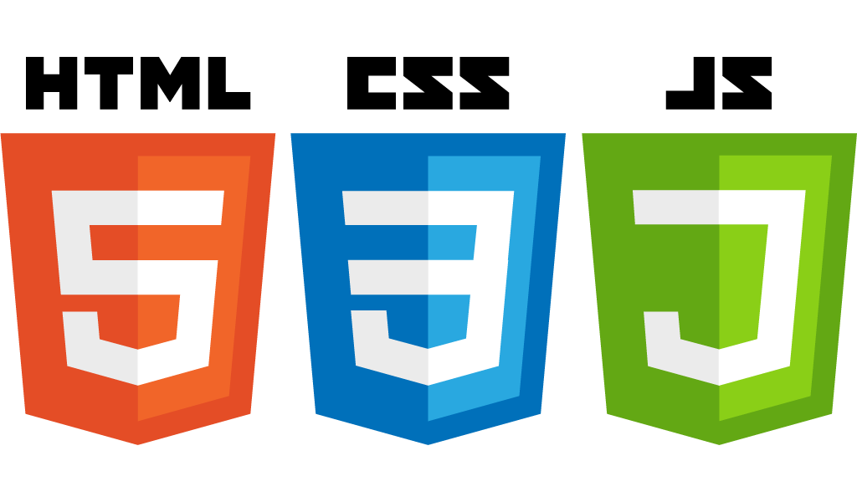


HTML5 Hello World example
Startup-ready web skeleton with Spring Boot, HTML5, CSS3, Javascript/JQuery, Bootstrap, Stripe and AWS

Slide 2

An introduction to HTML5
Install Brackets.io
Create the folder structure
Open folder with Brackets.io
Hello World example with HTML
Codeacademy free HTML course

