Slide 1



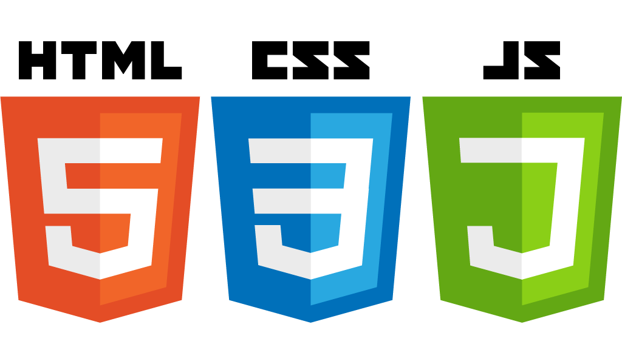


HTML5 basic elements
Startup-ready web skeleton with Spring Boot, HTML5, CSS3, Javascript/JQuery, Bootstrap, Stripe and AWS

Slide 2

An introduction to HTML5
<h1> to <h6> - Headings
<!-- --> - Comments
<p> - Paragraph
<ul> and <ol> - Unordered and Ordered lists
<img> - Image
<a> - Anchor
<div> - Division
<section> - Section
<br> - New line
<table> - Table

