Slide 1



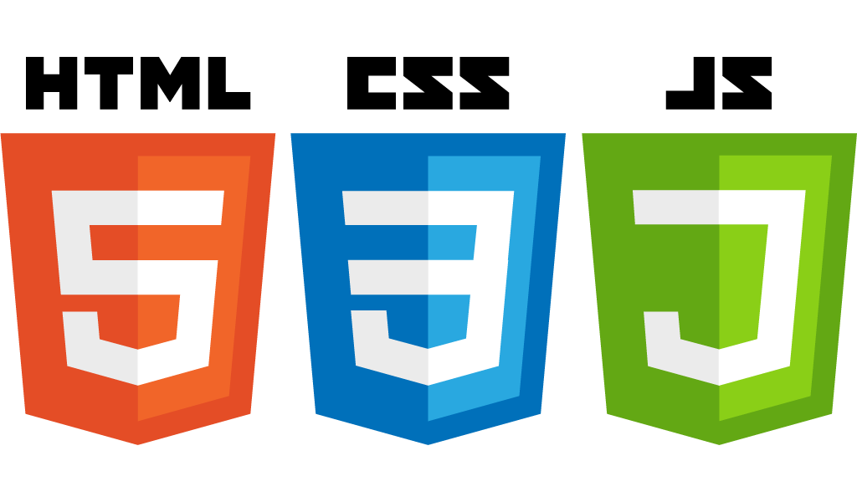
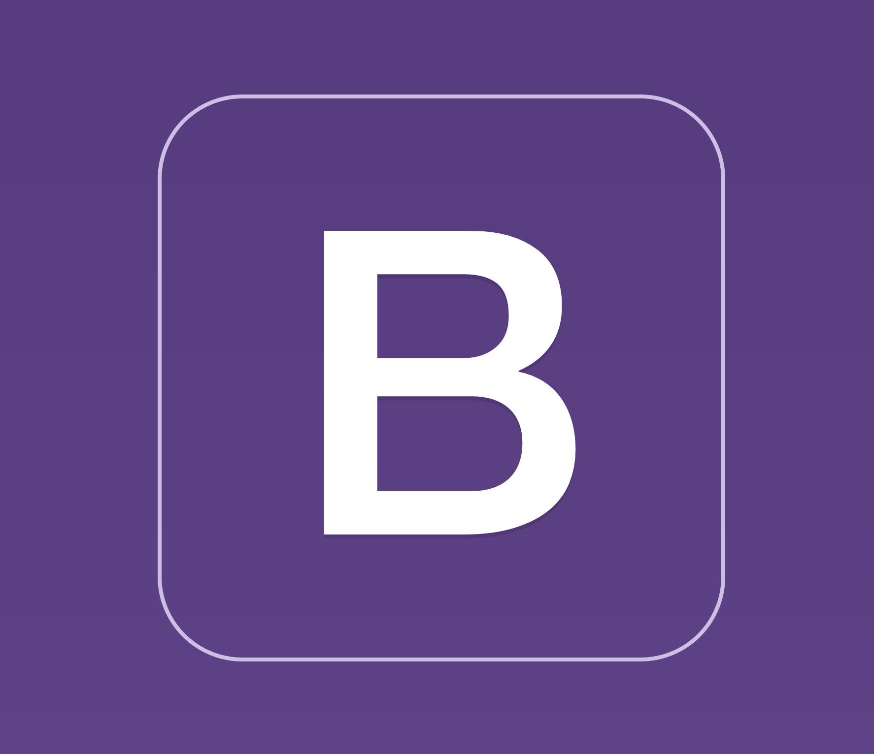

RESTful APIs and HTML Forms
Startup-ready web skeleton with Spring Boot, HTML5, CSS3, Javascript/JQuery, Bootstrap, Stripe and AWS

Slide 2
In this lecture…
What is REST?
What is a RESTful API?
RESTful verbs
CRUD verbs
Idempotent and non-idempotent requests
A possible mapping between RESTful and CRUD verbs
HTML Forms
Input field types
The submit button
The <form> “action” and “method” attributes

Slide 3
How the Web works
The Web is a gigantic network of interconnected computers
Browsers interact with web applications via Requests and Responses
The concept of Requests and Responses is fundamental to understand how the web works
HTML forms are the tool that we use to send data to a web server for further processing

Slide 4
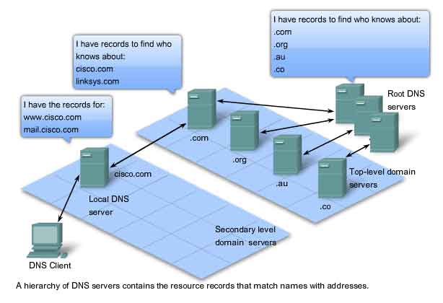
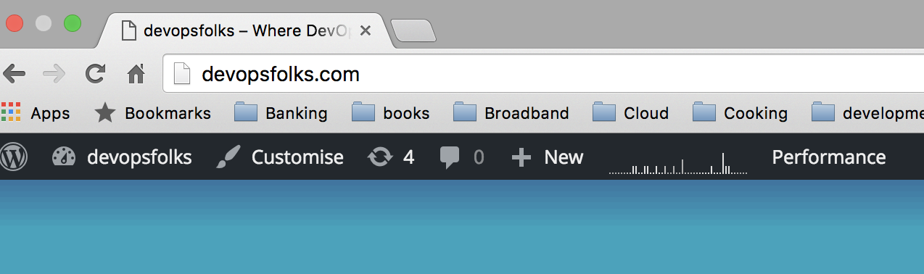
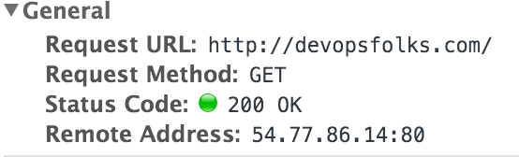


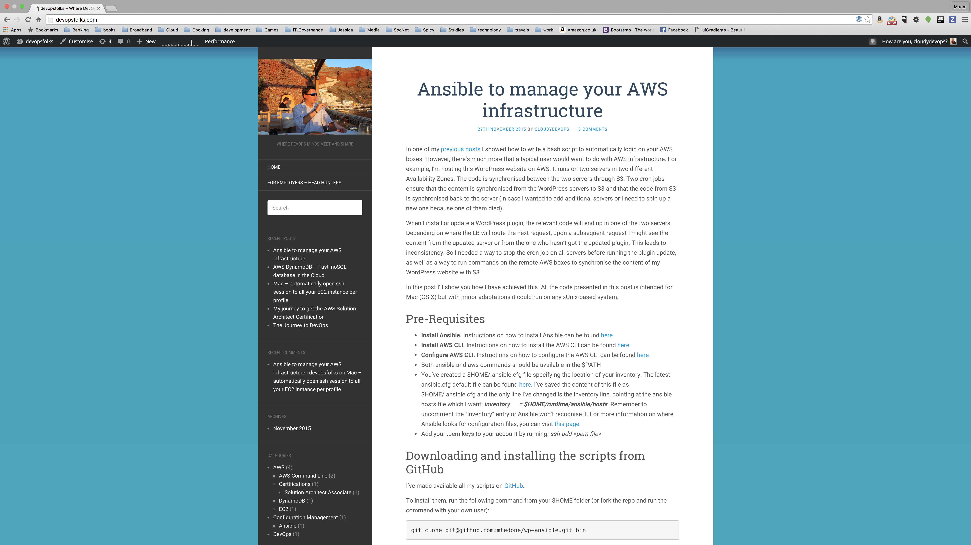


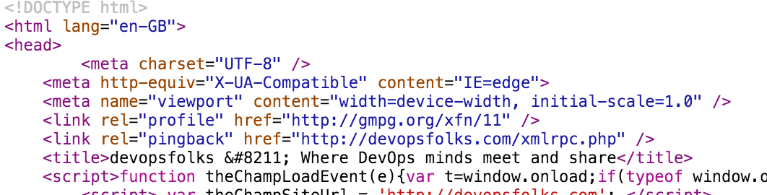

DNS
Client (Browser)
2. DNS Server returns IP address 54.77.86.14
1. Who knows the IP address of devopsfolks.com?
3. Sends HTTP GET request to 54.77.86.14:80
devopsfolks.com
4. Server receives Request
5. Server might execute some process which generates HTML
Server
7. The browser renders HTML and the user sees the web page
6. Server sends HTML back to the browser
Notes:
2) Before delving into the nitty and gritty of the web, I’d like us to have a look at how the network works. It’s important to have an understanding of this because the Web is a giant network and any web application relies on the network to transmit and receive its data
- The network works in layers. At the very bottom there’s the physical link which transmits bits (0s and 1s) either through electric signals or wirelessly
- The Data Link Layer defines how the data is sent, e.g. whether we’re using Ethernet, Wi-Fi, etc
- The Network layer defines the protocol that will be used to send the data, e.g. are we sending packets, and if so how many bits are we sending in each packet, etc.
- The Transport layer defines how the data will be transported, e.g. via TCP, UDP, etc. In order for two end-points to send data, they need to agree on a protocol. For instance, with TCP, a handshake between sender and receiver needs to be established first any data can be transmitted and once the transmission is complete, a connection termination series of messages closes the connection.
- The Session layer defines the mechanisms for opening, closing and managing a session between sender and receiver
- The Presentation Layer is responsible for the delivery and formatting of the data transported by previous layers. Data is 0s and 1s and it’d be very difficult for end-users to understand (or work effectively) with data represented in binary. It’s much easier to understand text. This layer is responsible to ensure that bits are formatted according to the target format (e.g. ASCII). Encryption is typically done at this layer too.
- The Application Layer is where applications (typically servers) reside. Examples include HTTP, FTP and DNS servers. It’s an abstraction which defines shared protocols and interface methods. For instance, we know that an HTTP server needs to support GET, POST, PUT, DELETE (and other) request methods and that a request sent to an HTTP server needs to follow a particular format (more on this in the next slide)
- End-user Applications. This is where the application we write live. Unless you’re writing your own HTTP server, typically your application will use the Application Layer to offer some functionality. This layer is also where our web skeleton will reside.

Slide 5
How do we normally interact with a web application?
Typically we will open a web page either to:
Read a publicly available article with no further interaction (like a blog)
Login to a social networking website (like Facebook, LinkedIn or Twitter)
Login to my online banking account
Online shopping, like Amazon, Ebay, Apple, etc.
Connecting to my office from home when working remotely

Slide 6
The four typical operations when interacting with a website
Read content, whether protected or not
Delete content, for example when we cancel items in a shopping cart
Update content, for example when we change email or phone details on a social networking website
Create content, when we create a social networking account

Slide 7
CRUD
CRUD
Create, Retrieve, Update, Delete
These are the four typical operations that an application would perform on a data store
Our web applications will typically need to perform the same operations
Notes:
2) Before delving into the nitty and gritty of the web, I’d like us to have a look at how the network works. It’s important to have an understanding of this because the Web is a giant network and any web application relies on the network to transmit and receive its data
- The network works in layers. At the very bottom there’s the physical link which transmits bits (0s and 1s) either through electric signals or wirelessly
- The Data Link Layer defines how the data is sent, e.g. whether we’re using Ethernet, Wi-Fi, etc
- The Network layer defines the protocol that will be used to send the data, e.g. are we sending packets, and if so how many bits are we sending in each packet, etc.
- The Transport layer defines how the data will be transported, e.g. via TCP, UDP, etc. In order for two end-points to send data, they need to agree on a protocol. For instance, with TCP, a handshake between sender and receiver needs to be established first any data can be transmitted and once the transmission is complete, a connection termination series of messages closes the connection.
- The Session layer defines the mechanisms for opening, closing and managing a session between sender and receiver
- The Presentation Layer is responsible for the delivery and formatting of the data transported by previous layers. Data is 0s and 1s and it’d be very difficult for end-users to understand (or work effectively) with data represented in binary. It’s much easier to understand text. This layer is responsible to ensure that bits are formatted according to the target format (e.g. ASCII). Encryption is typically done at this layer too.
- The Application Layer is where applications (typically servers) reside. Examples include HTTP, FTP and DNS servers. It’s an abstraction which defines shared protocols and interface methods. For instance, we know that an HTTP server needs to support GET, POST, PUT, DELETE (and other) request methods and that a request sent to an HTTP server needs to follow a particular format (more on this in the next slide)
- End-user Applications. This is where the application we write live. Unless you’re writing your own HTTP server, typically your application will use the Application Layer to offer some functionality. This layer is also where our web skeleton will reside.

Slide 8
REST and RESTful APIs
REST stands for REpresentational State Transfer
Software Architectural Style of the WWW
A RESTful API conforms to the REST architecture
Will typically use HTTP as communication protocol
Will typically use HTTP verbs (e.g. GET, POST, PUT, DELETE)
Notes:
2) Before delving into the nitty and gritty of the web, I’d like us to have a look at how the network works. It’s important to have an understanding of this because the Web is a giant network and any web application relies on the network to transmit and receive its data
- The network works in layers. At the very bottom there’s the physical link which transmits bits (0s and 1s) either through electric signals or wirelessly
- The Data Link Layer defines how the data is sent, e.g. whether we’re using Ethernet, Wi-Fi, etc
- The Network layer defines the protocol that will be used to send the data, e.g. are we sending packets, and if so how many bits are we sending in each packet, etc.
- The Transport layer defines how the data will be transported, e.g. via TCP, UDP, etc. In order for two end-points to send data, they need to agree on a protocol. For instance, with TCP, a handshake between sender and receiver needs to be established first any data can be transmitted and once the transmission is complete, a connection termination series of messages closes the connection.
- The Session layer defines the mechanisms for opening, closing and managing a session between sender and receiver
- The Presentation Layer is responsible for the delivery and formatting of the data transported by previous layers. Data is 0s and 1s and it’d be very difficult for end-users to understand (or work effectively) with data represented in binary. It’s much easier to understand text. This layer is responsible to ensure that bits are formatted according to the target format (e.g. ASCII). Encryption is typically done at this layer too.
- The Application Layer is where applications (typically servers) reside. Examples include HTTP, FTP and DNS servers. It’s an abstraction which defines shared protocols and interface methods. For instance, we know that an HTTP server needs to support GET, POST, PUT, DELETE (and other) request methods and that a request sent to an HTTP server needs to follow a particular format (more on this in the next slide)
- End-user Applications. This is where the application we write live. Unless you’re writing your own HTTP server, typically your application will use the Application Layer to offer some functionality. This layer is also where our web skeleton will reside.

Slide 9
Why is RESTful important?
It’s the architecture of the WWW
It could lead to higher-performing and more maintainable systems
It communicates to the world our intentions and ensures that our API is semantically correct
Notes:
2) Before delving into the nitty and gritty of the web, I’d like us to have a look at how the network works. It’s important to have an understanding of this because the Web is a giant network and any web application relies on the network to transmit and receive its data
- The network works in layers. At the very bottom there’s the physical link which transmits bits (0s and 1s) either through electric signals or wirelessly
- The Data Link Layer defines how the data is sent, e.g. whether we’re using Ethernet, Wi-Fi, etc
- The Network layer defines the protocol that will be used to send the data, e.g. are we sending packets, and if so how many bits are we sending in each packet, etc.
- The Transport layer defines how the data will be transported, e.g. via TCP, UDP, etc. In order for two end-points to send data, they need to agree on a protocol. For instance, with TCP, a handshake between sender and receiver needs to be established first any data can be transmitted and once the transmission is complete, a connection termination series of messages closes the connection.
- The Session layer defines the mechanisms for opening, closing and managing a session between sender and receiver
- The Presentation Layer is responsible for the delivery and formatting of the data transported by previous layers. Data is 0s and 1s and it’d be very difficult for end-users to understand (or work effectively) with data represented in binary. It’s much easier to understand text. This layer is responsible to ensure that bits are formatted according to the target format (e.g. ASCII). Encryption is typically done at this layer too.
- The Application Layer is where applications (typically servers) reside. Examples include HTTP, FTP and DNS servers. It’s an abstraction which defines shared protocols and interface methods. For instance, we know that an HTTP server needs to support GET, POST, PUT, DELETE (and other) request methods and that a request sent to an HTTP server needs to follow a particular format (more on this in the next slide)
- End-user Applications. This is where the application we write live. Unless you’re writing your own HTTP server, typically your application will use the Application Layer to offer some functionality. This layer is also where our web skeleton will reside.

Slide 10
Idempotent Requests
An operation is idempotent if a sequence of two or more of the same operation result in the same resource state as would a single instance of that operation
GET, PUT and DELETE are idempotent
POST is non-idempotent
Notes:
2) Before delving into the nitty and gritty of the web, I’d like us to have a look at how the network works. It’s important to have an understanding of this because the Web is a giant network and any web application relies on the network to transmit and receive its data
- The network works in layers. At the very bottom there’s the physical link which transmits bits (0s and 1s) either through electric signals or wirelessly
- The Data Link Layer defines how the data is sent, e.g. whether we’re using Ethernet, Wi-Fi, etc
- The Network layer defines the protocol that will be used to send the data, e.g. are we sending packets, and if so how many bits are we sending in each packet, etc.
- The Transport layer defines how the data will be transported, e.g. via TCP, UDP, etc. In order for two end-points to send data, they need to agree on a protocol. For instance, with TCP, a handshake between sender and receiver needs to be established first any data can be transmitted and once the transmission is complete, a connection termination series of messages closes the connection.
- The Session layer defines the mechanisms for opening, closing and managing a session between sender and receiver
- The Presentation Layer is responsible for the delivery and formatting of the data transported by previous layers. Data is 0s and 1s and it’d be very difficult for end-users to understand (or work effectively) with data represented in binary. It’s much easier to understand text. This layer is responsible to ensure that bits are formatted according to the target format (e.g. ASCII). Encryption is typically done at this layer too.
- The Application Layer is where applications (typically servers) reside. Examples include HTTP, FTP and DNS servers. It’s an abstraction which defines shared protocols and interface methods. For instance, we know that an HTTP server needs to support GET, POST, PUT, DELETE (and other) request methods and that a request sent to an HTTP server needs to follow a particular format (more on this in the next slide)
- End-user Applications. This is where the application we write live. Unless you’re writing your own HTTP server, typically your application will use the Application Layer to offer some functionality. This layer is also where our web skeleton will reside.

Slide 11
RESTful vs CRUD
RESTful and CRUD share some similarities but they aren’t exactly the same
GET and DELETE can be mapped to Retrieve and Update in CRUD as is
PUT and POST require a bit more consideration
Notes:
2) Before delving into the nitty and gritty of the web, I’d like us to have a look at how the network works. It’s important to have an understanding of this because the Web is a giant network and any web application relies on the network to transmit and receive its data
- The network works in layers. At the very bottom there’s the physical link which transmits bits (0s and 1s) either through electric signals or wirelessly
- The Data Link Layer defines how the data is sent, e.g. whether we’re using Ethernet, Wi-Fi, etc
- The Network layer defines the protocol that will be used to send the data, e.g. are we sending packets, and if so how many bits are we sending in each packet, etc.
- The Transport layer defines how the data will be transported, e.g. via TCP, UDP, etc. In order for two end-points to send data, they need to agree on a protocol. For instance, with TCP, a handshake between sender and receiver needs to be established first any data can be transmitted and once the transmission is complete, a connection termination series of messages closes the connection.
- The Session layer defines the mechanisms for opening, closing and managing a session between sender and receiver
- The Presentation Layer is responsible for the delivery and formatting of the data transported by previous layers. Data is 0s and 1s and it’d be very difficult for end-users to understand (or work effectively) with data represented in binary. It’s much easier to understand text. This layer is responsible to ensure that bits are formatted according to the target format (e.g. ASCII). Encryption is typically done at this layer too.
- The Application Layer is where applications (typically servers) reside. Examples include HTTP, FTP and DNS servers. It’s an abstraction which defines shared protocols and interface methods. For instance, we know that an HTTP server needs to support GET, POST, PUT, DELETE (and other) request methods and that a request sent to an HTTP server needs to follow a particular format (more on this in the next slide)
- End-user Applications. This is where the application we write live. Unless you’re writing your own HTTP server, typically your application will use the Application Layer to offer some functionality. This layer is also where our web skeleton will reside.

Slide 12
A possible mapping between CRUD and RESTful
CRUD verbs
RESTful verbs
Retrieve
GET
Delete
DELETE
Ends in at most 1 new resource?
PUT
Create
A new resource for each request?
POST
Ends in at most 1 new resource?
PUT
Update
A new resource for each request?
POST
Notes:
2) Before delving into the nitty and gritty of the web, I’d like us to have a look at how the network works. It’s important to have an understanding of this because the Web is a giant network and any web application relies on the network to transmit and receive its data
- The network works in layers. At the very bottom there’s the physical link which transmits bits (0s and 1s) either through electric signals or wirelessly
- The Data Link Layer defines how the data is sent, e.g. whether we’re using Ethernet, Wi-Fi, etc
- The Network layer defines the protocol that will be used to send the data, e.g. are we sending packets, and if so how many bits are we sending in each packet, etc.
- The Transport layer defines how the data will be transported, e.g. via TCP, UDP, etc. In order for two end-points to send data, they need to agree on a protocol. For instance, with TCP, a handshake between sender and receiver needs to be established first any data can be transmitted and once the transmission is complete, a connection termination series of messages closes the connection.
- The Session layer defines the mechanisms for opening, closing and managing a session between sender and receiver
- The Presentation Layer is responsible for the delivery and formatting of the data transported by previous layers. Data is 0s and 1s and it’d be very difficult for end-users to understand (or work effectively) with data represented in binary. It’s much easier to understand text. This layer is responsible to ensure that bits are formatted according to the target format (e.g. ASCII). Encryption is typically done at this layer too.
- The Application Layer is where applications (typically servers) reside. Examples include HTTP, FTP and DNS servers. It’s an abstraction which defines shared protocols and interface methods. For instance, we know that an HTTP server needs to support GET, POST, PUT, DELETE (and other) request methods and that a request sent to an HTTP server needs to follow a particular format (more on this in the next slide)
- End-user Applications. This is where the application we write live. Unless you’re writing your own HTTP server, typically your application will use the Application Layer to offer some functionality. This layer is also where our web skeleton will reside.

Slide 13
HTML Forms
Used to send data to a server
The type of action will be determined by the verb used in the <form method=“ “> attribute
Can be any of the RESTful verbs
To submit data to a web server, we need to click on the Submit button, identified by <input type=“submit”>
The <form action=“ “> attribute defines the URL of the resource that will process this request
Notes:
2) Before delving into the nitty and gritty of the web, I’d like us to have a look at how the network works. It’s important to have an understanding of this because the Web is a giant network and any web application relies on the network to transmit and receive its data
- The network works in layers. At the very bottom there’s the physical link which transmits bits (0s and 1s) either through electric signals or wirelessly
- The Data Link Layer defines how the data is sent, e.g. whether we’re using Ethernet, Wi-Fi, etc
- The Network layer defines the protocol that will be used to send the data, e.g. are we sending packets, and if so how many bits are we sending in each packet, etc.
- The Transport layer defines how the data will be transported, e.g. via TCP, UDP, etc. In order for two end-points to send data, they need to agree on a protocol. For instance, with TCP, a handshake between sender and receiver needs to be established first any data can be transmitted and once the transmission is complete, a connection termination series of messages closes the connection.
- The Session layer defines the mechanisms for opening, closing and managing a session between sender and receiver
- The Presentation Layer is responsible for the delivery and formatting of the data transported by previous layers. Data is 0s and 1s and it’d be very difficult for end-users to understand (or work effectively) with data represented in binary. It’s much easier to understand text. This layer is responsible to ensure that bits are formatted according to the target format (e.g. ASCII). Encryption is typically done at this layer too.
- The Application Layer is where applications (typically servers) reside. Examples include HTTP, FTP and DNS servers. It’s an abstraction which defines shared protocols and interface methods. For instance, we know that an HTTP server needs to support GET, POST, PUT, DELETE (and other) request methods and that a request sent to an HTTP server needs to follow a particular format (more on this in the next slide)
- End-user Applications. This is where the application we write live. Unless you’re writing your own HTTP server, typically your application will use the Application Layer to offer some functionality. This layer is also where our web skeleton will reside.

Slide 14
Summary
How the Web works
REST, RESTful APIs and verbs
Idempotent vs non-idempotent requests
CRUD verbs
Comparison between RESTful and CRUD verbs
HTML Forms and basic form elements
How to decide on the form method verb
Notes:
2) Before delving into the nitty and gritty of the web, I’d like us to have a look at how the network works. It’s important to have an understanding of this because the Web is a giant network and any web application relies on the network to transmit and receive its data
- The network works in layers. At the very bottom there’s the physical link which transmits bits (0s and 1s) either through electric signals or wirelessly
- The Data Link Layer defines how the data is sent, e.g. whether we’re using Ethernet, Wi-Fi, etc
- The Network layer defines the protocol that will be used to send the data, e.g. are we sending packets, and if so how many bits are we sending in each packet, etc.
- The Transport layer defines how the data will be transported, e.g. via TCP, UDP, etc. In order for two end-points to send data, they need to agree on a protocol. For instance, with TCP, a handshake between sender and receiver needs to be established first any data can be transmitted and once the transmission is complete, a connection termination series of messages closes the connection.
- The Session layer defines the mechanisms for opening, closing and managing a session between sender and receiver
- The Presentation Layer is responsible for the delivery and formatting of the data transported by previous layers. Data is 0s and 1s and it’d be very difficult for end-users to understand (or work effectively) with data represented in binary. It’s much easier to understand text. This layer is responsible to ensure that bits are formatted according to the target format (e.g. ASCII). Encryption is typically done at this layer too.
- The Application Layer is where applications (typically servers) reside. Examples include HTTP, FTP and DNS servers. It’s an abstraction which defines shared protocols and interface methods. For instance, we know that an HTTP server needs to support GET, POST, PUT, DELETE (and other) request methods and that a request sent to an HTTP server needs to follow a particular format (more on this in the next slide)
- End-user Applications. This is where the application we write live. Unless you’re writing your own HTTP server, typically your application will use the Application Layer to offer some functionality. This layer is also where our web skeleton will reside.

