Slide 1



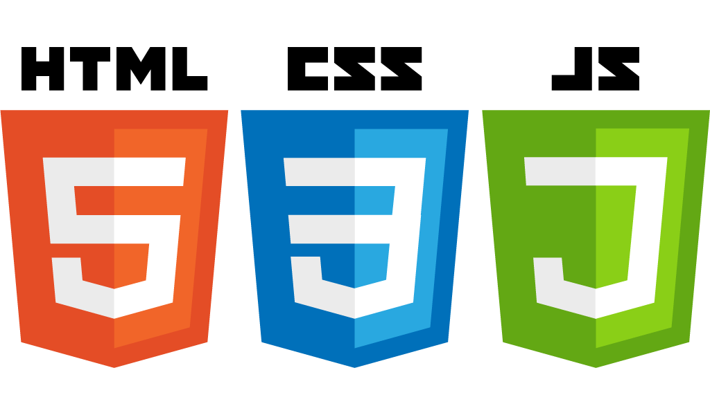


Introduction to CSS
Startup-ready web skeleton with Spring Boot, HTML5, CSS3, Javascript/JQuery, Bootstrap, Stripe and AWS

Slide 2
In this lecture…
What is CSS and why it’s important
How to set up CSS in your HTML pages
Basic CSS syntax
Basic CSS Selectors
The Box Model
A brief introduction to Bootstrap
CSS in Action:
Linking to an HTML page
Some basic styling
Google Chrome DevTools
How to style a navigation bar with tab-like buttons
A simple three columns layout with CSS positioning

Slide 3
What is CSS and why it’s important
CSS stands for Cascading Style Sheet
It’s a stylesheet language used to style HTML (and XML) documents
It enables the separation of concerns between the content (HTML) and how the content is presented (CSS)
This separation allows for higher maintainability and more precise semantic content.

Slide 4


How to setup CSS in your HTML pages
There are three ways we can style our pages with CSS:
Inline, e.g. <p style=“color: blue;”>Hello</p>
Internal:
<head>
<style>
p { color: blue; }
External CSS linked to a page
<head>
<link rel=“stylesheet” type=“text/css” href=“/css/styles.css”

Slide 5
Basic CSS syntax
Once CSS has been linked to a page we can start defining our page style
CSS works by selectors
<selectors> {
<property> : <value>;
<property> : <value>;
}

Slide 6
Basic CSS selectors
CSS selectors are used to select elements on a page
id selectors (#element)
Since there can only be one id per HTML page this is the most precise selector and most efficient
element selector (e.g p, body, h1, etc.)
class selector (.class), for example:
HTML -> <p class=“main-heading”>Text</p>
CSS -> .main-heading { font-size: 80px; }
“behavioural” selectors
Act upon user’s interaction with some elements on a page (e.g. :hover will act on hovered link, :checked acts on every checked element on the page)

Slide 7
What can we define with CSS?
Colours (fonts, backgrounds, borders, etc)
Fonts (families, sizes, etc)
Display types (blocks, inline, hidden, etc)
<ul>, <ol>, <h1> to <h6> display as blocks
<img> displays inline
Hyperlink properties
Positioning
Margins, borders, padding
Device responsive layouts. This has recently gained more and more importance, e.g. websites that look good regardless of whether they’re being displayed on a web browser or on a mobile device

Slide 8
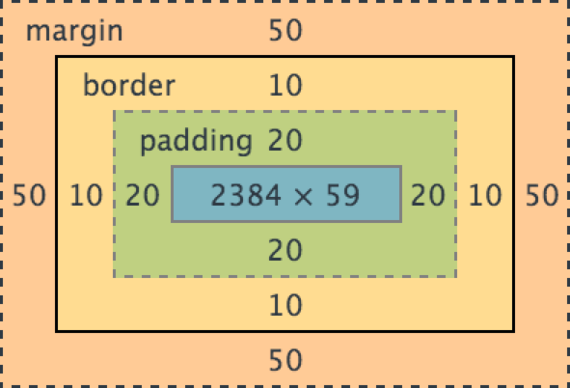
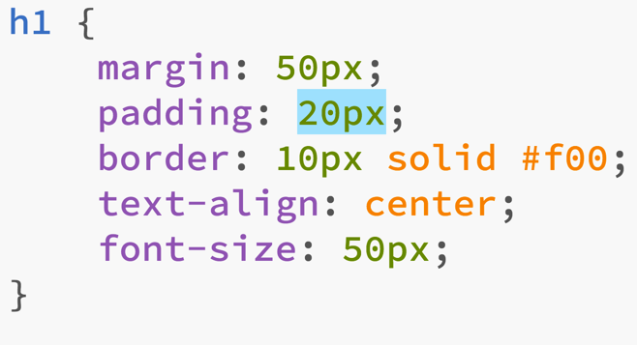


The Box Model
Natural text contour
Padding
Border
Margin

Slide 9
Twitter Bootstrap and CSS
Although knowing CSS is fundamental to write web applications, Bootstrap does a lot of boilerplate work for us
Bootstrap defines a collection of CSS styles that make the styling of our HTML pages quick and effective
As Bootstrap evolves, we will likely have to write less and less CSS and can just benefit from Bootstrap incredible features
Let’s now see some CSS examples in action!

Slide 10
Summary
What is CSS and why it’s important
How to set up CSS in your HTML pages
Basic CSS syntax
Basic CSS Selectors
The Box Model
A brief introduction to Bootstrap
CSS in Action:
Linking to an HTML page
Some basic styling
Google Chrome DevTools
How to style a navigation bar with tab-like buttons
A simple three columns layout with CSS positioning
Notes:
2) Before delving into the nitty and gritty of the web, I’d like us to have a look at how the network works. It’s important to have an understanding of this because the Web is a giant network and any web application relies on the network to transmit and receive its data
- The network works in layers. At the very bottom there’s the physical link which transmits bits (0s and 1s) either through electric signals or wirelessly
- The Data Link Layer defines how the data is sent, e.g. whether we’re using Ethernet, Wi-Fi, etc
- The Network layer defines the protocol that will be used to send the data, e.g. are we sending packets, and if so how many bits are we sending in each packet, etc.
- The Transport layer defines how the data will be transported, e.g. via TCP, UDP, etc. In order for two end-points to send data, they need to agree on a protocol. For instance, with TCP, a handshake between sender and receiver needs to be established first any data can be transmitted and once the transmission is complete, a connection termination series of messages closes the connection.
- The Session layer defines the mechanisms for opening, closing and managing a session between sender and receiver
- The Presentation Layer is responsible for the delivery and formatting of the data transported by previous layers. Data is 0s and 1s and it’d be very difficult for end-users to understand (or work effectively) with data represented in binary. It’s much easier to understand text. This layer is responsible to ensure that bits are formatted according to the target format (e.g. ASCII). Encryption is typically done at this layer too.
- The Application Layer is where applications (typically servers) reside. Examples include HTTP, FTP and DNS servers. It’s an abstraction which defines shared protocols and interface methods. For instance, we know that an HTTP server needs to support GET, POST, PUT, DELETE (and other) request methods and that a request sent to an HTTP server needs to follow a particular format (more on this in the next slide)
- End-user Applications. This is where the application we write live. Unless you’re writing your own HTTP server, typically your application will use the Application Layer to offer some functionality. This layer is also where our web skeleton will reside.

