Slide 1



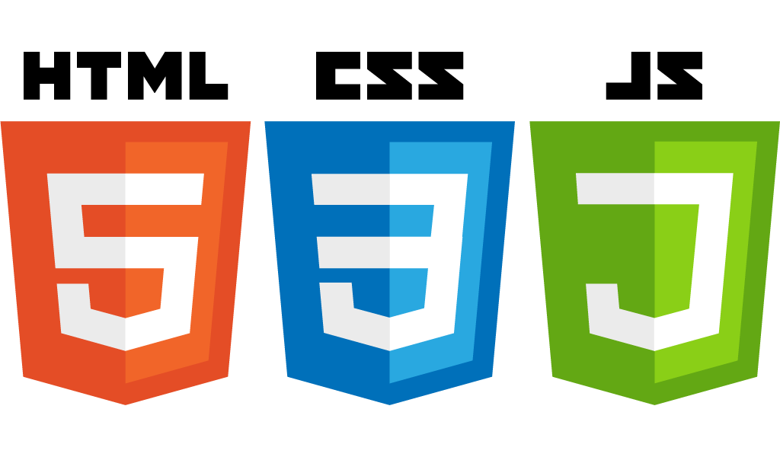


Introduction to Javascript
Startup-ready web skeleton with Spring Boot, HTML5, CSS3, Javascript/JQuery, Bootstrap, Stripe and AWS

Slide 2
In this lecture…
Types
Variables
Conditional statements with if, else, else if
Loops (for, while, do)
Switch
Functions
Objects and Arrays
Scopes
The window and document objects
The Document Object Model (DOM)
How can Javascript interact with HTML

Slide 3
What we will not cover
More advanced topics, such as OO and Server Side Programming, asynchronous calls, events and Ajax
Constructors and Classes
Prototypes
Inheritance
Introspection-like functionality, such as typeOf, hasOwnProperty, and so on

Slide 4
Javascript Types
Javascript has got the following types:
String (e.g. “Hello”)
Number (e.g. 1, 6.98)
NaN – Everything that is not a legal number
isNaN(“A”) = true
Boolean (e.g. true, false)
Array (e.g. [1, “Hello”, true])
Container of things
Can contain different types and other arrays
Object – A container of properties and behaviour
Object properties represent “things” or “nouns”, e.g. age, firstName
Object functions represent behaviour, e.g. doSomething()
Undefined: Something undefined
Null. Although this is supposed to represent “nothing”, it’s actually an Object

Slide 5
Variables
In Javascript we define a variable with the var keyword.
Javascript is not a strongly typed language, therefore we don’t need to declare the variable type
The Javascript engine will infer the variable type from the value assigned to that variable
Example: var myName = “Marco”;
The type of myName is inferred to be a String

Slide 6
Conditional Statements
Conditional statements in Javascript work like in Java.
Example:
if (myName === “Marco”) {
console.log(“There you are”);
} else if (myName === “John”) {
console.log(“Hello John”);
} else {
console.log(“Don’t recognise the name”);
}

Slide 7
Difference between == and ===
The only difference between the double and triple equality operator is that the === operator will not attempt to perform a type conversion if the two operands are not of the same type.
This also means that with the triple equality operator, two operands must be of the same type to be considered equal
You can also think of the == operator as being more “relaxed” in terms of type checking compared to the === operator.
Generally, use the triple equality operator whenever you would use equals() in Java, unless you want to relax type checking

Slide 8
Loops
Loops in Javascript work exactly like Java, e.g.
for (var i = 0; i < aNumber; i++) {
doSomething();
}
while (condition is true) {
doSomething();
}
do {
something();
} while (condition is true)

Slide 9
“switch” statement
The switch operator in Javascript work exactly like in Java, e.g.:
switch(aString) {
case “aValue”:
doSomething();
break;
case “anotherValue”:
doSomething();
break;
default:
doSomething();
}

Slide 10
Functions in Javascript
A function in Javascript is conceptually equivalent to a method in Java, however the similarities stop there.
Declared with the keyword function
A function in Javascript is an Object
It can be assigned to a variable
It can be passed as argument to a function for later execution
Functions in Javascript can be anonymous
They can return a value, but the type of this value doesn’t have be defined in the function declaration
As well as we don’t have to declare the argument types

Slide 11
Objects in Javascript
In Javascript, an Object is a container or properties and functions
var me= {
firstName: “Marco”,
lastName: “Tedone”,
sayHello: function() {
console.log(“Hello from: “ + this.firstName + “ “ + this.lastName);
}
}
It’s then possible to access properties with various notations:
var myFirstName = me.firstName;
Or
var myLastName = me[“lastName”];

Slide 12
Nested Objects
Objects can contain other Objects, effectively resolving to a tree-like structure
var me= {
firstName: “Marco”,
lastName: “Tedone”,
sayHello: function() {
console.log(“Hello from: “ + this.firstName + “ “ + this.lastName);
}
Address: {
firstLine: “34, Fancy Street”,
city: “Woodford”,
postCode: “W15 6RG”,
country: “UK”
}
}

Slide 13
Javascript Objects and JSON
JSON objects are a subset of Javascript Objects
{
“firstName” : “Marco”,
“lastName” : “Tedone”,
“address”: {
“firstLine”: “40, Hampton Road”,
And so on…
}
}
JSON stands for JavaScript Object Notation
Gained popularity in recent years as the format to move data across RESTful services (and not only)
Less verbose than XML
Natively supported in Javascript
Javascript-based frameworks are taking web-development by storm
JQuery
Node.js
Angular.js
And others…

Slide 14
Arrays
Arrays work pretty much like in Java with one important difference: in Javascript arrays can be extended, whereas in Java they can’t.
var myArray = [];
Or
var myArray = [“John”, “Jim”, “Louise”];
Or
var myArray = new Array();
To access an array just use the index, starting at zero
var firstElement = myArray[1]; // returns “Jim”
To assign values to an array, just use the familiar Java syntax:
myArray[0] = “Marco”; //[“Marco”, “Jim”, “Louise”]
Or
myArray[array.length] = “New element”; // Will extend the array

Slide 15
Javascript Scopes
A scope in Javascript is the set of variables you have access to
global scope. Anything not defined within curly braces. This is also the default scope
private scope. Generally defined within curly braces {}
Anything declared at the Javascript top-level is assigned to the global scope
Automatic global scope
Occurs when, within a function, we assign a value to a variable without declaring it. The variable assume global scope and therefore can be used outside the function even by code preceding the function declaration

Slide 16
Global and Private scope considerations
The order in which variables are declared is not as strict as in Java
The Javascript runtime loads the code and then assigns variables, objects and functions to either the global or private scope.
We need to exercise caution when defining variables in global scope, because of the potential conflict with other libraries
Better to use namespaces to avoid conflicts

Slide 17
The window and document objects
When we execute Javascript within an HTML page, the Javascript runtime makes available to us a number of variables at the global scope.
window. This is the root object and is the first object loaded by the Javascript runtime when it loads an HTML page
document. This object represents our HTML page and it’s contained within the window object

Slide 18
The DOM Model
window
history
location
document
…and many others
html
head
body
title
h1
form
p
…and many others
Text: Hello
Text: Welcome
Text: Some text
radio
checkbox
text
textarea
…and many others

Slide 19
Javascript and HTML
Javascript is used to make web applications interactive
In recent times it’s probably not the most popular choice, as there are other frameworks (like JQuery) which make this interaction easier
In order to execute Javascript in a page we need to write Javascript code
Inline ☹
Internal code ☹
External Link ☺
A good practice is to write the Javascript code in a separate file and associate it to the HTML page
<script type=“text/javascript” src=“/js/myscript.js></script>

Slide 20
Where to define the <script> element?
Browser loads the HTML document
When it finds a <script> element, blocks the HTML loading and waits for the script content to be loaded
If we place the <script> element too early in the HTML body, users might experience a delay in the page loading
The preferred solution is to place the <script> elements before the </body> element

Slide 21
Examples on when Javascript can be use with HTML
Examples of how we can use Javascript in HTML pages:
Form Validation
Dynamic addition and removal of HTML elements
Image a Task application that, after the user has added a task and clicked a button, adds a new task on the page
Alter an HTML element “class” attribute to change how the element appears
Asynchronous interaction with server side components (e.g. Ajax)
Respond to events (e.g. mouse clicks, keyboard keystrokes and so on

Slide 22
Summary
In this lecture we have introduce Javascript. Some important concepts:
Types
Variables
Conditional statements with if, else, else if
Loops (for, while, do)
Switch
Functions
Objects and Arrays
Scopes
The window and document objects and what is a DOM
How can Javascript interact with HTML

