Slide 1



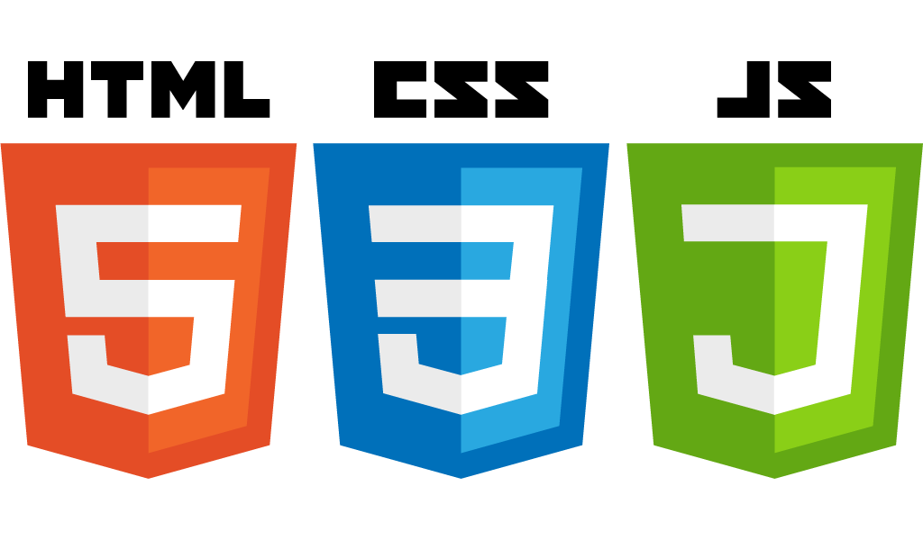


Basic Javascript hands-on
Startup-ready web skeleton with Spring Boot, HTML5, CSS3, Javascript/JQuery, Bootstrap, Stripe and AWS

Slide 2
Summary
Variables
Conditional statements
Loops
The switch operator
Functions
Objects
Arrays
How Javascript interacts with HTML

