Slide 1



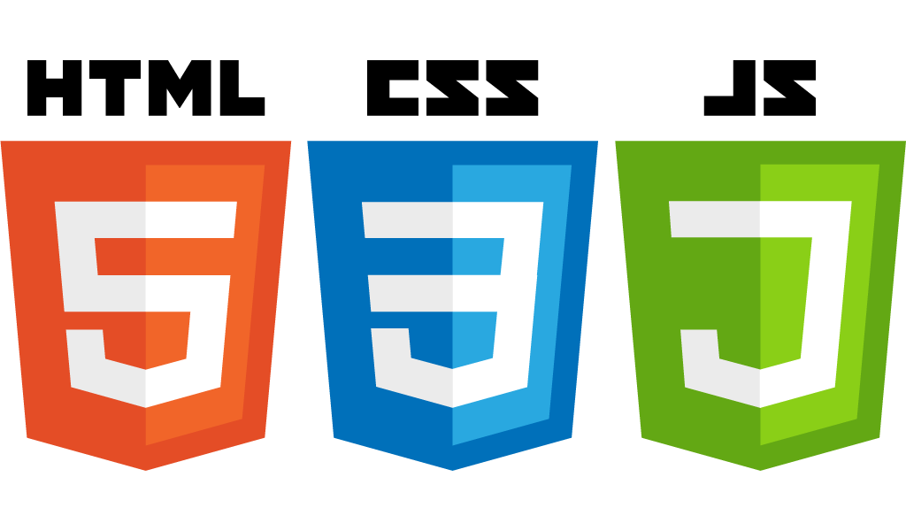


Introduction to Bootstrap
Startup-ready web skeleton with Spring Boot, HTML5, CSS3, Javascript/JQuery, Bootstrap, Stripe and AWS

Slide 2
In this lecture…
What is Bootstrap
Installing Bootstrap
Basic Bootstrap elements
The Grid System
The Bootstrap Jumbotron element
Bootstrap Forms
Bootstrap Buttons

Slide 3
Bootstrap
Bootstrap is a collection of CSS styles, themes and fonts
It enables quick and effective development of appealing websites
It started in mid-2010 at Twitter and it has become one of the most popular open source projects in the world
20 releases since
From version 3, Bootstrap is responsive by default
Without any effort, a Bootstrap website will look good on any device
With minimal effort, the user’s experience on mobile devices can be enhanced
Provides a set of CSS classes for most HTML components
Provides a set of icons for most use cases

Slide 4
Advantages
Time To Market
We can create nice-looking websites in minutes
Ease of use
It’s extremely easy to use the basic constructs to achieve pretty good results
Consistency
By using Bootstrap, we can apply the same look and feel to all our websites
Responsive by default
By using Bootstrap, our websites will look good on any device by default and with minimal effort we could create a compelling user’s experience on mobile devices
Open Source
Bootstrap is continuously being improved and new versions are being released regularly. This also means that it’s free to use, which is bonus not to be underestimated

Slide 5
Installing Bootstrap
Visit getboostrap.com/getting-started/
Choose -> Download Bootstrap
Unzip the downloaded file
Choose the files you want to use (e.g. minified vs non minified version) and copy the to your CSS and Javascript folders

Slide 6
Summary
In this lecture we have covered a lot of ground. We have looked at:
What is Bootstrap
The advantages of using it
How to install Bootstrap and have our HTML page use it
We then created a started Bootstrap index.html page
We have introduced the Grid System
We have seen how to declare a Jumbotron
Finally, we have declared a Bootstrap form and used Bootstrap buttons for a nice-looking form

Slide 7
In the next section
Git, GitHub and the Git flow
Spring STS
IntelliJ
AWS
Stripe
MySQL

