Slide 1



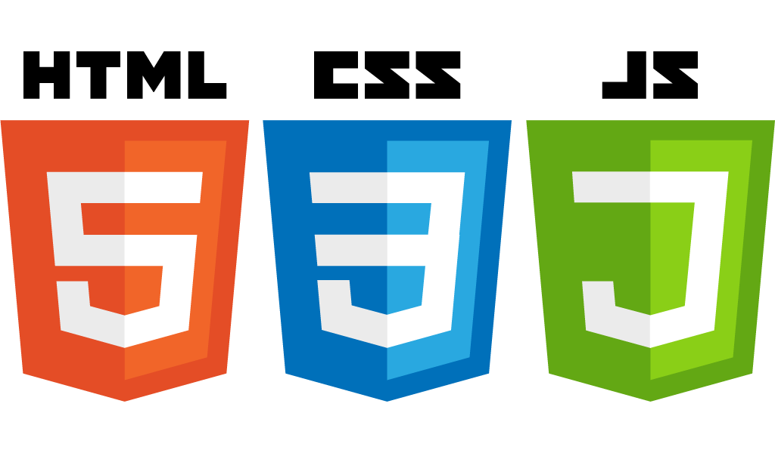


Introduction to JQuery
Startup-ready web skeleton with Spring Boot, HTML5, CSS3, Javascript/JQuery, Bootstrap, Stripe and AWS

Slide 2
In this lecture…
What is JQuery
Using JQuery with HTML
JQuery main building blocks
How to initiate a JQuery block
Simple interaction with HTML
Button click events
Dynamically add HTML content to HTML elements
Dynamically add / remove CSS classes from HTML elements

Slide 3
What is JQuery?
JQuery is a Javascript library
It makes it much easier to use Javascript in HTML pages
Less code compared to Javascript
Very popular library
Example: add a class to an HTML element
With Javascript: document.getElementById("MyElement").className += " MyClass”;
With Jquery: $(“MyElement).addClass(“MyClass);

Slide 4
Using JQuery with HTML
Download JQuery from jquery.com/download
JQuery comes in two versions: minified and uncompressed and place it where you keep your Javascript files
Add a <script> element to your HTML page, pointing to JQuery.
That’s it! You can now start using JQuery

Slide 5
JQuery main building blocks
JQuery provides a $() operator which functions as a selector
Many Javascript libraries use the $ as a function.
In JQuery, the $ function is just a shorthand for jQuery
In case of a conflict, you can use jQuery instead, e.g. jQuery(“MyElement”).addClass(“My class”);
The syntax is generally:
$(“selector”).action();
Where “selector” is typically one of the CSS selectors (id, element, class, etc.)

Slide 6
JQuery in Action
Let’s now see some practical examples!

Slide 7
Summary
What is JQuery
How to install JQuery
How to link JQuery to HTML pages
Basic JQuery constructs
Simple interaction with HTML pages
Dynamically add HTML content to an HTML element
Handle Button click events
Dynamically change an HTML element CSS class

