Slide 1

MBEYA UNIVERSITY OF SCIENCE & TECHNOLOGY COLLEGE OF ICT DEPT. OF NFORMATION SYSTEM & TECHNOLOGY SYSTEM DESIGN AND PROTOTYPE
PROJECT TITLE: DEVELOPMENT OF MOBILE APPLICATION TO ENHANCE GRAPE PRODUCTS MARKETING IN DODOMA
STUDENT NAME: SHUFAA MAJIDI ISSA
STUDENT REG.NO: 22101133370014
SUPERVISOR’S NAME/S: SIR NICODEMUS SANGA

Slide 2
CONTENT
Introduction
Objectives
System overview
System design
Prototype demo
Conclusion

Slide 3
Introduction
Dodoma's grape farmers face challenges in marketing their products due to limited access to markets and buyers.
Traditional methods are slow, inefficient, and offer little visibility for local producers.
The proposed mobile application system provides a digital platform to connect farmers, processors, and buyers directly.

Slide 4
System overview..
The system aims to improve the marketing and distribution of grape products by providing a centralized mobile platform for advertising, selling, and buying
The targeted Users
Grape farmers
Local and regional buyers/consumers
Distributors and retailers
Basic functionalities of the study
User registration and login for different user roles
Product listing with images, prices, and descriptions
Real-time search and filtering of grape products
In-app messaging between buyers and sellers
Order placement and tracking
Admin dashboard for managing users and content

Slide 5
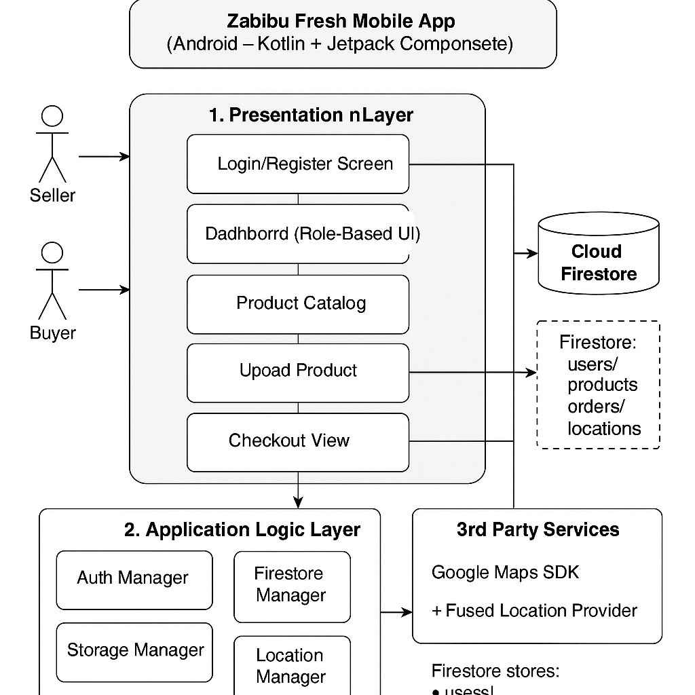
System design cont..
System architecture

Slide 6
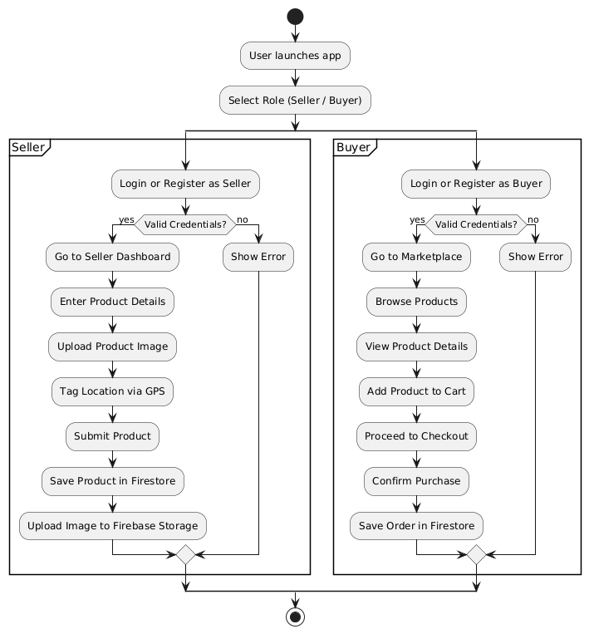
System design cont..
This Flow Elaborates the User Activity Based on his or Her Role
But Both Activity Run On the Same Flow As from the Firestone Database

Slide 7

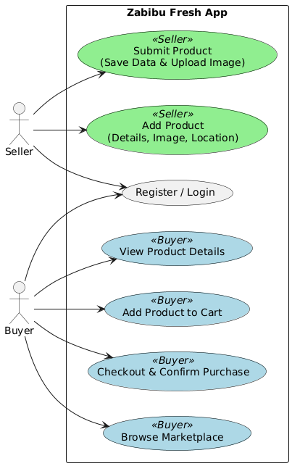
System design cont… Use case or System interaction with users

Slide 8
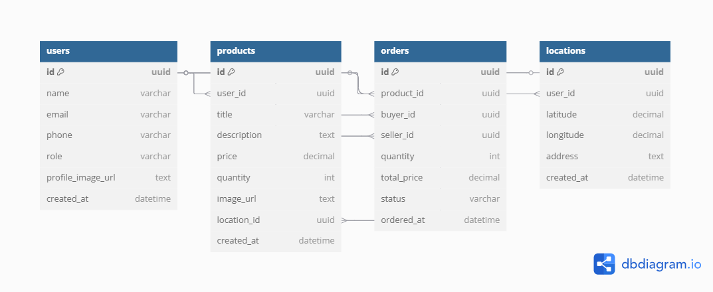
System design cont…
Database design

Slide 9
System design cont..
Tools used for design
PlantUML
For creating system diagrams such as activity diagrams, use case diagrams, and sequence diagrams to visualize workflows and architecture.
Firebase
Backend-as-a-Service platform providing Firestore (NoSQL database) for data storage and Firebase Storage for image uploads.
Kotlin JetPack Compose
Mobile app framework for building the user interface for both Seller and Buyer apps.
Git & GitHub
Version control tool to manage source code and track changes during development.
Figma
UI/UX design tools for prototyping and designing app interfaces before actual development.
Android Studio
Native development environments for building and debugging the app on Android
Google Maps API / GPS Services
For location tagging of products using device GPS in the app.
Firebase Authentication
Service used to manage user registration and login securely.

Slide 10
System Design cont…
Technology Stack
Kotlin:
A modern, concise, and safe programming language officially supported by Google for Android development.
Offers improved readability, null safety, and interoperability with existing Java code.
Enables faster development with fewer bugs compared to Java.
Jetpack Compose:
Android’s modern toolkit for building native UI using a declarative approach.
Simplifies UI development by letting developers describe the UI in Kotlin code instead of XML layouts.
Supports reactive programming—UI automatically updates when app data changes, improving performance and reducing boilerplate code.
Integrates seamlessly with Kotlin coroutines and ViewModel for efficient state management and asynchronous operations.
Provides built-in material design components, animations, and theming support out of the box.

Slide 11
Prototype demo
This prototype illustrates the core interfaces of our grape marketing system.
It demonstrates key user actions like product posting, ordering, and notifications and payment
The demo offers a visual guide to how the final system is expected to function

Slide 12
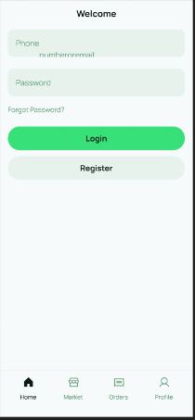
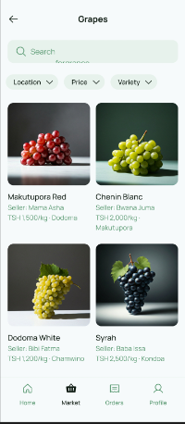
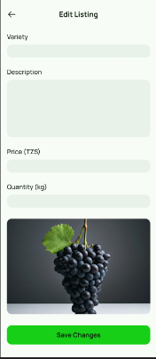
Prototype demo
Login page Product catalog Product listing

Slide 13
Conclusion…
The system offers a steady grape marketing platform with offline and online access for rural and urban users.
Despite its strengths, current limitations include basic notification features and limited payment integrations.
Future upgrades will aim at enhancing real-time notifications, adding more payment methods, and integrating advanced analytics for farmers and buyers.

