Slide 1

Visualization – Tutorial Presentation for Feedback Date: 28/11/2022
Group Id: a_group129 Name of Student Presenting: Pratyush Garg

Slide 2
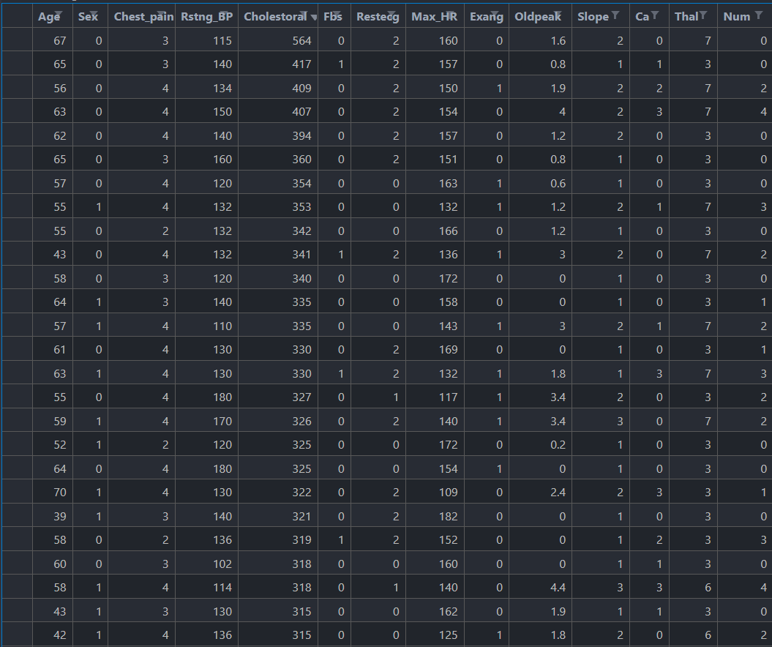
We are using the dataset https://data.world/uci/heart-disease to answer our
Research question “ Is there a difference in the mean Cholesterol level in Cleveland between Male and Female population? ”
Independent Variable: Sex – 1 (Male)
0 (Female)
Dependent Variable : Cholesterol Level
Total number of Rows 303 and Columns 14

Slide 3
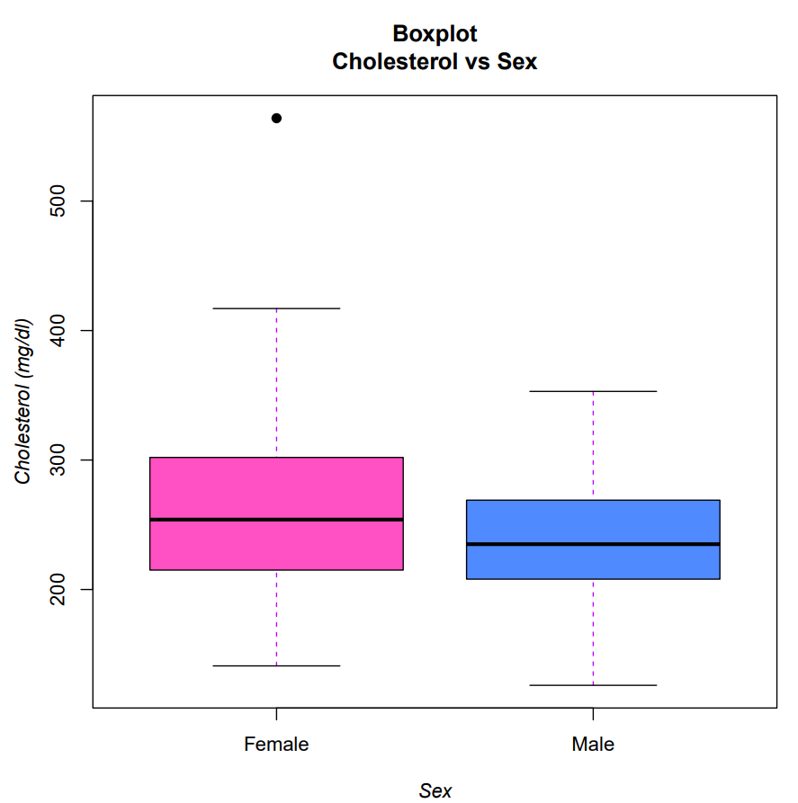
Box Plot :

Slide 4
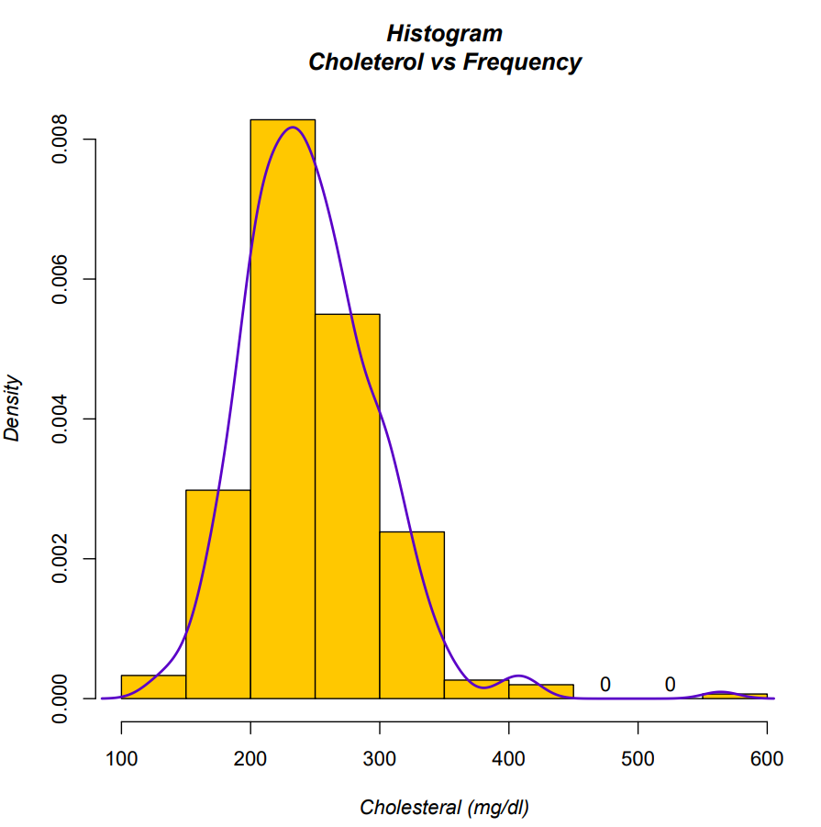
Histogram :

