Slide 1
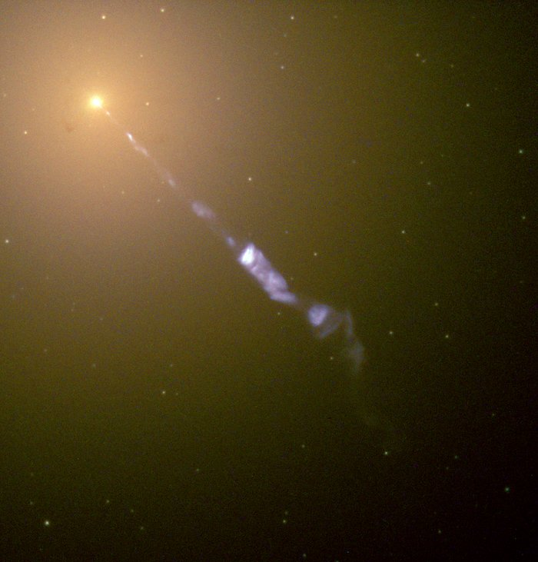
Investigating Supermassive Black Holes and Their Variability Using A Structure Function

Slide 2
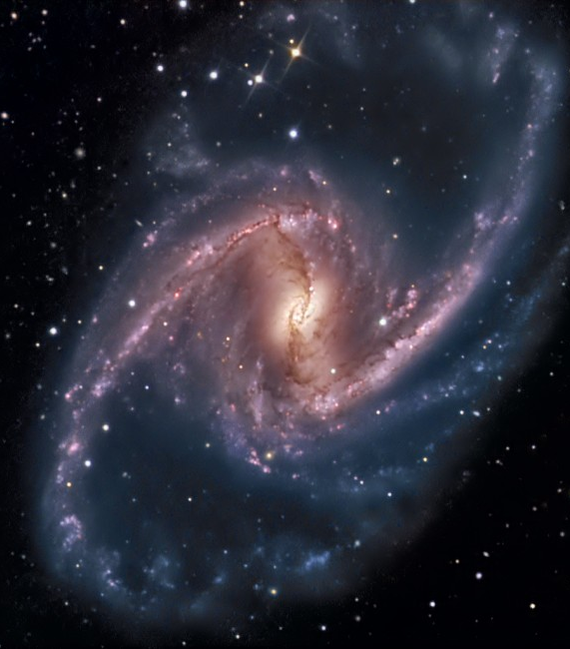
A brief introduction to space

