Slide 1

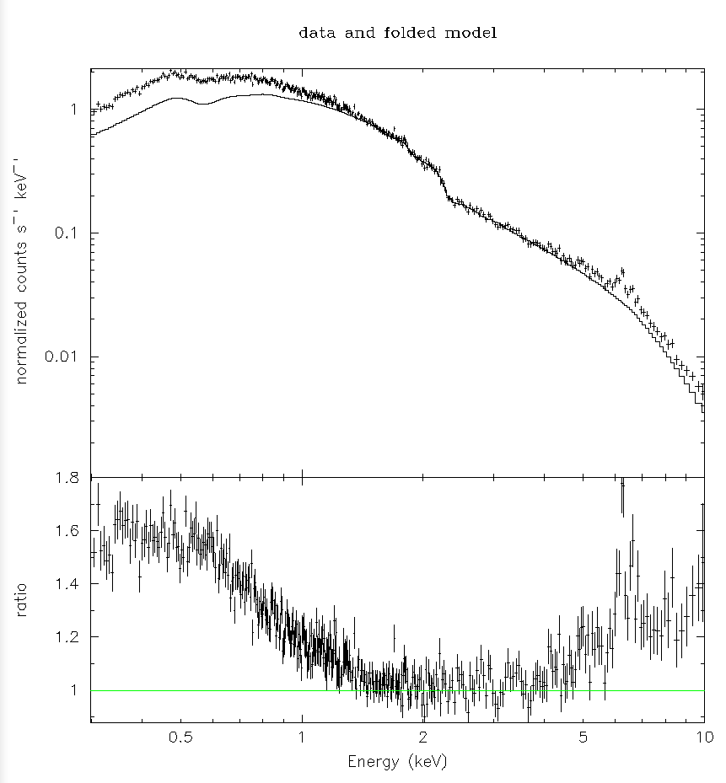
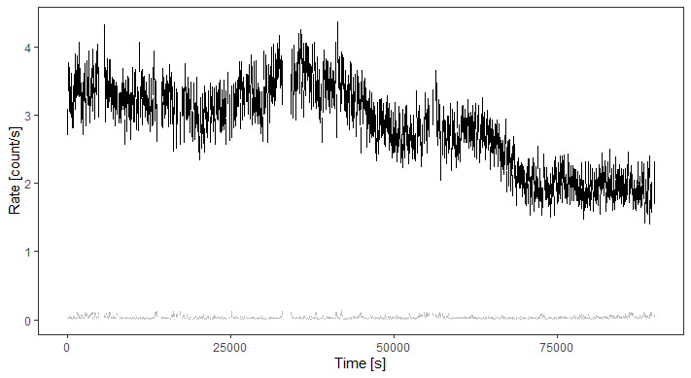
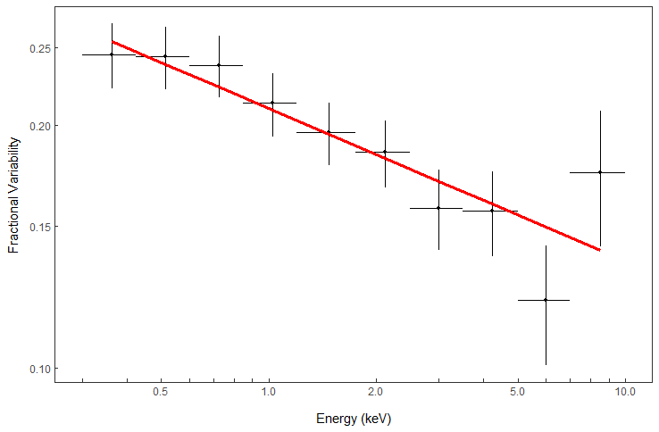
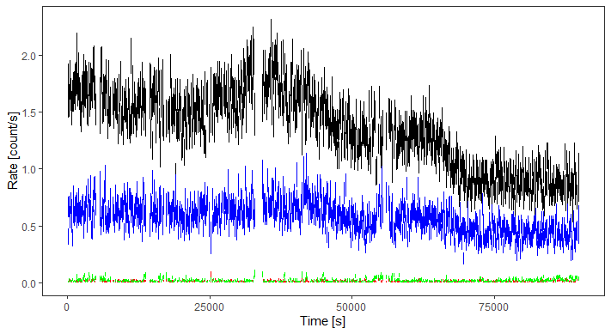
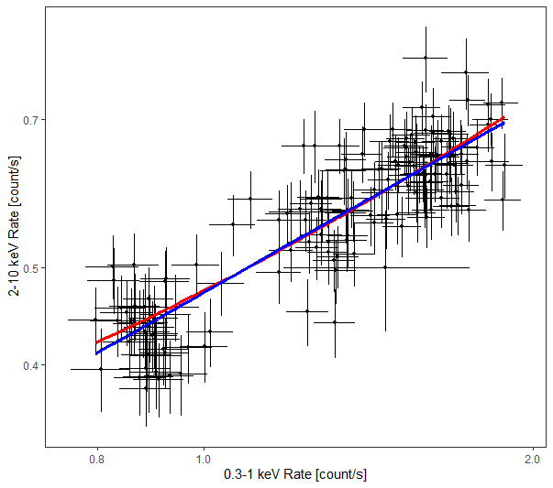
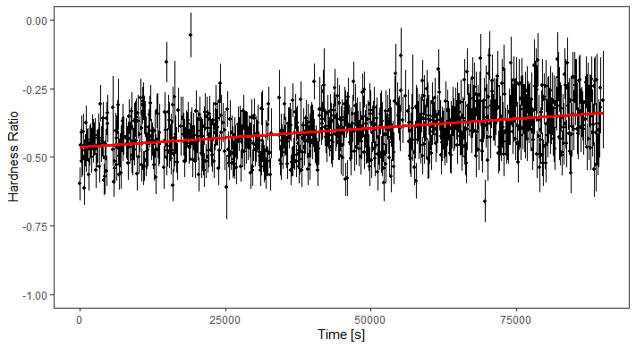
Exploring the temporal variability and spectral properties of the Seyfert 1 MCG-02-14-009
D. M. Blue¹, L. C. Gallo¹
¹Saint Mary’s University, Halifax, N.S., Canada
1 ― Introduction Active galactic nuclei (AGN) are supermassive black hole systems at the centers of active galaxies. These systems consist of a black hole whose mass can range from millions to billions of solar masses, and typically occupy a region of their host galaxies no larger than our own solar system. MCG-02-14-009 is a member of a sub-class of AGN known as Seyfert 1 galaxies. Seyfert 1 galaxies present one of the best opportunities to explore the regions surrounding these extreme systems as they typically have an inclination to our view that allows light from the innermost regions of the nucleus to reach us without being obscured by the various components of the nucleus.
2 ― The X-ray Emitting Region
The primary source of light in AGN is from an accretion disk of highly ionized infalling matter that is superheated to the point that it emits light in the ultra-violet. This process of superheating strips electrons from the matter in the disk, depositing them into a region known as the corona, wherein light from the disk is scattered to higher energy X-rays through inverse Compton Scattering. The spectra of AGN typically consist of a power law accompanied by a strong iron emission line at 6.4 keV, an excess of emission below 1 keV, and a `hump` around 20 keV.
4 ― XMM Newton Light Curves
AGN have been observed to display extreme variability in their X-ray emission, often showing large amplitude variability on timescales as short as seconds. As such, light curves were created from the XMM Newton EPIC PN CCD detector for the broadband (0.3-10 keV), soft (0.3-1 keV), and hard (2-10 keV) energy bands. Data past 90ks into the observation exhibited extreme background flaring and so the light curves had to be cut to 90ks from their original 125ks. A further filter removing measurements for which the background count rate exceeded 0.1 counts/s was also applied.
The broadband light curves displays a dimming trend over the course of the observation however a look at the hard and soft energy bands separately shows that while the soft band light curve mimics the trend of the broadband light curve, the hard band light curve remains relatively consistent. This is supported by the harness ratio, or X-ray colour, plot which was found to be increasing in hardness with time.
5 ― Fractional Variability
A method of measuring the variability of a source over time as a function of energy is the fractional variability, or “RMS spectrum”². The fractional variability allows us to investigate temporal variability power in the spectrum while maintaining spectral features. The fractional variability for the XMM PN observation was calculated using evenly log-spaced binning in order to maximized signal to noise for each bin. The fractional variability for MCG-02-14-009 shows a gross decrease in fractional variability with energy, implying that the majority of the variability in the spectrum stems from the softer energies. It is interesting to note that the 6.4 keV iron band exhibits extremely low fractional variability and does not seem to be changing very much at all with time.
Soft Excess
6.4 keV Fe Line
3 ― Theoretical Models
The current theoretical models that we are investigating are a reflection scenario and a two corona scenario. In the reflection scenario, light from the primary corona is emitted isotropically and a portion is reflected off the accretion disk through fluorescence. In the two corona scenario a cool secondary corona rests above the accretion disk, inverse scattering to lower X-ray energies.
6 ― Flux-Flux Plots
When considering the two theoretical models we are testing, it is not unreasonable for the soft and hard bands of the X-ray spectrum to exhibit a level of correlation. Plotting the soft band flux against the hard band shows that there is indeed a direct correlation, though distinguishing a linear correlation from a log or power law is not possible given the data quality.
Inverse Scattered X-Ray Photons
Dusty Torus
Hot Corona
Thermal UV Photons
Black Hole
Accretion Disk
Inverse Scattered X-Ray Photons
Reflected Fluorescent Emission
Dusty Torus
Hot Corona
Thermal UV Photons
Black Hole
Accretion Disk
Inverse Scattered X-Ray Photons
Cool Coronal Emission
Dusty Torus
Second Thin Cool Corona
Hot Corona
Thermal UV Photons
Black Hole
Accretion Disk
References
¹ Ponti G., et al., 2004, A&A, 417, 451
7 ― Conclusions The work presented here shows that MCG-02-14-009 exhibits moderate variability in the soft band of its X-ray spectrum while remaining relatively constant in the hard band. This could be a potential indication of a change in the cool corona if one adopts a two corona model, or some level of inhomogeneous absorption due to passing gas or dust clouds. The steady decrease in soft X-ray emission with time appears to be the driving factor in the general dimming trend observed in the broadband X-ray light curve, supported by a steady increase in the hardness ratio, and a decrease in fractional variability with energy. Future works to continue investigating MCG-02-14-009 will include searching for a lag between the soft and hard energy bands using a discreet correlation function to investigate coupling.

