Slide 1
Практическое метапрограммирование:
Пишем гетерогенную хэш-таблицу
Денис Панин, NVIDIA
Senior System Software Engineer

Slide 2
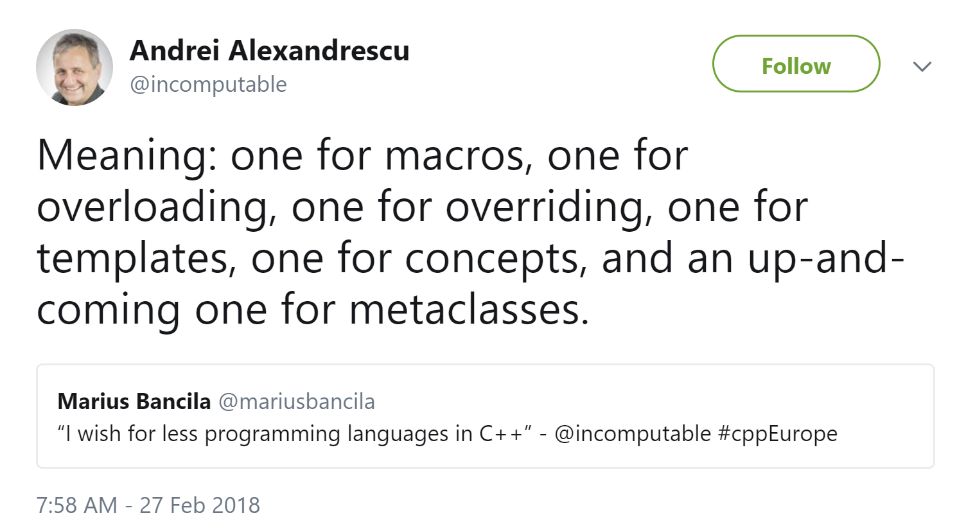

Slide 3
size_t very_bad_hash(std::string_view) {
return 3;
}

Slide 4
size_t very_bad_hash(std::string_view) {
return 3;
}
size_t still_bad_hash(std::string_view s) {
return s.size();
}

Slide 5
size_t very_bad_hash(std::string_view) {
return 3;
}
size_t still_bad_hash(std::string_view s) {
return s.size();
}
size_t good_enough_hash(std::string_view s) {
size_t hash{ 0 };
for (char c : s) {
hash += c * PRIME_1 ^ PRIME_2;
}
return hash;
}

Slide 6
Buckets = 5
0
{ "key1", value1 }, { "key6", value6 }
1
1
{ "key4", value4 }
2
2
{ "key5", value5 }
3
4
{ "key3", value3 }, { "key2", value2 }

Slide 7
Buckets = 5
0
{ "key1", value1 }, { "key6", value6 }
1
1
{ "key4", value4 }
size_t place = hash("key2") % buckets;
2
2
{ "key5", value5 }
3
4
{ "key3", value3 }, { "key2", value2 }

Slide 8
Buckets = 5
0
{ "key1", value1 }, { "key6", value6 }
1
1
{ "key4", value4 }
size_t place = hash("key2") % buckets;
2
2
{ "key5", value5 }
3
4
{ "key3", value3 }, { "key2", value2 }

Slide 9
Buckets = 5
0
{ "key1", value1 }, { "key6", value6 }
1
1
{ "key4", value4 }
size_t place = hash("key2") % buckets;
2
2
{ "key5", value5 }
3
4
{ "key3", value3 }, { "key2", value2 }

Slide 10
int main() {
const auto hashtable = make_hash_table(
HASH_TABLE_ENTRY("key1", 1),
HASH_TABLE_ENTRY("key2", nullptr)
);
}

Slide 11
int main() {
const auto hashtable = make_hash_table(
HASH_TABLE_ENTRY("key1", 1),
HASH_TABLE_ENTRY("key2", nullptr)
);
execute(hashtable, "key1", func);
execute(hashtable, "key2", func);
if (!execute(hashtable, "key3", func)
std::cout << "not found" << std::endl;
}

Slide 12
int main() {
const auto hashtable = make_hash_table(
HASH_TABLE_ENTRY("key1", 1),
HASH_TABLE_ENTRY("key2", nullptr)
);
const auto func = [](auto val) {
std::cout << typeid(val).name() << std::endl;
};
execute(hashtable, "key1", func);
execute(hashtable, "key2", func);
if (!execute(hashtable, "key3", func)
std::cout << "not found" << std::endl;
}

Slide 13
int main() {
const auto hashtable = make_hash_table(
HASH_TABLE_ENTRY("key1", 1),
HASH_TABLE_ENTRY("key2", nullptr)
);
const auto func = [](auto val) {
std::cout << typeid(val).name() << std::endl;
};
execute(hashtable, "key1", func);
execute(hashtable, "key2", func);
if (!execute(hashtable, "key3", func)
std::cout << "not found" << std::endl;
}

Slide 14
int main() {
const auto hashtable = make_hash_table(
HASH_TABLE_ENTRY("key1", 1),
HASH_TABLE_ENTRY("key2", nullptr)
);
const auto func = [](auto val) {
std::cout << typeid(val).name() << std::endl;
};
execute(hashtable, "key1", func);
execute(hashtable, "key2", func);
if (!execute(hashtable, "key3", func)
std::cout << "not found" << std::endl;
}

Slide 15
int main() {
const auto hashtable = make_hash_table(
HASH_TABLE_ENTRY("key1", 1),
HASH_TABLE_ENTRY("key2", nullptr)
);
const auto func = [](auto val) {
std::cout << typeid(val).name() << std::endl;
};
execute(hashtable, "key1", func);
execute(hashtable, "key2", func);
if (!execute(hashtable, "key3", func)
std::cout << "not found" << std::endl;
}

Slide 16
Проблемы, которые мы героически будем решать.
Взять "key1", и захэшировать в шаблонный параметр.
Как сделать хэш-таблицу из bucket’ов, наполнить их, используя шаблонный хэш?
Обеспечить run-time алгоритмическую сложность execute в O(1).
А если и ключи разных типов?
Бонус
Бонус #2

Slide 17
Часть #1
Где мы будем считать compile-time хэш

Slide 18
hash<"key1">::value
Нельзя, но обещали разрешить

Slide 19
hash<"key1">::value
Нельзя, но обещали разрешить
extern auto key1 = "key1";
hash<key1>::value
Можно, но это не в 1 строку,
и литерал должен быть глобальным

Slide 20
hash<"key1">::value
Нельзя, но обещали разрешить
extern auto key1 = "key1";
hash<key1>::value
Можно, но это не в 1 строку,
и литерал должен быть глобальным
hash<'k','e','y','1'>
::value
Можно, но у нас c-string

Slide 21
hash<"key1">::value
Нельзя, но обещали разрешить
extern auto key1 = "key1";
hash<key1>::value
Можно, но это не в 1 строку,
и литерал должен быть глобальным
hash<'k','e','y','1'>
::value
Можно, но у нас c-string
#define HASH(s) \
hash<s[0], s[1],
s[2], s[3]>
::value
Идеально! Но если у нас не 4 символа?

Slide 22
constexpr size_t calc_hash(const char* s) {
size_t init_val = 997;
while (*s != 0) {
init_val *=
size_t(*(s++)) * 37ULL ^ 85969ULL;
}
return init_val;
}
hash<calc_hash("1234")> h;

Slide 23
template <size_t HASH, typename VAL>
struct hash_table_entry {
const std::string_view key;
const VAL val;
static constexpr auto hash = HASH;
};
#define HASH_TABLE_ENTRY(key, val) \
hash_table_entry<calc_hash(key), decltype(val)> (key, val)

Slide 24
Часть #2
Где мы будем в compile-time собирать хэш таблицу

Slide 25
std::make_index_sequence<N>{} алиас для
std::index_sequence<0, 1, 2, ..., N - 1>

Slide 26
std::make_index_sequence<N>{} алиас для
std::index_sequence<0, 1, 2, ..., N - 1>
fn1(std::make_index_sequence<5>{});
template <size_t ... N>
void fn1(std::index_sequence<N...>) {
accept_any(N...);
// accept_any(0, 1, 2, ..., N - 1);
}

Slide 27
template <typename ... ARGS>
void fn(std::tuple<ARGS...> tpl) {
fn_helper(tpl,
std::make_index_sequence<sizeof...(ARGS)>{});
}
template <typename TPL, size_t ... N>
void fn_helper(TPL tpl, std::index_sequence<N...>) {
accept_any(std::get<N>(tpl)...);
// accept_any(get<0>(tpl), ..., get<N-1>(tpl));
}

Slide 28
template <typename ... TUPLES>
auto std::tuple_cat(TUPLES&& tuples);
tuple<int, char> t =
tuple_cat(tuple<int>{}, tuple<char>{});
tuple<tuple<int>, tuple<char>> t =
tuple_cat(std::make_tuple(tuple<int>{}),
std::make_tuple(tuple<char>{});

Slide 29
Buckets = 5
0
{ "key1", value1 }, { "key6", value6 }
1
1
{ "key4", value4 }
2
2
{ "key5", value5 }
3
4
{ "key3", value3 }, { "key2", value2 }

Slide 30
auto build_bucket(ARGS ... args, size_t bucket_num) {
std::tuple<> target;
for (auto arg : args...)
if (arg::HASH % sizeof...(ARGS) == bucket_num)
target.append(arg);
return target;
}

Slide 31
auto build_bucket(ARGS ... args, size_t bucket_num) {
std::tuple<> target;
for (auto arg : args...)
if (arg::HASH % sizeof...(ARGS) == bucket_num)
target.append(arg);
return target;
}
auto make_hash_table(ARGS ... args) {
std::tuple<> target;
for (size_t i = 0; i < sizeof...(args); ++i) {
auto bucket = build_bucket(args..., i);
target.append(bucket);
}
return target;
}

Slide 32
template <size_t BUCKET_ID, size_t BUCKET_COUNT,
typename TPL, typename HEAD, typename ... REST>
auto build_bucket(TPL tpl, HEAD head, REST ... rest) {
constexpr auto good_hash = HEAD::HASH % BUCKET_COUNT == BUCKET_ID;
constexpr auto more_elem = sizeof...(REST) > 0;
if constexpr (more_elem && good_hash) {
const auto new_tpl = std::tuple_cat(tpl, std::make_tuple(head));
return build_bucket<BUCKET_ID, BUCKET_COUNT>(new_tpl, rest...);
}
if constexpr (more_elem && !good_hash)
return build_bucket<BUCKET_ID, BUCKET_COUNT>(tpl, rest...);
if constexpr (!more_elem && good_hash)
return std::tuple_cat(tpl, std::make_tuple(head));
if constexpr (!more_elem && !good_hash)
return tpl;
}

Slide 33
template<typename ... ARGS>
auto make_hash_table(ARGS... args) {
return make_hash_table_impl(
std::make_index_sequence<sizeof...(ARGS)>{}, args...
);
}
template <typename ... ARGS, size_t ... N>
auto make_hash_table_impl(index_sequence<N...>, ARGS ... args) {
return tuple_cat(
make_tuple(build_bucket<0,sizeof...(ARGS)>(tuple<>{}, args...),
make_tuple(build_bucket<1,sizeof...(ARGS)>(tuple<>{}, args...),
make_tuple(build_bucket<2,sizeof...(ARGS)>(tuple<>{}, args...),
...,
make_tuple(build_bucket<E,sizeof...(ARGS)>(tuple<>{}, args...)
)
};

Slide 34
template<typename ... ARGS>
auto make_hash_table(ARGS... args) {
return make_hash_table_impl(
std::make_index_sequence<sizeof...(ARGS)>{}, args...
);
}
template <typename ... ARGS, size_t ... N>
auto make_hash_table_impl(index_sequence<N...>, ARGS ... args) {
return tuple_cat(
make_tuple(
build_bucket<N, sizeof...(ARGS)>(
tuple<>{}, args...
)
)...
);
}

Slide 35
Часть #3
Где мы будем делать run-time lookup за O(1)

Slide 36
execute(hashtable, "key1", func);
template <typename TPL, typename F>
bool execute(TPL tpl, const char* key, F functor) {
const size_t bucket = calc_hash(key) % tuple_size_v<TPL>;
switch (bucket) {
// What shall we do here? Big switch case?
...
default: return false;
}
}

Slide 37
execute(hashtable, "key1", func);
template <typename TPL, typename F>
bool execute(TPL tpl, const char* key, F functor) {
const size_t bucket = calc_hash(key) % std::tuple_size_v<TPL>;
switch (bucket) {
case 0: if constexpr (0 < tuple_size_v<TPL>)
return execute_for_key(get<0>(tpl), key, functor);
...
default: return false;
}
}

Slide 38
execute(hashtable, "key1", func);
template <typename TPL, typename F>
bool execute(TPL tpl, const char* key, F functor) {
const size_t bucket = calc_hash(key) % std::tuple_size_v<TPL>;
switch (bucket) {
case 0: if constexpr (0 < tuple_size_v<TPL>)
return execute_for_key(get<0>(tpl), key, functor);
case 1: if constexpr (1 < tuple_size_v<TPL>)
return execute_for_key(get<1>(tpl), key, functor);
...
default: return false;
}
}

Slide 39
execute(hashtable, "key1", func);
template <typename TPL, typename F>
bool execute(TPL tpl, const char* key, F functor) {
const size_t bucket = calc_hash(key) % std::tuple_size_v<TPL>;
#define MAX_SWITCHES 50
static_assert(tuple_size_v<TPL> < MAX_SWITCHES);
switch (bucket) {
// something interesting is happening?
default: return false;
}
}

Slide 40
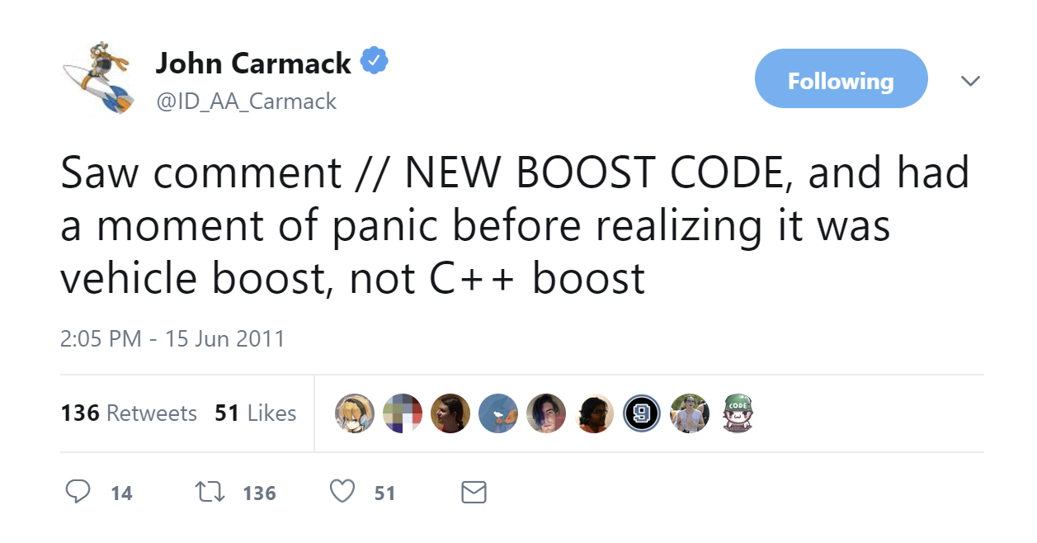

Slide 41
#include <boost/preprocessor/repeat.hpp>
BOOST_PP_REPEAT(count, macro, data)
count - сколько раз повторить макрос
macro - макрос, который boost будет повторять
data - значение, которое будет подставлено в макрос

Slide 42
#include <boost/preprocessor/repeat.hpp>
BOOST_PP_REPEAT(count, macro, data)
count - сколько раз повторить макрос
macro - макрос, который boost будет повторять
data - значение, которое будет подставлено в макрос
#define MACRO(unused, index, data) index, data,
BOOST_PP_REPEAT(5, MACRO, "ctx");
0, "ctx", 1, "ctx", 2, "ctx", 3, "ctx", 4, "ctx",

Slide 43
template <typename TPL, typename F>
bool execute(TPL tpl, const char* key, F functor) {
const size_t bucket = calc_hash(key) % std::tuple_size_v<TPL>;
#define MAX_SWITCHES 50
static_assert(tuple_size_v<TPL> < MAX_SWITCHES);
switch (bucket) {
BOOST_PP_REPEAT(MAX_SWITCHES, NV_SWITCH, 1);
default: return false;
}
}
#define NV_SWITCH(unused, idx, unused2)
case idx: if constexpr (idx < tuple_size_v<TPL>)
{ return execute_for_key(get<idx>(tpl), key, functor); }

Slide 44
int main() {
switch(rand()) {
case 0:
return printf("%i", 0);
case 1:
return printf("%i", 1);
case 2:
return printf("%i", 2);
case 3:
return printf("%i", 3);
case 4:
return printf("%i", 4);
case 5: case 6: case 10:
case 7: case 8: case 9:
default: return 0;
}
}

Slide 45
int main() {
switch(rand()) {
case 0:
return printf("%i", 0);
case 1:
return printf("%i", 1);
case 2:
return printf("%i", 2);
case 3:
return printf("%i", 3);
case 4:
return printf("%i", 4);
case 5: case 6: case 10:
case 7: case 8: case 9:
default: return 0;
}
}
main:
call rand
cmp eax, 4
ja .L2
jmp [QWORD PTR .L4[0+rax*8]]
.L2:
xor eax, eax
pop rdx
ret
.L4:
.quad .L3
.quad .L5
.quad .L6
.quad .L7
.quad .L8

Slide 46
template <size_t IDX = 0, typename TPL, typename F>
bool execute_for_key(TPL tpl, string_view key, F functor) {
if constexpr (std::tuple_size_v<TPL> > IDX) {
// something will appear here later...
if (std::get<IDX>(tpl).key == key) {
functor(std::get<IDX>(tpl).val);
return true;
}
return execute_for_key<IDX + 1>(tpl, key, functor);
}
return false;
}

Slide 47
Часть #4
Ключи тоже могут быть разных типов!

Slide 48
int main() {
const auto hashtable = make_hash_table(
HASH_TABLE_ENTRY(somestruct{}, 1),
HASH_TABLE_ENTRY("key2", nullptr)
);
const auto func = [](auto val) {
std::cout << typeid(val).name() << std::endl;
};
execute(hashtable, somestruct{}, func);
execute(hashtable, "key2", func);
if (!execute(hashtable, otherstruct{}, func)
std::cout << "not found" << std::endl;
}

Slide 49
struct somestruct {
constexpr somestruct() = default;
}
bool comparator(somestruct, somestruct) {
return true;
}
bool comparator(const char* a, const char* b) {
return strcmp(a, b) == 0;
}
constexpr size_t calc_hash(somestruct) {
return 7;
}

Slide 50
template <size_t IDX = 0, class KEY, class TPL, class F>
bool execute_for_key(TPL tpl, KEY key, F functor) {
if constexpr (std::tuple_size_v<TPL> > IDX) {
// something will appear here later...
if (comparator(std::get<IDX>(tpl).key, key) {
functor(std::get<IDX>(tpl).val);
return true;
}
return execute_for_key<IDX + 1>(tpl, key, functor);
}
return false;
}

Slide 51
template <size_t IDX = 0, class KEY, class TPL, class F>
bool execute_for_key(TPL tpl, KEY key, F functor) {
if constexpr (std::tuple_size_v<TPL> > IDX) {
if constexpr(is_same_v<std::decay_t<KEY>,
std::decay_t<decltype(std::get<IDX>(tpl).key)>)
if (comparator(std::get<IDX>(tpl).key, key) {
functor(std::get<IDX>(tpl).val);
return true;
}
return execute_for_key<IDX + 1>(tpl, key, functor);
}
return false;
}

Slide 52
BONUS
Несколько интересных вещей, которые не попали в доклад

Slide 53
template <size_t>
using int_seq = int;

Slide 54
template <size_t>
using int_seq = int;
template <size_t ... IS>
static auto helper(std::index_sequence<IS...>) {
return std::tuple<int_seq<IS>...>{};
}

Slide 55
template <size_t>
using int_seq = int;
template <size_t ... IS>
static auto helper(std::index_sequence<IS...>) {
return std::tuple<int_seq<IS>...>{};
}
template <size_t N>
struct tuple_mold {
using type = decltype(helper(make_index_sequence<N>{}));
}
tuple_mold<3>::type t;
std::tuple<int_seq<0>, int_seq<1>, int_seq<2>> t;
std::tuple<int, int, int> t;

Slide 56
template <size_t BEG = 0, typename TPL, typename KEY, typename F>
bool execute(const TPL& tpl, KEY key, F functor) {
const size_t bucket = calc_hash(key) % std::tuple_size_v<TPL>;
switch (bucket) {
case BEG * 5 + 0: if constexpr (BEG * 5 + 0 < tuple_size_v<TPL>)
{ return execute_for_key(get<BEG * 5 + 0>(tpl), key, functor); }
case BEG * 5 + 1: if constexpr (BEG * 5 + 1 < tuple_size_v<TPL>)
{ return execute_for_key(get<BEG * 5 + 1>(tpl), key, functor); }
...
default: if constexpr (BEG * 5 + 5 < tuple_size_v<TPL>)
{ return execute<BEG + 1>(tpl, key, functor); }
}
} return false;
}

Slide 57
template<size_t OFF, size_t ... N>
constexpr auto mcis_helper(index_sequence<N...>) {
return std::index_sequence<(N + OFF)...>{};
}
template<size_t FROM, size_t TO>
constexpr auto make_custom_index_sequence() {
static_assert(TO > FROM);
return mcis_helper<FROM>(make_index_sequence<TO - FROM>{});
}

Slide 58
template<size_t OFF, size_t ... N>
constexpr auto mcis_helper(index_sequence<N...>) {
return std::index_sequence<(N + OFF)...>{};
}
template<size_t FROM, size_t TO>
constexpr auto make_custom_index_sequence() {
static_assert(TO > FROM);
return mcis_helper<FROM>(make_index_sequence<TO - FROM>{});
}
template<typename TPL, size_t ... N>
constexpr auto cut_helper(TPL tpl, std::index_sequence<N...>) {
return std::make_tuple(get<N>(tpl)...);
}
template<size_t FROM, size_t TO, typename TPL>
constexpr auto cut_tuple(TPL tpl) {
return cut_helper(tpl, make_custom_index_sequence<FROM, TO>());
}

Slide 59
BONUS #2
Пример использования из одного проекта...

Slide 60
void fn1(int, float);
void fn2(something, something_else);
const auto hashtable = make_hash_table(
HASH_TABLE_ENTRY("key1", &fn1),
HASH_TABLE_ENTRY("key2", &fn2)
);

Slide 61
void fn1(int, float);
void fn2(something, something_else);
const auto hashtable = make_hash_table(
HASH_TABLE_ENTRY("key1", &fn1),
HASH_TABLE_ENTRY("key2", &fn2)
);
vector<string> params{ ... };
const auto func = [&params](auto fnX) {
const auto tpl_fn_args = get_params(fnX);
};
execute(hashtable, "key1", func);

Slide 62
void fn1(int, float);
void fn2(something, something_else);
const auto hashtable = make_hash_table(
HASH_TABLE_ENTRY("key1", &fn1),
HASH_TABLE_ENTRY("key2", &fn2)
);
vector<string> params{ ... };
const auto func = [&params](auto fnX) {
const auto tpl_fn_args = get_params(fnX);
run_converter(tpl_fn_args, params);
};
execute(hashtable, "key1", func);

Slide 63
void fn1(int, float);
void fn2(something, something_else);
const auto hashtable = make_hash_table(
HASH_TABLE_ENTRY("key1", &fn1),
HASH_TABLE_ENTRY("key2", &fn2)
);
vector<string> params{ ... };
const auto func = [&params](auto fnX) {
const auto tpl_fn_args = get_params(fnX);
run_converter(tpl_fn_args, params);
std::apply(fnX, tpl_fn_args);
};
execute(hashtable, "key1", func);

Slide 64
THE END
github.com/starl1ght
Тут можно посмотреть.
t.me/starl1ght
Тут можно пообщаться.

